Slide 1
Classification Based Machine
Learning Algorithms
Shriram Mogal
36053
1

Slide 2
What is Classification?
Classification is a data mining task of predicting the value of a categorical variable (target or class)
This is done by building a model based on one or more numerical and/or categorical variables ( predictors, attributes or features)
Considered an instance of supervised learning
Corresponding unsupervised procedure is known as clustering
2

Slide 3
Naive Bayes Classifier
Works based on Bayes’ theorem
Why its is called Naive?
- Because it assumes that the presence of a particular feature in a class is unrelated to the presence of any other feature
Easy to build
Useful for very large data sets
4

Slide 4
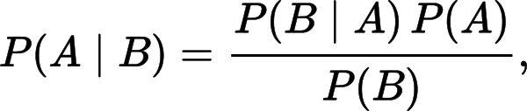
Bayes’ Theorem
The theorem can be stated mathematically as follow:
P(A) and P(B) are the probabilities of observing A and B without regard to each other. Also known as Prior Probability.
P(A | B), a conditional (Posterior) probability, is the probability of observing event A given that B is true.
P(B | A) is the conditional (Posterior)probability of observing event B given that A is true.

Slide 5
The Decision Tree Classifier

Slide 6
Decision Tree
Decision tree builds classification or regression models in the form of a tree structure
It breaks down a dataset into smaller and smaller subsets while at the same time an associated decision tree is incrementally developed.
The final result is a tree with decision nodes and leaf nodes.
A decision node has two or more branches
Leaf node represents a classification or decision
The topmost decision node in a tree which corresponds to the best predictor called root node
Decision trees can handle both categorical and numerical data

Slide 7
Example Set
Outlook | Temp | Humidity | Windy | Play Golf
Rainy | Hot | High | False | No
Rainy | Hot | High | True | No
Overcast | Hot | High | False | Yes
Sunny | Mild | High | False | Yes
Sunny | Cool | Normal | False | Yes
Sunny | Cool | Normal | True | No
Overcast | Cool | Normal | True | Yes
Rainy | Mild | High | False | No
Rainy | Cool | Normal | False | Yes
Sunny | Mild | Normal | False | Yes
Rainy | Mild | Normal | True | Yes
Overcoast | Mild | High | True | Yes
Overcoast | Hot | Normal | False | Yes
Sunny | Mild | High | True | No

Slide 8
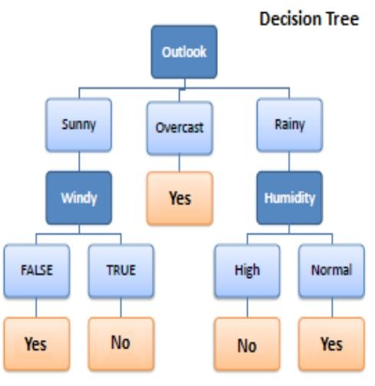
So, our tree looks like this...

Slide 9
K Nearest Neighbors Classification

Slide 10
k-NN Algorithm
K nearest neighbors is a simple algorithm that stores all available cases and classifies new cases based on a similarity measure (e.g., distance functions)
KNN has been used in statistical estimation and pattern recognition already in the beginning of 1970’s
A case is classified by a majority vote of its neighbors, with the case being assigned to the class most common amongst its K nearest neighbors measured by a distance function.

Slide 11
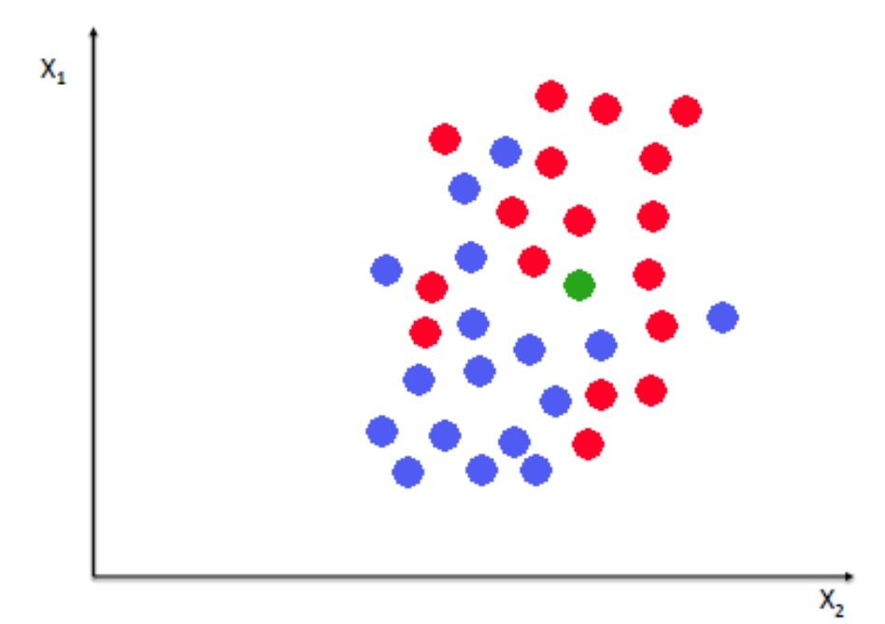
Diagram

Slide 12
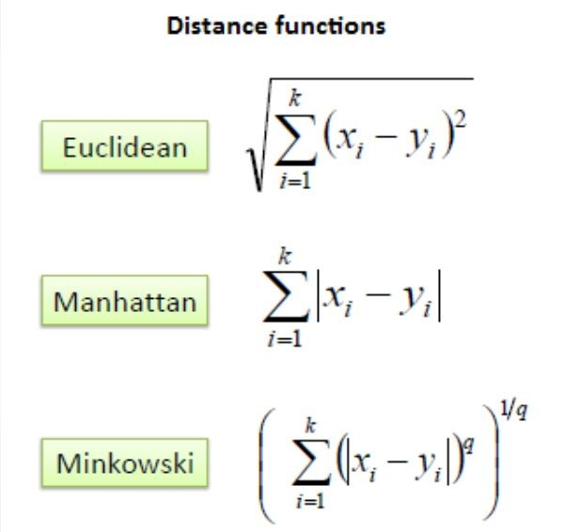
Distance measures for cont. variables

Slide 13
How many neighbors?
Choosing the optimal value for K is best done by first inspecting the data
In general, a large K value is more precise as it reduces the overall noise but there is no guarantee
Cross-validation is another way to retrospectively determine a good K value by using an independent dataset to validate the K value
Historically, the optimal K for most datasets has been between 3-10. That produces much better results than 1NN

Slide 14
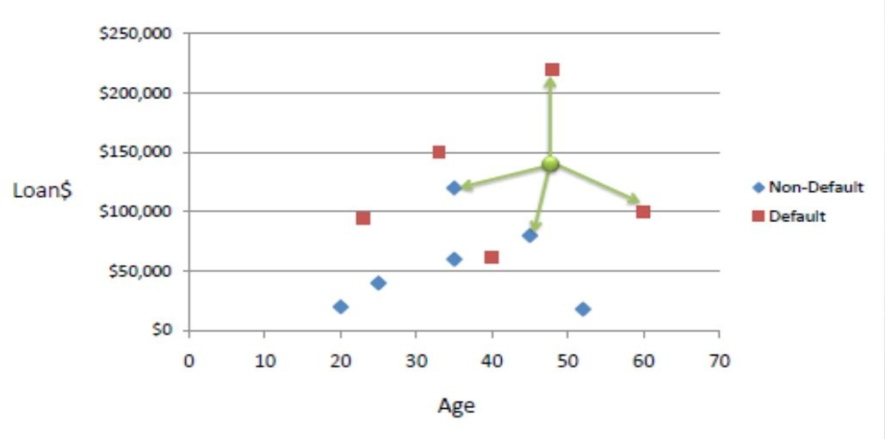
Example
Consider the following data concerning credit default. Age and Loan are two numerical variables (predictors) and Default is the target

Slide 15
Thank You!...

