Slide 1
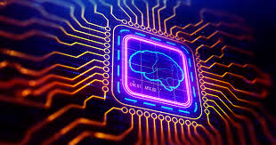
Welcome
26/08/2019
Nural Network
Presented By-Kharad Saurabh(36070)
Guided By-Prof.Amruta Joshi

Slide 2
CONTENT
Introduction
Literature Survey
Brief on System
Conclusion
References

Slide 3
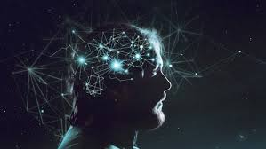
INTRODUCTION
Neural networks are a set of algorithms, modeled loosely after the human brain, that are designed to recognize patterns. They interpret sensory data through a kind of machine perception, labeling or clustering raw input.

Slide 4

LITERATURE SURVEY
Deep learning in neural networks: An overview – Jurgen Schmidhuber
Deep learning in spiking neural network - Amirhossein Tavanaei
Nural Network Overview – Stanford University

Slide 5
BRIEF ON SYSTEM
Neural networks help us cluster and classify. You can think of them as a clustering and classification layer on top of the data you store and manage.
It help to group unlabeled data according to similarities among the example inputs,.
It classify data when they have a labeled dataset to train on.

Slide 6
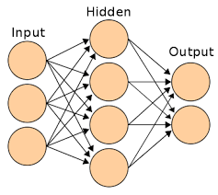
WORKING

Slide 7
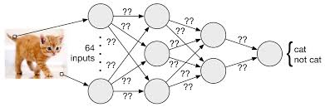
EXAMPLE

Slide 8
Conclusion
Nural Network is for Artificial Intelligence(Sofia) and Deep Learning.
Classification and Clustering Algorithms.
Works on both labled and non labled data.

Slide 9
References
https://www.sciencedirect.com/science/article/pii/S0893608018303332#!
https://www.sciencedirect.com/science/article/pii/S0893608014002135
Neural Networks & Learning Machines –Simam Haykin

Slide 10
THANK YOU

