Slide 1
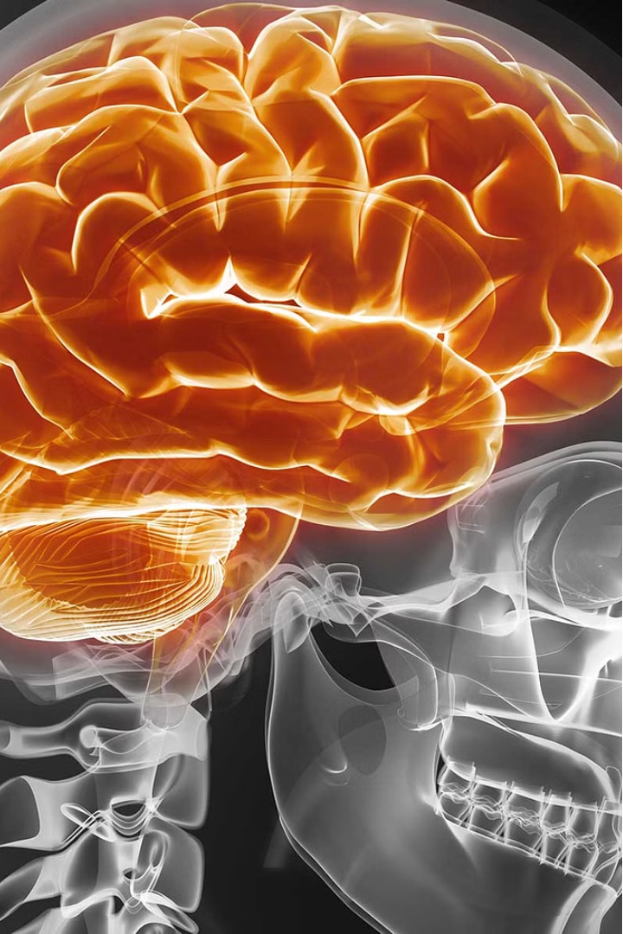

Introduction to BRAIN Stroke Prediction
Stroke is a leading cause of disability and death worldwide. BRAIN, a cutting-edge machine learning model, aims to revolutionize early stroke detection and prevention. By harnessing the power of data-driven analytics, this innovative approach can help save lives and improve patient outcomes.
PRESENTED BY: SHARADA PUJARI

Slide 2
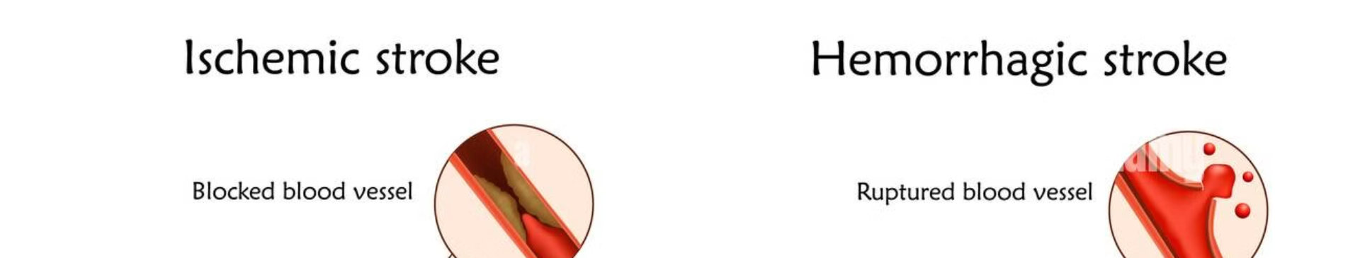
Overview of Stroke and its Impact
1
Stroke Prevalence
2
Risk Factors
3
Devastating Consequences
Stroke affects millions of people globally, with significant health and economic consequences.
Factors like high blood pressure, diabetes, and unhealthy lifestyle choices can increase the risk of stroke.
Strokes can lead to long-term disabilities, impaired mobility, cognitive decline, and reduced quality of life.

Slide 3

Importance of Early Stroke Detection
Rapid Response
1
Early detection enables prompt medical intervention, which is crucial for minimizing damage and improving patient outcomes.
2
Preventive Measures
With early warning signs, individuals can take proactive steps to address underlying health conditions and reduce stroke risk.
Saved Lives
3
Timely detection and treatment can significantly increase the chances of survival and recovery for stroke patients.

Slide 4
Data Collection and Preprocessing
Data Sources
Data Cleansing and Normalization
BRAIN gathers information from a variety of medical records, patient histories, and lifestyle factors to create a robust dataset for analysis.
The team ensures data quality by addressing missing values, eliminating inconsistencies, and standardizing the format to prepare the data for model training.
FEATURE Enginnering
Data Splliting
Derive new features from the raw data that can improve the model's predictive power, such as risk factor combinations.
Divide the dataset into training, validation, and testing sets to properly evaluate the performance of the machine learning models.

Slide 5





Error uploading image.
Feature Selection and Model Training
Identify Key Indicators
BRAIN's feature selection process identifies the most influential factors that contribute to stroke risk, such as age, blood pressure, and lifestyle habits.
Model Optimization
The team fine-tunes the machine learning algorithms, adjusting hyperparameters and testing various model architectures to achieve the highest predictive accuracy.
Robust Training
BRAIN is trained on a diverse dataset to ensure the model's ability to generalize and provide accurate predictions for a wide range of patients.

Slide 6


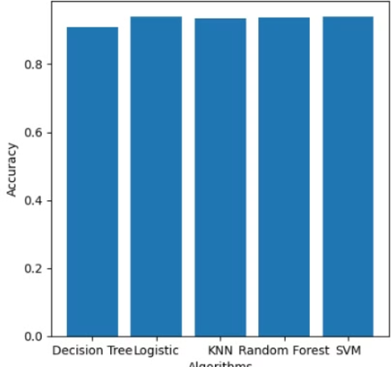
Model Evaluation and Validation
Accuracy
Sensitivity
BRAIN's predictive models are rigorously tested and validated to ensure they achieve high accuracy in identifying stroke risk.
The model's ability to correctly identify individuals at risk of stroke is a critical measure of its performance.

Slide 7
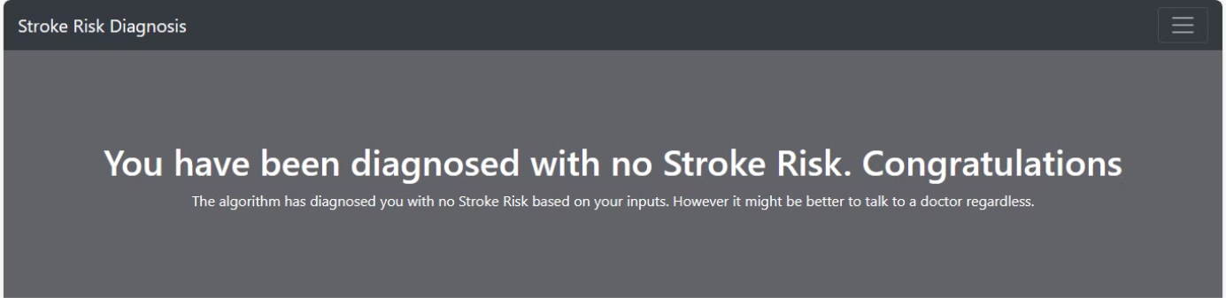
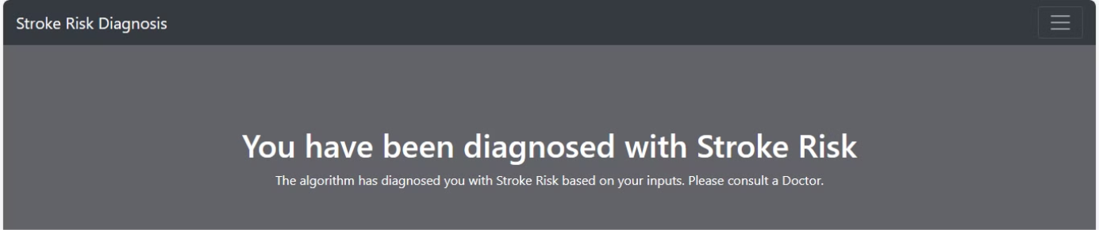

Slide 8
Conclusion and Future Directions
Improved Outcomes
BRAIN's stroke prediction model has the potential to significantly enhance early detection and enable more effective preventive interventions, ultimately leading to better health outcomes for patients.
Expanded Applications
The versatile nature of BRAIN's machine learning approach can be adapted to address other critical health challenges, expanding the model's impact beyond stroke prevention.
Continuous Innovation
Researchers are committed to ongoing refinements and advancements, incorporating the latest medical research and technological breakthroughs to ensure BRAIN remains at the forefront of stroke prediction and prevention.

