Slide 1
Titanic Dataset - Exploratory Data Analysis
Visual Insights and Observations

Slide 2
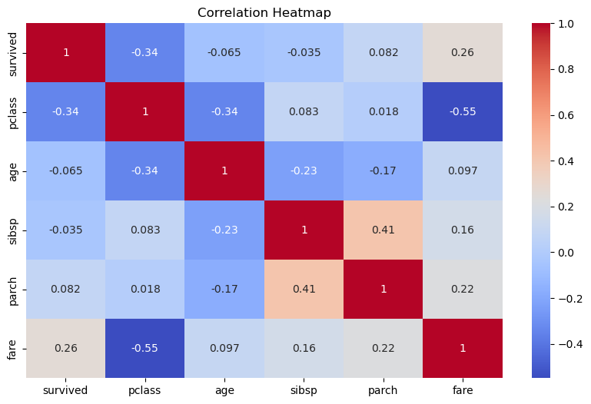
Correlation Heatmap
Fare and Pclass are most correlated with survival. Family features show weak correlation.

Slide 3
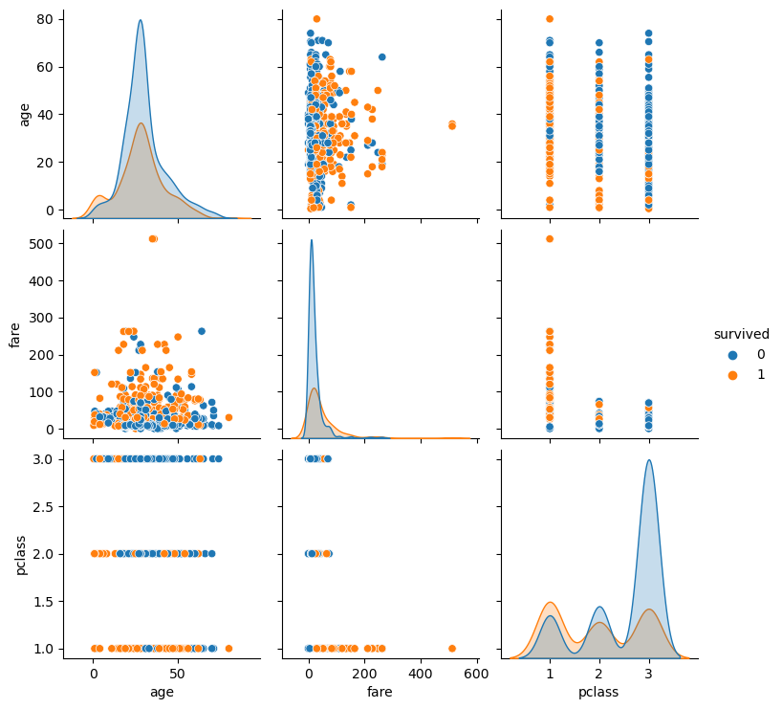
Pairplot
Survivors cluster among high fare and low Pclass. No strong age effect.

Slide 4
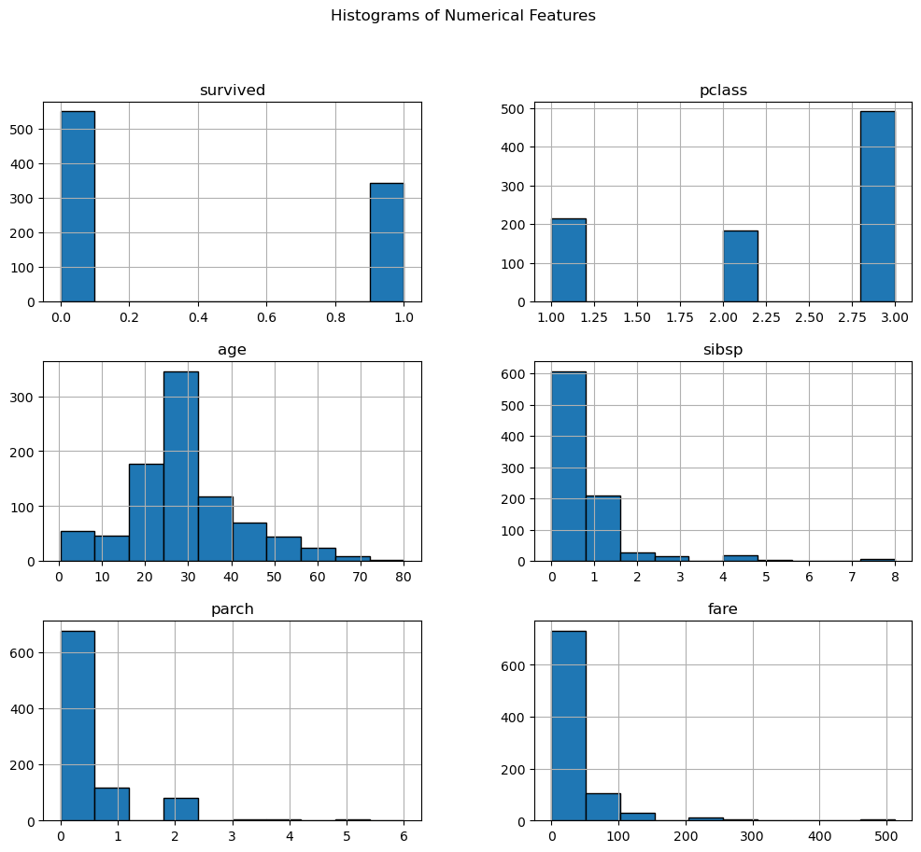
Histograms
Distributions show most passengers were young, in 3rd class, and many traveled alone.

Slide 5
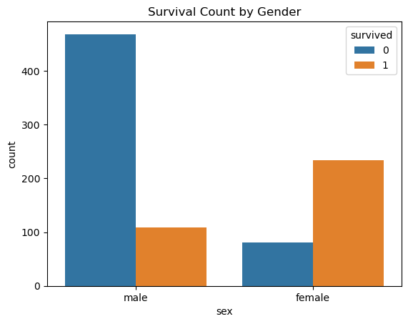
Survival by Gender
Females had much higher survival rates than males.

Slide 6
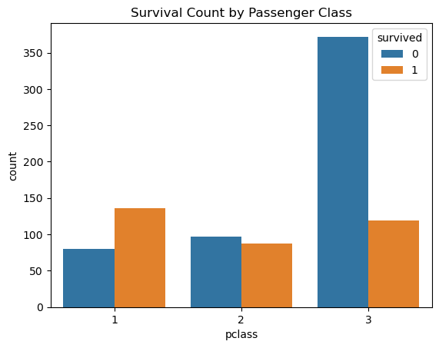
Survival by Class
1st class passengers had the best survival chances, 3rd class the worst.

Slide 7
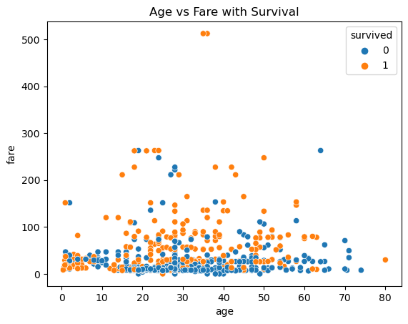
Age vs Fare with Survival
Higher fares improved survival chances. Age was not a strong predictor.

Slide 8
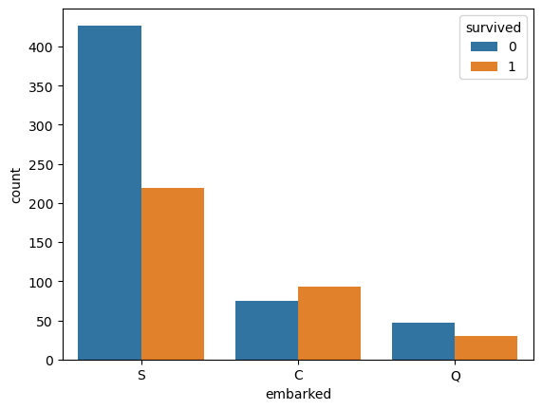
Embarked vs Survival
Cherbourg (C) embarkation had the highest survival rate.

Slide 9
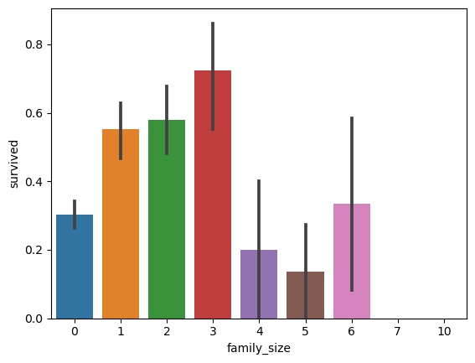
Family Size vs Survival
Passengers with 1–3 family members had the highest survival rates.

