Slide 1
Decision Support for a Two Stage Multi-Product Supply Chain
Presented By:
Akshay Kamath (1206429402)
Amrut Deshpande (1211537636)
Kartik Murali (1211409040)
Samyak Jain (1211425082)

Slide 2
Executive Summary
The aim of this project is to design a reliable dynamic Decision Support System (DSS) to aid company executives make effective fiscal decisions with regard to planning the logistics infrastructure require to meet product demand.
The DSS comprises of a minimum cost flow based multi stage route optimization scheme at its core . This ensures optimal product deployment to meet demand at minimal cost.
The DSS is supported by a MySQL backend server and encapsulated in a intuitive VBA based GUI.
An inventory management system synchronized with the database ensures that company executives keep track of product inventory levels, reorder points and operational trends.

Slide 3
Design Considerations
The DSS was designed to be reliable. Relational Database System in MYSQL was used to provide the data integrity required by sensitive yet robust logistic databases. All tables were normalized to ensure optimal data usage and minimal data redundancy.
The GUI was designed using VBA, a versatile platform that integrates seamlessly with Excel reports to provide the user with a comprehensive interactive graphical interface that’s simple to use.
For the sake of computational simplicity the logistic setup was scaled down to a Three Product Supply Chain.
These three products transverse the following logistic nodes : Two Plant, Four Distribution Centers & Five Dealers.
The Demand for products is a forecasted value and would normally be predicted through historical sales data. This component is not included in the scope of this project.
All distance considerations were made using the Euclidian method of point to point measurements.

Slide 4
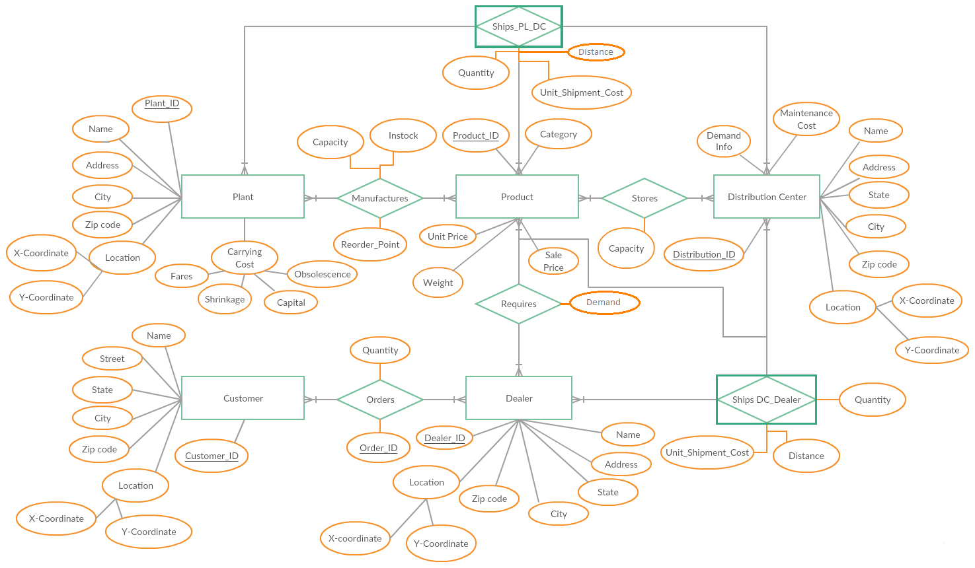
Entity-Relationship Diagram
ER Diagram

Slide 5
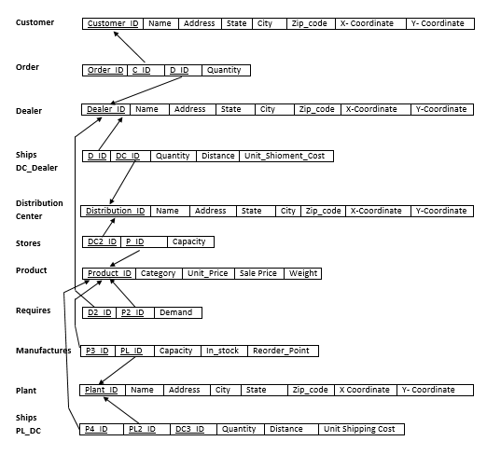
Relational
Tables

Slide 6
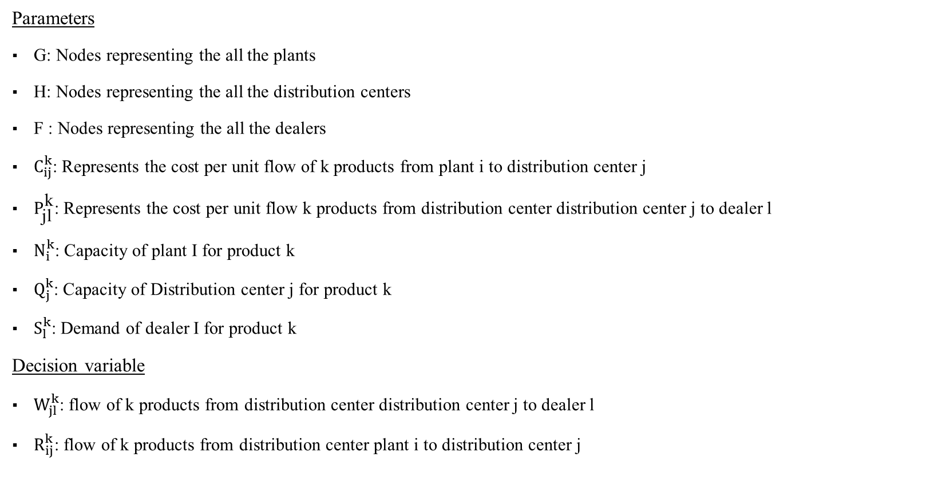
Multi Stage Cost Flow Optimization
Parameters
G: Nodes representing the all the plants
H: Nodes representing the all the distribution centers
F : Nodes representing the all the dealers
$C_{ij}^{k}$: Represents the cost per unit flow of k products from plant i to distribution center j
$P_{\text{jl}}^{\text{k}}$: Represents the cost per unit flow k products from distribution center distribution center j to dealer l
$N_{i}^{k}$: Capacity of plant I for product k
$Q_{j}^{k}$: Capacity of Distribution center j for product k
$S_{l}^{k}$: Demand of dealer I for product k
Decision variable
$W_{jl}^{k}$: flow of k products from distribution center distribution center j to dealer l
$R_{ij}^{k}$: flow of k products from distribution center plant i to distribution center j

Slide 7

Multi Stage Cost Flow Optimization
Constraints
$\sum_{i∈G}{ R_{ji}^{k}≤N_{i}^{k}} ∀ j∈H$
$\sum_{l∈F}{W_{jl}^{k}≥S_{l}^{k}} ∀ j∈H$
$\sum_{j∈H}{ R_{ji}^{k}≤Q_{j}^{k}} ∀ i∈G$
$\sum{ R_{ji}^{k}}$ - $\sum{ R_{ij}^{k}}=B_{i}$
$\sum{W_{jl}^{k}}$ - $\sum{W_{jl}^{k}}=B_{j}$

Slide 8
OR based System Approach
Dealer1
-
Plant 1
DC 1
Dealer 2
-
DC 2
Dealer 3
-
Plant 2
DC 3
Dealer 4
-
…
…
Dealer 5
Supply
DC 4
Demand
Plant
Distribution centers
Dealer
-

Slide 9
Demonstration

Slide 10
Lessons learned
Excel VBA is an extremely powerful tool.
How best to integrate VBA and MYSQL platforms to ensure optimal deployment of information based support infrastructure.
Database planning is key. Effective database design provides easy data storage and retrieval while maintaining minimal data redundancy.
Developed a deeper understanding of DSS design and the intricacies of Supply Chain Management.
Debugging is not fun.

Slide 11
Conclusion
The optimal integration of various platforms like VBA and SQL is essential to create a good support system. They aren’t as effective by themselves.
Design of a intuitive GUI can simplify otherwise complex executive financial decisions.

Slide 12
THANK YOU… Questions ?

