Slide 1
Amruth Jaligama
INFO 5810 Spring 2021
Term Project-Text Mining

Slide 2
WOMEN’S E-COMMERCE CLOTHING REVIEWS DATA ANALYSIS
The dataset I want to work on is Women’s e-commerce clothing reviews dataset. The main reason I chose to work on this dataset is because the number of e-commerce websites is rapidly increasing, particularly when it comes to clothing and apparel items, and many people feel comfortable purchasing apparel from e-commerce websites because of the versatility it offers and majority of the time, we buy items based on our preferences, ratings, and feedback found online and for the Analysis I want to perform I found this dataset ideal. In this analysis I examine how reviews are based on ratings and the relationship between various numerical measures.

Slide 3
About The Data Set
The dataset has been downloaded from Kaggle website and it contains data of reviews given by customers based on the apparel they have purchased.
Dataset Link: Women's E-Commerce Clothing Reviews | Kaggle
The original dataset consists of 23,486 rows and 11 column but the cleaned dataset I use for my analysis consists of 10 columns and 10,000 rows. The columns are as follows ClothingID, Age, Title, Review Text, Rating, Recommended IND, Positive Feedback Count, Division Name, Department Name and Class Name.
Data Cleaning & Data Filtering
I have removed the first column from the original dataset because it simply represents the row number of each record.
After the first step performed above I remove all the rows which have Title column values as blanks, Review Text column values as blank, Division Name values as blanks.
After the above two steps we are left with 19,663 rows where one row is the name of the columns.
So we have 19,662 records in our dataset and to make it suit our requirement for the project we delete top 4,831 rows and bottom 4,831 rows which makes it total of 10,000 records in our dataset.
After we import the cleaned dataset into Rapidminer Studio because of some syntax errors in the data the number of records in the dataset is reduced to 9,497 rows and there are some null values which form in some rows. The rows which have missing values are filtered out using the filter example operator in Rapidminer Studio.

Slide 4
Analysis Goals
The research questions that I have are as follows:
As the Positive Feedback Count increases does the rating increase and is there any relation between Rating and Recommended IND i.e., to see if there is any relation between rating and product recommendation?
How the reviews are for dresses whose rating is above average?
Are there any reasons as to why some dresses have rating below average?
Initial Ideas Of Data Analysis and Gathering Insights
Firstly, I analyse how the data is ordered and what is the data type of each column and what all values are there in each columns of dataset to see what all analysis I can perform on the dataset
By looking at the numerical measures I thought I can see if there is any correlation between the numerical attributes in the dataset.
By looking at the reviews, rating, department name and Class name columns I thought I can analyse the reviews given by customers based on the rating, department name and class name.
Data Mining Techniques Used
Correlation Analysis
Association Analysis
Cluster Analysis

Slide 5
Correlation Analysis
Through this technique we see the relationship between two variables i.e., if two variables when comparing to each other are directly proportional to each other or inversely proportional to each other. The scale of correlation analysis ranges from -1 to +1 where ‘-‘ symbol represents negative relationship i.e., there is an inverse relationship between two variables and no symbol means there is a positive relationship between two variables i.e., there is a direct relationship between two variables.
Analysis Goal 1
As the Positive Feedback Count increases does the rating increase and is there any relation between Rating and Recommended IND i.e., to see if there is any relation between rating and product recommendation?
To see if there is any relationship between Positive Feedback Count and rating, in between rating and product recommendation we perform correlation analysis
To perform correlation analysis in Rapid Miner Studio we use correlation matrix operator.
Correlation Matrix Operator- This operator is used to calculate the correlation coefficients between attributes. It is used to see the relationship between two variables i.e. if they are directly proportional or inversely proportional and how strong the relationship between any two attributes is. It takes values from -1 to +1 where ‘-‘symbol represents negative correlation and the other one being positive correlation.

Slide 6
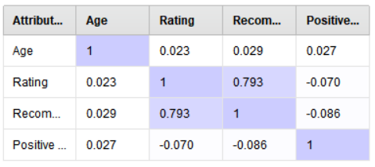
Analysis Result
By looking at the correlation matrix we can say that there is no relationship between Positive Feedback count and Rating as the correlation coefficient value is -0.070 which when looked up in the correlation coefficient index scale tells us that there is no correlation.
-(0.1) to (0.1)- No Correlation
-(0.1) to -(0.5)-Weak Negative Correlation
-(0.5) to -(0.8)- Moderate Negative Correlation
-(0.8) to -(1.0)- Strong Negative Correlation
(0.1) to (0.5)- Weak Positive Correlation
(0.5) to (0.8)- Moderate Positive Correlation
(0.8) to (1.0)- Strong Positive Correlation
For variables Rating and Recommended IND there is Moderate positive correlation as the correlation coefficient value is 0.793 which when looked up in the correlation coefficient index scale tells us that there is moderate positive correlation so we can say that as the rating increases the product recommendation increases.

Slide 7
Association Analysis
Association Analysis is a data mining technique through which we can try to find the pattern between items in a group. Simply put the real time applications of this is when we purchase an item online through amazon website we get other recommended products this is done through association Amazon analyses the data of people who have purchased first item and purchased the second item and the data of how frequently was the second item purchased when the first item was purchased is analyzed. This is nothing but Association Analysis. In this case of Amazon the term used to refer these associations is called as market basket analysis.
Analysis Goal 2
How are the reviews for dresses whose rating is above average?
To see how the general reviews given by customers are for the dresses whose rating above average we have to perform Association analysis in Rapid Miner Studio we use FP growth operator and Create Association Rules Operator.
FP-Growth Operator- This operator is based on Frequent pattern growth algorithm which is represented by a set of nodes which are connected to each other and are in the form of a tree which signifies frequently occurring items that are together in the sentences or paragraphs.
Create Association Rules Operator- This operator takes frequent item set as input and outputs frequent item sets and association rules. Association rules are unsupervised machine learning techniques which are used to see if there is any association between items in a group or not

Slide 8
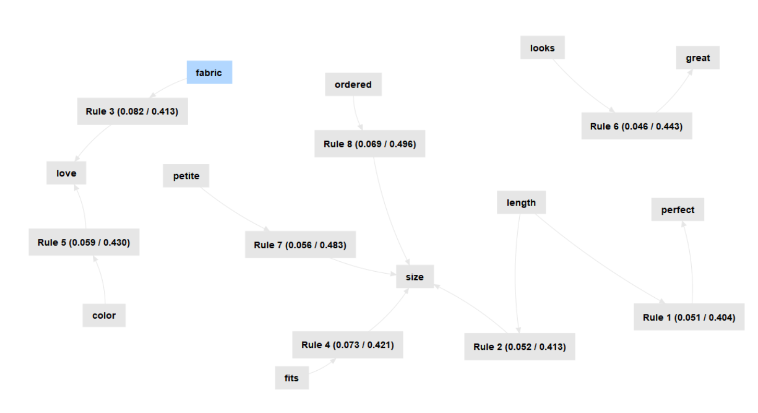
Analysis Result
With minimum support as 5% and minimum confidence as 40% we get the association rules specified to the right for the reviews of the dresses whose rating is above average i.e., we can infer how the general reviews are for the dresses whose rating is above 3.0.
From the Association Rules Graph we can infer that the customers love the fabric and the color. The customers got their ordered size, the dress fits to size and dresses are of perfect length and size and look great.

Slide 9
Cluster Analysis
It is a data mining technique through which we group objects based on their similarities. Similar items are grouped into same group or clusters. There are different algorithms through which clustering can be done some of them are K-means Clustering, Hierarchical Clustering, Density Based Spatial Clustering, Mean shift Clustering and so on.
Analysis Goal 3
Are there any reasons as to why some dresses have rating below average?
To know the reasons as to why some dresses have rating below average we have to analyse the reviews of the dresses whose rating is below 3.0. In order to perform cluster analysis in Rapid Miner Studio we use K-means clustering operator and to measure its performance we use the cluster distance perfomance operator.
K-means clustering operator- This operator is based on K-means clustering algorithm. We use K-means clustering algorithm to group items of similar kind or characteristics into a cluster. The aim of K-means is to reduce the number of squared errors across all K clusters to a minimum. At first we choose number of clusters to be 4 and later to be 5.
Cluster distance perfomance operator- This operator is used to evaluate the performance of clustering algorithms that are based on centroid. It gives average distance within centroid as a whole, average distance within centroid of each cluster, Davies Bouldin index. The lower the average distance within centroid as a whole and close to zero the better the perfomance is.

Slide 10
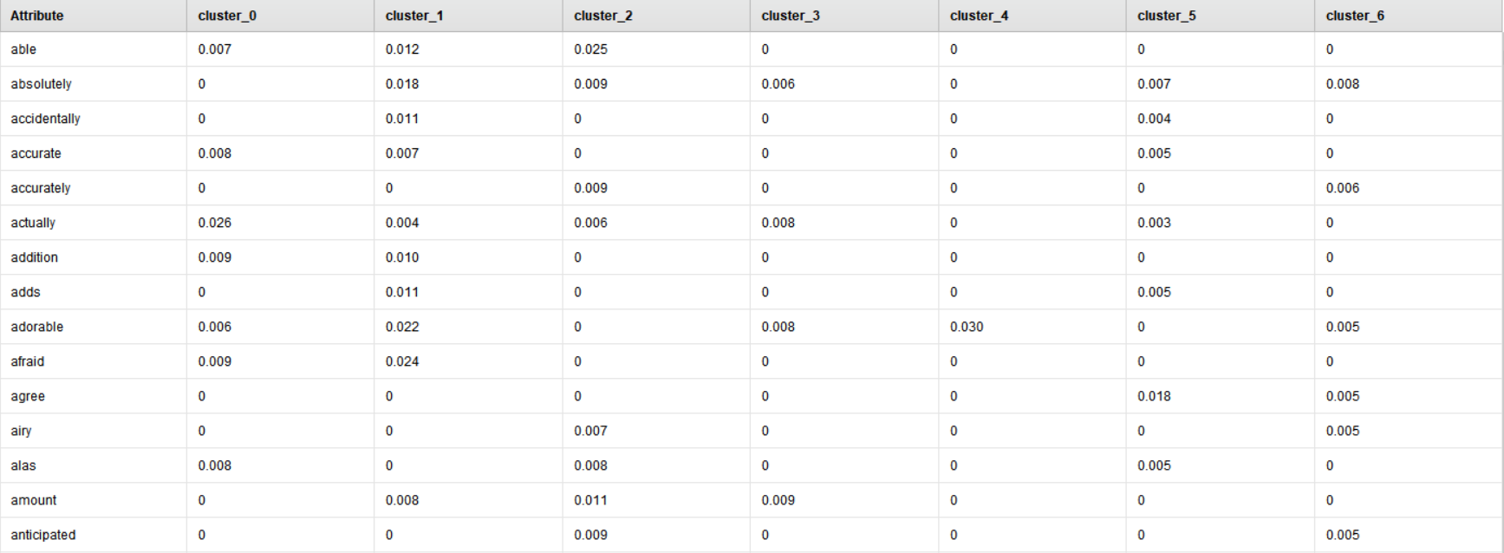
Analysis Results: Centroid Table

Slide 11
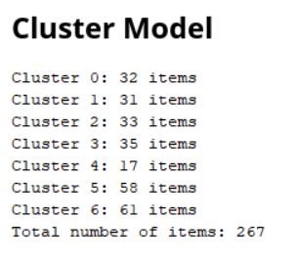
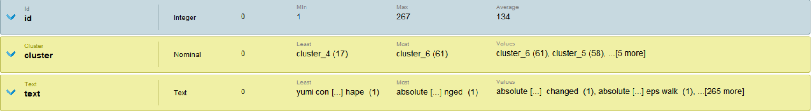
Analysis Results: Cluster Model Items and Cluster Model Statistics

Slide 12
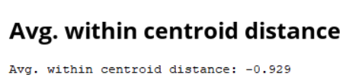
Analysis Result
We first take number of cluster as 4 i.e k value as 4 and run the model then we get the Average within centroid distance as -0.946 and when we take the number of clusters as 7 i.e k value as 7 and run the model again then we get the Average within centroid distance as -0.929 so for the k-values that I consider the optimal value of k is 7.
The reasons for some dresses having rating below average is because customers are disappointed with the dress, fabric, they want to return the product, it is wrinkled, it looks cheap, felt baggy, the dresses are huge which can be found out from the words that appear in the clusters.

Slide 13
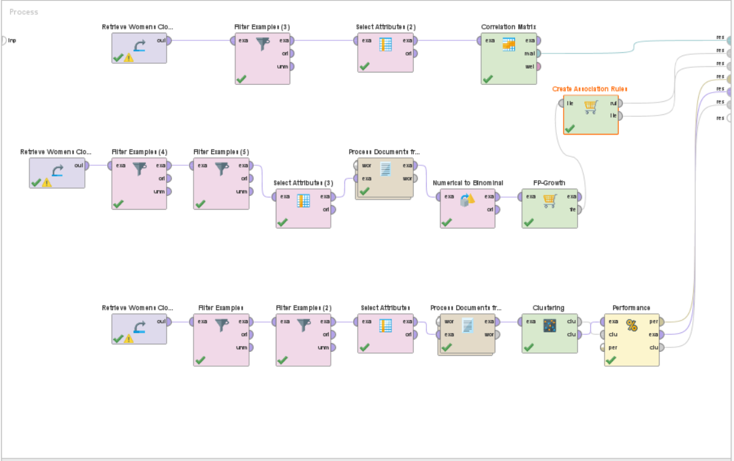
Final Design Diagram

Slide 14
Conclusion
From the analysis I performed on the data I conclude that there is no relation between positive feedback count and rating. The measures Rating and Recommended IND are moderately positively correlated so we can conclude that as the Rating increases the product recommendation increases. For the dresses whose rating is above average we can infer that the customers love the fabric and color of the product, feel that the looks are great, length is perfect, the fit is as per the ordered size. From the Cluster Analysis results we can infer that the reviews for dresses whose rating is below average is as follows the customers are disappointed with the dress, fabric, they want to return the product, it is wrinkled, it looks cheap, felt baggy, the dresses are huge.
Experience
Through the analysis I have done in this project I understand how different types of analysis are performed to find answers for different business questions, such as if we have to find the relation between two numerical variables we use correlation analysis and to study the association or pattern between items in a group we use association analysis, to group objects based on similarity we use cluster analysis and I learned about how Rapid Miner studio as a data mining tool can be used to answer these business questions.

Slide 15
Thank You

