Slide 1
EXCEL REASSESSMENT
AMRUTHA K
EMP ID:4351
ILMS ID: LVADSUSR143

Slide 2
CASE STUDY QUESTIONS
1-10

Slide 3
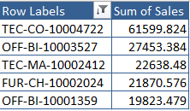
Select product ID and calculate total sales for each product with the help of pivot table.
Sort the products based on total sales in descending order.
Value filter to get the top 5 products by sales.
The product “Canon imageCLASS 2200 Advanced Copier with ID TEC-CO-10004722” has the highest sales (61599.824)

Slide 4
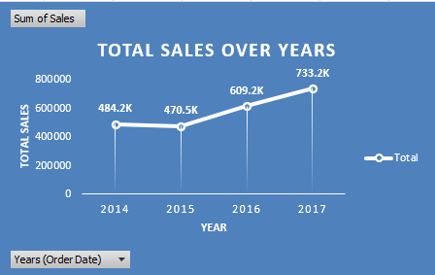
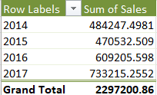
The year of order date and sum sales are calculated using pivot.
A line graph is plotted to show the trend of total sales over year.
The year “2015” had sudden decrease and then an increase in sales.

Slide 5
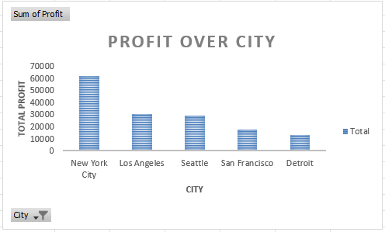
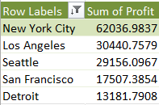
Select city and calculate the sum of profit for each city in pivot.
Sort the city based on total profit in descending order.
Value filter to get the top 5 city by profit.
Plotted a column chart to represent the data.
The city of “NEW YORK” has highest profitability compared to other cities with total profit “62036.9837”.

Slide 6
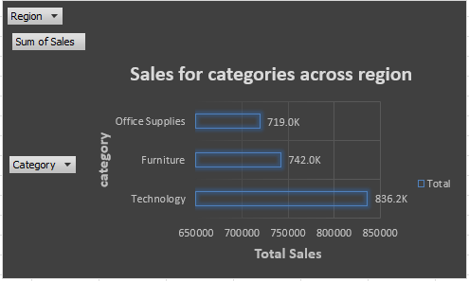

Using pivot table, filter the region and find the total sales for each category of items.
Insert bar chart to plot the sales for categories in each region.
Filter the region “west” to find the category with best sales.
The category “Furniture” performed best in “WEST” region.

Slide 7
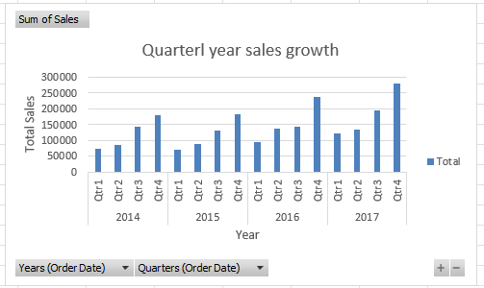

Calculate the quarter from order date and total sales using pivot.
Sort and filter the year of order date and quarter of order date based on total sales.
Value filter top 1 to year and quarter with highest growth sales.
The quarter 4 of year “2017” has the highest growth in sales.

Slide 8
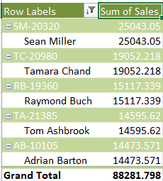
Using pivot, filter the customer id, customer name in rows and total sales in values field.
Sort both customer ID and name based on total sales.
Using value filter, find top 5 customers with highest sales.
“Sean Miller” is the top customer with total sales amount “25043.05”.

Slide 9
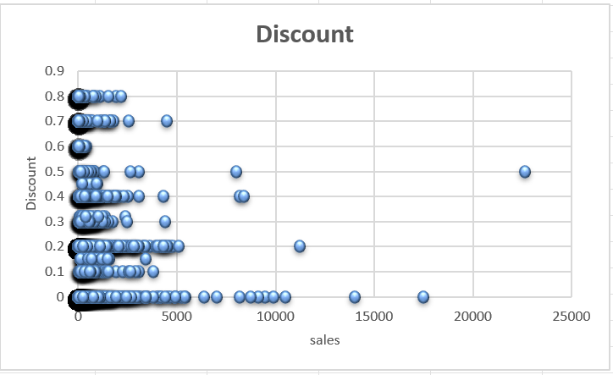
=CORREL(U:U,S:S)
-0.0281901
The correlation between discount and sales is weak and negative.
As the discount increases, sales has increased.

Slide 10

The subcategory “binders” in category “Furniture” has sold most products.

Slide 11
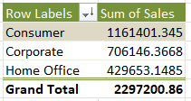
Using pivot, calculate segments and sum of sales.
Sort by descending of total sales to find highest customer segment.
The “consumer” segment has most total sales

Slide 12
DASHBOARD

Slide 13
