Slide 1
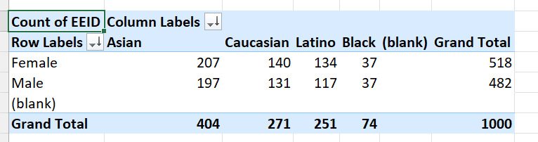
SUMMARY OF GENDER AND ETHINICITY DISTRIBUTION
Out of 1000 employees, 518 are female and 482 are male with ethinicities varying from Asian,Caucasian,Latino and Black out of which 207(highest) employees are female with Asian Background.

Slide 3
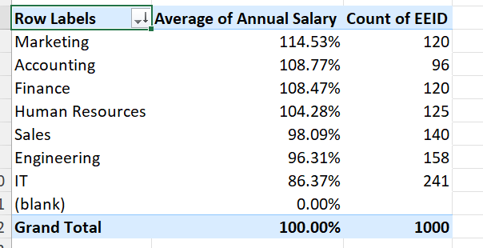
Significant difference in average salaries between different departments
Marketing employees have highest salary and IT employees have the lowest.

Slide 4
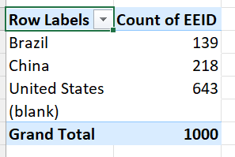
Country with highest number of employees
United States have the highest number of employees(643)

Slide 7
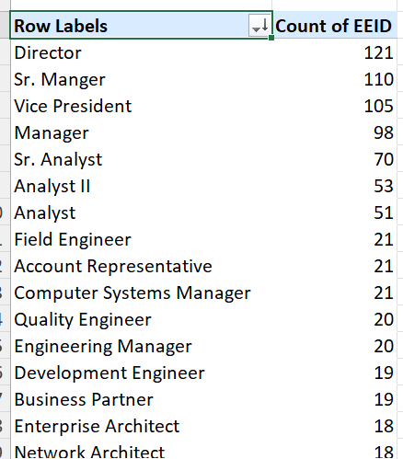
Job title occurs most frequently
The job title Director occurs most frequently with 121 employees

Slide 8
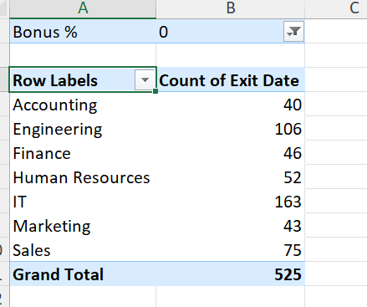
Most employees leave because of less bonus

Slide 9
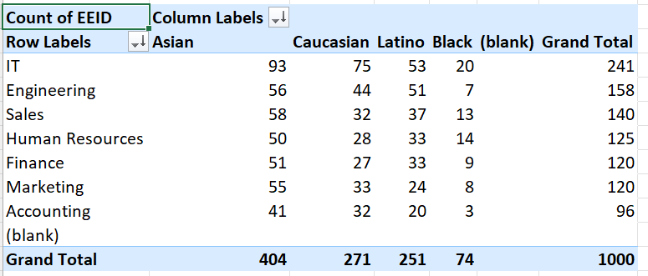
Department and diversity
The IT department has most employees with all types of ethinicity

