Slide 1

GLOBAL ACADEMY OF TECHNOLOGY
DEPARTMENT OF COMPUTER SCIENCE AND ENGINEERING
Subject Name | Project Work Phase II | Subject Code | 18CSP83
Student Name | AKHILADEVI M | USN | 1GA18CS017
 | AMRUTHA M |  | 1GA18CS023
 | CHANDANASHREE K R |  | 1GA18CS045
 | AMRUTHA K |  | 1GA18CS194
Domain | MACHINE LEARNING
Project Title | “ROAD ACCIDENT ANALYSIS USING KNN MACHINE LEARNING ALGORITHM”
Under taken at | GLOBAL ACADEMY OF TECHNOLOGY
Guide Name | Dr. ANITHA K

Slide 2
Agenda
Introduction
Problem Statement
Objectives
Existing System
Proposed System
System Design
High-Level Design
Implementation Modules
Conclusion
References

Slide 3
Introduction
Machine learning is the study of computer algorithms that can improve automatically through experience and by the use of data. It is seen as a part of artificial Intelligence.
Machine Learning algorithms build a model based on sample data, known as “training data”, to make predictions or decisions without being explicitly programmed to do so.
Machine Learning algorithms are used in a wide variety of applications, such as in medicine, email filtering, speech recognition, and computer vision.

Slide 4
Problem Statement
Road condition monitoring is a challenging worldwide problem in the field of transportation. Poor road surface conditions create a risk of damage to vehicles and increase the chances of traffic accidents. To minimize accidents, KNN Machine Learning Algorithms are used to predict and analyze the road accidents.

Slide 5
Objectives
To design and develop the model which will be cost-effective, simple, and determine the accuracy of accidents using the KNN Algorithm.
To analyze the previously occurred accidents in the locality which will help us to determine the most accident-prone area.
To make predictions based on constraints like weather, Light conditions, road structure, etc.

Slide 6
Existing System
1. Sachin Kumar: Used data mining techniques to identify the locations where high-frequency accidents occurred and then analyzed them to identify the factors that have an effect on road accidents at that locations.
2. S.Shanthi: Proposed data mining classification technology based on gender classification, in which RndTree and C4.S use AdaBoost Meta classifier to provide high-precision results.
3. Lukuman Wahab, Haobin Jiang: In this research machine learning based algorithms is proposed to predict motorcycle crash severity.

Slide 7
4. Tessa K. Anderson: Proposed a method of identifying high-density accident hotspots using machine learning algorithms such as neural networks, support vector machines, and decision tree.
5. Vipul Rana, Hemant Joshi, Deepak Parmar: In predicting traffic accidents data mining techniques and machine learning algorithms were used.
6. IJIRCCE-Samila Kumar, M Prashanthi: For road accident prediction data mining technique and machine learning such as random forest is used.

Slide 8
Proposed System
Models are created using accident data records, which can help to understand the characteristics of many features like latitude, longitude, roadway conditions, weather conditions and so on.
Machine learning will help to train the model.
The model is trained by using a KNN after training helps to predict and analyse the accuracy.
The model is performed to identify statistically significant factors which can be able to analyze the probabilities of crashes and injuries.

Slide 9
System Design
1.Decision Tree
2.KNN
3.Regression Algorithm
Data collection
1.Data Cleaning
2.Feature Selection
3.Model Evaluation
Data Processing
Machine Learning Algorithms
Trained Data
Test Data
classification rules based on algorithms
Fatal/Simple Injury/Motor Collision
Predicted accident survey
Fig 1: System Design of Road Accident Analysis

Slide 10
High-level design
Data Flow Diagram – Level 0
Start
Data Collection
Data Cleaning
Analysing
Stop
Fig 2: Level 0 Data Flow Diagram of Road Accident Analysis

Slide 11
Data Flow Diagram – Level 1
Start
Select the Dataset
Data collection
Data pre-processing and Feature Selection with Graphs
Data Cleaning
Train the model to get high accuracy
Analyzing which algorithm is the best.
Select the model by performing different Algorithms on the Dataset.
Stop
Fig 3: Level 1 Data Flow Diagram of Road Accident Analysis

Slide 12
Class Diagram
PERSON
0..*
0..*
VEHICLE
License_Id
Person_Name
Date_of_Birth
Gender
Religion
Job
Veh_Plate_Number
Vehicle_Type
Vehicle_Mode year
0..*
1..1
INSURANCE
Insurance_Id
Bank_Name
Amount
ACCIDENT
1..1
Calculate_Age()
Accident_Id
Date/Time
Location
Cause
POLICE
Police_Id
Police_Name
Police_Area
Fig 4: Class Diagram of Road Accident Analysis

Slide 13

Use Case Diagram
Report Accident to police
Police examine the accident area
Police Officer
Report accident to insurance agent
Insurance agent generates the report
Insurance Agent
Vehicle Owner
Give personal details
Give external details such as time of accident
Use the details as train/test set on the algorithms to predict future accidents
System Admin
Fig 5: Use Case Diagram of Road Accident Analysis
Alert travellers regarding probability of an accident

Slide 14
Implementation Modules
Module 1: Data Acquisition.
Module 2: Data Pre-Processing.
Module 3: Machine Learning Training.
Module 4: Model Evaluation.

Slide 15
Data Acquisition
Functionality: Data acquisition, is to collect data from relevant sources before it can be stored, cleaned, preprocessed, and used further. It is the process of retrieving relevant information, transforming the data into the required form, and loading it into the designated system.
Algorithm:
Acquiring the data from the dataset.
Analyzing the dataset.
Notes:
Data and Acquisition, where data is the raw facts and figures, which could be structured and unstructured and acquisition means acquiring data for the given task at hand.

Slide 16
Data Pre-Processing
Functionality: Pre-processing refers to the transformations applied to our data before feeding it to the algorithm. Data pre-processing is a technique that is used to convert the raw data into a clean data set.
Input: Raw Data.
Output: Cleaned data.

Slide 17
Algorithm:
Getting the dataset.
Importing libraries.
Importing datasets.
Finding Missing Data.
Encoding Categorical Data.
Splitting dataset into training and test set.
Feature scaling.

Slide 18
Machine Learning Training
Functionality: A Machine Learning system learns from historical data, builds the prediction models, and whenever it receives new data, predicts the output for it using KNN Algorithm, Logistic Regression, Random Forest, and Decision Tree.
Input: Pre-Processed Data.
Output: Accuracy of machine learning algorithms such as KNN Algorithm, Logistic Regression, Random Forest and Decision Tree.

Slide 19
Algorithm - KNN:
Select the number K of the neighbors.
Calculate the Euclidean distance of K number of neighbors.
Take the K nearest neighbors as per the calculated Euclidean distance.
Among these k neighbors, count the number of the data points in each category.
Assign the new data points to that category for which the number of the neighbor is maximum.
Our model is ready.

Slide 20
Algorithm - Logistic Regression:
Data Pre-processing step.
Fitting Logistic Regression to the Training set.
Predicting the test result.
Test accuracy of the result(Creation of Confusion matrix).
Visualizing the test set result.

Slide 21
Algorithm - Decision Tree:
It begins with the original set S as the root node.
On each iteration of the algorithm, it iterates through the very unused attribute of the set S and calculates Entropy(H) and Information gain(IG) of this attribute.
It then selects the attribute which has the smallest Entropy or Largest Information gain.
The set S is then split by the selected attribute to produce a subset of the data.
The algorithm continues to recur on each subset, considering only attributes never selected before.

Slide 22
Algorithm - Random Forest:
Select random K data points from the training set.
Build the decision trees associated with the selected data points (Subsets).
Choose the number N for decision trees that you want to build.
Repeat Step 1 & 2.
For new data points, find the predictions of each decision tree, and assign the new data points to the category that wins the majority votes

Slide 23
Model Evaluation
Model Evaluation is an integral part of the model development process. It helps to find the best model that represents our data and how well the chosen model will work in the future.
Input: Accuracy score of Algorithm.
Output: Comparing the graphs.

Slide 24
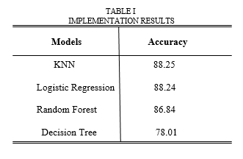
Conclusion
Proposed solutions is above 88% accuracy using KNN algorithm which is more than other algo like logistic regression, random forest and decision. Hence we conclude that KNN is having better accuracy.

Slide 25
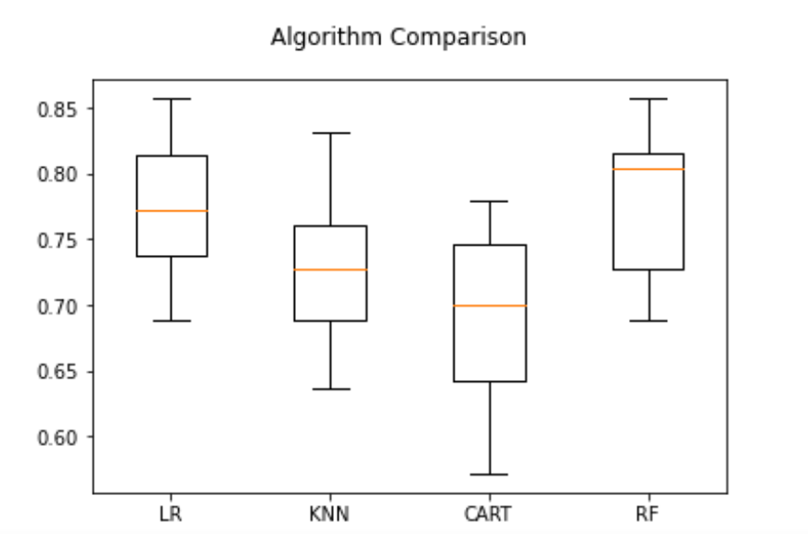
The graph depicted shows the comparison between all the algorithms used along with the accuracy of different models which can be visualized based on the metric parameters.

Slide 26
Bibliography
[1]. Mubariz Manzoor, Muhammad Umer, Saima Sadiq Saleem Ullah, hamza Ahmad Madni, abid Ishaq, and carmen bisogni.” Traffic Accident Severity Prediction Based on Decision Level Fusion of Machine and Deep Learning Model.”IEEE Access 10.1109/ACCESS.2021.3112546
[2]. N. Sridevi, M. V. Keerthana, Monisha V. Pal, T. R. Nikshitha, P. Jyothi.” Road Accident Analysis Using Machine Learning.” International Journal of Research in Engineering, Science and Management Volume-3, Issue-5, May-2020 www.ijresm.com | ISSN (Online): 2581-5792
[3]. Akanksh Basavaraju, Jing Du, Fujie Zhou, and Jim Ji.”A Machine Learning Approach to Road Surface Anomaly Assessment Using Smartphone Sensors .”IEEE SENSORS JOURNAL, VOL. 20, NO. 5, MARCH 1, 2020.”

Slide 27
[4]. Sahil Dabhade, Sai Mahale, Avinash Chitalkar, Pushkar Gawhad, Vicky Pagare.”Road Accident Analysis and Prediction using Machine Learning.”International Journal for Research in Applied Science & Engineering Technology (IJRASET) ISSN: 2321-9653; IC Value: 45.98; SJ Impact Factor: 7.177 Volume 8 Issue I, Jan 2020- Available at www.ijraset.com
[5]. Vipul Rana, Hemant Joshi, Deepak Parmar, Pradnya Jadhav, Monika Kanojiya.” Road Accident Prediction using Machine Learning Algorithm.” International Research Journal of Engineering and Technology (IRJET) Volume: 06 Issue: 03 | Mar 2019 www.irjet.net
[6]. Meenu Rani Dey,Utkalika Satapathy,Pranali Bhanse,Bhabendu Kr. Mohanta,Debasish Jena.” Detecting Road Surface Condition using
Smartphone Sensors and Machine Learning.”Information Security Lab IIIT Bhubaneswar Odisha, India a117004@iiit-bh.ac.in 978-1-7281-1895-6/19/$31.00 c2019 IEEE.

Slide 28
Thank You

