Slide 1


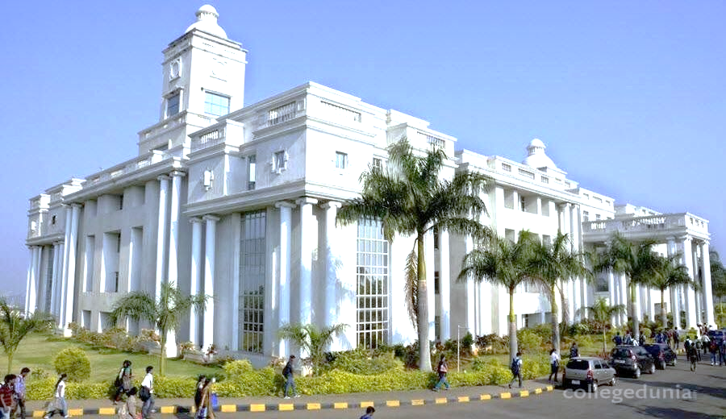
Global Academy of Technology
An Autonomous Institute, Affiliated to VTU Belagavi,
Approved by AICTE, Accredited by NAAC,’A’ Grade,
Ideal Homes Township, Rajarajeshwari Nagar, Bengaluru – 560 098
Tel: +91 80 28603158 (Ext - 300), Email: hodcse@gat.ac.in Web: www.gat.ac.in
Department of Computer Science and Engineering
Accredited by NBA 2019-2022
Internship (18CSI85)
Full Stack Web Development
Amrutha K
1GA18CS194

Slide 2
Company Name
Address
Internal Guide Details
Name: Dr. Anitha K
Designation: Associate Professor
Organization: GAT, Bengaluru
External Guide Details
Name: Vinod Pattar
Designation: Technological Lead(CTO)
Company Name: EldersIndia
Email ID: vinod@tharsha.com
Phone: 7795768096

Slide 3
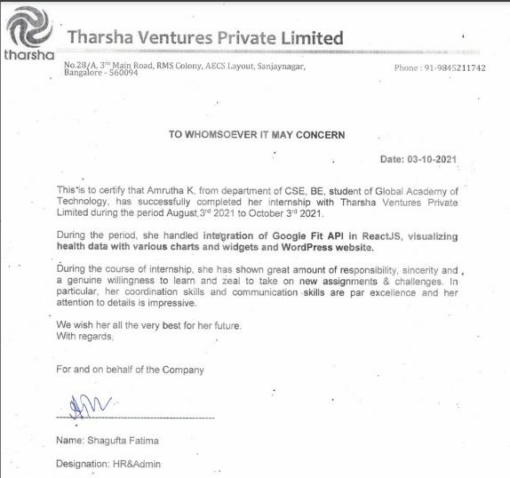
Internship Certificate

Slide 4
Presentation outline
Company Overview
Company products and services
Team/Department Overview
Project description
    Domain details
Internship Details
    Technical skills acquired
    Challenges faced
    Soft skills acquired
    My Roles and responsibilities
    Results
Overall experience
Conclusion

Slide 5

Company Overview
EldersIndia is a unique initiative bringing corporates, employees, their senior family members and service providers under one platform with an aim to:
Improve the quality of life of elders
Help corporate employees manage their responsibilities towards elderly family members
Assist corporates to support employees in the workplace
Address – 28/A, 3rd Main Rd, RMS colony, AECS Layout, Sanjaynagar, Bengaluru, Karnataka 560094

Slide 6


Company products and services
HealthCare
Elderly Assistance
Emergency Response
Safety & Security
Wealth Management
Recreational Services

Slide 7
Team/Department Overview
CEO – K S Raghunandan
H R & Admin – Shagufta Fatima
Technological Team Lead – Vinod patter
Software development Interns
Operations Head - Omprakash
Operation Executive Head – Rajesh Rathod
Operational Executive Team Members

Slide 8
Project Description
Building websites in React JS, React Native and WordPress
Connecting the frontend to database using Laravel
Designing the UI of the website.
Using different libraries to build dynamic charts in React JS
Connecting to Google Fit API

Slide 9
Domain Details
  React (also known as React.js or ReactJS) is a free and open-source front-end JavaScript library for building user interfaces based on UI components.
  React Native is a JavaScript framework for writing real, natively rendering mobile applications for iOS and Android.
  WordPress (WP, WordPress.org) is a free and open-source content management system (CMS) written in PHP and paired with a MySQL or MariaDB database.
  Laravel is an open-source PHP framework, which is robust and easy to understand.

Slide 10
  Technical skills acquired
  React JS
  WordPress
  React Native
  Laravel

Slide 11
Challenges faced
Co-ordination with the team
New Concepts – Getting updated with new technologies
Huge amount work was assigned
Lack of experience made certain task harder
Breaking down the assigned work into tangible task was difficult

Slide 12
  Soft Skills
Time management
Team work
Communication
Creativity
Adaptability

Slide 13
  My Roles and responsibilities
The primary responsibility was to designing user interactions on websites, developing servers and databases for website functionality and coding for mobile platforms.
Researching, designing, implementing, and managing software programs.
Testing and evaluating new programs.
Identifying areas for modification in existing programs and subsequently developing these modifications.
Writing and implementing efficient code.

Slide 14
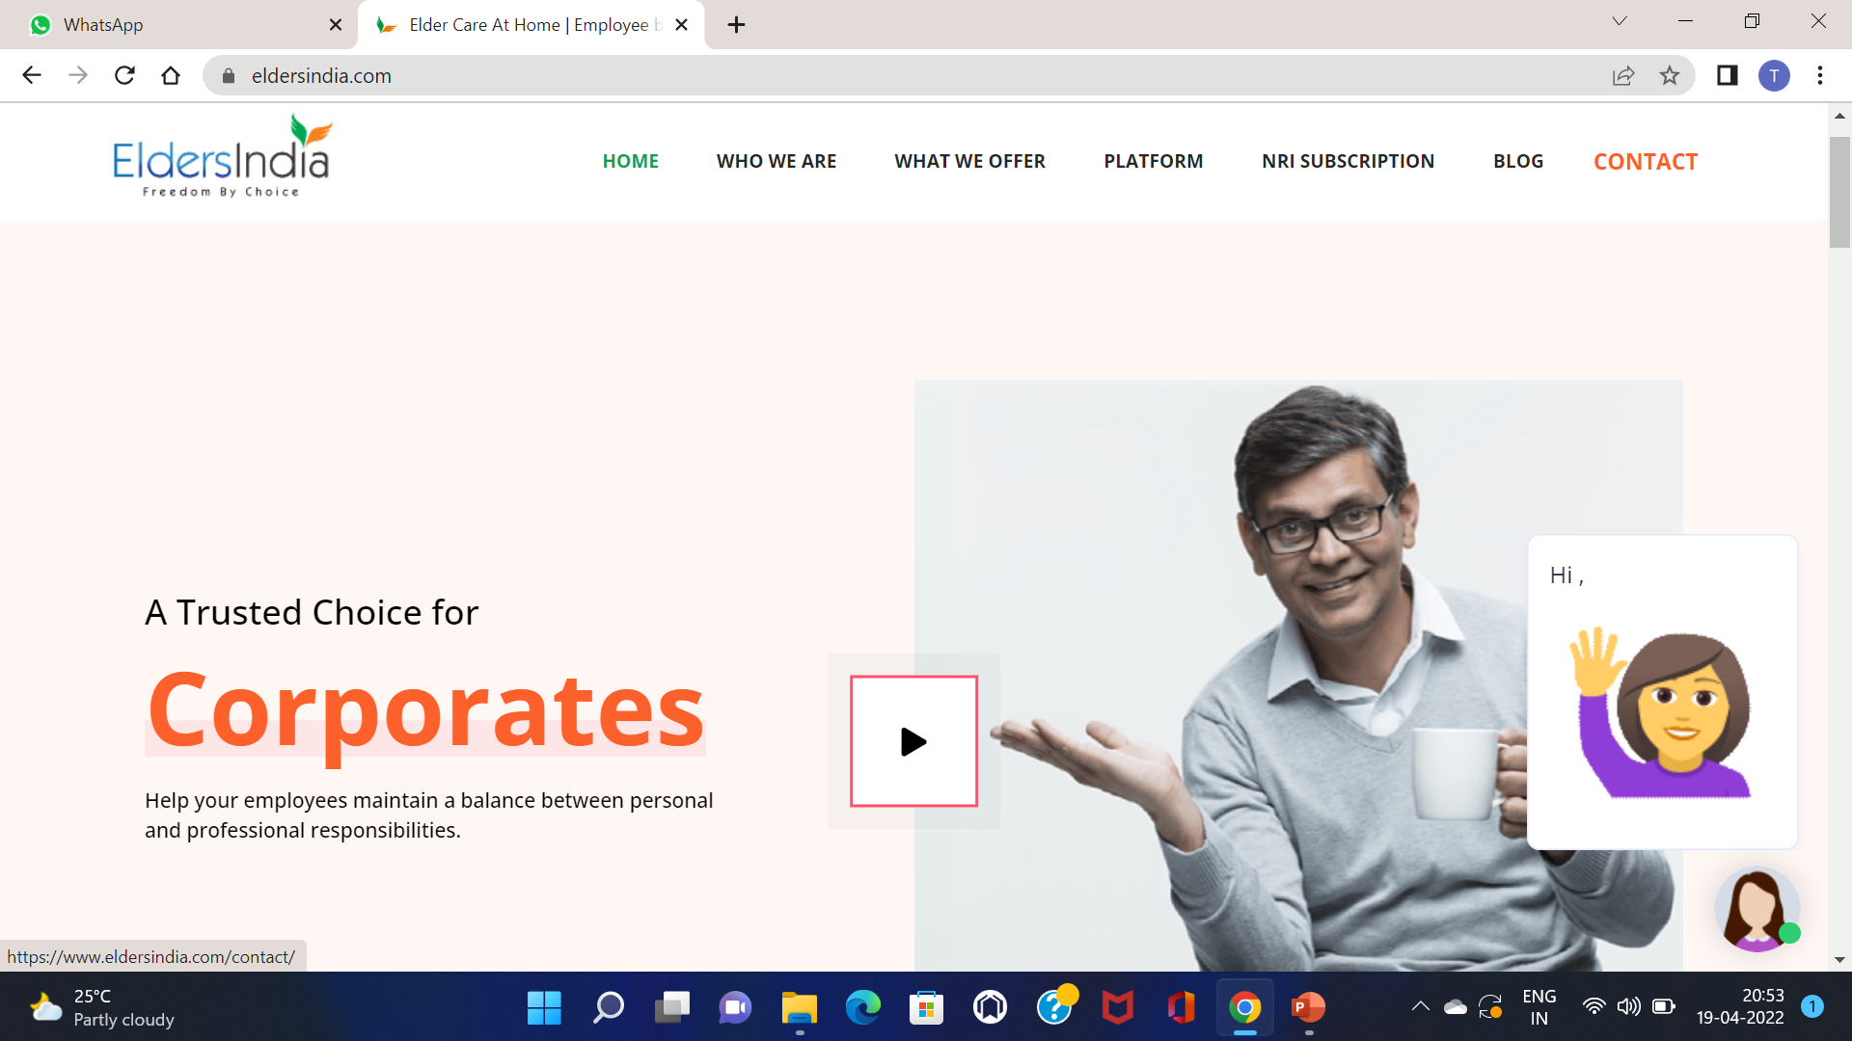
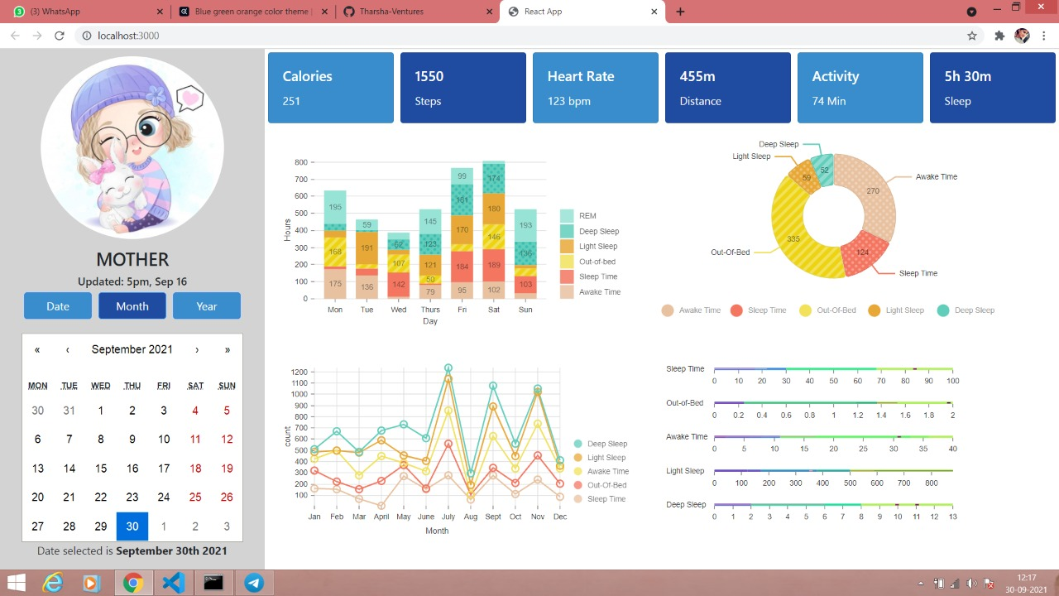
Results
Homepage using WordPress
.
Chats using React JS

Slide 15
Overall experience
Got exposed to IT field
Became strong in React JS and GitHub
Learnt people and time management
Exposed to new skills like React Native, Laravel and WordPress

Slide 16
Conclusion
An internship is a professional learning experience that offers meaningful, practical work related to a student’s field of study or career interest. An internship gives a student the opportunity for career exploration and development, and to learn new skills. It offers the employer the opportunity to bring new ideas and energy into the workplace, develop talent and potentially build a pipeline for future full-time employees.
It was great working with EldersIndia which indirectly helped me serve our nation.
I became strong in React JS
Usage of GitHub.
Got explore to React Native, Laravel and WordPress
Also there were a lot of challenges which I could overcome successfully.

Slide 17
References
[1] http://ijrra.net/Vol5issue1/IJRRA-05-01-27.pdf
[2] https://ieeexplore.ieee.org/abstract/document/9141070
[3] https://ijisrt.com/assets/upload/files/IJISRT20NOV485.pdf
[4] https://www.eldersindia.com/
[5] https://medium.com/@kimtnguyen/relational-database-schema-design-overview-70e447ff66f9
[6] https://bestofreactjs.com/repo/OvalMoney-react-native-fitness-react-react-integration
[7] https://restfulapi.net/http-status-codes
[8] https://link.springer.com/chapter/10.1007/978-1-4842-1245-5_1
[9] https://ieeexplore.ieee.org/abstract/document/8869134
[10] https://ieeexplore.ieee.org/abstract/document/8263583

Slide 18
Thank you

