Slide 1

Department of Computer Science and Engineering
Technical Seminar -18CSS84
Smart city as a smart service system: Human-Computer interaction and smart city surveillance systems
Paper Authors:
Mohamad Kashef
Anna Visvizi
Orlando Troisi
Presented by
Amrutha K
1GA18CS194
8th semester ‘A’ section
Guided by
Dr Anitha K

Slide 2
Agenda
Introduction about domain
About paper and authors
Rationale for selecting the paper
Abstract
System architecture
Applications
Results
References

Slide 3
Introduction
Smart city services, smart applications and smart devices form an ecosystem of tools and artifacts that challenge, and times even disrupt, conventions, norms, and rites of behavior, thus prompting diverse behavioral changes at the level of the individual, the group, and the society at large.
The adoption of a wireless integrated mesh-technology enhanced (WIMTE) security apparatus is proposed. WIMTE systems can help urban decision-makers in the management challenges, risks and threats in contemporary smart cities.

Slide 4
Introduction
Through the lens of service science, cities can be explored as complex systems in which the active engagement of people can lead to the co-development of innovative solutions for the well-being of all the stakeholders in the system
The existent surveillance systems are limited and the current ICT (Information communication technology) are obscured for the end user today.
In other words, smart service systems constitute networked groups of actors, including people and organizations, whose interactions are strengthened and intensified through technology channels.

Slide 5
About the paper
Title: Smart city as a smart service system: HCI and smart city surveillance systems
Author 1: Mohamad Kashef
East Carolina and Effat University
Author 2: Anna Visvizi
SGH Warsaw School of Economics and Effat University
Author 3: Mohamad Kashef
University of salerno
Year of publication: 2021

Slide 6
About the paper
Resource: Elsevier
Link to the paper: https://www.sciencedirect.com/science/article/abs/pii/S0747563221002466

Slide 7
Rationale for selecting the paper
The value of mesh-technology should be explored.
Highlight the mechanisms by means of which they might be involved in the co-design of smart city solutions and in urban decision-making.
To bridge these two imperatives, smart city is conceptualized as a smart service system and, consequently, a wireless integrated mesh-technology enhanced (WIMTE) smart city surveillance system is elaborated.
To explore dimensions of the complex HCI in the smart city context.
The governance should be to engage people as end-users, citizens and as contributors to the innovative strength of the smart city.

Slide 8
Abstract
Smart city services, smart applications and smart devices form an ecosystem of tools and artifacts that challenge, and times even disrupt, conventions, norms, and rites of behavior, thus prompting diverse behavioral changes at the level of the individual, the group, and the society at large.
By adopting this perspective, this paper queries the existing smart city surveillance systems to identify their key limitations and sources of frequently justified controversies.
This paper aims to conceptualize the essential ingredients of a high-tech, state of the art, smart city surveillance system (WIMTE) that can enhance smart cities’ safety and security and doubles as a critical tool for infrastructure management and infectious disease control.

Slide 9
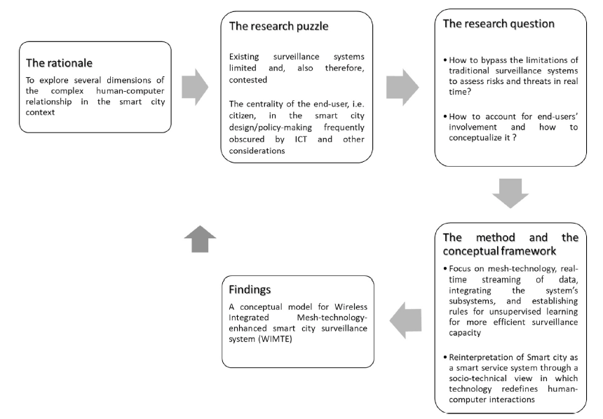
System Architecture

Slide 10
System Architecture
Recent approaches to the study of the smart city suggest the value of viewing the smart city from a three-tiered perspective, i.e., as an analytical concept.
The smart city turns into the key venue in which information needs to be managed both efficiently and sustainably.
The process of managing information in the smart city efficiently and sustainably requires that the mechanisms that bring the city inhabitants, and allow them to engage in a meaningful and constructive/innovative ways.

Slide 11
Applications
Battlefield surveillance
Tunnels
Mobile video applications
Real time car racing
In-vehicle video surveillance
Smart Meters
Intelligent Transportation

Slide 12
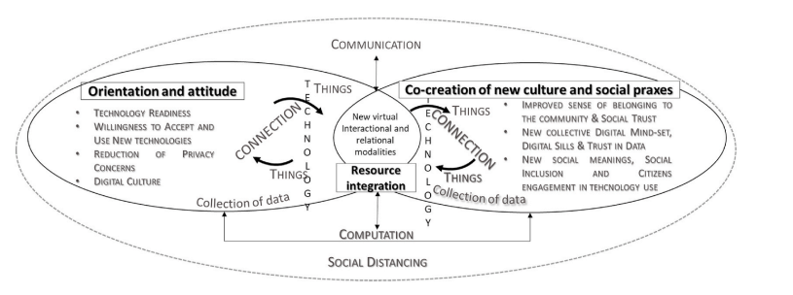
Results

Slide 13
Results
The conceptual model introduced identifies:
The main technological drivers for smart surveillance to redefine smart cities infrastructure to challenge epidemic
The complex process of redefinition of actor’s interactions and communication modalities between actors
The key determinants of social change as a result of the transformation of citizens attitude toward technology and behavior.
The integrated WIMTE framework proposed in this study contributes to shed light on how ecosystems can challenge social and economic crisis through the integration of technologies with human attitude and individual intentions.

Slide 14
Results
The elaboration of a model that examines how technology can redefine humans’ interactions in smart cities can address a gap in literature related to the absence of studies exploring the role of ICT.

Slide 15
References
A. Joy, C. Babu and D. A. Chandy, "Enhanced Security Mechanism for ATM Machines," 2021 7th International Conference on Advanced Computing and Communication Systems (ICACCS), 2021.
S. Hazra, "Smart ATM Service," 2019 Devices for Integrated Circuit (DevIC), 2019.
B. M. Nelligani, N. V. U. Reddy and N. Awasti, "Smart ATM security system using FPR, GSM, GPS," 2016 International Conference on Inventive Computation Technologies (ICICT), 2019.
O. H. Embarak, "A two-steps prevention model of ATM frauds communications," 2018 Fifth HCT Information Technology Trends (ITT), 2018.
V. Jacintha, J. Nagarajan, K. T. Yogesh, S. Tamilarasu and S. Yuvaraj, "An IOT Based ATM Surveillance System," 2017 IEEE International Conference on Computational Intelligence and Computing Research (ICCIC), 2017.

Slide 16
Thank You

