Slide 1

Muzirislive
Submitted By: Amrutha P Biju Project Guide: Praveen C Menon
Course: MCA S6

Slide 2
contents
Abstract
Modules
Technology hierarchy
System specification
Table Design
UML
Forms

Slide 3
ABSTACT
Muziris Live is a customized mobile application that can help you in various ways. It can provide various services such as instant news updates, blood donation information, notifies about various job opportunities both in government and private sector, large database of previous question papers, theatre releases and show timing, local directory, sports updates and various government application forms. This revolutionary Mobile application introduced with a vision of bringing the important services in our fingerprints.

Slide 4
Module description
Mobile application ( android & IOS application)
Web portal
Mobile application ( android & IOS application)
News
Blood donor
Jobs
Model questions
Government forms
Movie release
Directory
Feedback

Slide 5
News
Display different category of news such as general, politics, entertainment, sports, local news, business, health, environmental, technical, obituary, career, Muziris corner. The news will be display briefly after we touch in that.
Blood donor
We can search for blood groups from different locations and contact them. The available blood groups and their locations are displayed in a drop down box.
Jobs
Notifies about various job opportunities both in government and private sector and we can know the scheduled interview or exam date details.
Model questions
Large collection of previous question papers and their corresponding answers.

Slide 6
Govt. Forms
View and download various government application forms.
Movie releases
Show newly released movies and show time.
Directory
Directory contain name and contact number of all educations, govt. offices, hospitals, transportations, personal, emergency and business

Slide 7
Web Portal
News update
Add/delete blood groups and donors
Update job details
Add new govt.forms
Update movie releases
Add new contact information in the directory

Slide 8
Technology hierarchy
MOBILE APPLICATION – HYBRID
Cordova Ionic
Angular JS version .1
WEBPORTAL – RESPONSIVE
HTML
CSS
JQuery
Twitter Bootstrap
BACKEND
CODE-IGNITER
PHP
MySQL

Slide 9
Introduction to PHP
PHP is a server-side scripting language designed for web development but also used as a general-purpose programming language. PHP code is usually processed by a PHP interpreter, which is usually implemented as a web server's native module or a Common Gateway Interface (CGI) executable. After the PHP code is interpreted and executed, the web server sends resulting output to its client, usually in form of a part of the generated webpage; for example, PHP code can generate a web page's HTML code, an image, or some other data. PHP has also evolved to include a command-line interface (CLI) capability and can be used in standalone graphical applications.

Slide 10
My SQL
Structured Query Language (SQL), in computer science, a database sub language used in querying, updating and managing relational databases. MY SQL Server is a relational database management system for distributed Client-Server computing. Like all other database management systems, it provides the following features:
A variety of user interfaces
Physical data independence
Logical data independence
Query optimization
Data integrity
Concurrency control
Backup and recovery
Security and authorization

Slide 11
Android
Android is a mobile operating system developed by Google, based on the Linux kernel and designed primarily for touch screen mobile devices such as smart phones and tablets. Android's user interface is mainly based on direct manipulation, using touch gestures that loosely correspond to real-world actions, such as swiping, tapping and pinching, to manipulate on-screen objects, along with a virtual keyboard for text input.

Slide 12
NETBEANS
Netbeans is an integrated development environment (IDE) for developing primarily with Java, but also with other languages, in particular PHP, C/C++, and HTML5.It is also an application platform framework for Java desktop applications and others. The NetBeans IDE is written in Java and can run on Windows, OS X, Linux, Solaris and other platforms supporting a compatible JVM. The Net Beans Platform allows applications to be developed from a set of modular software components called modules
Among the features of the platform are:
User interface management (e.g. menus and toolbars)
User settings management
Storage management (saving and loading any kind of data)
Window management

Slide 13
IONIC FRAMEWORK
Ionic is a powerful HTML5 SDK that helps you build native-feeling mobile apps using web technologies like HTML, CSS, and JavaScript.Ionic is focused mainly on the look and feel, and UI interaction of your app. That means we aren't a replacement for PhoneGap or your favourite JavaScript framework. Instead, Ionic simply fits in well with these projects in order to simplify one big part of your app: the front end. We recommend reading, Where does the Ionic Framework fit in? to get a good understanding of Ionic's goals.

Slide 14
Code-igniter
Codeigniter is an application development framework, which can be used to develop websites, using PHP. It is an Open Source framework. It has a very rich set of functionality, which will increase the speed of website development work.If you know PHP well, then Codeigniter will make your task easier. It has a very rich set of libraries and helpers. By using Codeigniter, you will save a lot of time, if you are developing a website from scratch. Not only that, a website built in Codeigniter is secure too, as it has the ability to prevent various attacks that take place through websites.
Codeigniter Features
Model-View-Controller Based System
Extremely Light Weight
Full Featured database classes with support for several platforms.
Query Builder Database Support
Form and Data Validation

Slide 15
Table design
Tbl_blood_donor
FIELD | KEY | TYPE | DESCRIPTION
id | PK | bigint(10) | Id
name | No | varchar(100) | Name
blood_group | No | varchar(10) | Blood group
phone | No | varchar(100) | Phone
email | No | varchar(100) | Email
location_id | FK | bigint(10) | Location id

Slide 16
Tbl_category
FIELD | KEY | TYPE | DESCRIPTION
id | PK | Bigint(10) | Id
category_title | No | Varchar(100) | Category title
category_desc | No | Text | Category description
type | No | Varchar(100) | Type
order | No | Bigint(10) | order

Slide 17
Tbl_contact
FIELD | KEY | TYPE | DESCRIPTION
Id | PK | bigint(10) | Id
Name | No | varchar(100) | Name
Phone | No | varchar(30) | Phone
category_id | FK | bigint(10) | Category id

Slide 18
Tbl_forms
FIELD | KEY | TYPE | DESCRIPTION
Id | PKTYPE | bigint(10) | Id
Title | No | Varchar(100) | Title
`attatchment | No | Text | Attactchment
Preview | No | Text | Preview
`category_id | FK | bigint(10) | Category id

Slide 19
Tbl_jobs
FIELD | KEY | TYPE | DESCRIPTION
`id | PK | bigint(10)
`job_title | No | varchar(100) | Id
`job_description | No | Text | Job title
`last_date | No | Datetime | Last date
`posted_date | No | datetime | Posted date
`skills | No | varchar(100) | Skills
`contact_email | No | varchar(100) | Contact email
`contact_website | No | varchar(100) | Website
`phone | No | varchar(100) | Phone
`category_id` | Fk | bigint(10) | Category id

Slide 20
Tbl_locations
FEILD | KEY | TYPE | DESCRIPTION
`id | PK | bigint(10) | Id
`location_name | No | varchar(100) | Location name
`address | No | text | Address
`volunteer_id | FK | bigint(10) | Volunteer id

Slide 21
Tbl_movies
FEILD | KEY | TYPE | DESCRIPTION
`id | PK | bigint(10) | Id
`movie_name | No | varchar(100) | Movie name
`release_date | No | datetime | Released date
`featured | No | varchar(100) | Featured
`thumb | No | varchar(100) | Thumb
`language | No | varchar(100) | Language
`rating | No | varchar(100) | rating

Slide 22
Tbl_news
FIELD | KEY | TYPE | DESCRIPTION
`id | PK | bigint(10) | Id
`title |  | varchar(100) | Title
`date | No | Datetime | Date
`contents | No | Text | Content text
`excerpt | No | varchar(100) | Excerpt
`featured | No | varchar(100) | Featured
`status | No | varchar(100) | Status
`thumb | No | varchar(100) | Thumb
`category_id | FK | bigint(10) | Category id

Slide 23
Tbl_options
FEILD | KEY | TYPE | DESCRIPTION
`id | PK | bigint(10) | Id
`option | No | varchar(100) | Option
`question_id | FK | bigint(10) | Question id
is_answer` | No | tinyint(1) | Is answer

Slide 24
Tbl_reset
FEILD | KEY | TYPE | DESCRIPTION
`id | PK | bigint(10) | Id
`user_id | FK | bigint(10) | User id
`reset_key` | No | varchar(100) | Reset key

Slide 25
Tbl_shows
FEILD | KEY | TYPE | DESCRIPTION
`id | PK | bigint(10) | Id
`show_id | No | bigint(10) | Show id
`movie_id` | FK | bigint(10) | Movie id

Slide 26
Tbl_test
FEILD | KEY | TYPE | DESCRIPTION
`id | PK | bigint(10) | Id
`result` | no | text | Result

Slide 27
Tbl_theatres
FEILD | KEY | TYPE | DESCRIPTION
`id | PK | bigint(10) | Id
`theatre | No | varchar(200) | Theatre
`shows | No | varchar(200) | Shows
`location | No | varchar(200) | Location
`phone | No | varchar(200) | Phone
`email | No | varchar(200) | Email

Slide 28
UML

Slide 29
Activity diagram
ADMIN-SIDE

Slide 30
USER-SIDE

Slide 31
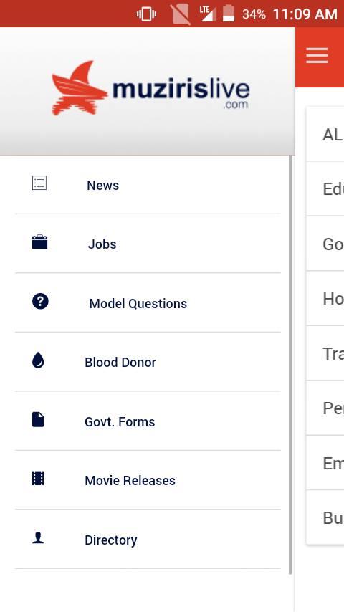
Form
NAVIGATION MENU

Slide 32
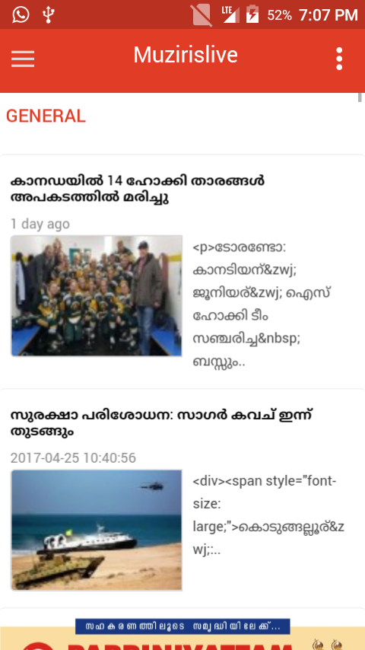
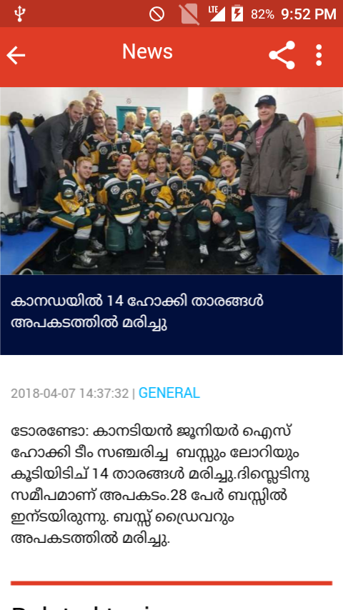
NEWS

Slide 33
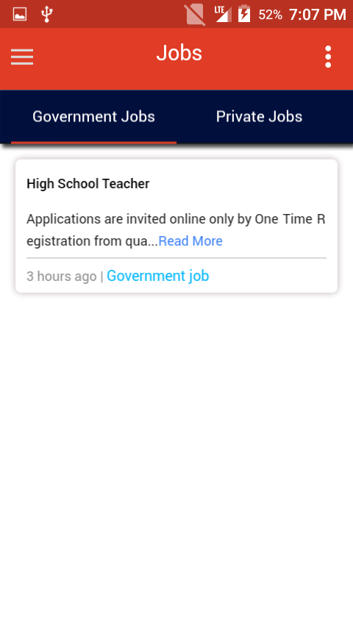
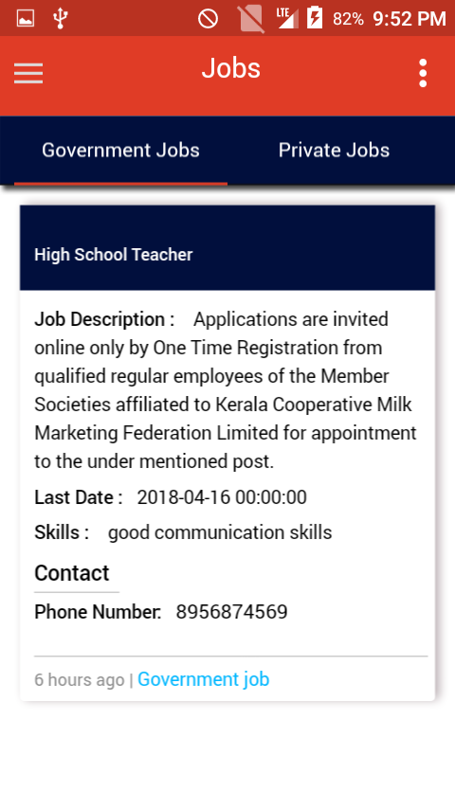
JOB

Slide 34
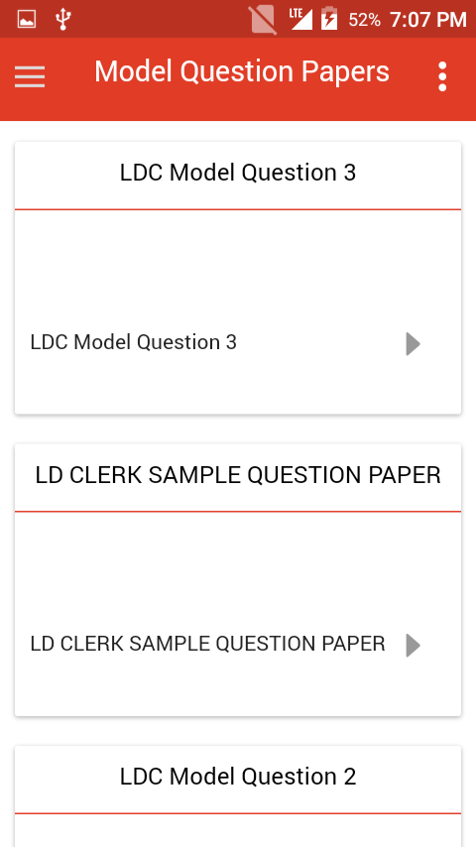
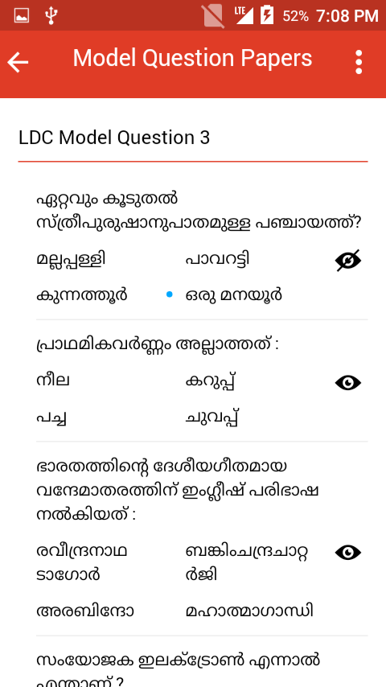
MODEL QUESTION PAPER

Slide 35
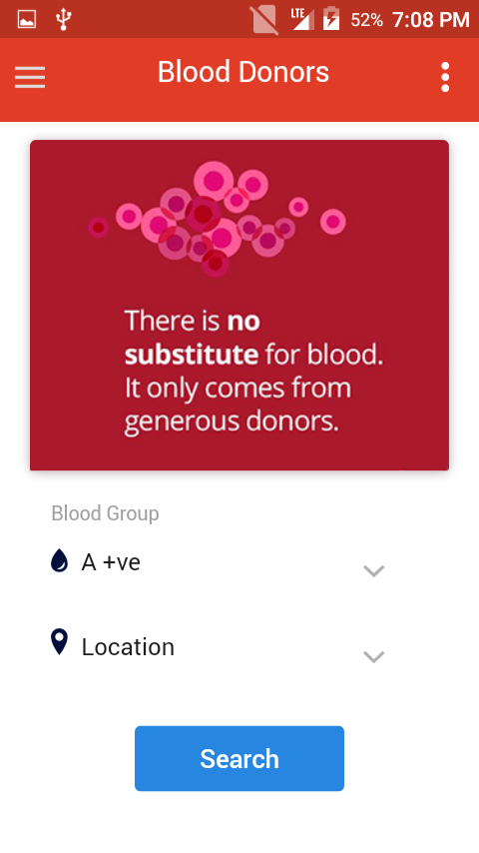
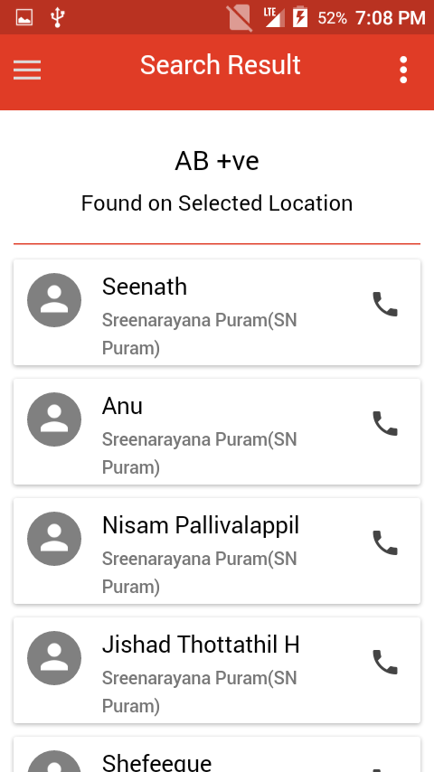
BLOOD DONOR

Slide 36
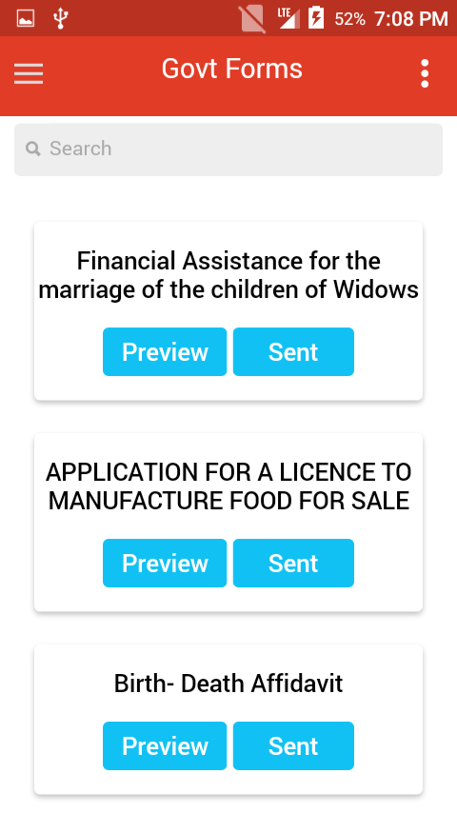
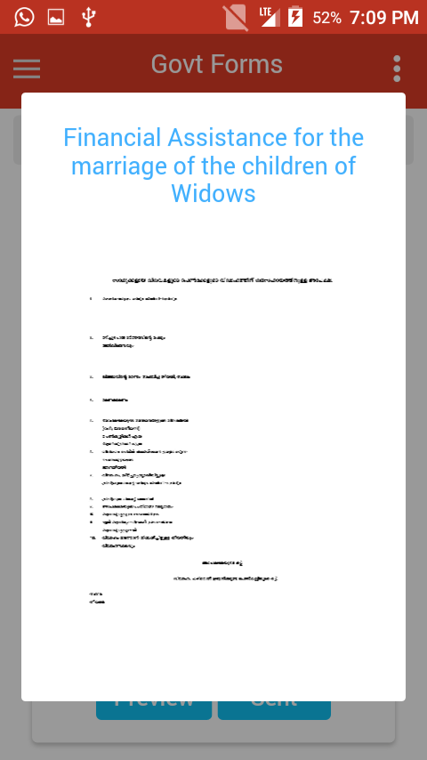
GOVERNMENT FORMS

Slide 37
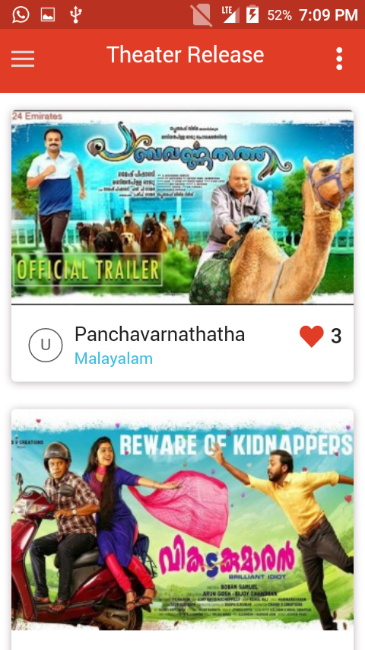
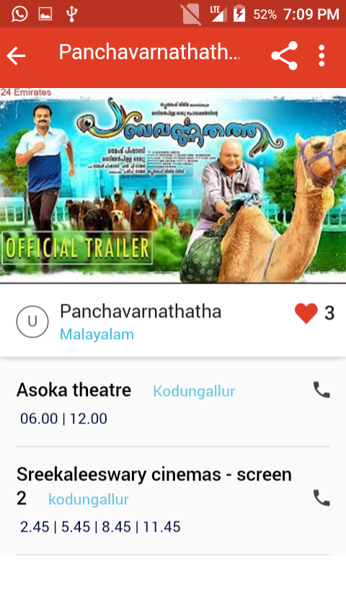
THEATER RELEASE

Slide 38
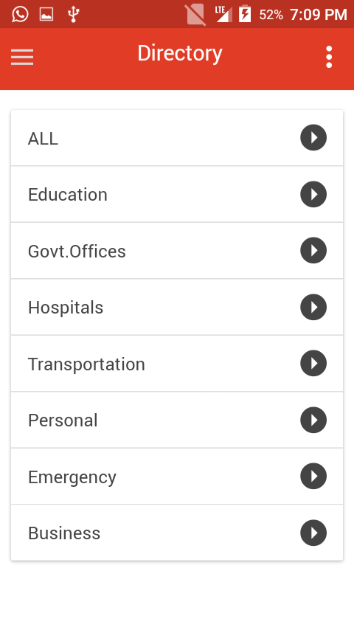
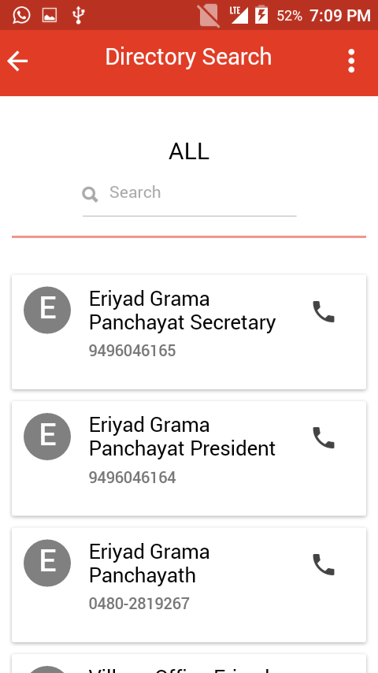
DIRECTORY

Slide 39
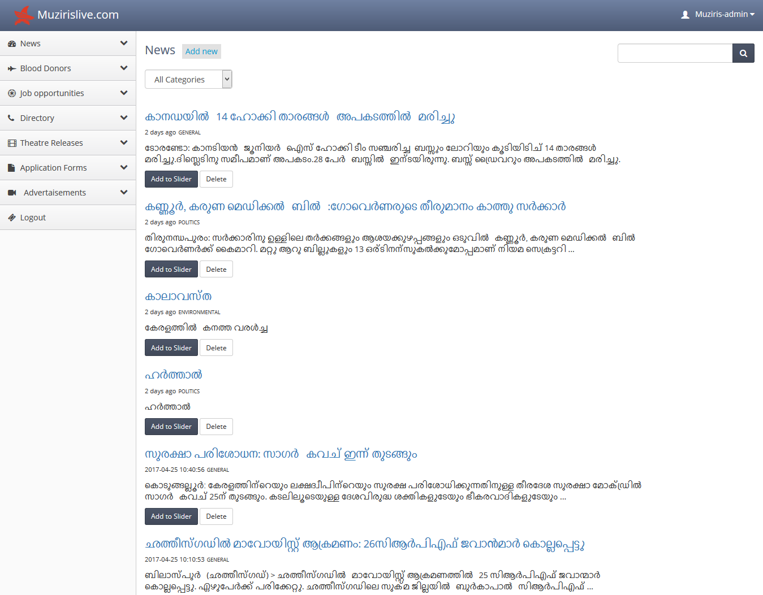
Web Portal

Slide 40
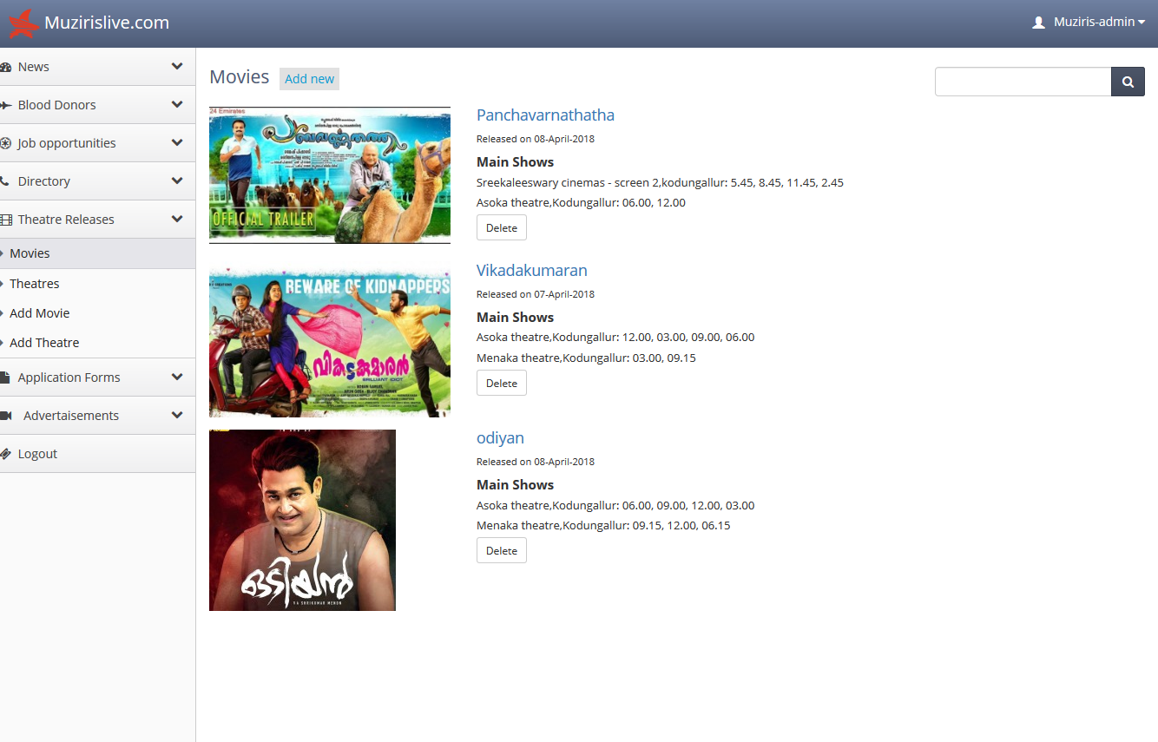

Slide 41
Bibliography
https://en.wikipedia.org/wiki/PHP
https://www.Microsoft.com
https://en.wikipedia.org/wiki/SQL
https://en.wikipedia.org/wiki/SQL#Syntax
https://www.w3schools.com
https://developer.android.com/work/overview.html
https://clearbridgemobile.com/how-to-build-a-mobile-app-requirements-document

Slide 42


