Slide 1
Behavioural Fingerprinting for Insider Threat Detection
By: Amrutha Ajish Achuthan
Goal: Detect insider threats using ML on network traffic

Slide 2
Overview of Insider Threats
- Legitimate users misusing access
- Difficult to detect via traditional security
- Behavioural fingerprinting = profile-based anomaly detection

Slide 3
Project Objectives
- Capture real/simulated network traffic
- Extract flow-level features
- Apply unsupervised ML for anomaly detection

Slide 4
Tools Used
- Wireshark for packet capture
- CICFlowMeter for feature extraction
- Python: scikit-learn, matplotlib, seaborn

Slide 5
Data Simulation
- Simulated web, file transfer, and scanning activity
- Captured traffic as .pcap files
- Extracted CSV using python code

Slide 6
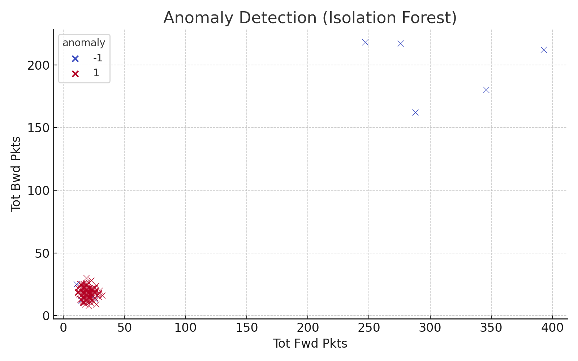
Isolation Forest Output

Slide 7
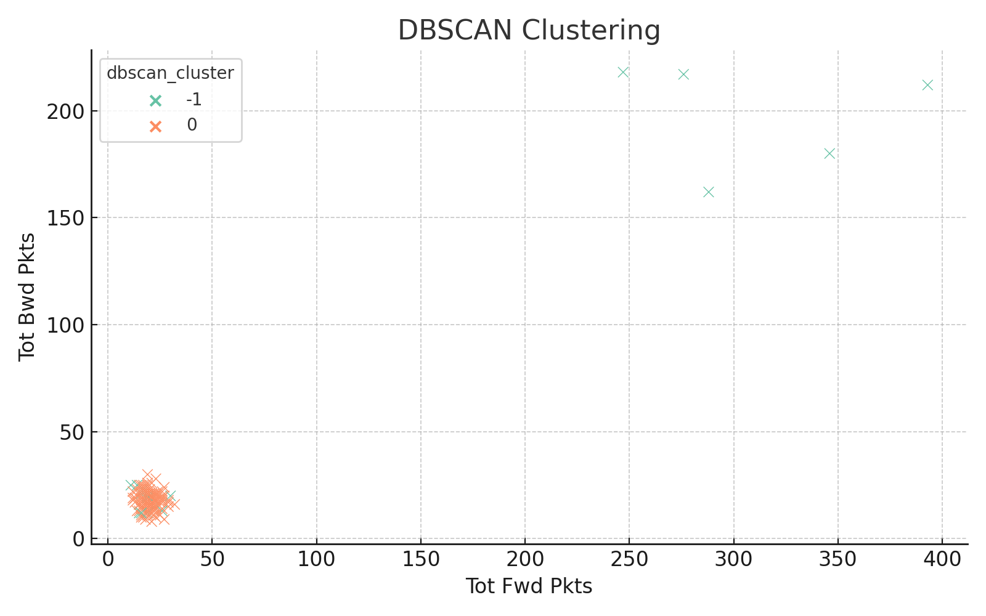
DBSCAN Clustering Output

Slide 8
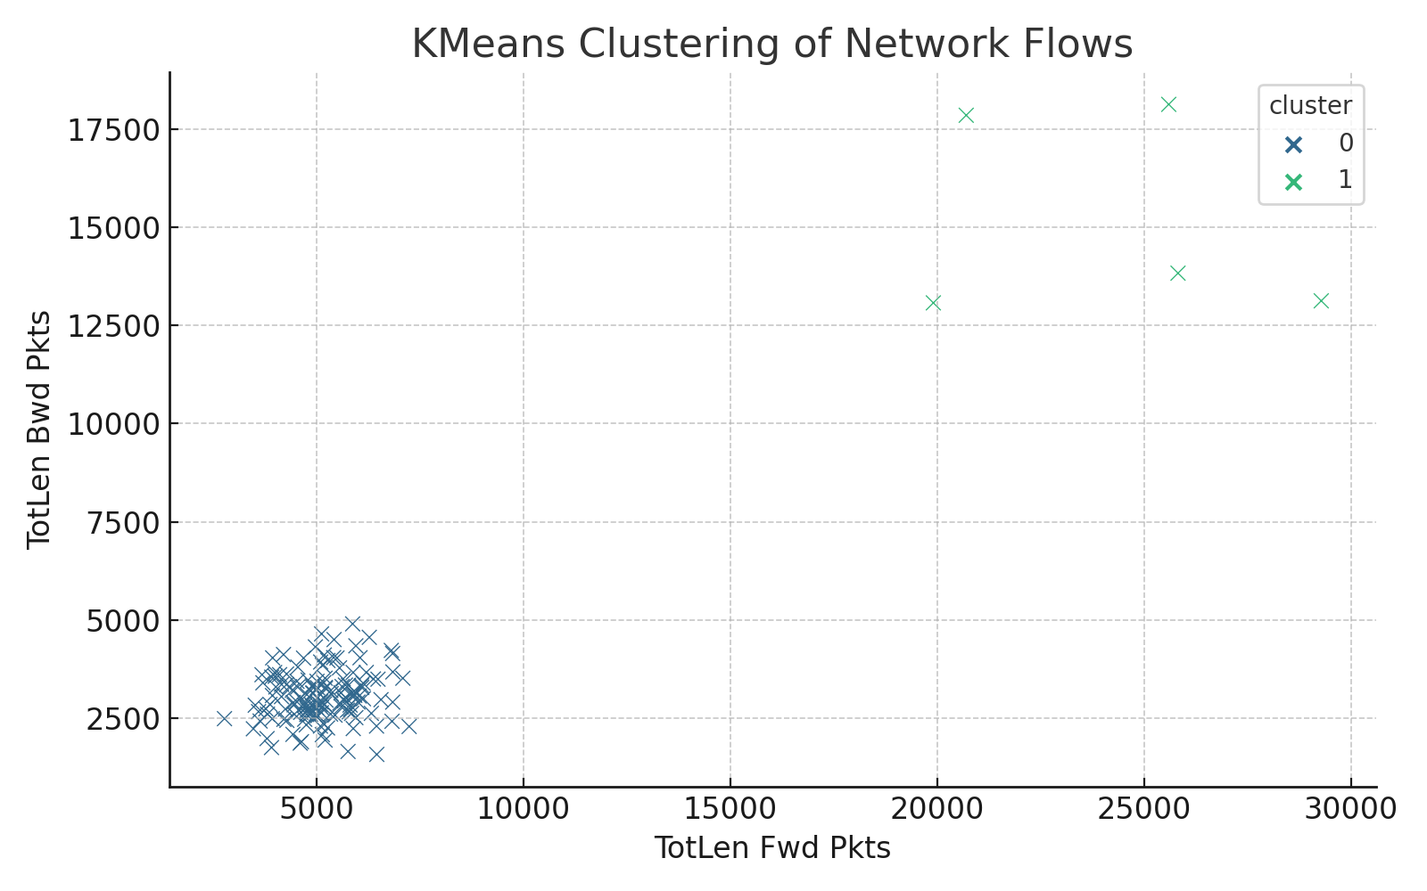
KMeans Clustering Output

Slide 9
ML Models Used
- Isolation Forest: unsupervised anomaly detection
- KMeans: cluster-based behavior grouping
DBScan
- Results visualized to confirm anomalies

Slide 10
Conclusion & Future Work
- Behavioural patterns can flag threats
- Need real-time and real-user data
- Extend with deep learning in future

