Slide 1


Realme Smartphone Analysis
Title: Web Scraping and Exploratory Data Analysis of Realme Product Data

Slide 2
About Me:
I am Yarragodala Amrutha Sai B.Pharmacy graduate with a strong passion for Data Analytics and Visualization.
Skilled in exploring real-world datasets to uncover meaningful insights.
Experienced in web data extraction and cleaning using Python tools.
Continuously learning to enhance expertise in data science and analytics tools.
GITHUB - https://github.com/amruthasai0524
LINKEDIN -https://www.linkedin.com/in/amruthasaiyarragodala/

Slide 3
Preface:
INTRODUCTION
BUSINESS PROBLEM
OBJECTIVE
TOOLS USED
WEB SCRAPPING
DATA CLEANING STEPS
DATA VISUALIZATION
CONCLUSION

Slide 4
Introduction:
Comprehensive analysis of Realme smartphone product portfolio
Data extracted from Flipkart e-commerce platform
9,768 smartphone records across multiple product pages
Focus on pricing, specifications, ratings & customer reviews

Slide 5
Business Problem:
Understand pricing strategies across Realme product lineup
Identify correlation between specifications and market price
Analyse customer satisfaction through ratings & reviews
Discover discount patterns and revenue optimization opportunities

Slide 6
Objectives:
Extract smartphone data using web scraping techniques
Clean and standardize raw data for analysis
Perform statistical analysis on price & specifications
Create actionable visualizations for insights

Slide 7
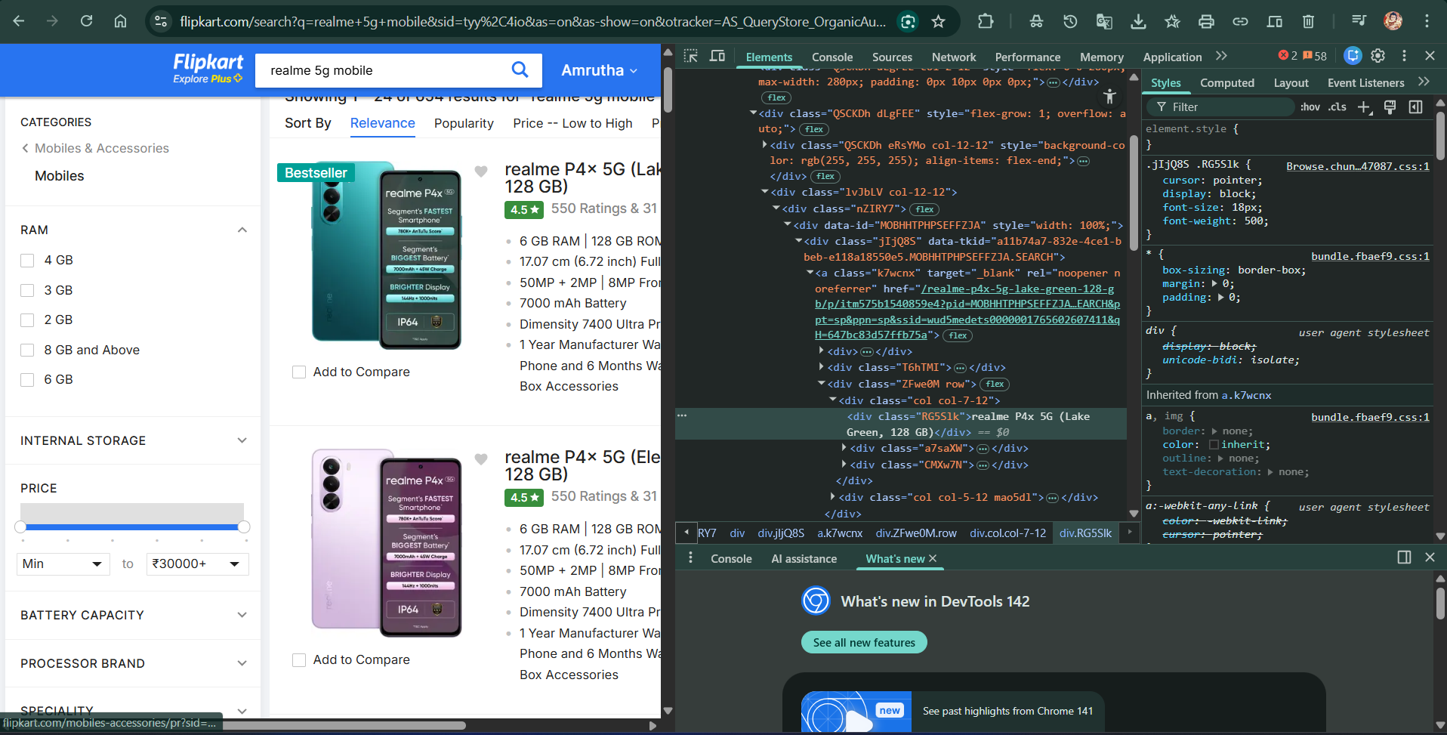
Web Scraping:
Extracted data from Flipkart's Realme product listing pages
Used BeautifulSoup to parse HTML structure
Captured 413 pages of smartphone data
Collected: Product name, price, ratings, specifications, reviews

Slide 8
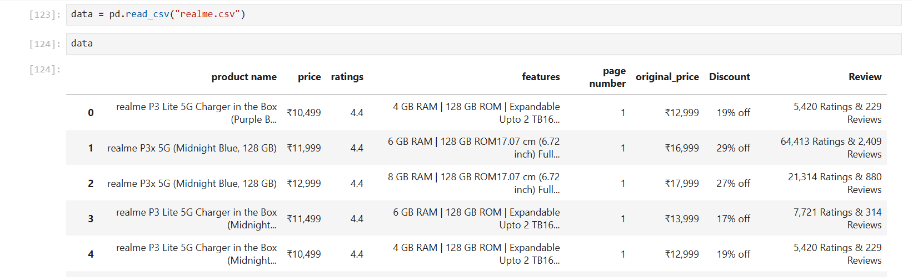
Dataset:

Slide 9






libraries Used:

Slide 10
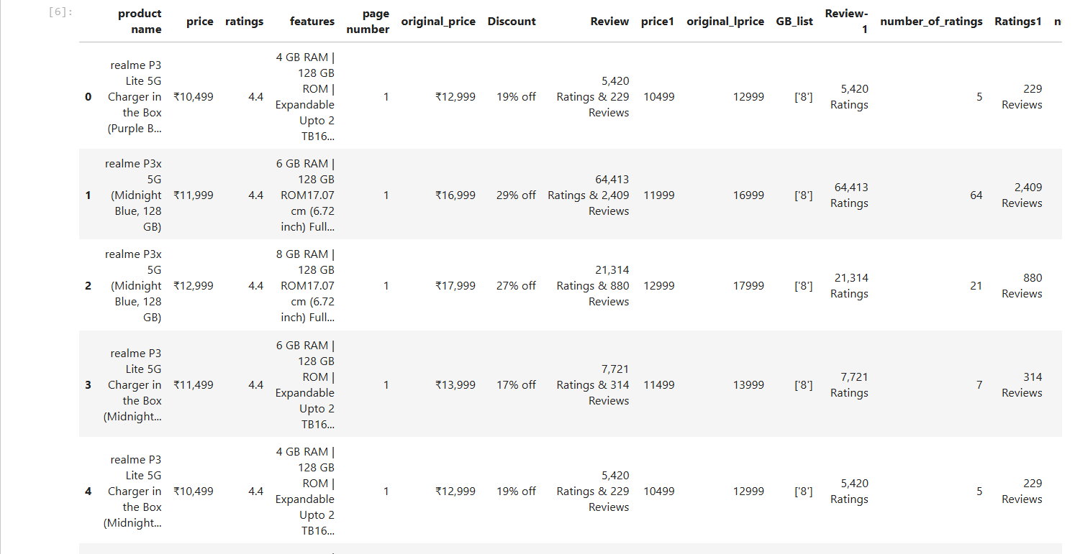
Data Cleaning Steps:
Removed currency symbols (₹) from price columns
Converted text prices to numeric format
Extracted RAM & ROM values from feature strings
Parsed discount percentages and original prices
Extracted colour variants from product names using regex
Separated ratings from review counts
Handled missing and duplicate records
Standardized data types and formats

Slide 11
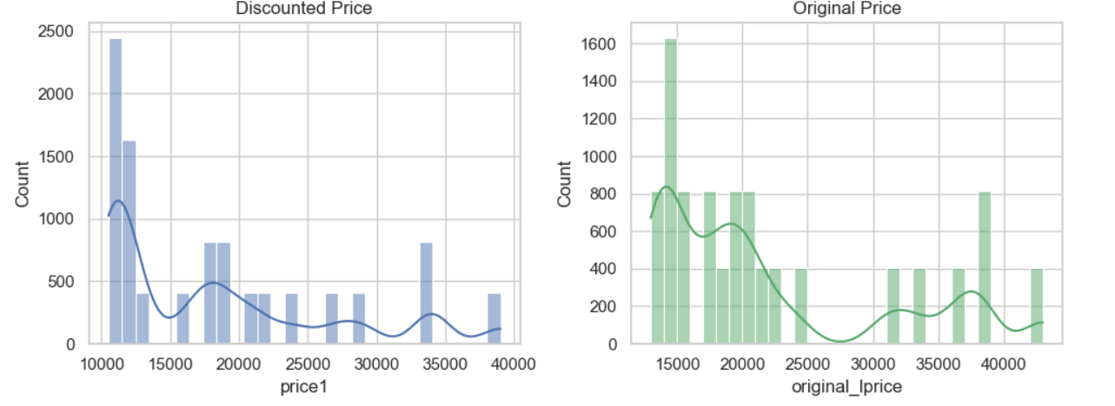
Data Visualization:
📌Price is right‑skewed (some premium phones), engagement is also skewed with few very popular models.

Slide 12
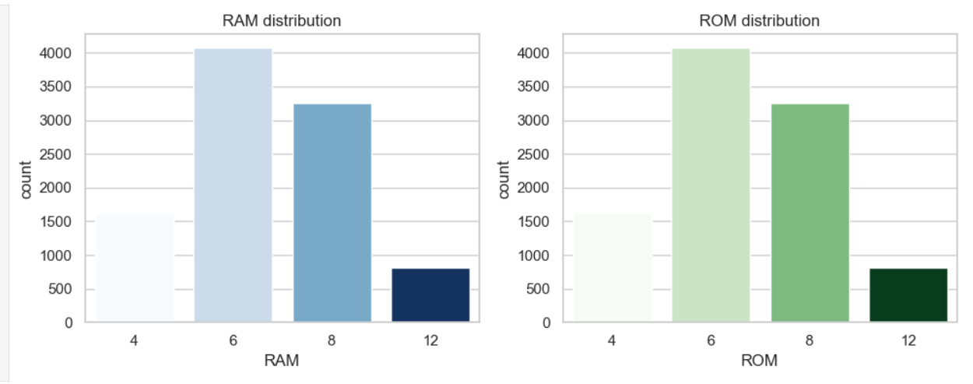
Data Visualization:
📌 6 GB and 8 GB RAM with 128 GB ROM dominate the catalogue; 4 GB and 12 GB RAM, and 256 GB ROM, appear much less often.

Slide 13
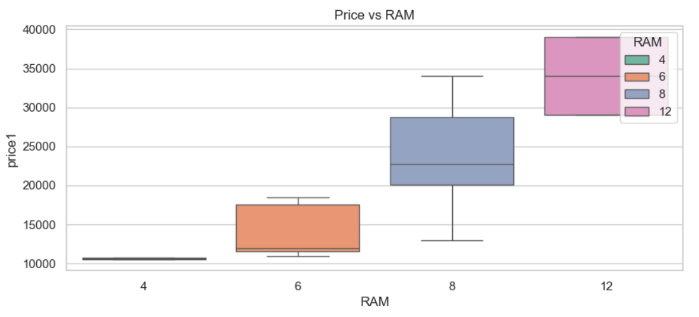
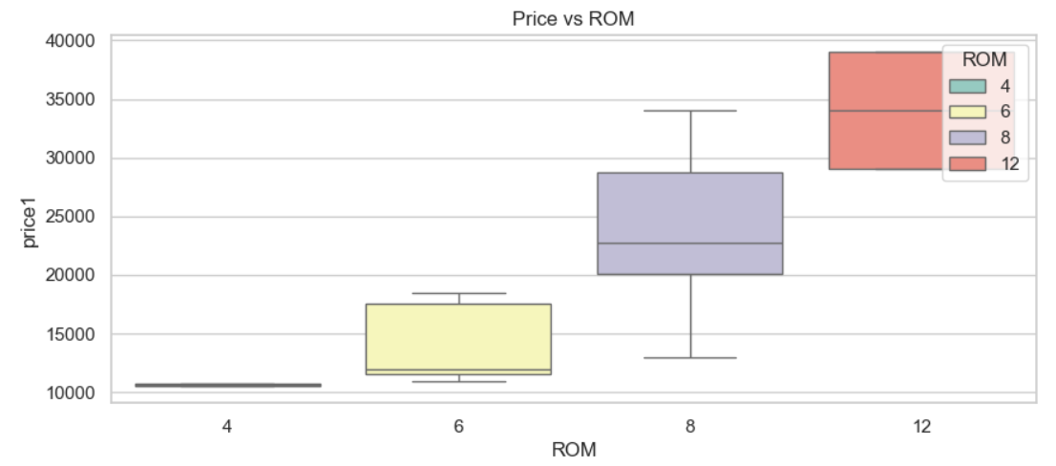
Data Visualization:
How does price vary by RAM and ROM?
📌Shows how much extra customers pay for higher RAM/ROM tiers; good to discuss up‑selling strategy Median price clearly increases as RAM goes from 4 → 6 → 8 → 12 GB and when ROM goes from 128 → 256 GB, with only small overlap between tiers.

Slide 14
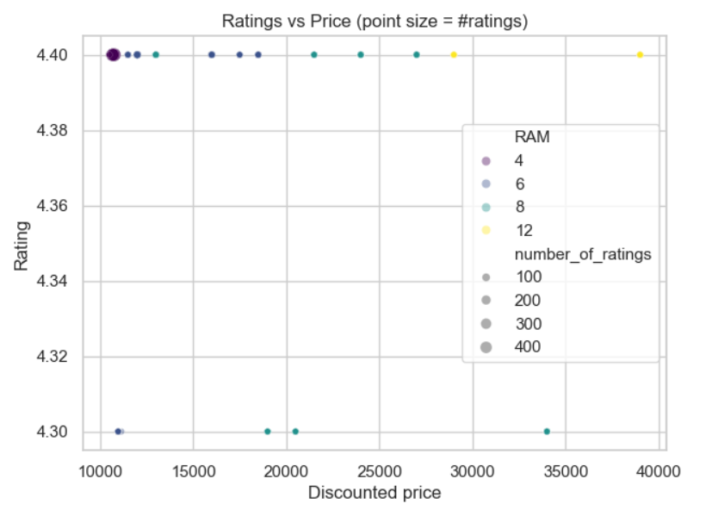
Data Visualization:
Are higher‑priced phones actually rated better?
📌Often ratings stay around 4.3–4.4 across price bands, so premium price doesn’t guarantee higher satisfaction; big bubbles show best‑selling models cluster in certain price ranges.No; phones across all price levels sit around 4.3–4.4 stars, so expensive models are not noticeably better rated than cheaper ones.

Slide 15
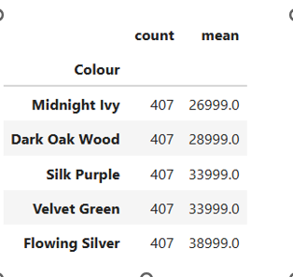
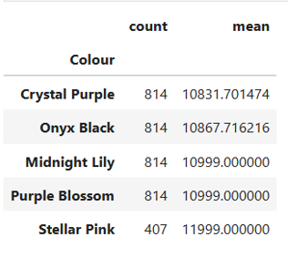
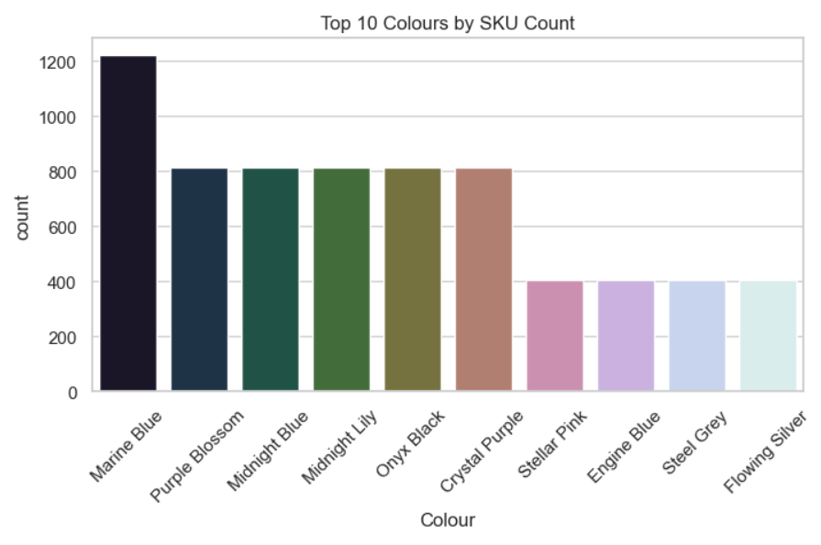
Data Visualization:
Which colours and variants are most popular?
📌You can say which colours dominate the catalogue and whether any colour consistently commands higher/lower prices. Colours like Crystal Purple, Onyx Black, Midnight Lily, and Purple Blossom have the highest counts and are tied to mid‑range prices, while colours like Midnight Ivy, Dark Oak Wood, Silk Purple, Velvet Green, and Flowing Silver are fewer and linked to much higher prices

Slide 16
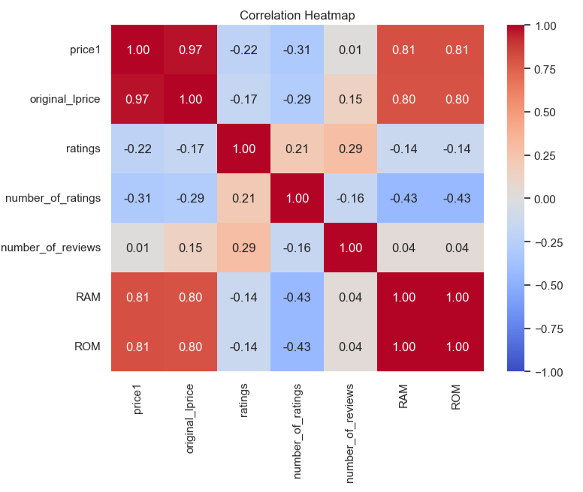
Data Visualization:
What are the correlations and key drivers?
📌price1 vs original_lprice should be very high (discount is mainly % off).number_of_ratings vs number_of_reviews will be strongly correlated (engagement).Weak correlation between price1 and ratings supports the earlier scatter‑plot insight.
📌Ratings and review counts are strongly correlated with each other, prices correlate strongly with original prices and moderately with RAM/ROM, but the rating score itself has only weak correlation with price or engagement.¶

Slide 17
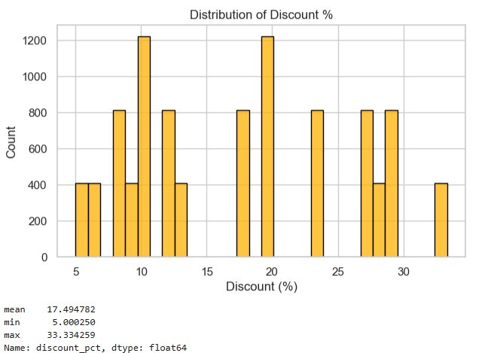
Data Visualization:
What discount do customers actually get?
📌Talk about typical discount range and extreme offers. Calculated discount percentages cluster in a moderate range, with most phones getting similar mid‑level discounts and only a few receiving very deep cuts.¶

Slide 18
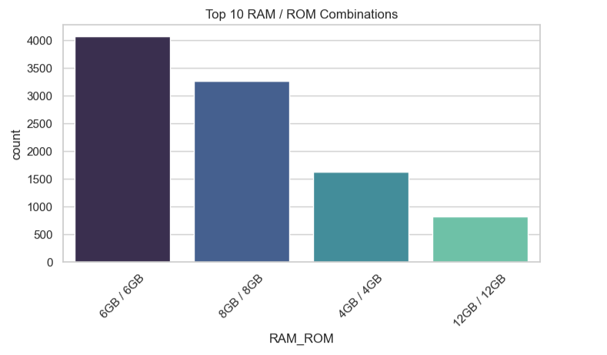
Data Visualization:
Which RAM–ROM combos are most common?
📌Easy slide showing most offered hardware configurations.The 6 GB / 128 GB and 8 GB / 128 GB combinations appear most frequently, forming the core of the portfolio; 4 GB / 128 GB and 8–12 GB / 256 GB are niche segments.​¶

Slide 19
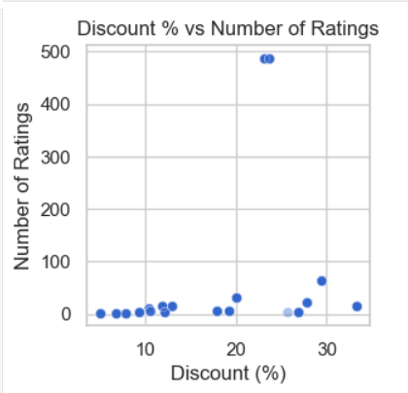
Data Visualization:
Do higher discounts boost ratings count?
📌If the pattern is upward, you can say deeper discounts are associated with more buyers/ratingsThe scatter between discount % and number_of_ratings shows at best a mild positive pattern: heavily discounted phones sometimes attract more ratings, but discount alone does not fully explain engagement.¶

Slide 20
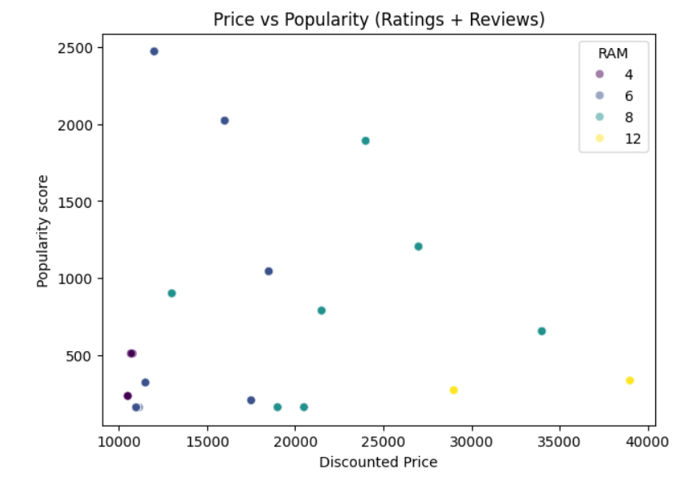
Data Visualization:
Which models balance price and popularity best?
📌Identify “value for money” cluster – moderate price, high popularity. On the price vs popularity plot, the most attractive phones cluster in the mid‑price range with high ratings/reviews counts, indicating strong demand at affordable prices rather than at extreme low or high prices.

Slide 21
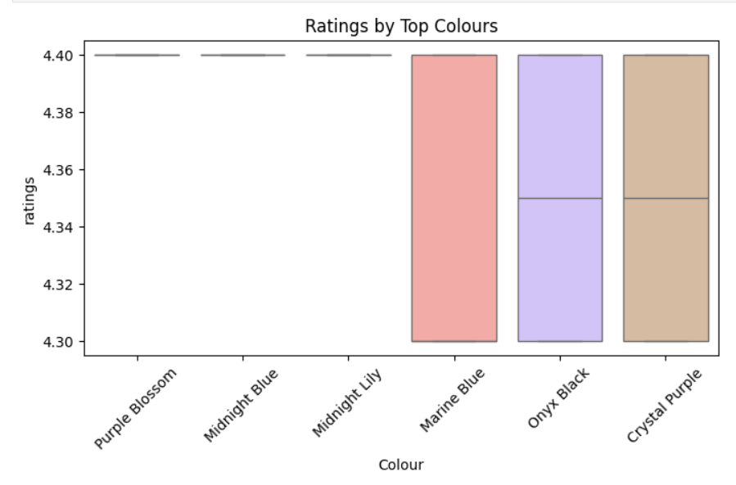
Data Visualization:
Are ratings different across colours?
📌Boxplots of ratings by colour stay tight around 4.3–4.4 for all major colours, so colour influences price and positioning more than customer satisfaction scores.

Slide 22
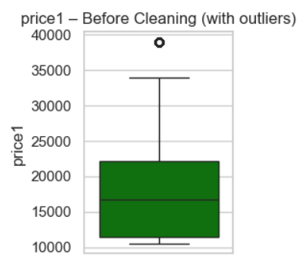
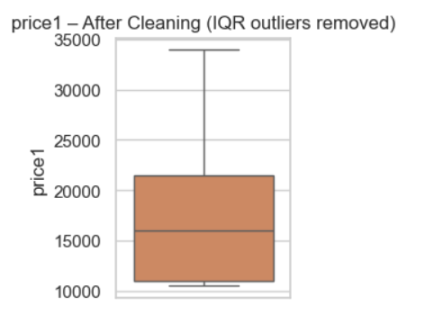
Data Visualization:
Realme’s smartphone lineup in this dataset is mainly mid-range priced with consistently high customer ratings, where higher RAM/ROM and advanced features define a smaller premium segment, showing strong value-for-money positioning and stable user satisfaction across models.

Slide 23
Key Insights :
🔝 Most popular: 6GB RAM + 128GB ROM (volume driver)
💎 Premium tiers: 8GB/12GB RAM + 256GB storage
📈 Strong correlation between specs & pricing strategy
🌐 5G standard across entire lineup
📊 Price distribution across colour variants
🔗 Correlation matrix: RAM ↔ ROM ↔ Price ↔ Ratings
💹 Discount patterns & market segmentation
📈 Ratings consistency & product positioning
Customer Satisfaction:
⭐ Average rating: 4.3-4.4/5.0 across all models
✅ High consistency shows quality reliability
💬 Popular models: 30K+ ratings with 2K+ reviews
🎯 Ratings stable despite price differences
Business Insights:
📊 Budget drives volume, premium drives margin
🎨 Colour variants have minimal price impact
⚙️ Specs strongly influence ratings & perception
🎁 Optimal discount range: 25%-33% for positioning

Slide 24
Conclusion:
💵 Average price: ₹15,500-17,500 across models
🏆 Budget segment (₹10K-13K) dominates with 30% market share
🎁 Discount range: 5%-33% off original price
⭐ Premium models show lower discounts, stronger positioning
Realme's mid-range focus with consistent 4.3-4.4★ ratings demonstrates strong value-for-money positioning, where budget segment drives volume, premium specs command pricing power, and strategic discounting (5%-33%) enables market dominance.

Slide 25

THANK YOU

