Slide 1

Streaming Trajectories with MDAnalysis
Office of Advanced Cyberinfrastructure
CSSI Elements: Award #2311372
Contributors
ASU
Lawson Woods
Amruthesh Thirumalaiswamy
Heekun Cho
Oliver Beckstein
Matthias Heyden
MDAnalysis
Hugo McDermott-Opeskin
Jennifer Clark
Yuxuan Zhuang

Slide 2
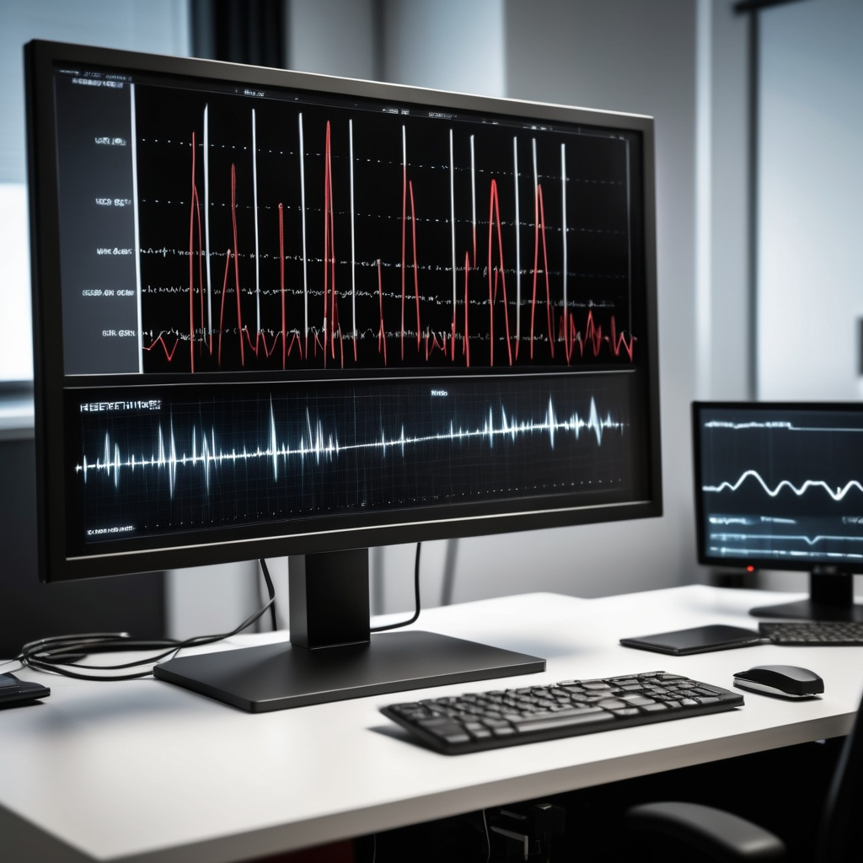
Why Streaming of MD trajectories?
“On-the-fly” Analysis of Trajectories
→ Analyze fast (sub-picosecond) processes w/o writing large trajectory output files
solvent dynamics (HBs, diffusion)
molecular vibrations
friction (force time correlations)
→ Event Detection
monitor arbitrary collective variables
weighted ensemble methods
water/ion flux through membrane
Control Output
→ save disk space & post-processing
store only data you need (e.g., unwrapped protein coordinates)
Notes:
Also mention streaming of trajectories on remote servers (instead of downloading and storing entire file locally)

Slide 3
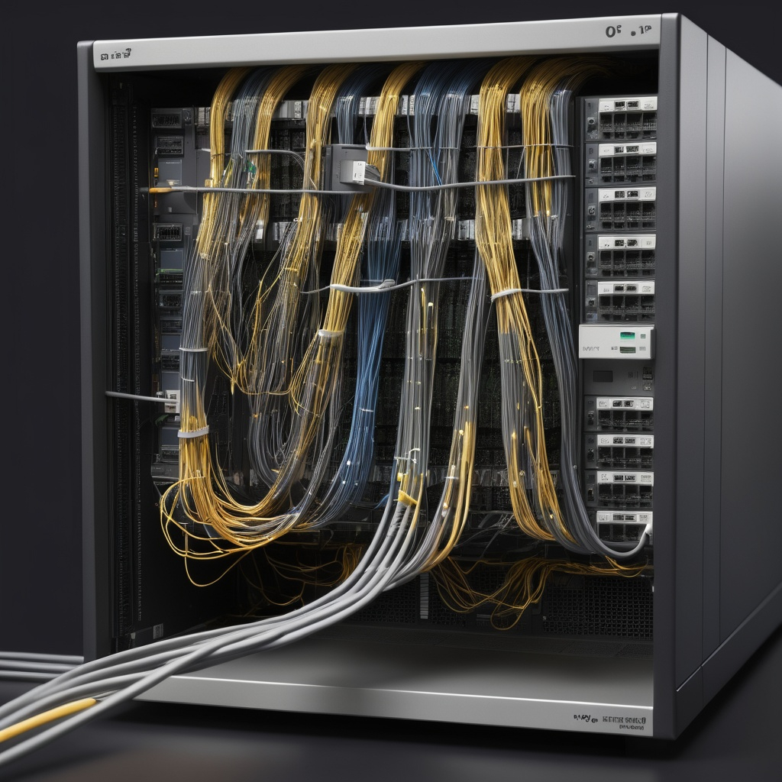
Nomenclature
TCP/IP socket interface
→ Server
MD Simulation software (“serves” trajectory data) ➔ producer
you’ll need its address: localhost or IP-address
→ Client (here: your MDAnalysis script/notebook)
receives data from server ➔ consumer
→ TCP/IP port number
communication channel between server and client
(→ set to same value for both)
0-1023 = well-known ports (stay away, may require superuser privileges)
1024-49151 = registered ports (free to use, possible conflicts)
49152-65535 = dynamic, private or ephemeral ports (free to use)

Slide 4
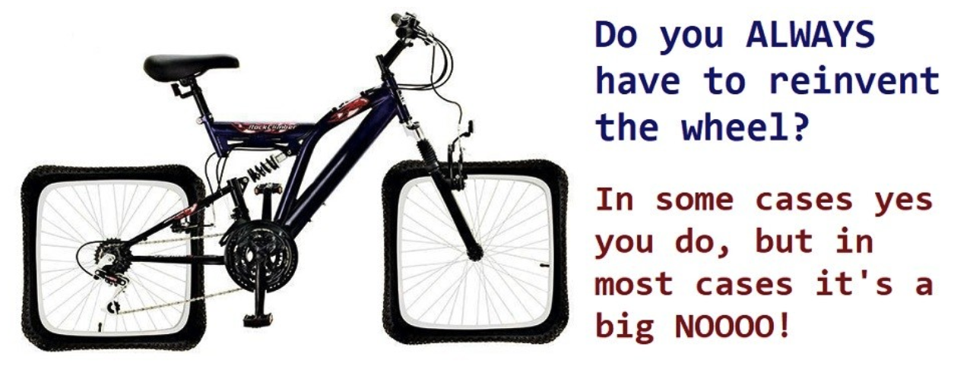
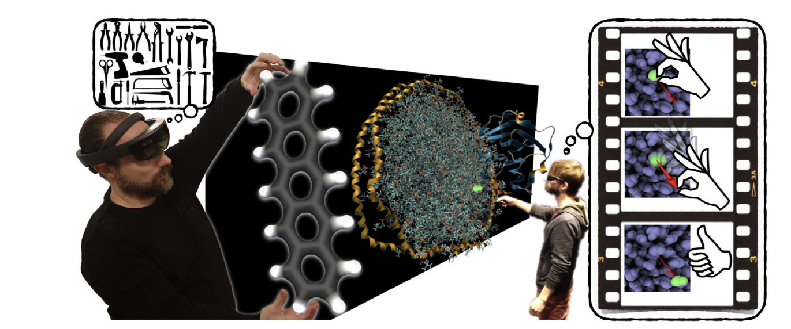
Standing on the Shoulders of Giants: Interactive Molecular Dynamics (IMD)
Original Implementation (IMD version 2):
John E. Stone, Justin Gullingsrud, Klaus Schulten, Paul Grayson 2001 ACM Symposium on Interactive 3D Graphics
Original: Interface NAMD & VMD
supported by GROMACS, LAMMPS, etc.
Main purpose:
Visualization & Interaction
Application:
A. Lanrezac, N. Férey, M. Baaden, WIREs Comput. Mol Sci. 12, e1594 (2022).

Slide 5
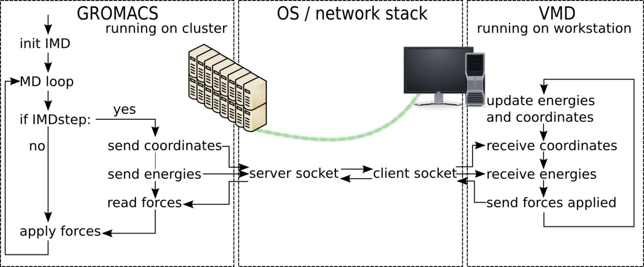
IMD (version 2)
Functionality:
communicate coordinates [optional: and energies] from MD simulation (server) to VMD (client) for visualization
communicate interactive forces from VMD back to MD engine
(c) M. Hoefling & H. Grubmueller, Max Planck Institute for Multidisciplinary Sciences

Slide 6
Why IMD version 3?
IMD version 2
only atom coordinates communicated to client → sufficient for visualization
can set transmit frequency (e.g., communicate every 10 MD steps)
IMD version 3
For analysis of MD trajectories, we need (at least as an option):
simulation box dimensions (if not constant)
→ otherwise cannot compute distances in periodic space
atomic velocities (e.g., for time correlation functions, molecular vibrations)
atomic forces (e.g., to compute friction coefficients)
Nice to have:
control wrapping/unwrapping of molecules in periodic system
simulation time (avoids reconstructing from frame number)

Slide 7
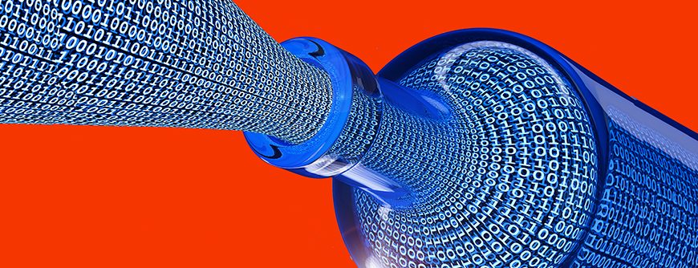
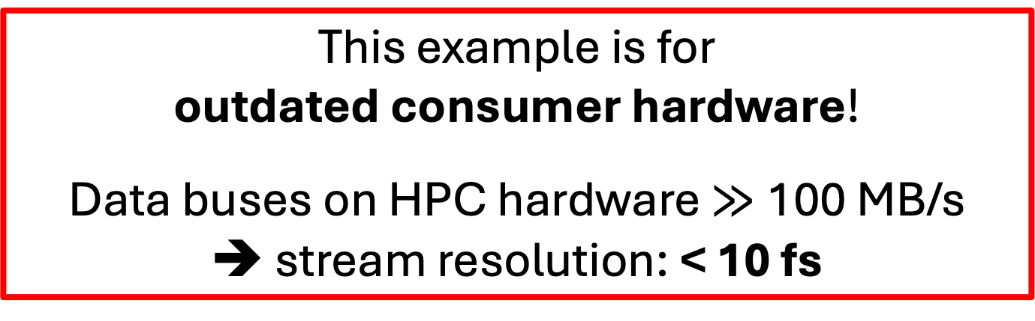
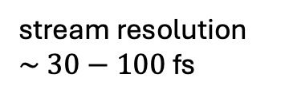


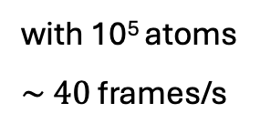
Limits
www.purestorage.com
Data Transfer Rate via TCP/IP (2018 iMac)
on localhost:
→ $>$45 MBytes/s = 45 $×$ 1,024 $×$ 1,024 bytes/s = 47,185,920 bytes/s
→ bytes/atom = 12 (crds only) to 36 (crds,velo,force)
If we transmit only coordinates:
$\frac{4,7185,920 bytes/s}{12 bytes/atom}=3.93 × {10}^{6} atoms/s$
If we transmit full atom info:
$\frac{4,7185,920 bytes/s}{36 bytes/atom}=1.31 × {10}^{6} atoms/s$
This example is for
outdated consumer hardware!
Data buses on HPC hardware $≫$100 MB/s
➔ stream resolution: < 10 fs
with 10⁵ atoms
$\sim 40$ frames/s
$\sim 13$ frames/s
Assuming MD performance on GPU of 100 ns/day with 2 fs time steps
→ 578 frames/s
adjust transmit frequency (time resolution in stream)
or simulation will slow down
stream resolution
$\sim 30−100$ fs
➔

Slide 8
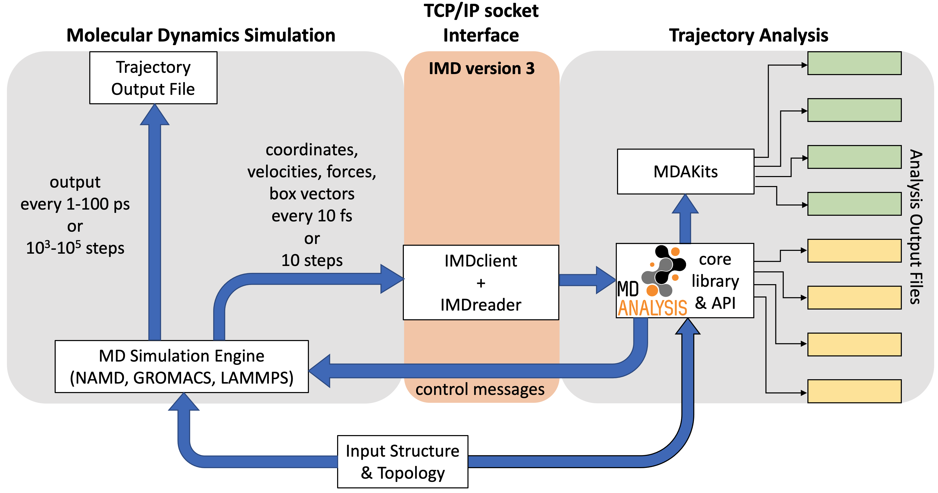
IMD version 3 protocol (working title IMDv3)
https://imdclient.readthedocs.io/en/latest/protocol_v3.html
new message types
backwards compatible with IMDv2
straightforward to expand
implemented in: GROMACS, NAMD3, LAMMPS (forks of recent release)
IMDclient & IMDreader class for MDAnalysis

Slide 9
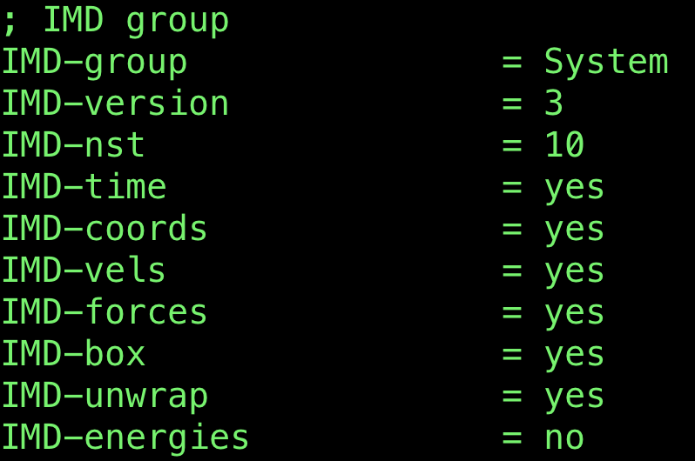

IMD version 3 protocol (working title)
https://imdclient.readthedocs.io/en/latest/protocol_v3.html
IMD version 2 vs. version 3 →
Message Type | IMD version | receiver
handshake | 2 | server (MD)
go | 2 | server (MD)
disconnect | 2 | server (MD)
kill | 2 | server (MD)
md-communication | 2 | server (MD)
pause | 2 | server (MD)
transmission rate | 2 | server (MD)
I/O error | 2 | server (MD)
coordinates | 2 | client
sessioninfo | 3 | client
resume | 3 | server (MD)
no wait | 3 | server(MD)
time | 3 | client
velocities | 3 | client
forces | 3 | client
box | 3 | client
Setup in MD input file (here: GROMACS)
new in
IMD version 3
Setup in MDAnalysis script

Slide 10
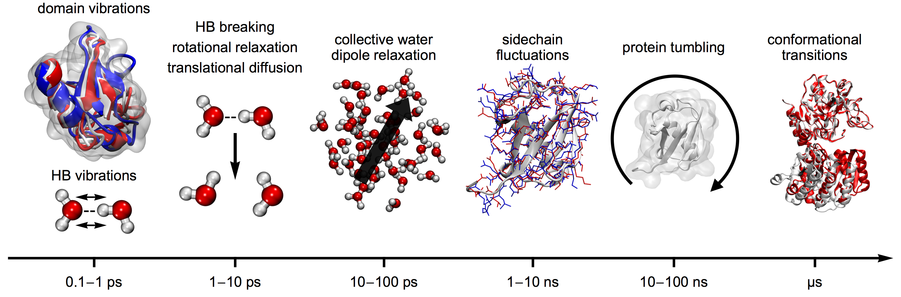
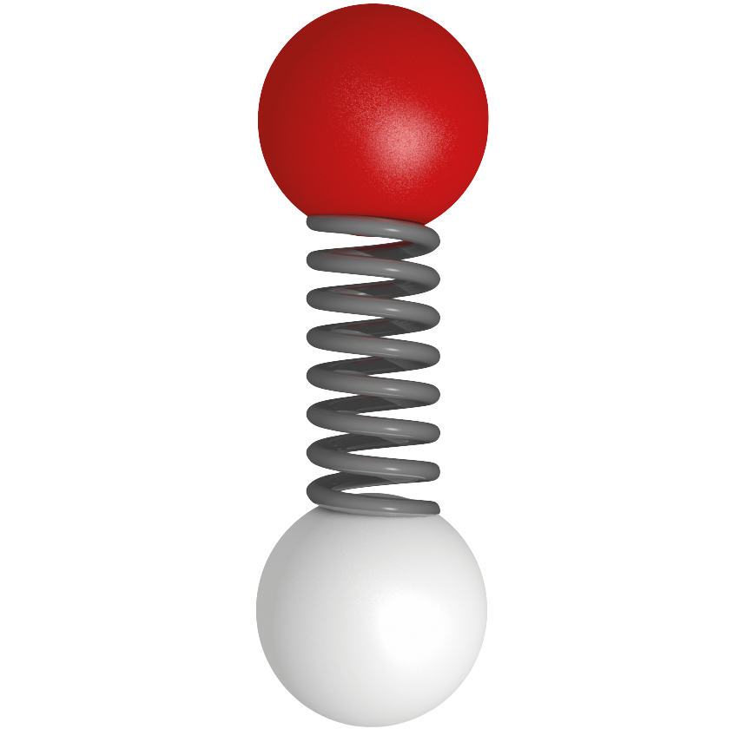
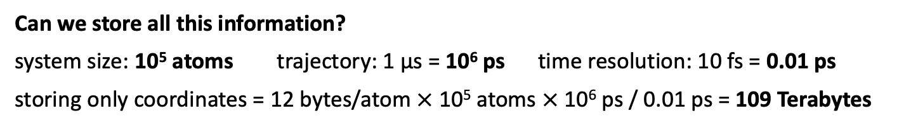
Time Paradox in MD Simulations
MD simulations cover timescales over at least 9 orders of magnitude
→ femtosecond 10⁻¹⁵ s to microseconds (10⁻⁶ s)
bond vibrations
10 – 100 fs
Can we store all this information?
system size: 10⁵ atoms trajectory: 1 µs = 10⁶ ps time resolution: 10 fs = 0.01 ps
storing only coordinates = 12 bytes/atom $×$10⁵ atoms $×$ 10⁶ ps / 0.01 ps = 109 Terabytes
No, we can’t store this amount of data
“Solution”: 1000-fold lower time resolution: from 0.01 ps to 10 ps (99.9% of data ignored)

Slide 11
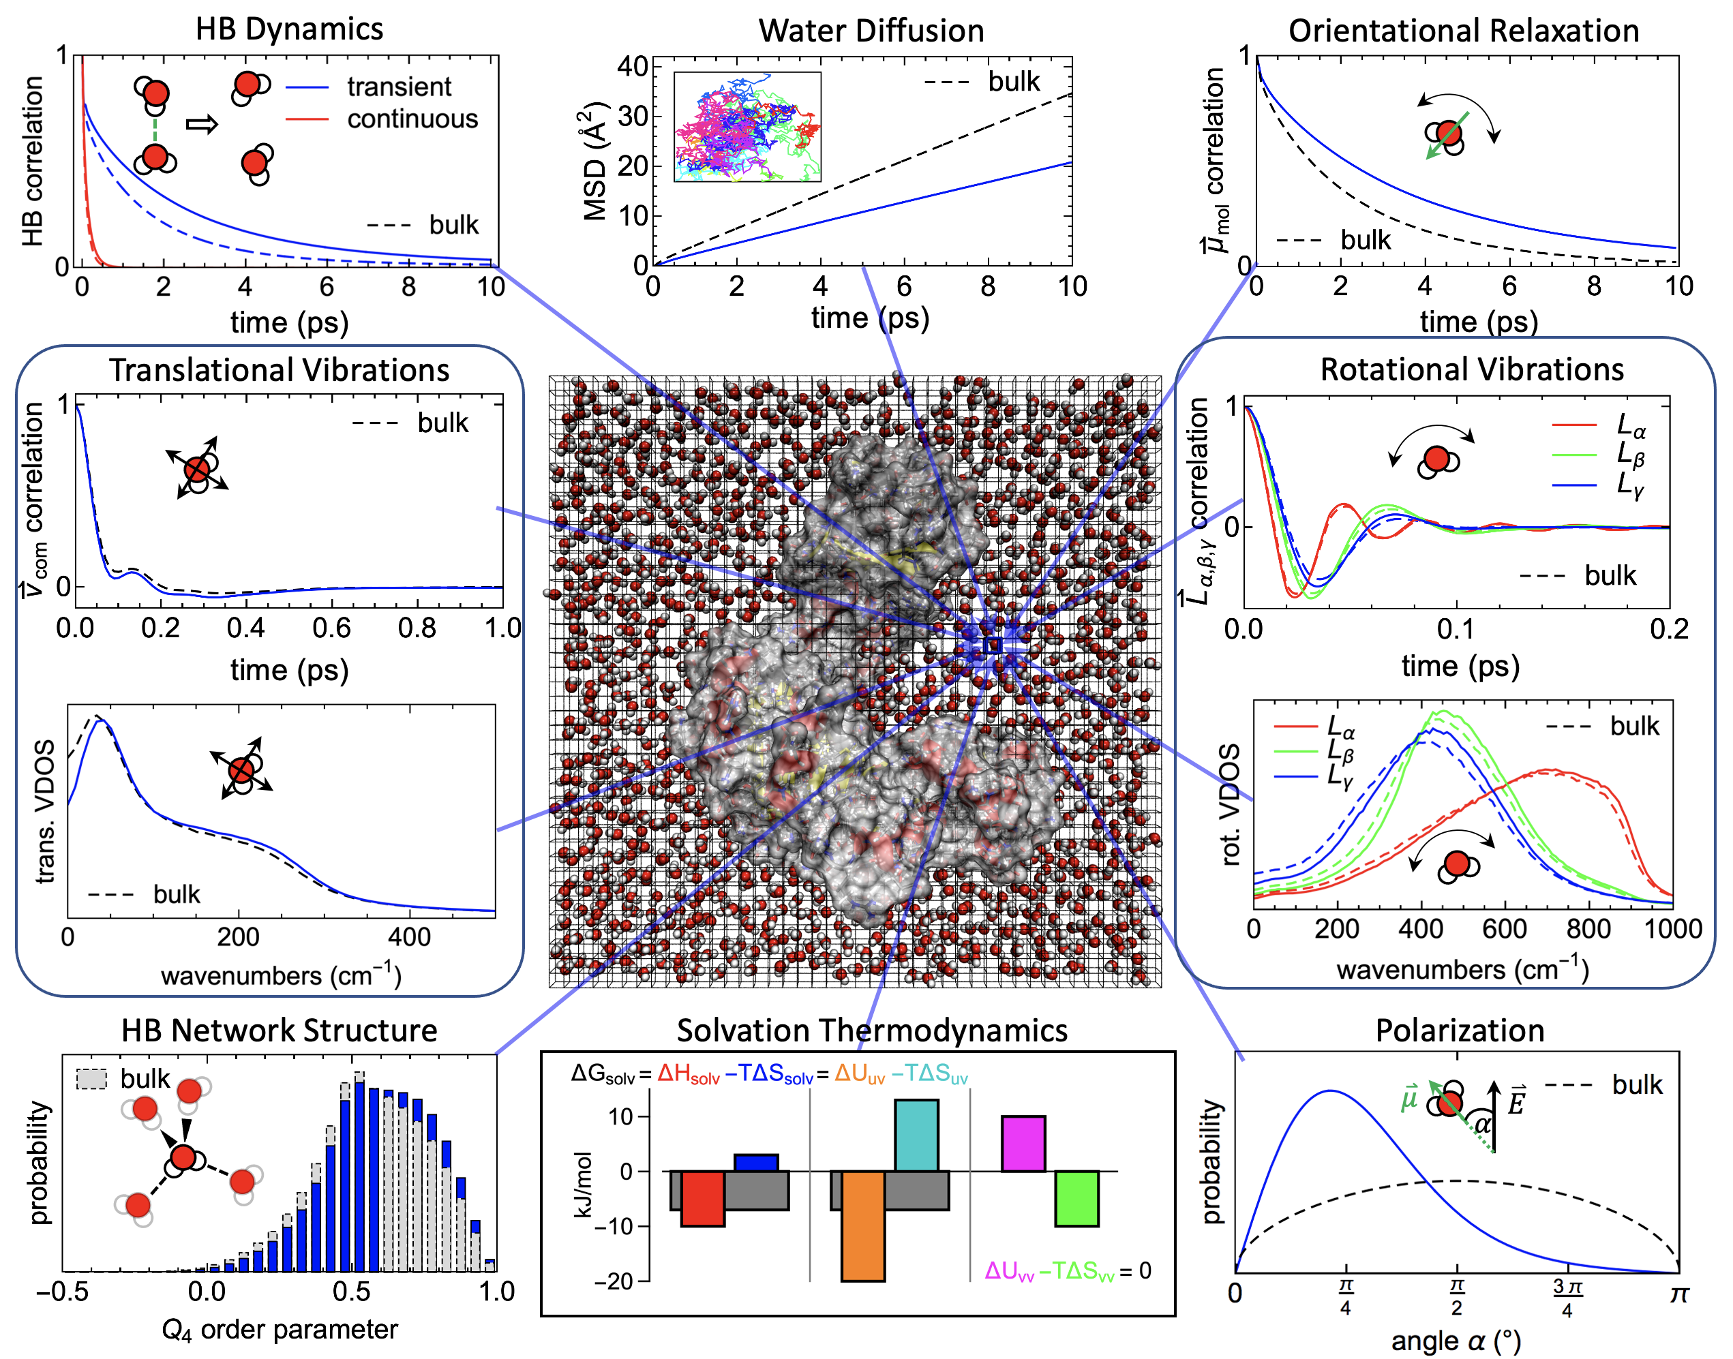
What do we miss in such trajectories?
Example: Solvent Dynamics
Picosecond Dynamics in Hydration Water
diffusion (mean squared displacements)
HB correlation functions
residence times
orientational relaxation
intermolecular vibrations (vibrational density of states)
thermodynamic information via 2PT
our specialty:
analyzing water dynamics with 3D resolution

