Slide 1
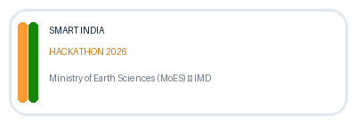
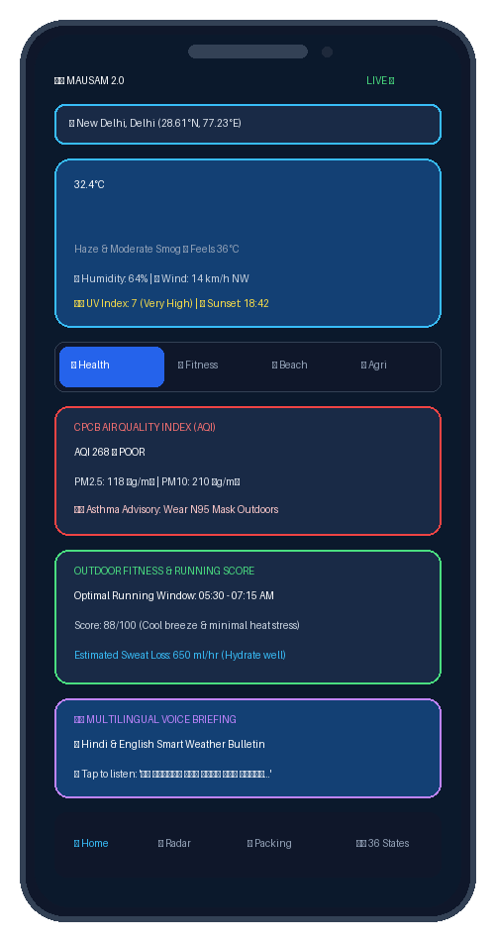
MAUSAM 2.0: Next-Gen Personalized Weather System
Adaptive, Multi-Persona Homepage & Proactive Meteorological Intelligence Platform
PROBLEM STATEMENT ID
26076
MINISTRY / DEPARTMENT
Ministry of Earth Sciences (MoES) India Meteorological Department (IMD)
THEME & PS CATEGORY
Theme: Smart Automation Category: Software
PROBLEM STATEMENT TITLE
Development of personalized homepage for 'Mausam' mobile application
Team ID: [Your Team ID] | Team Name: [Your Registered Team Name] | Team Leader: [Leader Name]
Smart India Hackathon 2026 | Problem Statement ID: 26076 | Ministry of Earth Sciences (MoES) - IMD
Slide 1 of 6

Slide 2


Problem Statement & Proposed Solution
Bridging the gap between raw meteorological data and actionable citizen lifestyle decisions
Current Bottlenecks in Weather Apps
• Generic Weather Experience: Farmers, athletes, travelers, parents, commuters receive the exact same static temperature card.
• High Cognitive Load: Users receive raw atmospheric parameters (68% RH, 1008 hPa, 38 dBZ) without activity context.
• Lack of Actionable Insights: Weather data does not translate into advice: best workout time, school commute safety, or spray windows.
• Static Homepage: The homepage remains rigid instead of adapting dynamically as daily activities shift.
Proposed Solution: Mausam 2.0
Mausam 2.0 is an adaptive, persona-driven platform converting meteorological data into contextual, actionable guidance.
• 8 Tailored Persona Dashboards: Dedicated views for Health, Fitness, Beach, Travel, Family, Agriculture, Commute, Events.
• Automated Intelligence Models: Calculates WBGT heat stress, running score, tidal harmonics, topsoil moisture %, and packing lists.
• Universal Pan-India Precision: Directory covering all 28 States & 8 UTs + GPS pinpoint reverse geocoding.
• Multilingual Voice Briefing: Natural Text-to-Speech (TTS) bulletins in English and हिन्दी (Hindi).
TRANSFORMATION PROCESS DIAGRAM
Weather Data (Synoptic Feeds) ➔ Mausam Intelligence (Scoring Engine) ➔ Persona Engine (8 Profiles) ➔ Personalized Insights ➔ Actionable Recommendations
Smart India Hackathon 2026 | Problem Statement ID: 26076 | Ministry of Earth Sciences (MoES) - IMD
Slide 2 of 6

Slide 3








8 Persona Intelligence Modules + Smart Auto-Blend
Contextual dashboards tailored to specific user activities, vulnerability factors, and routines
Health-Conscious
CPCB AQI (PM2.5/10), Pollen risk, UV sunburn timer, asthma alerts.
Outdoor Fitness
Best Running Hours (0-100), WBGT heat index, sweat hydration rate.
Beach & Surfers
Sea condition status, 24h Tide harmonic curve, swell wave height (m).
Travelers
Multi-city comparator, airport fog delay risks, AI packing checklist.
Parents & Families
School commute windows (7-9 AM & 2-4 PM), rain radar alerts, playground.
Agriculture / GKMS
Topsoil (0-7cm) moisture %, 7-day crop rain balance, spraying window.
Daily Commuters
Road visibility distance (meters), urban waterlogging risk, traction ratings.
Event Planners
14-day rain probability, Outdoor Thermal Comfort Index, wind load gust.
SMART AUTO-BLEND (AI + ROUTINE ENGINE): Dynamically transitions homepage: Morning Fitness (06-08:30) ➔ Commute (08:30-10:30) ➔ School Transit (14-16:00) ➔ Evening Leisure (18-21:30).
Smart India Hackathon 2026 | Problem Statement ID: 26076 | Ministry of Earth Sciences (MoES) - IMD
Slide 3 of 6

Slide 4



Technical Architecture & System Methodology
Modular, scalable, zero-dependency full-stack meteorological pipeline implemented in code
1. Data Ingestion & API Gateway
• server.py (Python 3): Standard library async HTTP proxy server for weather, air quality, marine, and geocoding feeds.
• weatherService.js: Multi-stream aggregator fetching synoptic forecasts, CPCB AQI, INCOIS marine waves & soil moisture.
• Pan-India Geocoding: Directory covering all 28 States & 8 UTs + OpenStreetMap reverse geocoding for GPS coordinate resolution.
• 5-Min Cache Layer: Memory caching eliminating redundant external API queries.
2. Persona Intelligence Engine
• personaEngine.js: Core dispatch module containing mathematical algorithms and widget renderers for all 8 personas.
• WBGT & Thermal Models: Computes heat stress and dynamic sweat-rate hydration loss (ml/hr) for fitness routines.
• Tidal Harmonics Model: Generates 24h sinusoidal tidal curves (1.6 + 1.2 sin(ωt)) and peak high/low tide times.
• packingAdvisor.js: AI travel matrix analyzing destination temperature deltas, rainfall & UV for gear checklists.
3. Client Experience & Voice TTS
• Universal PWA Client: Responsive HTML5, Tailwind CSS, and Glassmorphism styling with 1-click Mobile Shell simulator in index.html.
• charts.js Visualization: Hardware-accelerated Chart.js canvases for dual-axis time series, AQI bars, and crop moisture curves.
• voiceBriefing.js: W3C Web Speech API engine synthesizing voice weather briefings in English and हिन्दी (Hindi).
• app.js Orchestrator: Master state management, local storage caching, search debounce, and GPS location handler.
Smart India Hackathon 2026 | Problem Statement ID: 26076 | Ministry of Earth Sciences (MoES) - IMD
Slide 4 of 6

Slide 5

Innovation, Feasibility & Expected Impact
Delivering high-value public safety, agricultural efficiency, and citizen engagement
Key Innovations
• Smart Auto-Blend: The user experience adapts to different daily activities and times of day instead of remaining static.
• Persona Intelligence: The same raw weather data is transformed into distinct, specialized insights per persona.
• AI Smart Packing: Destination forecast parameters dynamically generate tailored travel gear checklists.
• Actionable Guidance: Replaces raw numbers with concrete recommendations (spray window, N95 mask).
• Multilingual Voice: Built-in Text-to-Speech in English & Hindi improves accessibility for all citizens.
Technical Feasibility
• Zero Dependency Backend: Built with Python 3 standard library; runs cleanly on any standard VM or edge server.
• Modular Architecture: Clean separation of data service, persona engine, charts, and voice briefing layers.
• High-Speed Caching: 5-minute memory caching minimizes outbound API queries and avoids rate limits.
• Offline-First Resilient: Local storage caching maintains full functionality during connectivity drops.
• Seamless Deployment: Lightweight static + API design compatible with PWA, Android & Webview.
Expected Impact
• Public Health: Provides actionable warnings correlating humidity with PM2.5 to mitigate asthma triggers & heatstroke.
• Agricultural Savings: Helps farmers make weather-informed irrigation and foliar pesticide spraying decisions.
• Travel & Transit Safety: Reduces travel packing uncertainty and provides road visibility & waterlogging alerts.
• Citizen Empowerment: Transforms complex meteorological datasets into easy-to-understand recommendations for all citizens.
• Universal Inclusion: Voice audio briefings ensure elderly and rural users receive weather intelligence seamlessly.
Smart India Hackathon 2026 | Problem Statement ID: 26076 | Ministry of Earth Sciences (MoES) - IMD
Slide 5 of 6

Slide 6
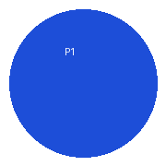
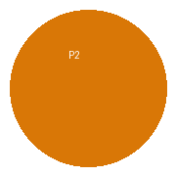
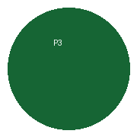
Roadmap, Scalability & Future Scope
Phased deployment strategy for national rollout across 1.4 billion citizens (Proposed Future Scope)
PHASE 1 — Platform Expansion
Timeline: Immediate / Short Term (0 - 3 Months)
• Deploy Mausam 2.0 PWA across Android, iOS, and Web platforms.
• Expand weather data integrations with IMD NOWCAST push notifications.
• Enhance recommendation quality and user preference customization.
• Expand multilingual voice briefing to 12 regional Indian languages (Tamil, Telugu, Bengali, Marathi, etc.).
• Strengthen offline mobile caching and PWA installability.
PHASE 2 — Advanced Alerts & Citizen Integration
Timeline: Medium Term (3 - 6 Months)
• Integrate with NDMA Common Alerting Protocol (CAP) for severe weather and disaster alerts.
• Enable crowdsourced hyper-local weather & urban waterlogging reporting (Citizen Science).
• Integrate with IRCTC & Flight booking portals for automated travel packing alerts.
• Provide district-level push notifications for extreme weather events.
PHASE 3 — Hyper-Local & Edge Intelligence
Timeline: Long Term (6 - 12 Months)
• Implement on-device Edge ML for offline micro-climate forecasting at 1km grid resolution.
• Integrate with Gramin Krishi Mausam Sewa (GKMS) village-level IoT weather sensors.
• Provide Smart-Home and Wearable integration (WearOS / Apple Watch morning briefings).
• Develop AI-driven personalized micro-climate forecasting models.
Smart India Hackathon 2026 | Problem Statement ID: 26076 | Ministry of Earth Sciences (MoES) - IMD
Slide 6 of 6

