Slide 1
Constraint Removal Solutions

Slide 2
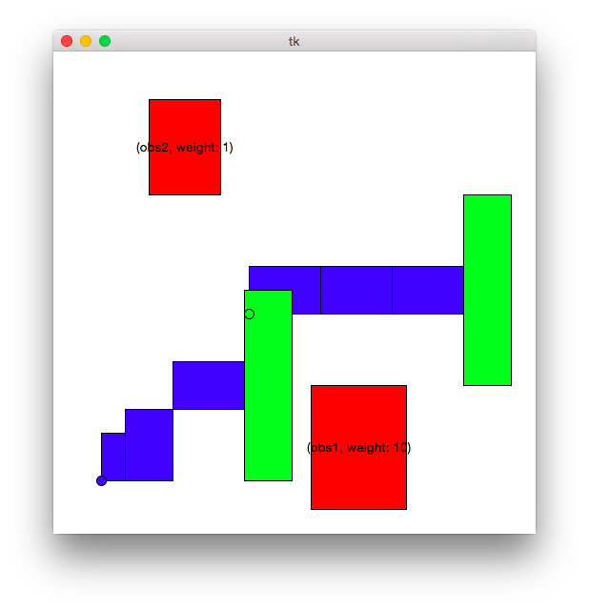
Simple Feasible world (150 iter, 200 trials, 40 interval)
algorithm | success rate | avg time | avg path length | avg cover score
MCR | 100 | 34.287 | 5460.661 | 2.38
RRT | 14 | 0.248 | 5527.593 | 0
BiRRT | 100 | 1.386 | 5381.128 | 0
TLP MCR | 100 | 0.962 | 5255.805 | 0
Greedy Removal | 100 | 0.797 | 4880.441 | 1.31
Probabilistic Removal | 100 | 0.788 | 4887.153 | 2.465
Ignore non permanent | 100 | 0.555 | 4695.232 | 10.14
Repeated probabilistic removal | 100 | 8.527 | 4664.228 | 0
Search then greedy removal | 100 | 1.192 | 5402.802 | 0.125

Slide 3
Takeaway
RRT can’t find paths often
Ignoring obstacles clearly doesn’t work well (there exists a collision free path but gets cover of 10)
Greedy does better than probabilistic Removal
Repeated probabilistic does as good as a birrt
Search then greedy removal does almost as good as a normal birrt (expected since a collision free path exists)
Not as good because it doesn’t repeat the birrt 5 times before falling on collision removal

Slide 4
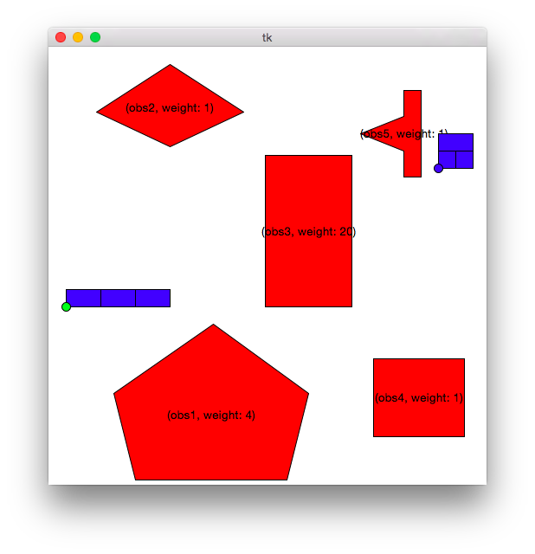
Complicated Feasible World (150 iter, 200 trials, 40 interval)
algorithm | success rate | avg time | avg path length | avg cover score
MCR | 100 | 22.55 | 8161.90 | 2.34
RRT | 0 | 0.00 | 0.00 | 0.00
BiRRT | 37 | 1.68 | 8751.02 | 0.00
TLP MCR | 39 | 1.61 | 8595.15 | 0.00
Greedy Removal | 100 | 3.36 | 8483.14 | 8.22
Probabilistic Removal | 100 | 2.71 | 8627.41 | 11.08
Ignore non permanent | 100 | 0.89 | 6525.40 | 22.63
Repeated probabilistic removal | 100 | 26.48 | 8564.99 | 1.13
Search then greedy removal | 100 | 4.19 | 9036.66 | 4.61

Slide 5
Takeaway
Even though feasible, in limited time birrts can’t always find a path
Obviously when they do they have a better cover than MCR alternatives
MCR can outperform the other algorithms but it takes around 7x longer
Repeated removal > Greedy > Probabilistic
Search then removal does better than just removal

Slide 6
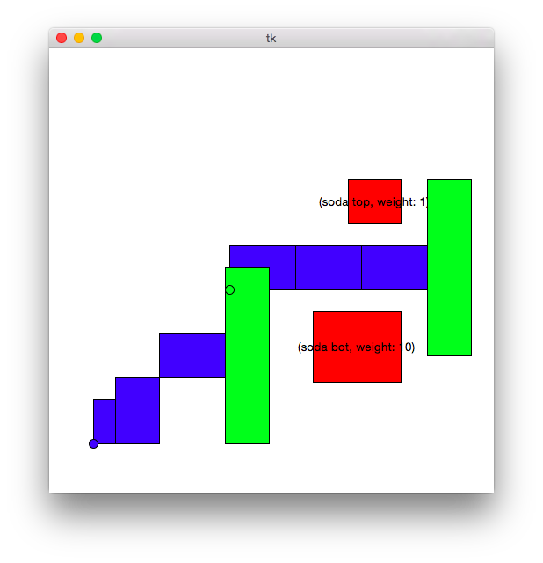
Simple Unfeasible world (150 iter, 200 trials, 40 interval)
algorithm | success rate | avg time | avg path length | avg cover score
MCR | 100 | 12.58 | 6060.29 | 1.1
RRT | 0 | 0.00 | 0.00 | 0
BiRRT | 0 | 0.00 | 0.00 | 0
TLP MCR | 0 | 0.00 | 0.00 | 0
Greedy Removal | 100 | 1.39 | 5219.89 | 1.8
Probabilistic Removal | 100 | 1.37 | 5123.52 | 2.44
Ignore non permanent | 100 | 0.62 | 4684.83 | 10.935
Repeated probabilistic removal | 100 | 13.97 | 5105.20 | 1
Search then greedy removal | 100 | 3.43 | 5234.13 | 1.595

Slide 7
Takeaway
Normal RRTs/BiRRTs are incapable
Other trends still hold

Slide 8
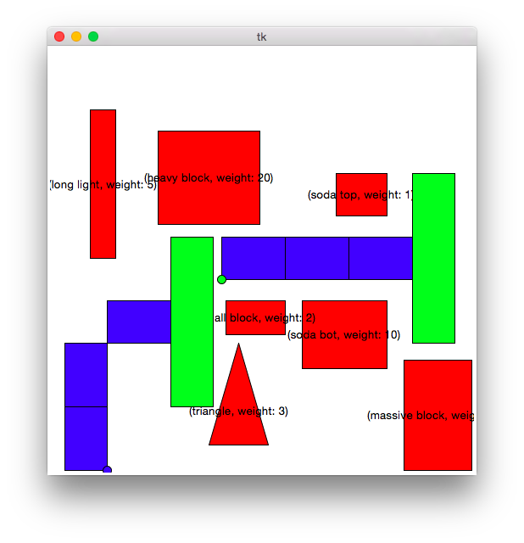
Cluttered with greedy path (150 iter, 200 trials, 40 interval)
algorithm | success rate | avg time | avg path length | avg cover score
MCR | 100 | 118.69 | 4891.49 | 19.04
RRT | 0 | 0.00 | 0.00 | 0.00
BiRRT | 0 | 0.00 | 0.00 | 0.00
TLP MCR | 0 | 0.00 | 0.00 | 0.00
Greedy Removal | 0 | 0.00 | 0.00 | 0.00
Probabilistic Removal | 8.5 | 0.70 | 5343.86 | 23.53
Ignore non permanent | 100 | 1.37 | 5389.07 | 58.80
Repeated probabilistic removal | 70 | 78.09 | 5152.31 | 22.95
Search then greedy removal | 100 | 7.25 | 4582.05 | 16.80

Slide 9
Takeaway
Probabilistic removal can outperform greedy removal in finding paths in the event where number of removals is too low for greedy removal to find a path
Search then greedy removal, however, beats probabilistic removal and MCR

Slide 10
Cluttered with greedy path (200 iter, 200 trials, 40 interval)
algorithm | success rate | avg time | avg path length | avg cover score
MCR | 100 | 118.69 | 4891.49 | 19.04
RRT | 0 | 0.00 | 0.00 | 0.00
BiRRT | 0 | 0.00 | 0.00 | 0.00
TLP MCR | 0 | 0.00 | 0.00 | 0.00
Greedy Removal | 100 | 3.84 | 4603.27 | 16.59
Probabilistic Removal | 99.5 | 4.99 | 4934.23 | 20.63
Ignore non permanent | 100 | 1.36 | 5283.39 | 53.74
Repeated probabilistic removal | 100 | 51.24 | 4451.03 | 16.03
Search then greedy removal | 100 | 8.68 | 4655.65 | 16.75

Slide 11
Takeaway
With enough removals, greedy does outperform probabilistic removal
Probabilistic wins because in some odd case it will happen to remove the right obstacles
Greedy does about as good as search then remove
Unsurprising in this case since we need to get rid of these obstacles to even get a dense tree

Slide 12

Cluttered world with top light path (150 iter, 200 trials, 40 interval)
algorithm | success rate | avg time | avg path length | avg cover score
MCR | 100 | 163.32 | 6789.82 | 22.43
RRT | 0 | 0.00 | 0.00 | 0.00
BiRRT | 0 | 0.00 | 0.00 | 0.00
TLP MCR | 0 | 0.00 | 0.00 | 0.00
Greedy Removal | 69.5 | 4.65 | 5002.43 | 19.00
Probabilistic Removal | 43 | 3.14 | 5452.67 | 16.73
Ignore non permanent | 100 | 1.39 | 5286.91 | 59.35
Repeated probabilistic removal | 99.5 | 100.96 | 5797.85 | 14.70
Search then greedy removal | 100 | 8.39 | 5274.88 | 24.93

Slide 13
Takeaway
Greedy removal finds paths more often than probabilistic but with a worse path
Interesting that it succeeds more often here but less in the previous example where the direct path had less cover
Note: Seems to be that the quality of paths found, if found at all, rely on removing enough obstacles (a function of the number of iterations ran)

Slide 14
Cluttered world with top light path (200 iter, 200 trials, 40 interval)
algorithm | success rate | avg time | avg path length | avg cover score
MCR | 100 | 163.32 | 6789.82 | 22.43
RRT | 0 | 0 | 0 | 0
BiRRT | 0 | 0 | 0 | 0
TLP MCR | 0 | 0 | 0 | 0
Greedy Removal | 100 | 3.71 | 5270.01 | 25.15
Probabilistic Removal | 100 | 5.09 | 5471.49 | 24.375
Ignore non permanent | 100 | 1.35 | 5426.95 | 60.55
Repeated probabilistic removal | 100 | 50.37 | 5901.01 | 14.8
Search then greedy removal | 100 | 9.03 | 5248.62 | 25.2

Slide 15
Takeaway
Repeated probabilistic does by far the best and in fact averages out to close to the minimum cover but takes more than 12x as long as the greedy removal

Slide 16
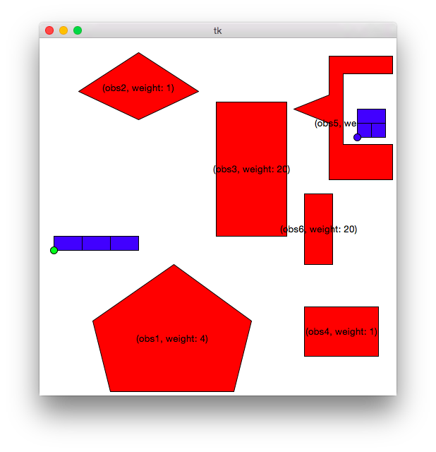
World where expect search to Have an impact(150 iter, 200 trials, 40 interval)
algorithm | success rate | avg time | avg path length | avg cover score
MCR | 100.00 | 51.05 | 9083.23 | 3.44
RRT | 0.00 | 0.00 | 0.00 | 0.00
BiRRT | 0.00 | 0.00 | 0.00 | 0.00
TLP MCR | 0.00 | 0.00 | 0.00 | 0.00
Greedy Removal | 100.00 | 2.08 | 7213.76 | 19.88
Probabilistic Removal | 100.00 | 2.71 | 7657.89 | 21.18
Ignore non permanent | 100.00 | 1.03 | 6487.22 | 26.48
Repeated probabilistic removal | 100.00 | 25.49 | 8302.03 | 9.78
Search then greedy removal | 100.00 | 2.44 | 7263.43 | 20.30

Slide 17
Winner: Greedy Removal With Search
Search then greedy removal doesn’t hurt the cover of paths found and only increases the runtime in a non-significant manner
It can be outperformed by (repeated) probabilistic removal or MCR in some cases but seems to perform across the board more robustly

Slide 18
Exploring Memory factor for greedy removal
Run number of worlds with memory factors of
0.0 (no memory)
0.1
0.3
0.5
0.7
0.9
1.0 (full memory)

Slide 19
Simple Feasible world (150 iter, 500 trials, 40 remove interval)
discount factor | success rate | avg time | avg path length | avg cover score
0 | 100 | 0.82 | 4953.70 | 1.72
0.1 | 100 | 1.07 | 5001.04 | 1.65
0.3 | 100 | 0.85 | 5070.99 | 1.75
0.5 | 100 | 0.85 | 5033.90 | 1.97
0.7 | 100 | 0.84 | 5072.14 | 1.64
0.9 | 100 | 0.81 | 4998.58 | 1.59
1 | 100 | 0.84 | 5048.27 | 2.02

Slide 20
Two soda world (150 iter, 500 trials, 40 remove interval)
discount factor | success rate | avg time | avg path length | avg cover score
0 | 100 | 1.45 | 5186.97 | 1.80
0.1 | 100 | 1.40 | 5145.25 | 1.74
0.3 | 100 | 1.39 | 5095.47 | 1.54
0.5 | 100 | 1.40 | 5135.10 | 1.78
0.7 | 100 | 1.45 | 5097.36 | 1.76
0.9 | 100 | 1.41 | 5184.30 | 2.00
1 | 100 | 1.42 | 5234.30 | 1.96

Slide 21
Cluttered with greedy path (200 iter, 500 trials, 40 remove interval)
discount factor | success rate | avg time | avg path length | avg cover score
0 | 100 | 3.89 | 4634.87 | 16.21
0.1 | 100 | 3.90 | 4595.52 | 16.09
0.3 | 100 | 3.77 | 4619.86 | 16.34
0.5 | 100 | 3.80 | 4689.85 | 16.92
0.7 | 100 | 3.88 | 4714.40 | 17.50
0.9 | 100 | 4.04 | 4919.79 | 19.51
1 | 100 | 4.21 | 5022.85 | 21.08

Slide 22
Cluttered world with top light path (200 iter, 500 trials, 40 Remove interval)
discount factor | success rate | avg time | avg path length | avg cover score
0 | 100 | 4.16 | 5370.46 | 25.10
0.1 | 100 | 4.15 | 5393.97 | 25.16
0.3 | 100 | 3.79 | 5315.43 | 25.50
0.5 | 100 | 3.81 | 5362.26 | 25.51
0.7 | 100 | 3.81 | 5342.48 | 25.31
0.9 | 100 | 3.85 | 5417.17 | 25.35
1 | 100 | 3.75 | 5313.95 | 25.07

Slide 23
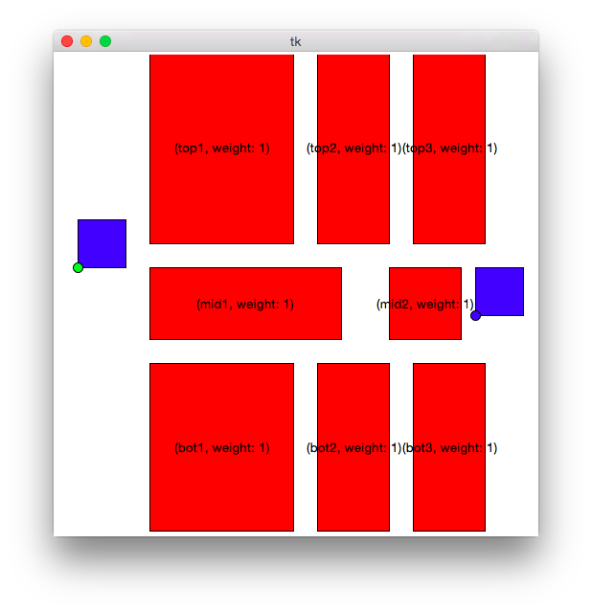
Memory factory world (150 iter, 500 trials, 40 interval)
discount factor | success rate | avg time | avg path length | avg cover score
0 | 73.6 | 1.16 | 2223.69 | 2.35
0.1 | 69.6 | 0.98 | 2201.90 | 2.39
0.3 | 61.4 | 0.94 | 2188.36 | 2.27
0.5 | 51.2 | 0.80 | 2153.86 | 2.21
0.7 | 43.4 | 0.69 | 2176.99 | 2.18
0.9 | 28.4 | 0.56 | 2216.65 | 2.17
1 | 24.4 | 0.40 | 2190.09 | 2.18

Slide 24
Conclusion
Don’t expect the memory factor to significantly impact low cost covers
It can alter because of the way it biases exploration but can raise or lower
Primarily beneficial with a lower memory (maybe none) because it encourages exploring the area just vacated which is stretching towards to the goal from the start or to the start from the goal

Slide 25
Now testing with no memory

Slide 26
Simple Feasible world (150 iter, 200 trials, 40 interval)
algorithm | success rate | avg time | avg path length | avg cover score
Greedy Removal | 100 | 0.81 | 5006.41 | 2.13
Probabilistic Removal | 100 | 0.82 | 5069.90 | 2.51
Probabilistic Removal Repeat | 100 | 8.10 | 4761.35 | 0.01
Search then greedy removal | 100 | 1.40 | 5507.63 | 0.03

Slide 27
Complicated Feasible World (150 iter, 200 trials, 40 interval)
algorithm | success rate | avg time | avg path length | avg cover score
Greedy Removal | 100 | 2.97 | 8974.33 | 6.2
Probabilistic Removal | 100 | 2.66 | 8633.05 | 10.3
Probabilistic Removal Repeat | 100 | 26.09 | 8663.81 | 1.3
Search then greedy removal | 100 | 4.57 | 9248.66 | 2.8

Slide 28
Simple Unfeasible world (150 iter, 200 trials, 40 interval)
algorithm | success rate | avg time | avg path length | avg cover score
Greedy Removal | 100 | 1.34 | 5169.30 | 1.9
Probabilistic Removal | 100 | 1.35 | 5249.24 | 2.1
Probabilistic Removal Repeat | 100 | 13.48 | 5134.46 | 1
Search then greedy removal | 100 | 4.60 | 5261.55 | 1.7

Slide 29
Cluttered with greedy path (200 iter, 200 trials, 40 interval)
algorithm | success rate | avg time | avg path length | avg cover score
Greedy Removal | 100 | 4.14 | 4600.63 | 16.15
Probabilistic Removal | 100 | 5.45 | 4884.20 | 19.81
Probabilistic Removal Repeat | 100 | 52.19 | 4454.09 | 15.98
Search then greedy removal | 100 | 8.48 | 4619.16 | 16.05

Slide 30
Cluttered world with top light path (200 iter, 200 trials, 40 interval)
algorithm | success rate | avg time | avg path length | avg cover score
Greedy Removal | 100 | 4.56 | 5417.62 | 25.35
Probabilistic Removal | 100 | 5.88 | 5365.74 | 23.78
Probabilistic Removal Repeat | 100 | 57.05 | 5733.22 | 14.7
Search then greedy removal | 100 | 9.98 | 5386.19 | 25.48

Slide 31
World where expect search to Have an impact(150 iter, 200 trials, 40 interval)
algorithm | success rate | avg time | avg path length | avg cover score
Greedy Removal | 100 | 1.96 | 7352.45 | 19.51
Probabilistic Removal | 100 | 2.43 | 7649.26 | 20.9
Probabilistic Removal Repeat | 100 | 23.28 | 8611.35 | 8.09
Search then greedy removal | 100 | 2.57 | 7454.56 | 19.49

Slide 32
SUmmary
Simple collision removal strategies work well in practice
Zero memory works best
Repeated probabilistic removal works best but will take too long if used as a core component in a planner
Next best runner-up is a search followed by greedy collision removal
Reason: helps find collision free paths if they exist, otherwise doesn’t really help. Reason? 0 memory
If we instead precede the greedy search with a independent birrt, no need to do search

