Slide 1
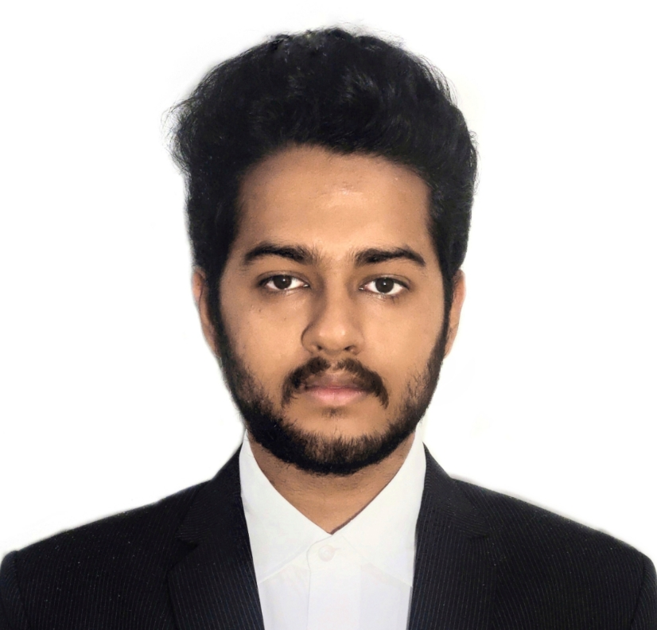

Amruth V Bhat
Analyst/Software Engineer
Masters of Computer Applications : 2020-2022
Skills
Java 8 /J2EE | Java Basics, OOPS, Generics, Collections, Arrays, Loops, Lambda Exp, Stream API Junit, Mockito, Servlets
Spring core | IOC & Dependency Injection, Autowire
Spring REST | REST controllers, Implementation of GET, POST, PUT & DELETE, Bean Validation & Exception Handling, Testing Services, Controller & Repository layer
Spring Data JPA | Implement DAO layer using spring Data repositories, Transaction Management
Spring Boot Microservices | Spring Boot Starters, annotations, Messaging Service, Sync/Async comms, Swagger API documents
Spring Cloud | Eureka server, Eureka Client, Netflix Hystrix & Config Server
React | Components, Hooks, Event handling, Redux, material ui.
Database | MongoDB No Sql Basics My SQL
UI Tech | HTML 5 & CSS 3,JavaScript, ES6 & TypeScript Optimized UI Designed
Tools | Git, Postman, Maven, IDE
Add On skills | Communications, Team management. Peer learning
Bangalore
1rn20mc006.amruthvbhat@gmail.com
+91 8217437053
A4
Worked on the hands on practice of Microservices framework with spring boot, spring cloud gateway , Eureka server, load balancer and circuit breaker.
Experienced in implementing postman, swagger-ui and unit testing using Junit, Mockito.
Efficient understanding of HTML5, CSS3, Bootstrap and Javascript.
Practical experience of working on React concepts such as Hooks, Redux and routing.
Experienced in implementing NodeJS and upskilling during case study.
Proficient in creating Single page Web Application using React along with React routing and creating React forms.
Practical understanding of advanced Javascript concepts.
E-Commerce Shopping Cart Application
Completed end to end case study of Shopping Cart Application along with Swagger and responsive UI with react js, have done unit testing and has mongoDB database.
Location Based Search Using Proxy Server Over Network Traffic
This project spreads the load forming up on the central server and divides the load of data to different servers. The project makes use of core java concepts along with HTML, css and apache tomcat server.
Core Java Internship at Techciti pvt ltd.
Theoretical and practical understanding of core java concepts and implementation.

