Slide 1
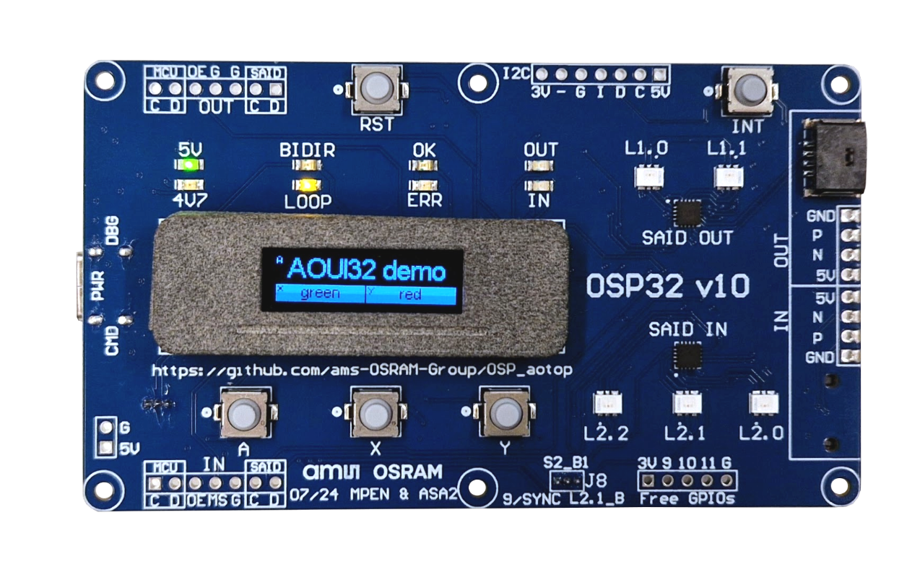
OSP on Arduino – Training
Using the Arduino OSP evaluation kit

Slide 2
Homework
boards
P2
To be completed before the training
Make sure all software is downloaded, installed and running.
Follow the chapter “Installation” at https://github.com/ams-OSRAM/OSP_aotop/blob/main/gettingstarted.md
Steps
Install Arduino IDE
Via Arduino board manager add ESP32 boards
Via Arduino library manager add the OSP libraries
Compile and run example aoosp_min
Hope you did that
Because needed for the first hands-on of this training
… which is now … 😱

Slide 3
Training0 – saidbasic

Slide 4

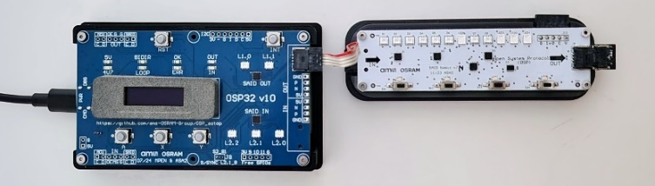
Assignment – Training0 - saidbasic
boards
P2
User manual of this demo in OSP_aotop\extras\manuals\saidbasic.pptx
Get familiar with the evaluation kit
In Arduino IDE:
From library aotop open the example saidbasic
Build using “ESP32S3 Dev Module”
Flash/upload it to the ESP (use USB “CMD”)
Connect the SAIDbasic board in BiDir mode
Don’t forget the terminator
In app Dithering
Use mobile phone video recording with high frame rate
Toggle dithering
0
4
In Arduino IDE (with app Running LEDs active)
Open Serial monitor on correct port (and baud 115200)
Type topo dim, then topo dim 1, and topo dim 1024
Press A button and see message on terminal
5
Meet the command interpreter
Signaling LEDs on OSP32 board
Green OK heartbeat and BiDir LED is on
Remove terminator and reset
Notice red ERR (io heartbeat) and message on OLED
Connect Loop wire and reset
Notice heartbeat and Loop LED is on
Press Y for high FPS in Animation script: blue OUT on
Start Switch flag; blue IN on (reading buttons)
Switch USB cable from CMD to PWR; check 5V/4V7 LEDs
6
In app Animation script
Change animation by plugging in I2C EEPROM stick
FPS up and down with X and Y button
1
Understand the signaling LEDs
In app Running LED (press A switch for next app)
Add second demo board (SAIDlooker) to see autoconfig
Dim up and down with X and Y button
2
In app Switch flag
Change flags (press one of 4 buttons, see indicator LED)
Dim up and down with X and Y button
3
Use the demo
Use the demo
Use the demo
Use the demo

Slide 5
Training1 – green/magenta/green

Slide 6
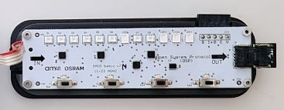
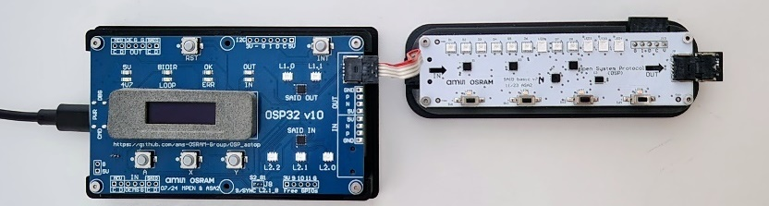

Assignment – Training1 – green/magenta/green
telegrams
P4
“Hello world” on OSP
In step 0: magenta RGBI
In step 3: two greens
From aotop build training1 using “ESP32S3 Dev Module”
Flash/upload it to the ESP (use USB “CMD”)
Connect the SAIDbasic board in BiDir mode
Don’t forget the terminator
0
void setup() {
Serial.begin(115200);
Serial.printf("\n\ntraining1.ino - green/magenta/green\n");
aospi_init();
aoosp_init();
// aoosp_loglevel_set( aoosp_loglevel_tele );
anim();
// Serial.printf("tx %d rx %d\n", aospi_txcount_get(), aospi_rxcount_get() );
}
reset has 150us exec time
Check the logging
Uncomment aoosp_loglevel_set()
and/or aospi_txcount_get()
static void anim( ) {
// Reset all nodes (broadcast) in the chain (all "off"; they also lose their address).
result= aoosp_send_reset(0x000); delayMicroseconds(150);
Serial.printf("reset(000) %s\n", aoresult_to_str(result) );
// Assign an address to each node (starting from 1, serialcast).
aospi_dirmux_set_bidir();
result= aoosp_send_initbidir(0x001, &last, &temp, &stat);
Serial.printf("initbidir(001) %s last %03X\n", aoresult_to_str(result), last );
// Switch the state node 004 (unicast) to active (allowing to switch on LEDs).
result= aoosp_send_goactive(0x004);
Serial.printf("goactive(004) %s\n", aoresult_to_str(result) );
// Set three PWM values of RGBI at 004 (unicast) to dim magenta (all 3 in nightmode)
result= aoosp_send_setpwm(0x004, 0x04FF/*red*/, 0x0000/*green*/, 0x08FF/*blue*/, 0b000);
Serial.printf("setpwm(004) %s\n", aoresult_to_str(result) );
}
1
Switch system to Loop mode
Replace terminator by cable
Use aoosp_send_initloop()
Use aospi_dirmux_set_loop()
2
Make led to the left and right of the magenta RGBI turn green
Use aoosp_send_setpwmchn() – pass correct channel
Use aoosp_send_goactive() – don’t forget to clear error first
3

Slide 7

Switch system to Loop mode
telegrams
P4
2
Don’t forget to set the mux
“Hello world” on OSP
static void anim( ) {
// Reset all nodes (broadcast) in the chain (all "off"; they also lose their address).
result= aoosp_send_reset(0x000); delayMicroseconds(150);
Serial.printf("reset(000) %s\n", aoresult_to_str(result) );
// Assign an address to each node (starting from 1, serialcast).
aospi_dirmux_set_bidir();
result= aoosp_send_initbidir(0x001, &last, &temp, &stat);
Serial.printf("initbidir(001) %s last %03X\n", aoresult_to_str(result), last );
// Switch the state node 004 (unicast) to active (allowing to switch on LEDs).
result= aoosp_send_goactive(0x004);
Serial.printf("goactive(004) %s\n", aoresult_to_str(result) );
// Set three PWM values of RGBI at 004 (unicast) to dim magenta (all 3 in nightmode)
result= aoosp_send_setpwm(0x004, 0x04FF/*red*/, 0x0000/*green*/, 0x08FF/*blue*/, 0b000);
Serial.printf("setpwm(004,magenta) %s\n", aoresult_to_str(result) );
}
static void anim( ) {
// Reset all nodes (broadcast) in the chain (all "off"; they also lose their address).
result= aoosp_send_reset(0x000); delayMicroseconds(150);
Serial.printf("reset(000) %s\n", aoresult_to_str(result) );
// Assign an address to each node (starting from 1, serialcast).
aospi_dirmux_set_loop();
result= aoosp_send_initloop(0x001, &last, &temp, &stat);
Serial.printf("initloop(001) %s last %03X\n", aoresult_to_str(result), last );
// Switch the state node 004 (unicast) to active (allowing to switch on LEDs).
result= aoosp_send_goactive(0x004);
Serial.printf("goactive(004) %s\n", aoresult_to_str(result) );
// Set three PWM values of RGBI at 004 (unicast) to dim magenta (all 3 in nightmode)
result= aoosp_send_setpwm(0x004, 0x04FF/*red*/, 0x0000/*green*/, 0x08FF/*blue*/, 0b000);
Serial.printf("setpwm(004,magenta) %s\n", aoresult_to_str(result) );
}
training1.ino - green/magenta/green
spi: init
osp: init
reset(000) ok
initbidir(001) ok last 008
goactive(004) ok
setpwm(004,magenta) ok
training1.ino - green/magenta/green
spi: init
osp: init
reset(000) ok
initloop(001) ok last 009
goactive(004) ok
setpwm(004,magenta) ok
One more node in chain

Slide 8
Make led to the left and right of the magenta RGBI turn green
telegrams
P4
3
“Hello world” on OSP
static void anim( ) {
// Reset all nodes (broadcast) in the chain (all "off"; they also lose their address).
result= aoosp_send_reset(0x000); delayMicroseconds(150);
Serial.printf("reset(000) %s\n", aoresult_to_str(result) );
// Assign an address to each node (starting from 1, serialcast).
aospi_dirmux_set_loop();
result= aoosp_send_initloop(0x001, &last, &temp, &stat);
Serial.printf("initloop(001) %s last %03X\n", aoresult_to_str(result), last );
// Switch the state node 004 (unicast) to active (allowing to switch on LEDs).
result= aoosp_send_goactive(0x004);
Serial.printf("goactive(004) %s\n", aoresult_to_str(result) );
// Set three PWM values of RGBI at 004 (unicast) to dim magenta (all 3 in nightmode)
result= aoosp_send_setpwm(0x004, 0x04FF/*red*/, 0x0000/*green*/, 0x08FF/*blue*/, 0b000);
Serial.printf("setpwm(004,magenta) %s\n", aoresult_to_str(result) );
// Clear the error flags of node 003 (unicast)
result= aoosp_send_clrerror(0x003);
Serial.printf("clrerror(003) %s\n", aoresult_to_str(result) );
// Switch the state node 003 (unicast) to active (allowing to switch on LEDs).
result= aoosp_send_goactive(0x003);
Serial.printf("goactive(003) %s\n", aoresult_to_str(result) );
// Set three PWM values of SAID.CH2 at 003 (unicast) to dim green
result= aoosp_send_setpwmchn(0x003, 2, 0x0000/*red*/, 0x05FF/*green*/, 0x0000/*blue*/);
Serial.printf("setpwmchn(003,2,green) %s\n", aoresult_to_str(result) );
// Clear the error flags of node 005 (unicast)
result= aoosp_send_clrerror(0x005);
Serial.printf("clrerror(005) %s\n", aoresult_to_str(result) ); // Switch the state node 005 (unicast) to active (allowing to switch on LEDs).
result= aoosp_send_goactive(0x005);
Serial.printf("goactive(005) %s\n", aoresult_to_str(result) ); // Set three PWM values of SAID.CH0 at 005 (unicast) to dim green
result= aoosp_send_setpwmchn(0x005, 0, 0x0000/*red*/, 0x05FF/*green*/, 0x0000/*blue*/);
Serial.printf("setpwmchn(005,0,green) %s\n", aoresult_to_str(result) );
}
// Get the state of node 003 to find SLEEP and OV_FLAG.
result= aoosp_send_readstat(0x003,&stat);
Serial.printf("getstatus(003) %s %02X\n", aoresult_to_str(result),stat );
→ getstatus(003) ok 50 → 0b_0101_0000 → SLEEP + OV_FLAG
SAIDs have the V flag (under-voltage) after reset, preventing them from going active; we must clear the error flags of 003 and 005.
SAIDs have the V flag (over-voltage) after reset, preventing them from going active; clear the error flags of 003 and 005.
SAIDs have three channels. We can not use setpwm(), we must use setpwmchn().
For node 003 we must use the left-most channel.
For node 005 we must use the right-most channel.

Slide 9
Shorten the code
telegrams
P4
3
“Hello world” on OSP
static void anim( ) {
// Reset all nodes (broadcast) in the chain (all "off"; they also lose their address).
result= aoosp_send_reset(0x000); delayMicroseconds(150);
Serial.printf("reset(000) %s\n", aoresult_to_str(result) );
// Assign an address to each node (starting from 1, serialcast).
aospi_dirmux_set_loop();
result= aoosp_send_initloop(0x001, &last, &temp, &stat);
Serial.printf("initloop(001) %s last %03X\n", aoresult_to_str(result), last );
// Switch the state node 004 (unicast) to active (allowing to switch on LEDs).
result= aoosp_send_goactive(0x004);
Serial.printf("goactive(004) %s\n", aoresult_to_str(result) );
// Set three PWM values of RGBI at 004 (unicast) to dim magenta (all 3 in nightmode)
result= aoosp_send_setpwm(0x004, 0x04FF/*red*/, 0x0000/*green*/, 0x08FF/*blue*/, 0b000);
Serial.printf("setpwm(004,magenta) %s\n", aoresult_to_str(result) );
// Clear the error flags of node 003 (unicast)
result= aoosp_send_clrerror(0x003);
Serial.printf("clrerror(003) %s\n", aoresult_to_str(result) );
// Switch the state node 003 (unicast) to active (allowing to switch on LEDs).
result= aoosp_send_goactive(0x003);
Serial.printf("goactive(003) %s\n", aoresult_to_str(result) );
// Set three PWM values of SAID.CH2 at 003 (unicast) to dim green
result= aoosp_send_setpwmchn(0x003, 2, 0x0000/*red*/, 0x05FF/*green*/, 0x0000/*blue*/);
Serial.printf("setpwmchn(003,2,green) %s\n", aoresult_to_str(result) );
// Clear the error flags of node 005 (unicast)
result= aoosp_send_clrerror(0x005);
Serial.printf("clrerror(005) %s\n", aoresult_to_str(result) ); // Switch the state node 005 (unicast) to active (allowing to switch on LEDs).
result= aoosp_send_goactive(0x005);
Serial.printf("goactive(005) %s\n", aoresult_to_str(result) ); // Set three PWM values of SAID.CH0 at 005 (unicast) to dim green
result= aoosp_send_setpwmchn(0x005, 0, 0x0000/*red*/, 0x05FF/*green*/, 0x0000/*blue*/);
Serial.printf("setpwmchn(005,0,green) %s\n", aoresult_to_str(result) );
}
static void anim( ) {
// Reset all nodes (broadcast) in the chain (all "off"; they also lose their address).
result= aoosp_send_reset(0x000); delayMicroseconds(150);
Serial.printf("reset(000) %s\n", aoresult_to_str(result) );
// Assign an address to each node (starting from 1, serialcast).
aospi_dirmux_set_loop();
result= aoosp_send_initloop(0x001, &last, &temp, &stat);
Serial.printf("initloop(001) %s last %03X\n", aoresult_to_str(result), last );
// Clear the error flags of all (broadcast)
result= aoosp_send_clrerror(0x000);
Serial.printf("clrerror(000) %s\n", aoresult_to_str(result) );
// Switch the state of all nodes (broadcast) to active (allowing to switch on LEDs).
result= aoosp_send_goactive(0x000);
Serial.printf("goactive(000) %s\n", aoresult_to_str(result) );
// Set three PWM values of RGBI at 004 (unicast) to dim magenta (all 3 in nightmode)
result= aoosp_send_setpwm(0x004, 0x04FF/*red*/, 0x0000/*green*/, 0x08FF/*blue*/, 0b000);
Serial.printf("setpwm(004,magenta) %s\n", aoresult_to_str(result) );
// Set three PWM values of SAID.CH2 at 003 (unicast) to dim green
result= aoosp_send_setpwmchn(0x003, 2, 0x0000/*red*/, 0x05FF/*green*/, 0x0000/*blue*/);
Serial.printf("setpwmchn(003,2,green) %s\n", aoresult_to_str(result) );
// Set three PWM values of SAID.CH0 at 005 (unicast) to dim green
result= aoosp_send_setpwmchn(0x005, 0, 0x0000/*red*/, 0x05FF/*green*/, 0x0000/*blue*/);
Serial.printf("setpwmchn(005,0,green) %s\n", aoresult_to_str(result) );
}
Dot no unicast each node, use broadcast
Dot no unicast each node, use broadcast
Dot no unicast each node, use broadcast

Slide 10
Libraries in detail – 4
telegrams
P4
The aoosp_exec module implements “macros”: multiple telegrams to achieve one user action
OSP Telegrams aoosp - continued
The resetinit performs reset then init, but tries both initloop and initbidir (and sets the dirmux)
// Sends RESET and INIT telegrams, auto detecting BiDir or Loop.
aoresult_t aoosp_exec_resetinit(uint16_t *last=0, int *loop=0);
// Reads the I2C_BRIDGE_EN bit in OTP (mirror).
aoresult_t aoosp_exec_i2cenable_get(uint16_t addr, int * enable);
// Checks if the SAID has an I2C bridge, if so, powers the I2C bus.
aoresult_t aoosp_exec_i2cpower(uint16_t addr);
// Writes to an I2C device connected to a SAID with I2C bridge..
aoresult_t aoosp_exec_i2cwrite8(uint16_t addr, uint8_t daddr7, uint8_t raddr, const uint8_t *buf, uint8_t count);
// Reads from an I2C device connected to a SAID with I2C bridge.
aoresult_t aoosp_exec_i2cread8(uint16_t addr, uint8_t daddr7, uint8_t raddr, uint8_t *buf, uint8_t count);
I2C is for a next chapter
static void anim( ) {
// Reset all nodes (broadcast) in the chain (all "off"; they also lose their address).
result= aoosp_send_reset(0x000); delayMicroseconds(150);
Serial.printf("reset(000) %s\n", aoresult_to_str(result) );
// Assign an address to each node (starting from 1, serialcast).
aospi_dirmux_set_loop();
result= aoosp_send_initloop(0x001, &last, &temp, &stat);
Serial.printf("initloop(001) %s last %03X\n", aoresult_to_str(result), last );
// Switch the state node 004 (unicast) to active (allowing to switch on LEDs).
result= aoosp_send_goactive(0x004);
Serial.printf("goactive(004) %s\n", aoresult_to_str(result) );
// Set three PWM values of RGBI at 004 (unicast) to dim magenta (all 3 in nightmode)
result= aoosp_send_setpwm(0x004, 0x04FF/*red*/, 0x0000/*green*/, 0x08FF/*blue*/, 0b000);
Serial.printf("setpwm(004,magenta) %s\n", aoresult_to_str(result) );
}
static void anim( ) {
// Reset and init all nodes
result= aoosp_exec_resetinit(&last);
Serial.printf("resetinit() %s %d\n", aoresult_to_str(result), last );
// Switch the state node 004 (unicast) to active (allowing to switch on LEDs).
result= aoosp_send_goactive(0x004);
Serial.printf("goactive(004) %s\n", aoresult_to_str(result) );
// Set three PWM values of RGBI at 004 (unicast) to dim magenta (all 3 in nightmode)
result= aoosp_send_setpwm(0x004, 0x04FF/*red*/, 0x0000/*green*/, 0x08FF/*blue*/, 0b000);
Serial.printf("setpwm(004,magenta) %s\n", aoresult_to_str(result) );
}

Slide 11
Training2 – eeprom

Slide 12
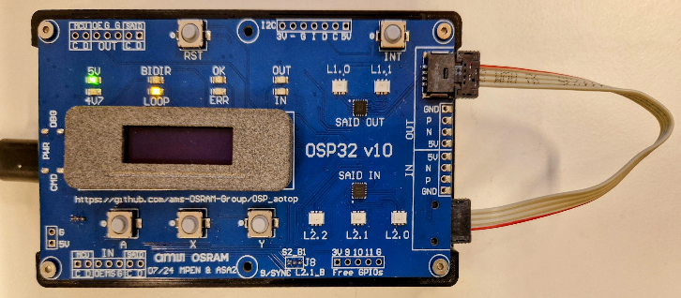
Assignment – Training2 - eeprom
i2c
P5
I2C EEPROM read/write
From aotop build training2 using “ESP32S3 Dev Module”
Connect OSP32.OUT to OSP32.IN (Loop)
Note SAID.OUT has an I2C EEPROM
void setup() {
Serial.begin(115200);
Serial.printf("\n\ntraining1.ino - step eeprom\n");
aospi_init();
aoosp_init();
// aoosp_loglevel_set( aoosp_loglevel_tele );
i2ceeprom();
// Serial.printf("tx %d rx %d\n", aospi_txcount_get(), aospi_rxcount_get() );
}
0
#define ADDR 0x001 // the address of the OSP node with I2C (SAID OUT on OSP32)
#define DADDR7 0x54 // I2C device address of the I2C EEPROM connected to SAID OUT
#define RADDR 0x40 // some "random" register address in the EEPROM
static void i2ceeprom( ) {
// Reset all nodes (broadcast); all "off"; they also lose their address
result= aoosp_exec_resetinit(&last);
Serial.printf("resetinit() %s %d\n", aoresult_to_str(result), last );
if( last!=2 ) Serial.printf("ERROR: unexpected topology\n");
// Power the I2C bus
...
// Read the current register value from the EEPROM
...
// Show value, step value
Serial.printf(" value %02x\n",buf[0]);
buf[0]++;
// Write the new register value to the EEPROM
...
}
The sketch should step location 40 in EEPROM by one
Fill out the gaps in the training2 sketch
Power the I2C bus
Read the current register value from the EEPROM
Show value, step value
Write the new register value to the EEPROM
Use the EEPROM on SAID.OUT (has I2C address 0x54)
Open serial monitor, and press reset (or power cycle)
1

Slide 13
Assignment
i2c
P5
1
I2C EEPROM read/write
static void i2ceeprom( ) {
#define BUFSIZE 1
uint8_t buf[BUFSIZE];
aoresult_t result;
uint16_t last;
// Reset all nodes (broadcast); all "off"; they also lose their address
result= aoosp_exec_resetinit(&last);
Serial.printf("resetinit() %s %d\n", aoresult_to_str(result), last );
if( last!=2 ) Serial.printf("ERROR: unexpected topology\n");
// Power the I2C bus
...
// Read the current register value from the EEPROM
...
// Show value, step value
Serial.printf(" value %02x\n",buf[0]);
buf[0]++;
// Write the new register value to the EEPROM
...
}
static void i2ceeprom( ) {
#define BUFSIZE 1
uint8_t buf[BUFSIZE];
aoresult_t result;
uint16_t last;
// Reset all nodes (broadcast); all "off"; they also lose their address
result= aoosp_exec_resetinit(&last);
Serial.printf("resetinit() %s %d\n", aoresult_to_str(result), last );
if( last!=2 ) Serial.printf("ERROR: unexpected topology\n");
// Power the I2C bus
result= aoosp_exec_i2cpower(ADDR);
Serial.printf("i2cpower(%03X) %s\n", ADDR, aoresult_to_str(result) );
// Read the current register value from the EEPROM
result= aoosp_exec_i2cread8(ADDR, DADDR7, RADDR, buf, BUFSIZE );
Serial.printf("i2cread8(%03X,%02X,%02X) %s\n", ADDR, DADDR7, RADDR, aoresult_to_str(result) );
// Show value, step value
Serial.printf(" value %02x\n",buf[0]);
buf[0]++;
// Write the new register value to the EEPROM
result= aoosp_exec_i2cwrite8(ADDR, DADDR7, RADDR, buf, BUFSIZE );
Serial.printf("i2cwrite8(%03X,%02X,%02X) %s\n", ADDR, DADDR7, RADDR, aoresult_to_str(result) );
}
training2.ino - step eeprom
spi: init
osp: init
resetinit() ok 2
i2cpower(001) ok
i2cread8(001,54,40) ok
value 07
i2cwrite8(001,54,40) ok
training2.ino - step eeprom
spi: init
osp: init
resetinit() ok 2
i2cpower(001) ok
i2cread8(001,54,40) ok
value 08
i2cwrite8(001,54,40) ok
training2.ino - step eeprom
spi: init
osp: init
resetinit() ok 2
i2cpower(001) ok
i2cread8(001,54,40) ok
value 09
i2cwrite8(001,54,40) ok

Slide 14
Training3 – command and topo

Slide 15
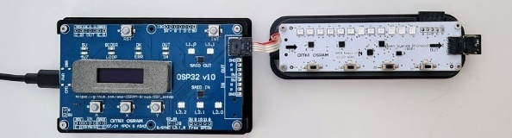
Assignment – Training3 – command and topo
commands
P7
Assignment
Flash and run training3
0
int anim_ticknum;
uint32_t anim_lastms;
static void anim_start() {
aoresult_t result = aoosp_exec_resetinit();
if( result!=aoresult_ok ) Serial.printf("ERROR topo_build %s\n", aoresult_to_str(result) );
result= aoosp_send_clrerror(0x000);
if( result!=aoresult_ok ) Serial.printf("ERROR send_clrerror %s\n", aoresult_to_str(result) );
result= aoosp_send_goactive(0x000);
if( result!=aoresult_ok ) Serial.printf("ERROR send_goactive %s\n", aoresult_to_str(result) );
anim_ticknum = 0;
anim_lastms = millis();
Serial.printf("anim: started\n");
}
static void anim_step() {
if( millis()-anim_lastms < 500 ) return;
if( anim_ticknum%2 == 0 ) {
aoresult_t result= aoosp_send_setpwmchn(0x001, 0, 0x1FFF/*red*/, 0x1FFF/*green*/, 0x0000/*blue*/);
if( result!=aoresult_ok ) Serial.printf("ERROR send_setpwmchn %s\n", aoresult_to_str(result) );
} else {
aoresult_t result= aoosp_send_setpwmchn(0x001, 0, 0x0000/*red*/, 0x1FFF/*green*/, 0x1FFF/*blue*/);
if( result!=aoresult_ok ) Serial.printf("ERROR send_setpwmchn %s\n", aoresult_to_str(result) );
}
anim_ticknum++;
anim_lastms= millis();
}
Use topo in start and step
aomw_topo_build()
omw_topo_settriplet()
1
Code a “walking yellow animation”
Step 1
Step 2
Step 3
Step 4
2
Every step read colors from EEPROM (daddr 0x54)
Foreground color (yellow) 6 bytes at 0x10
Background color (cyan) 6 bytes at 0x20
Write helper function
3
void anim_getcol(uint8_t raddr, aomw_topo_rgb_t * col )

Slide 16
Assignment – Training3 – command and topo
commands
P7
1
Using topo
int anim_ticknum;
uint32_t anim_lastms;
static void anim_start() {
aoresult_t result = aoosp_exec_resetinit();
if( result!=aoresult_ok ) Serial.printf(…);
result= aoosp_send_clrerror(0x000);
if( result!=aoresult_ok ) Serial.printf(…);
result= aoosp_send_goactive(0x000);
if( result!=aoresult_ok ) Serial.printf(…);
anim_ticknum = 0;
anim_lastms = millis();
Serial.printf("anim: started\n");
}
static void anim_step() {
if( millis()-anim_lastms < 500 ) return;
aoresult_t result; if( anim_ticknum%2 == 0 ) {
result= aoosp_send_setpwmchn(0x001, 0, 0x1FFF, 0x1FFF, 0x0000);
if( result!=aoresult_ok ) Serial.printf(…);
} else {
result= aoosp_send_setpwmchn(0x001, 0, 0x0000, 0x1FFF, 0x1FFF);
if( result!=aoresult_ok ) Serial.printf(…);
}
anim_ticknum++;
anim_lastms= millis();
}
int anim_ticknum;
uint32_t anim_lastms;
static void anim_start() {
aoresult_t result = aomw_topo_build();
if( result!=aoresult_ok ) Serial.printf("ERROR topo_build %s\n", aoresult_to_str(result) );
anim_ticknum = 0;
anim_lastms = millis();
Serial.printf("anim: started\n");
}
static void anim_step() {
if( millis()-anim_lastms < 500 ) return;
aoresult_t result; if( anim_ticknum%2 == 0 ) {
result= aomw_topo_settriplet( 0, &aomw_topo_yellow );
if( result!=aoresult_ok ) Serial.printf("ERROR topo_settriplet %s\n", aoresult_to_str(result) );
} else {
result= aomw_topo_settriplet( 0, &aomw_topo_cyan );
if( result!=aoresult_ok ) Serial.printf("ERROR topo_settriplet %s\n", aoresult_to_str(result) );
}
anim_ticknum++;
anim_lastms= millis();
}

Slide 17
Assignment – Training3 – command and topo
commands
P7
2
Walking yellow
int anim_ticknum;
uint32_t anim_lastms;
static void anim_start() {
aoresult_t result = aomw_topo_build();
if( result!=aoresult_ok ) Serial.printf(…);
anim_ticknum = 0;
anim_lastms = millis();
Serial.printf("anim: started\n");
}
static void anim_step() {
if( millis()-anim_lastms < 500 ) return;
aoresult_t result; if( anim_ticknum%2 == 0 ) {
result= aomw_topo_settriplet( 0, &aomw_topo_yellow );
if( result!=aoresult_ok ) Serial.printf(…);
} else {
result= aomw_topo_settriplet( 0, &aomw_topo_cyan );
if( result!=aoresult_ok ) Serial.printf(…);
}
anim_ticknum++;
anim_lastms= millis();
}
int anim_ticknum;
uint32_t anim_lastms;
static void anim_start() {
aoresult_t result = aomw_topo_build();
if( result!=aoresult_ok ) Serial.printf(…);
anim_ticknum = 0;
anim_lastms = millis();
Serial.printf("anim: started\n");
}
static void anim_step() {
if( millis()-anim_lastms < 500 ) return;
for( int tix=0; tix<aomw_topo_numtriplets(); tix++ ) {
const aomw_topo_rgb_t * col = tix%3 == anim_ticknum%3 ? &aomw_topo_yellow : &aomw_topo_cyan ;
aoresult_t result= aomw_topo_settriplet( tix, col );
if( result!=aoresult_ok ) Serial.printf("ERROR settriplet(%d) %s\n", tix, aoresult_to_str(result) );
}
anim_ticknum++;
anim_lastms= millis();
}

Slide 18
Assignment – Training3 – command and topo
commands
P7
#define ADDR 0x001 // the address of the OSP node with I2C (SAID OUT on OSP32)
#define DADDR7 0x54 // I2C device address of the I2C EEPROM connected to SAID OUT
#define RADDR_FG 0x10 // "random" register address in the EEPROM to store 6 bytes for fg color
#define RADDR_BG 0x20 // "random" register address in the EEPROM to store 6 bytes for bg color
#define BUFSIZE 6 // R/G/B each need two bytes
3
Read colors from EEPROM
int anim_ticknum;
uint32_t anim_lastms;
static void anim_start() {
aoresult_t result = aomw_topo_build();
if( result!=aoresult_ok ) Serial.printf(…);
anim_ticknum = 0;
anim_lastms = millis();
Serial.printf("anim: started\n");
}
static void anim_step() {
if( millis()-anim_lastms < 500 ) return;
for( int tix=0; tix<aomw_topo_numtriplets(); tix++ ) {
const … col = … ? &aomw_topo_yellow : &aomw_topo_cyan ;
aoresult_t result= aomw_topo_settriplet( tix, col );
if( result!=aoresult_ok ) Serial.printf(…);
}
anim_ticknum++;
anim_lastms= millis();
}
int anim_ticknum;
uint32_t anim_lastms;
static void anim_getcol(uint8_t raddr, aomw_topo_rgb_t * col ) {
uint8_t buf[BUFSIZE];
// Read the color from the EEPROM from location raddr
aoresult_t result= aoosp_exec_i2cread8(ADDR, DADDR7, raddr, buf, BUFSIZE );
if( result!=aoresult_ok ) Serial.printf("ERROR exec_i2cread8(%02X) %s\n", raddr, aoresult_to_str(result) );
col->r = (buf[0] & 0x7F) * 256 + buf[1];
col->g = (buf[2] & 0x7F) * 256 + buf[3];
col->b = (buf[4] & 0x7F) * 256 + buf[5];
}
static void anim_start() {
aoresult_t result = aomw_topo_build();
if( result!=aoresult_ok ) Serial.printf(…);
anim_ticknum = 0;
anim_lastms = millis();
Serial.printf("anim: started\n");
}
static void anim_step() {
if( millis()-anim_lastms < 500 ) return;
aomw_topo_rgb_t fgcol = { 0,0,0, "fg" }; anim_getcol(RADDR_FG, &fgcol);
aomw_topo_rgb_t bgcol = { 0,0,0, "bg" }; anim_getcol(RADDR_BG, &bgcol);
for( int tix=0; tix<aomw_topo_numtriplets(); tix++ ) {
const aomw_topo_rgb_t * col = tix%3 == anim_ticknum%3 ? &fgcol : &bgcol ;
aoresult_t result= aomw_topo_settriplet( tix, col );
if( result!=aoresult_ok ) Serial.printf("ERROR topo_setpwm(%d) %s\n", tix, aoresult_to_str(result) );
}
anim_ticknum++;
anim_lastms= millis();
}

Slide 19
Assignment – Training3 – command and topo
commands
P7
Command
>> said i2c 000 scan
SAID 001 has I2C (now powered)
00: 00 01 02 03 04 05 06 07 08 09 0a 0b 0c 0d 0e 0f
10: 10 11 12 13 14 15 16 17 18 19 1a 1b 1c 1d 1e 1f
20: 20 21 22 23 24 25 26 27 28 29 2a 2b 2c 2d 2e 2f
30: 30 31 32 33 34 35 36 37 38 39 3a 3b 3c 3d 3e 3f
40: 40 41 42 43 44 45 46 47 48 49 4a 4b 4c 4d 4e 4f
50: 50 51 52 53 [54] 55 56 57 58 59 5a 5b 5c 5d 5e 5f
60: 60 61 62 63 64 65 66 67 68 69 6a 6b 6c 6d 6e 6f
70: 70 71 72 73 74 75 76 77 78 79 7a 7b 7c 7d 7e 7f
SAID 001 has 1 I2C devices
SAID 005 has I2C (now powered)
00: 00 01 02 03 04 05 06 07 08 09 0a 0b 0c 0d 0e 0f
10: 10 11 12 13 14 15 16 17 18 19 1a 1b 1c 1d 1e 1f
20: [20] 21 22 23 24 25 26 27 28 29 2a 2b 2c 2d 2e 2f
30: 30 31 32 33 34 35 36 37 38 39 3a 3b 3c 3d 3e 3f
40: 40 41 42 43 44 45 46 47 48 49 4a 4b 4c 4d 4e 4f
50: [50] 51 52 53 54 55 56 57 58 59 5a 5b 5c 5d 5e 5f
60: 60 61 62 63 64 65 66 67 68 69 6a 6b 6c 6d 6e 6f
70: 70 71 72 73 74 75 76 77 78 79 7a 7b 7c 7d 7e 7f
SAID 005 has 2 I2C devices
total 2 SAIDs have 3 I2C devices
>>
>>
>>
>> @said i2c 000 scan
[54] SAID 001 has 1 I2C devices
[20][50] SAID 005 has 2 I2C devices
total 2 SAIDs have 3 I2C devices
>>
Read fgcol at 10
white: (FFFF FFFF FFFF)
>> said i2c 001 read 54 10 6
said(001).i2c.dev(54).reg(10) FF FF FF FF FF FF
>>
>> said i2c 001 write 54 10 1F FF 1F FF 00 00
said(001).i2c.dev(54).reg(10) 1F FF 1F FF 00 00
>>
>>
>>
>> said i2c 001 read 54 20 6
said(001).i2c.dev(54).reg(20) FF FF FF FF FF FF
>>
>> said i2c 001 write 54 20 00 00 1F FF 1F FF
said(001).i2c.dev(54).reg(20) 00 00 1F FF 1F FF
>>
>>
>> topo dim
dim 100/1024 (said 21x, rgbi 53x below max power)
>> topo dim 200
dim 200/1024 (said 11x, rgbi 28x below max power)
>>
Write Yellow at 10
Read bgcol at 20
Write Cyan at 20
Change dim level

