Slide 1

CHARLES DARWIN UNIVERSITY
SYDNEY CAMPUS
SplitSync
Group-based expense splitting, built as a PWA
PRT585 · Software Engineering Tools and Process
Final Project Presentation
Amsh Shrestha (S394695) · Devi Maya (S388017) · Shanti Moktan (S395240)
Submitted to Ahmedi Azra

Slide 2
OVERVIEW
Agenda
• 01 Introduction & problem
• 02 Aim & objectives
• 03 Scope
• 04 System architecture
• 05 Core features
• 06 Features: planned vs. implemented
• 07 Testing
• 08 Known gaps
• 09 Usage analytics
• 10 Conclusion
SplitSync · Agenda
2

Slide 3
01 · INTRODUCTION
What is SplitSync?
SplitSync is a group-based expense-splitting Progressive Web App. It lets groups of people, like roommates or travel groups, track, split and settle shared expenses in a synchronised, group-based environment.
It is explicitly group-oriented: no individual/personal expense tracking outside a group context.
The problem
Splitting shared costs in a group is ambiguous. Who paid, who owes, and how much, gets lost in chat threads and mental maths.
The fix
One shared source of truth per group: every expense, every split method, every settlement, with running balances always visible.
SplitSync · Introduction
3

Slide 4
02 · AIM & OBJECTIVES
What we set out to build
To build a mobile-first, web-accessible app that removes the friction and ambiguity of splitting shared costs within a group, and makes it clear at any time who owes what to whom.
OBJECTIVES
• Let any authenticated user create and manage spending groups.
• Support recording expenses split three ways: equally, unequally (custom amounts), or by percentage.
• Track and surface running balances (who owes whom) per group, without processing actual payments.
• Let members record settlements against those balances.
• Deliver it as a responsive PWA usable on both desktop and mobile browsers.
SplitSync · Aim & Objectives
4

Slide 5
03 · SCOPE
In scope vs. out of scope
IN SCOPE (per SRS)
OUT OF SCOPE (per SRS)
• Group creation / membership management
• Expense entry, editing, viewing, removal
• Equal / unequal / percentage split configuration
• Receipt / photo attachment
• Expense history & balance visibility
• Settlement recording
• Email notifications for unpaid balances
• Recurring expenses
• Group activity log
• Real-time in-app payment processing
• Removing a member with an unsettled balance
• Multi-currency support
• A native mobile app (PWA only)
• Debt simplification / netting
SplitSync · Scope
5

Slide 6
04 · ARCHITECTURE
System architecture
Client
React + TypeScript PWA (Vite)
lib/api.ts talks to the API
lib/session.ts handles the JWT
Light / dark theme
API
ASP.NET Core (.NET 10)
SplitSync.Api Web API
ASP.NET Core Identity + JWT
[Authorize] on every route but auth
Data
PostgreSQL on Supabase
EF Core, migrations in server/Migrations
Receipts in their own table
behind an IReceiptStorage interface
Gap vs. SRS: the SRS specified Kinde for login and Neon for the database. The team switched to ASP.NET Core Identity and Supabase Postgres instead, documented in Section 6 of the project report.
SplitSync · System Architecture
6

Slide 7
05 · CORE FEATURES
Accounts, groups & expenses
• Authentication Register / sign in with email or username, JWT-based sessions, self-service account deletion.
• Groups Create, rename, delete (creator-only); add/remove members by username search; join by group ID; leave a group.
• Expenses & splitting Equal, unequal (custom $) or percentage splits, validated server-side and computed in whole cents so shares always add up exactly.
• Edit & delete expenses The payer can edit or delete an expense after the fact, Week 08 addition, server re-runs the same split validation.
SplitSync · Core Features
7

Slide 8
05 · CORE FEATURES
Balances, notifications & receipts
• Settlements & balances Net balance per member, computed live from every expense share and settlement, no cached totals to keep in sync.
• Notifications In-app bell with unread count: fires when you're added to or removed from a group, an expense is added, or a settlement is recorded.
• Receipt photos Attach, view or remove a photo per expense; resized in the browser before upload; stored behind an IReceiptStorage interface.
• Theming Light/dark theme toggle across the whole app, matching the system's colour scheme by default.
SplitSync · Core Features
8

Slide 9
06 · STATUS
Features: planned vs. implemented
Feature (SRS) | Status
Account create / login / logout | Implemented
Account deletion (blocked if owning a group) | Implemented
Group create / rename / delete | Implemented
Add/remove members, join by ID, leave group | Implemented
Equal / unequal / percentage splitting | Implemented
Per-group balance view | Implemented
Settlement recording | Implemented
Expense editing / removal | Implemented (Week 08, payer only)
Receipt / photo attachment | Implemented (Week 09)
Notifications | In-app only, email reminders not built
Recurring expenses | Not implemented
Activity log | Not implemented (Transactions tab instead)
SplitSync · Features: Planned vs. Implemented
9

Slide 10
07 · TESTING
Testing
BACKEND
FRONTEND
• Integration tests in server.Tests, in-memory database
• Covers auth, groups, expenses (incl. split maths), settlements, receipts, health endpoint
• 49 tests, all passing as of 24 Sept
• Test cases for auth, groups, expenses, settlements, recurring expenses, activity, settings
• Documentation/Test Cases
• Cypress e2e test for the authentication page
Gap: no Cypress tests yet for the newer features like editing expenses, receipts and the group dashboard.
SplitSync · Testing
10

Slide 11
08 · KNOWN GAPS
Known gaps
• Login and database host are different from the SRS (Kinde/Neon swapped for ASP.NET Identity/Supabase).
• Recurring expenses, email notifications and the activity log are in the SRS but not built.
• Percentage splits only save the dollar amount per person, not the percentage itself, so editing one re-derives percentages from the amounts and may round.
• Only one receipt photo per expense.
• Not much frontend test coverage yet on the newer features.
SplitSync · Known Gaps
11

Slide 12
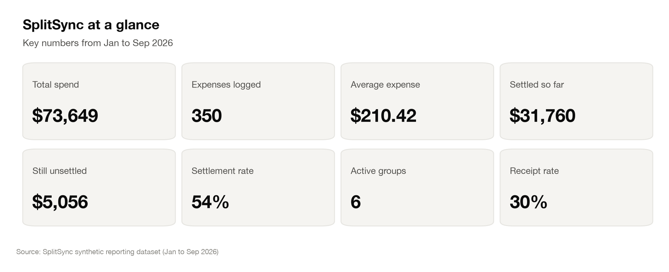
09 · USAGE ANALYTICS
SplitSync at a glance
Built from a seeded sample dataset shaped like the app's schema (Jan to Sep 2026), not live production data. A Tableau-ready workbook is included in the repo.
SplitSync · Usage Analytics
12

Slide 13
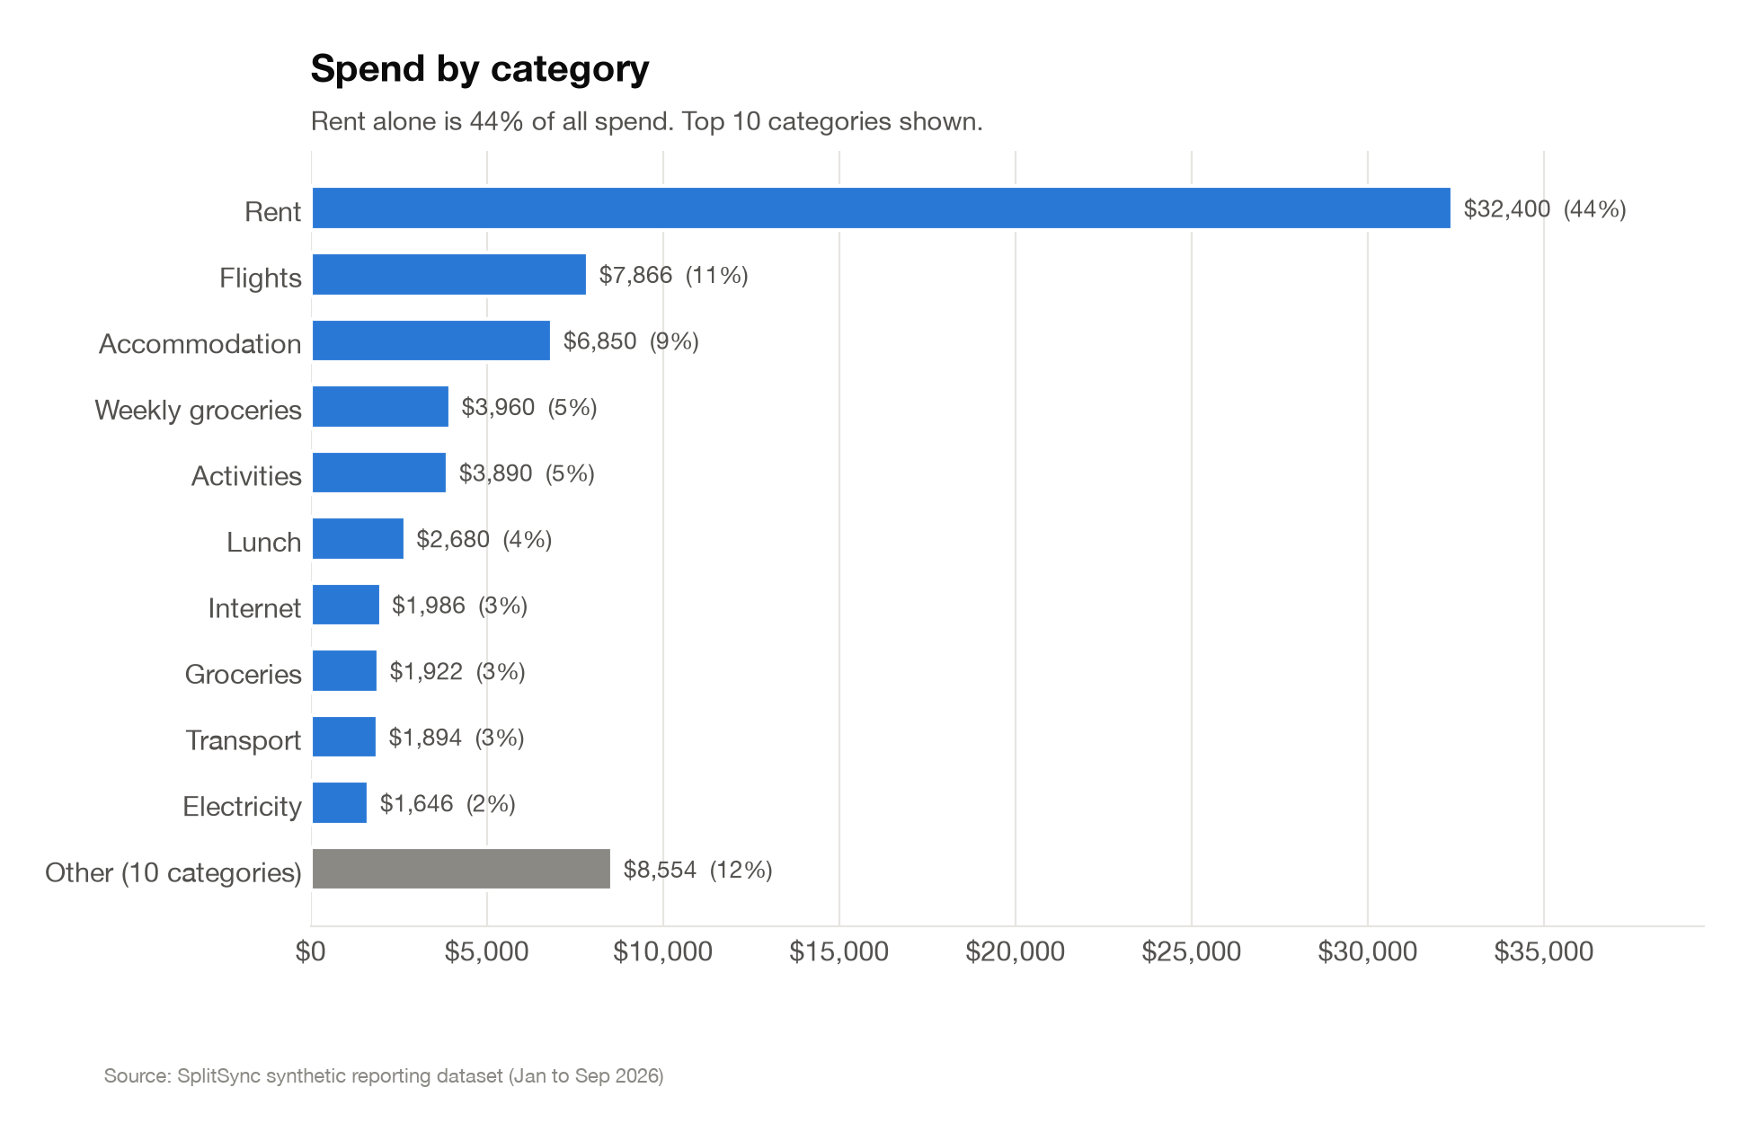
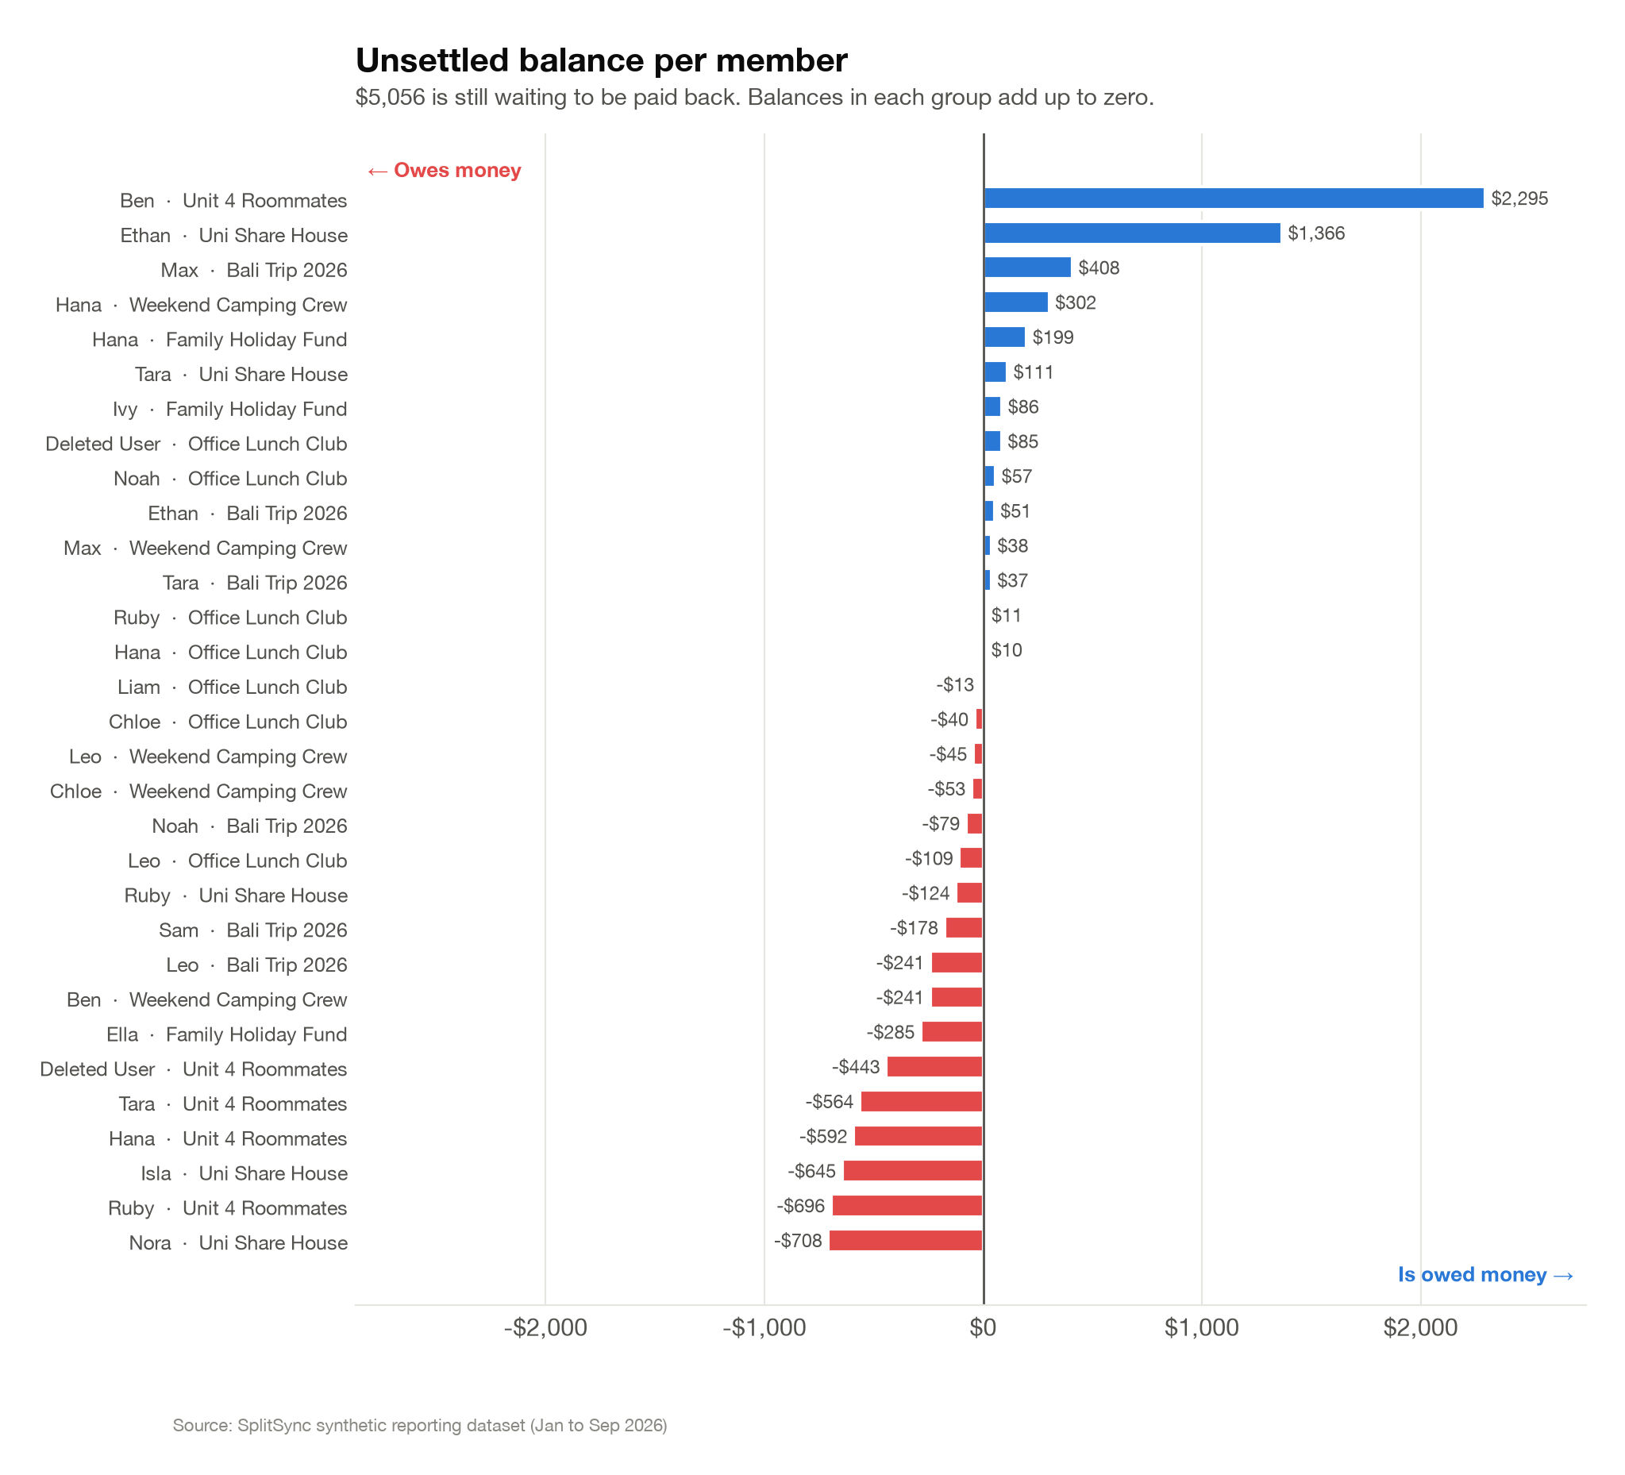
09 · USAGE ANALYTICS
Spend by category & unsettled balances
SplitSync · Usage Analytics
13

Slide 14
10 · CONCLUSION
Conclusion
SplitSync meets the aim and objectives set out at the start: groups, expense splitting (equal, unequal, percentage), balances, settlements, notifications, receipts, and editing/deleting an expense are all built and working.
What's left: recurring expenses and the activity log from the SRS, more frontend test coverage on the newer features, and the deployment + final QA pass before submission.
Repo: github.com/ams-sth/group01_software_project
SplitSync · Conclusion
14

Slide 15
Thank you
Questions?
Amsh Shrestha · Devi Maya · Shanti Moktan
PRT585 · Charles Darwin University

