Slide 1
SystemVerilog and UVM
Adil Sadik

Slide 2
Synopsys
Background and Motivation
Pre- Silicon verification flow
Programming languages for ASIC verification
SystemVerilog
UVM
UVM architecture
Code Example
Wrapping up
Reference

Slide 3
Motivation (Cont…)
Modern ASICs are large (transistor count) and complex
Example: Cell phone
Complex SoC: CPU, GPU, ML/AI accelerators, ISP, DSP… many IPs in one chip.
Verification is vital: can’t patch a chip once it’s shipped!
Verification consumes HW design cycle.
Project risk is directly proportional to verification capability of the team
Goal is to find all bugs before tapeout (even though it’s impossible!).

Slide 4
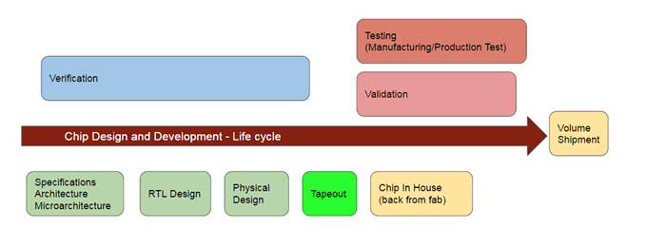
Motivation (Cont…)

Slide 5
Motivation (Cont…)
Pre- Silicon Verif
Post- Silicon Verif

Slide 6
Motivation (Cont…)
Pre- Silicon Verification:
Stress test the design in a simulation environment.
Analyze coverage to sign off (tapeout):
Every line of code should be covered.
Test cases should be able to reach all obscure corner cases.
Every possible input combination should be exercised.
Pre- Silicon Verif
Post- Silicon Verif
Post- Silicon Verification:
Verify the chip after getting it back from the fab.
Extremely hard to debug fails and fix bugs.

Slide 7
Pre-Silicon Verification
Simulation environment contains:
Design under test (DUT)
Written in HDL (hardware description language). Verilog, VHDL etc..
It can be in house design or an IP
Test generator and Reference model
Written in higher level language (C++, SystemVerilog, SystemC etc)
Scoreboard/ checkers
Checks if the output from DUT is correct and valid.
One env can inherit other child env (more on this in later slides…)

Slide 8
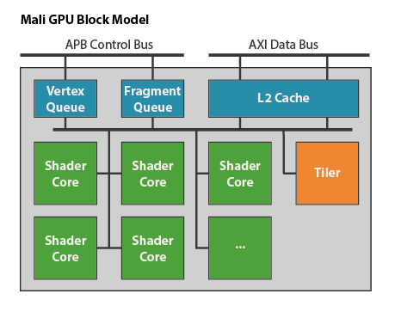
Pre-Silicon Verification
An example design- ARM Mali GPU
Many complex functional sub-blocks:
Fixed function math heavy units:
Tiler
Vertex Transformation (not shown here) etc…
Programmable Shader Core
Executes programs, OpenGL, CUDA etc
Standardized bus protocols: APB, AXI etc.
Cache
Data masters (vertex and fragment queue).
And more…

Slide 9
Pre-Silicon Verification
Goal of pre-silicon verification:
Individually verify all these different sub-blocks inside GPU.
Verify that all blocks interact and work coherently after final integration.
No unexpected surprises.
Example: run an OpenGL program and make sure it’s rendering an image correctly.
Exhaustively cover all real life scenarios including extremely hard to hit edge cases.
Things can get quite complicated- lets dive into a sim environment of one of the sub-blocks…

Slide 10
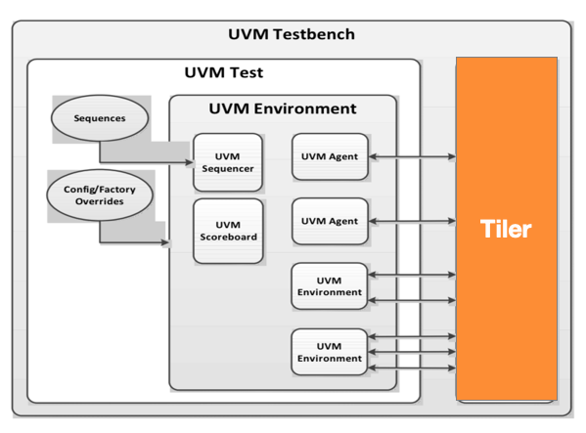
Pre-Silicon Verification
On a high level we only need following:
Something to drive the input interface of Tiler
Something to monitor the output interface and make sure output makes sense.
Some sort of mechanism to evaluate the quality of tests.
Should work seamlessly as a standalone model and a part of big verification system (full GPU).
Need a testbench or verification architecture that can meet and exceed these goals.

Slide 11
Pre-Silicon Verification
The TB (testbench) architecture should be highly scalable and fast.
Portable: easy port a standalone TB to top level TB. Each component within the TB should be able to configure itself depending on use case.
Reusability is the key. Not all functional blocks are same but if there is any similarity then we want to reuse code as much as possible.
Allow changes: quickly adopt new design changes without any major re-architecture.

Slide 12
Pre-Silicon Verification
OOP concepts comes to rescue:
OOP and design patterns are highly used in creating testbench architecture.
A good TB architecture should be:
Modular and Scalable
Easily integrate or inherit other test benches or verif components just by configuring few objects.
Can reconfigure itself based on use case.
Allow change
Interfaces, requirements, micro architecture changes multiple times in design cycle.
Accommodate changes without compromising quality.
Quality is judged by coverage. If a TB can hit 90% coverage then after an urgent interface (maybe a bug fix) change, it should be able to hit the same coverage without any major change in TB architecture.
Highly cohesive and loosely coupled
Example:
The class monitoring an output interface doesn’t need to know how the tests are generated.
The class generating complex test vectors doesn’t need to know the type of input interface. etc…
Encapsulate what varies
Example: class generating test vectors might need to follow an algorithm to generate intelligent tests. Algorithm will vary based on the type of design.
And many more…

Slide 13
Programming language for verif
Programming languages and tools used in Verification :
Front end ASIC design: mostly coded using HDL (Verilog, VHDL etc).
HDL: Hardware Description Language
TB architecture can be coded in any OOP language as long as there is an API to interact with HDL.
Eventually TB needs to stimulate the HW input interface written in HDL and monitor the output interface.
Sometimes it’s important to probe deep into the design to cover/stimulate hard to hit logic element.
Common languages used:
C++ : Verilog has an API to interact with C++ code.
Also used to create reference model.
SystemVerilog: An extension of Verilog.
SV supports OOP and it can natively interact with the Verilog design.
Hybrid environment: A mixture of C++ and SV.
Example: reference model in C++ but all other TB components are in SV.

Slide 14
Why SystemVerilog
SV is a superset of Verilog
Supports all Verilog features along with new OOP features.
Provides a rich set of language features to verification engineers:
Native Assertions – SVA (SystemVerilog Assertion)
Capture design intent as an assertion. Mathematically prove that the assertion is correct.
Exhaustive- prove that design is correct in ALL possible input combination.
No need to write complicated tests!
Complements the traditional stimulus driven verification.
Constrained random generator
A powerful random engine to generate constrained random numbers. Used for writing tests.
Coverage
Provides language features to write functional cover points.
Used to judge the quality of random tests.
Are we hitting all interesting input combination? If not then what is missing? Are we toggling every single bit in the design?
OOP features
Classes, inheritance, interfaces, polymorphism etc…
Direct programming interface – interface with a foreign language (C++ for example)
UVM (Universal Verification Methodology) class library is written in SV.

Slide 15
UVM
Universal Verification Methodology
A single, standard, industry wide solution for design verification.
A methodology for building advanced reusable verification environment.
Codifies the best practices from years of experience.
Class library written in SystemVerilog.
Engineers can use the UVM class library to quickly create testbenchs.

Slide 16
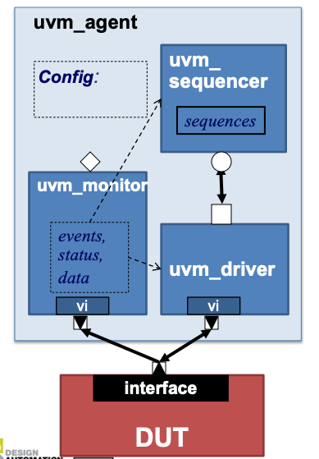
UVM architecture
uvm_agent:
uvm_agent is a virtual (abstract) class. It’s used as the base class for user defined agents.
Agent: agents has following components:
uvm_driver : it sends input to the device.
uvm_monitor: it monitors the input and output of the device.
uvm_sequencer: it generates traffic.
Agents also have standard config param that developer can configure or set.
Interface: abstract away the low level HDL interface (basically a bunch of wires).
Dev makes the connection between interface and agent.

Slide 17
UVM architecture
uvm_agent:
An agent can be ACTIVE or PASSIVE
ACTIVE:
If agent is active then it will send inputs to the device.
PASSIVE:
Passive agent will only monitor the output.
The config param is used to configure it as active or passive.
Example use case:
In previous GPU example, Tiler test bench is ACTIVE when we are only verifying Tiler and it’s not part of the final top level test bench.
If Tiler tb is part of the top level test bench then it’ll be PASSIVE. The neighboring block will send inputs to Tiler. Agent doesn’t need to generate input in this case.

Slide 18
UVM architecture
UVM Sequence
Sequence is basically the random meaningful test inputs.
uvm_sequencer executes the sequences.
Implementation of sequences are hidden from sequencer. The sole purpose of sequencer is to send the sequences to the device input interface.
Sequence has following built in supports:
Interrupt
Arbitration
Factory
Test writers extends the UVM sequence base class to create meaningful tests.

Slide 19
UVM architecture
UVM Tests:
UVM separates tests from the testbench.
Decouples stimulus generation from the structural hierarchy of testbench.
Testbench has many static and reusable components that don’t change over time. The sequencer, driver, monitor etc…
Test (or sequence) will change during the design and verification cycle.
Test instantiates the testbench environment and configures it accordingly.

Slide 20
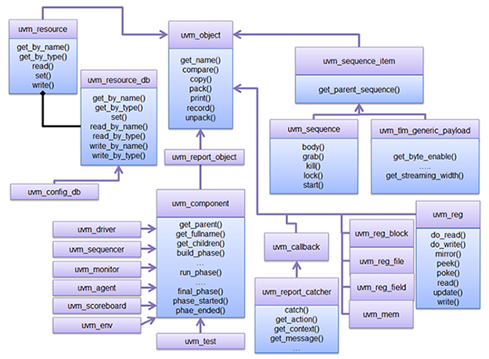
UVM architecture

Slide 21
UVM architecture
Base class of all uvm classes.

Slide 22
UVM architecture
Sequence item is the abstracted version of low level Device interface. Sequence randomizes the sequence item to create interesting stimulus.

Slide 23
UVM architecture
Base class to create test vectors using sequence item.

Slide 24
UVM architecture
Base classes to create structural elements like driver, monitor, sequencer, env etc.
Derived from uvm_component class

Slide 25
UVM architecture
Config database for various configuraiton. Example: name of an agent, active/passive, ID etc.
Derived from the uvm_resource class.

Slide 26
UVM architecture
Register abstraction
base class.

Slide 27
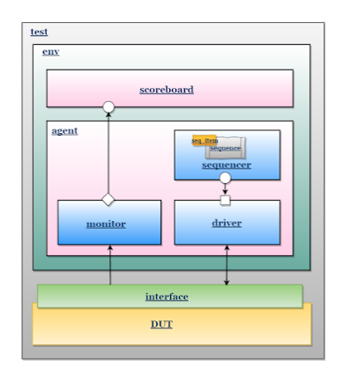
UVM architecture: Example
DUT:
Here the Design Under Test is a Memory.
It has following interface:
Input to DUT:
//data and control fields
bit [3:0] addr; // address
bit wr_en; // if 1 then writing to MEM
bit rd_en; // if 1 then reading from MEM
bit [7:0] wdata; // Write data
Output from DUT:
bit [7:0] rdata; // Read data

Slide 28
UVM architecture- Example
An example UVM tb shown in left.
As discussed in previous slides, lets point out few things from this arch diagram:
Test instantiates the testbnech (env).

Slide 29
UVM architecture- Example
An example UVM tb shown in left.
As discussed in previous slides, lets point out few things from this arch diagram:
env consists of:
Agents (one agent only in this simple example)
Driver to send sequence to Device (DUT)
Monitor to monitor the interface of DUT.
Sequencer to execute the sequence.

Slide 30
UVM architecture- Example
An example UVM tb shown in left.
As discussed in previous slides, lets point out few things from this arch diagram:
env consists of:
Agents (one agent only in this simple example)
Driver to send sequence to Device (DUT)
Monitor to monitor the interface of DUT.
Sequencer to execute the sequence.
Sequence uses seq_item to generate random input. Sequencer will eventually execute it using the driver.

Slide 31
UVM architecture- Example
An example UVM tb shown in left.
As discussed in previous slides, lets point out few things from this arch diagram:
Scoreboard to verify the output.
For simplicity lets assume the reference model is implemented inside scoreboard.

Slide 32
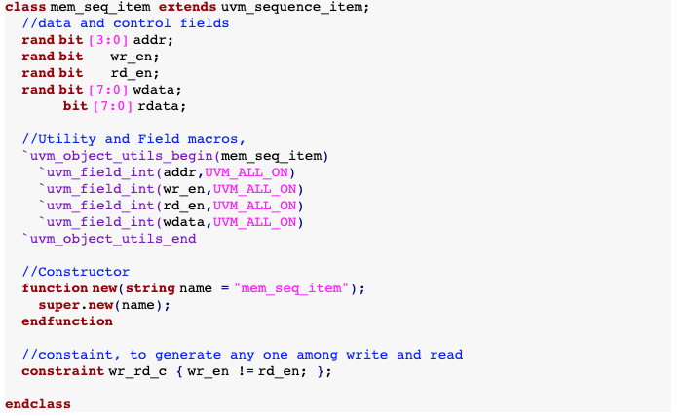
Example code
Sequence item:
rand keyword is used to enable
Randomization.
Here rand is added for all input signals.
`uvm_object_utils(class_name)
Register the type with UVM factory.
Constraint to control randomization

Slide 33
Example code
Sequence item:
rand keyword is used to enable
Randomization.
Here rand is added for all input signals.
`uvm_object_utils(class_name)
Register the type with UVM factory.
Constraint to control randomization
In summary: create a high level abstract layer from very low level bit accurate device wires (addr, wr_en, rd_en etc…)

Slide 34
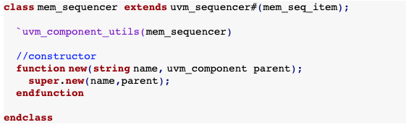
UVM architecture- Example
Sequencer
Sequencer sends sequence to device input interface with the help of driver.

Slide 35
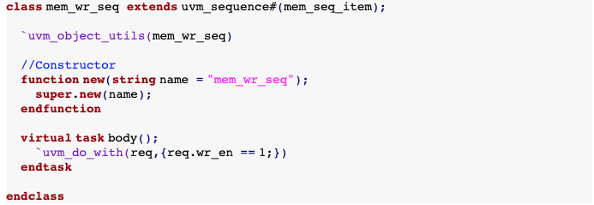
UVM architecture- Example
Tests or Sequences:
Example: Send a write transaction to device
virtual keyword:
If base class declares a method as virtual then the extended class can overwrite it.
function vs task:
They are both methods but:
function doesn’t consume time
task consumes time
`uvm_do_with(SEQ_ITEM, CONSTRAINTS)
Macro to send the sequence item with specified constraint to the sequencer.
There are other variants of `uvm_do_* macros.

Slide 36
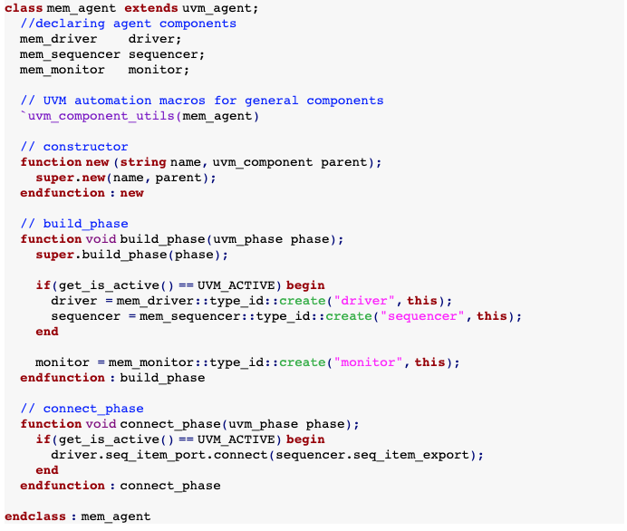
Agent
Instantiates driver,
sequencer and monitor
UVM Phases:
Build phase
Connect phase
Run phase
get_is_active():
Querying the config database to find out if agent is ACTIVE or PASSIVE.
In build_phase all
components
are created
connect_phase: connect
components

Slide 37
Agent
Instantiates driver,
sequencer and monitor

Slide 38
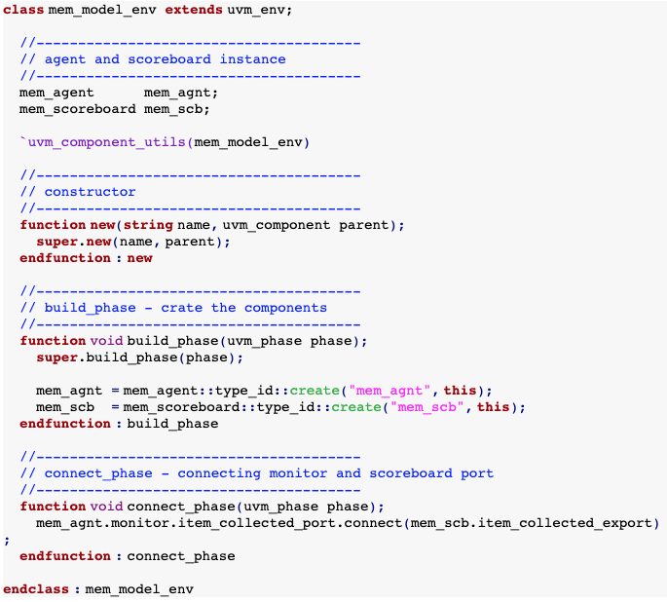
TB environment
Env:
Instantiates and connects all structural Components.
In this example, we have only two components:
Scoreboard
Agent

Slide 39
TB environment
Env:
Instantiates and connects all structural Components.
In this example, we have only two components:
Scoreboard
Agent

Slide 40
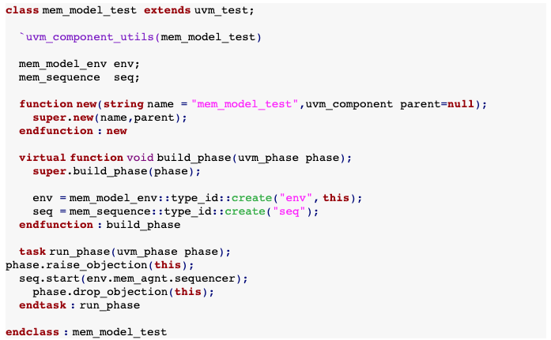
Test
Test instantiates the TB environment and sequence.
Test will launch the sequence.
The Agent (with help of sequencer, driver) executes sequence and send it to the device interface.
The monitor inside agent will snoop this transaction and collect coverage. After the test we can review the coverage and see what kind of test was generated by the sequence.
Monitor will also send the output transaction from device to scoreboard for checking.
run_phase: start the sequence in sequencer.
Not showing driver, monitor and scoreboard code here to keep things simple.

Slide 41
Wrapping up:
During the design and verification cycle, following components change the most:
Sequence item
Device interface can change to allow bug fixes, architectural, new feature request etc.
Sequence
It’s basically creates test by randomizing sequence items. Sequence changes a lot.
Test developers tune sequences, add new sequences all the time.
Driver, monitor, scoreboard etc. usually don’t change a lot.
There can be other features or components - UVCs (UVM Verification Component) – in the test bench.
Register model (UVC) for example. SW driver writes to the register to program device.
Performance verification- ensure the device meets performance goal.
Error injection- ensure device is robust.
Reset testing- what happens if device gets reset in the middle of a test/kick?
Designs are getting complex- hard to simulate full design. Slow and time consuming.
Simulation Acceleration techniques
Emulate the testbench in FPGA.

Slide 42
Wrapping up:
SV UVM class library provides a framework to create scalable, reusable and modular test benches.
Standard patterns used by all test benches using UVM.
Standard communication method between sequencer and driver
Separating testbench into structural and behavioral elements.
Standard configuration database model for all components in the tb.
Factory registration
Built in phasing (build_phase, run_phase, connect_phase etc). Makes developers life easy.
Encapsulates what varies:
Clear separation or hiding of implementation between sequence/tests and agent.
OOP techniques and SW design patterns are leveraged to achieve this goal.
SystemVerilog offers a rich set of language features to verification engineers.

Slide 43
Reference
“SystemVerilog Virtual Classes, Methods, Interfaces and Their Use in Verification and UVM”, Sunburst Design papers, Clifford E Cummings, Heath Chambers.
UVM documentation: https://verificationacademy.com/verification-methodology-reference/uvm/docs_1.2/html/files/macros/uvm_sequence_defines-svh.html#%60uvm_do_with
Open source example code from https://www.verificationguide.com
Universal Verification Methodology (UVM) 1.1 User’s Guide, accellera
ARM graphics and media processors: https://developer.arm.com/ip-products/graphics-and-multimedia/mali-gpus
https://workspace.accellera.org/activities/committees/uvm/UVM_Presentation_DAC2011_Final.pdf

