Slide 1
Implementation of DPA Tolerant AES Core
Design Review 1
Amandeep S. Chhabra, Adil Sadik, Dechhin Lama, Weo-Hao Yuan, & Jun Yin

Slide 2
Differential Power Analysis (DPA)

Slide 3
DPA
Side Channel Attack:
Physical Implementation provides the attacker information
E.g. Time Delay, Power Consumption, etc.
DPA
Very Effective in finding the secret key using off-the-shelf devices
Extract information from the power consumption that is correlated to the secret key.

Slide 4
Advanced Encryption Standard (AES)

Slide 5
AES Algorithm
Key: 128 bits
Data Blocks: 128 bits
AES operation:
Encryption:
4x4 matrix of bytes
Transformed in Rounds
Key is expanded and added to each Round.
Decryption:
Similar to Encryption but reversed.
Expanded Key is Added in reverse order.

Slide 6
AES Core
OpenCores.org
Author: Rudolf Usselmann
RTL written in Verilog
Concise, Well written Microarchitecture Specification
Very Basic Verification Environment with limited test cases

Slide 7
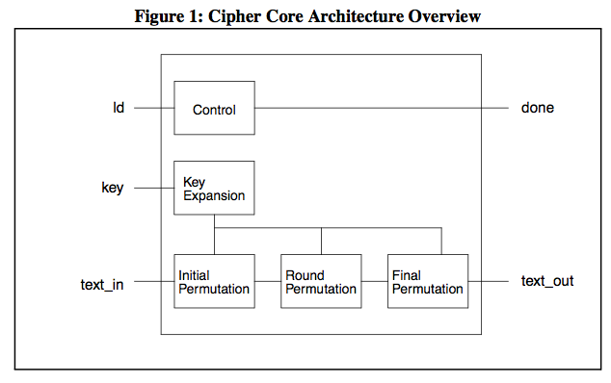
Microarchitecture (Encryption)

Slide 8
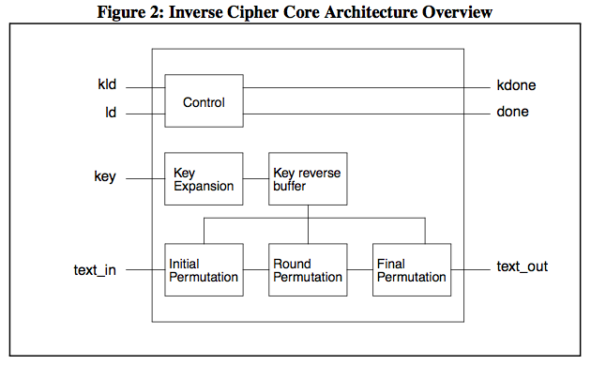
Microarchitecture (Decryption)

Slide 9
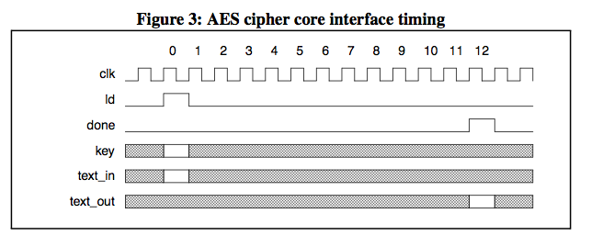
Timing Diagrams

Slide 10
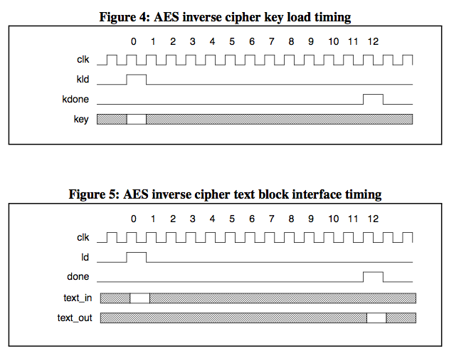
Timing Diagrams

Slide 11
Verification Testbench
To fully validate the core, a verification environment is developed.
Golden Model: written in C
RTL: written in Verilog
Interfaces, Testbench, Checker Class, Environment Class, Packet Generator: Written in SystemVerilog
VCS Simulator

Slide 12
Flow of Operations
Randomize data, key, reset, mode of Operation
Send random stimuli to DUT and golden model
Mimic DUT operation and timing in golden model
Compare outputs with expected value
Config.txt: file to constrain input vectors to reach corner cases

Slide 13
DPA attacks against AES Core

Slide 14
Vulnerability of AES against DPA
contents

Slide 15
Approaches
Circuit Level:
Analog Power Supply to Isolate Crypto Core from battery while core is processing the data. The power supply measured on battery becomes independent of operations executed at the AES core
Architectural Level
Randomized masking input data can be added to Standard AES algorithm. Power signature of AEC core becomes independent of input data due randomization
Gate Level
WDDL components of standard cells minimize the risk of determining power during core execution since power consumed during operation does not directly related the external battery of the circuit

Slide 16
Approaches
Circuit Level:
Analog Power Supply to Isolate Crypto Core from battery while core is processing the data. The power supply measured on battery becomes independent of operations executed at the AES core
Architectural Level
Randomized masking input data can be added to Standard AES algorithm. Power signature of AEC core becomes independent of input data due randomization
Gate Level
WDDL components of standard cells minimize the risk of determining power during core execution since power consumed during operation does not directly related the external battery of the circuit

Slide 17
Why Gate Level?

Slide 18
Wave Dynamic Differential Logic (WDDL)

Slide 19
Comparison with Std. Gates

Slide 20
Comparisons with Other Works

Slide 21
THE END

