Slide 1
Implementation of DPA Tolerant AES Core
Design Review 1
Amandeep S. Chhabra, Adil Sadik, Dechhin Lama, Weo-Hao Yuan, & Jun Yin

Slide 2
Differential Power Analysis (DPA)

Slide 3
DPA
Side Channel Attack:
Physical Implementation provides the attacker information
E.g. Time Delay, Power Consumption, etc.
DPA
Very Effective in finding the secret key using off-the-shelf devices
Extract information from the power consumption that is correlated to the secret key.

Slide 4
Advanced Encryption Standard (AES)

Slide 5
AES Algorithm
Key: 128 bits
Data Blocks: 128 bits
AES operation:
Encryption:
4x4 matrix of bytes
Transformed in Rounds
Key is expanded and added to each Round.
Decryption:
Similar to Encryption but reversed.
Expanded Key is Added in reverse order.

Slide 6
AES Core
OpenCores.org
Author: Rudolf Usselmann
RTL written in Verilog

Slide 7
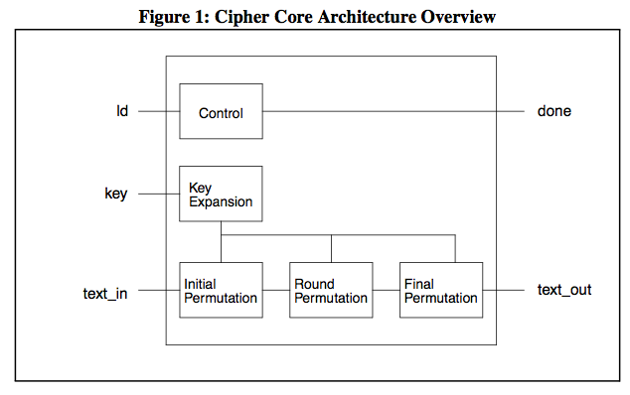
Microarchitecture (Encryption)

Slide 8
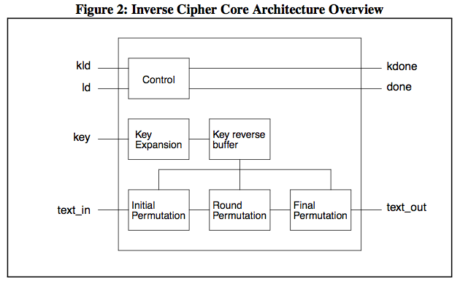
Microarchitecture (Decryption)

Slide 9
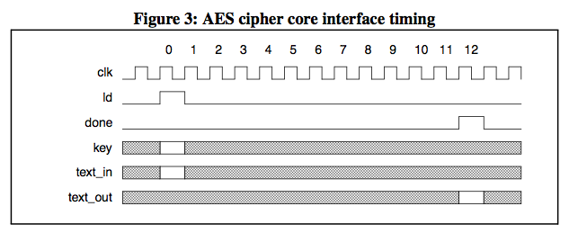
Timing Diagrams

Slide 10
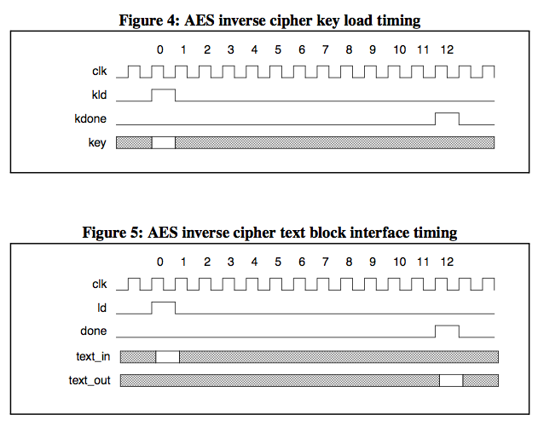
Timing Diagrams

Slide 11
Verification
Methodology: Random Verification
Each cycle:
Generate Random inputs.
Send random stimuli to DUT and golden model
Compare DUT and reference results.
If mismatch, exit simulation and debug the error.
Otherwise continue …

Slide 12
Verification Infrastructure
TEST
Generator
Golden Model
Checker
Interface
DUT

Slide 13
Verification Infrastructure
TEST
Generator
Golden Model
Checker
Interface
DUT
TEST:
Define constrains on random input generation- helps to hit corner cases.
Define simulation parameters (seed, probability, sim time etc…)
Generator generates random stimuli for DUT and golden model.
Interface provides a bidirectional path to drive DUT inputs and monitor outputs.
Checker compares the DUT result with reference result each clock cycle.

Slide 14
Verification Infrastructure
TEST
Generator
Golden Model
Checker
Interface
DUT
TEST:
Define constrains on input vectors.
Define simulation parameters (seed, probability, sim time etc…)
Generator generates random stimuli for DUT and golden model.
Each cycle, inputs are sent to golden model and DUT (through interface)
Interface provides a bidirectional path to drive DUT inputs and monitor outputs.
Checker compares the DUT result with reference result each clock cycle.

Slide 15
Verification Infrastructure
TEST
Generator
Golden Model
Checker
Interface
DUT
TEST:
Define constrains on input vectors.
Define simulation parameters (seed, probability, sim time etc…)
Generator generates random stimuli for DUT and golden model.
Interface provides a bidirectional path to drive DUT inputs and monitor outputs.
Input and outputs are sampled at each positive clock edge.
Checker compares the DUT result with reference result each clock cycle.

Slide 16
Verification Infrastructure
TEST
Generator
Golden Model
Checker
Interface
DUT
TEST:
Define constrains on input vectors.
Define simulation parameters (seed, probability, sim time etc…)
Generator generates random stimuli for DUT and golden model.
Interface provides a bidirectional path to drive DUT inputs and monitor outputs.
Checker compares the DUT result with reference result.
Exits the simulation if error is detected.
Provides detailed information about the error to facilitate debugging.

Slide 19
DPA attacks against AES Core

Slide 20
Vulnerability of AES against DPA
contents

Slide 21
Approaches
Circuit Level:
Analog Power Supply to Isolate Crypto Core from battery while core is processing the data. The power supply measured on battery becomes independent of operations executed at the AES core
Architectural Level
Randomized masking input data can be added to Standard AES algorithm. Power signature of AEC core becomes independent of input data due randomization
Gate Level
WDDL components of standard cells minimize the risk of determining power during core execution since power consumed during operation does not directly related the external battery of the circuit

Slide 22
Approaches
Circuit Level:
Analog Power Supply to Isolate Crypto Core from battery while core is processing the data. The power supply measured on battery becomes independent of operations executed at the AES core
Architectural Level
Randomized masking input data can be added to Standard AES algorithm. Power signature of AEC core becomes independent of input data due randomization
Gate Level
WDDL components of standard cells minimize the risk of determining power during core execution since power consumed during operation does not directly related the external battery of the circuit

Slide 23
Why Gate Level?

Slide 24
Wave Dynamic Differential Logic (WDDL)

Slide 25
Comparison with Std. Gates

Slide 26
Comparisons with Other Works

Slide 27
THE END

