Slide 1
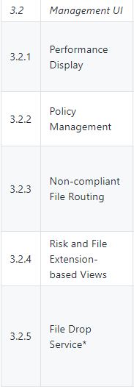
Wireframe – ICAP Management UI
https://github.com/filetrust/program-icap/wiki/Abridged-Amendment-3

Slide 2
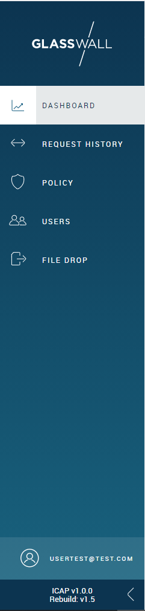
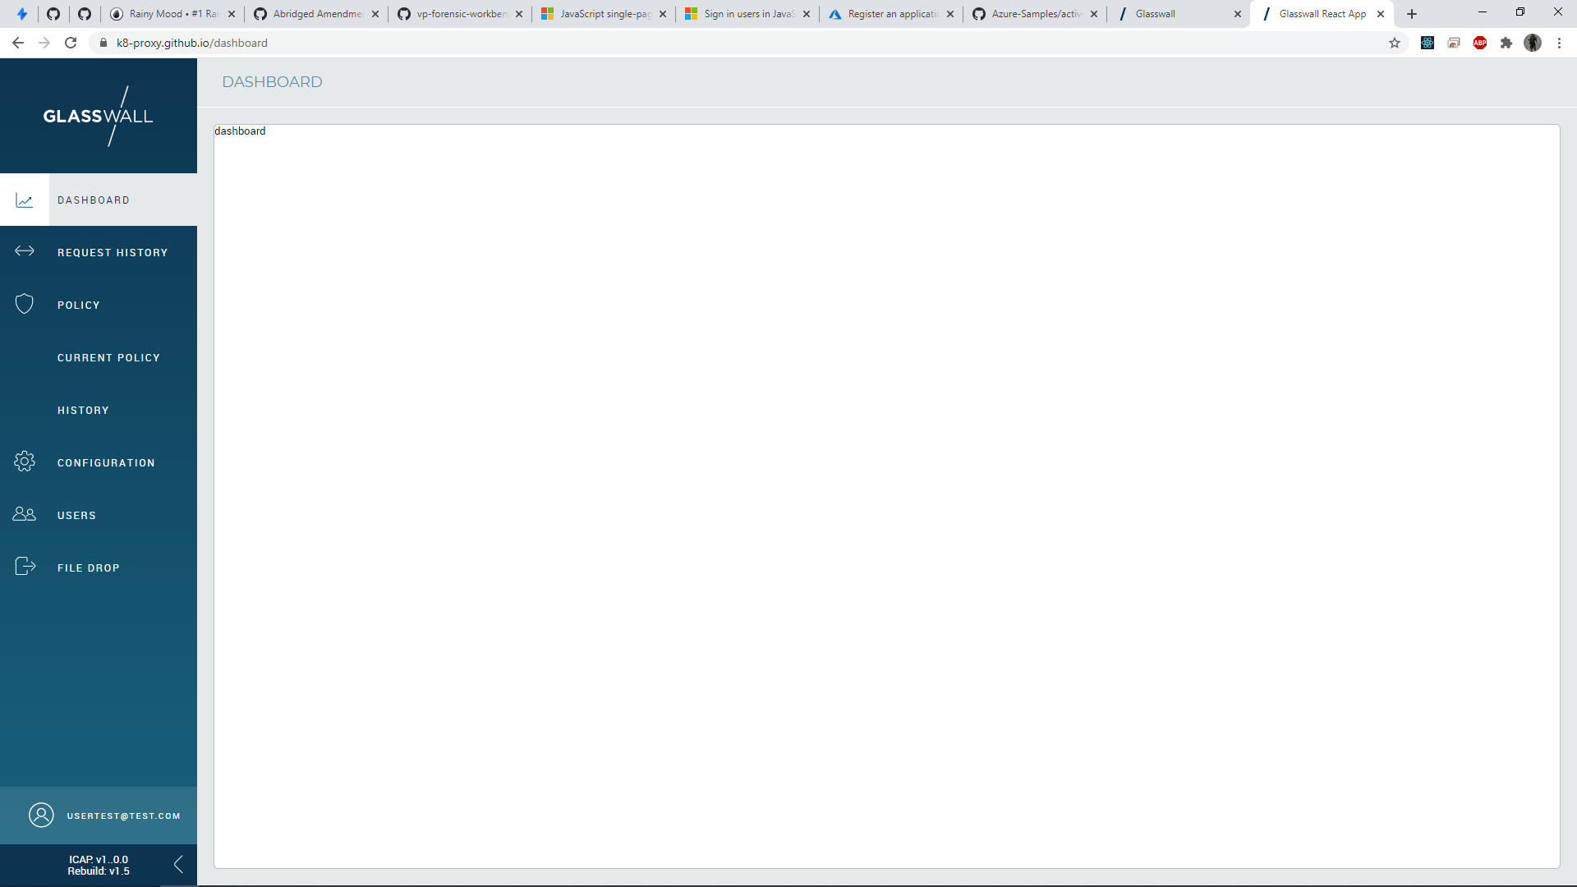




3.2.1 – Performance Display

Slide 3
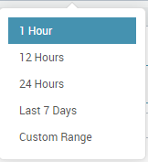
3.2.1 – Performance Display – Date Picker Presets

Slide 4
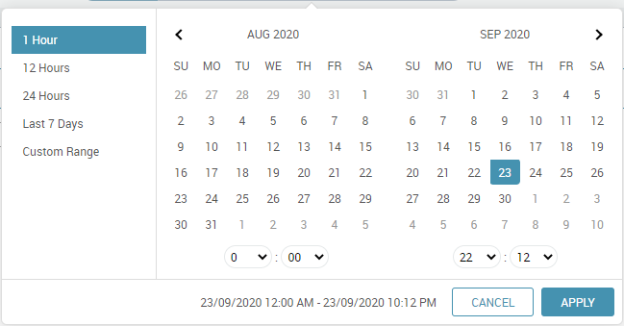
3.2.1 – Performance Display – Date Picker Custom Range

Slide 6
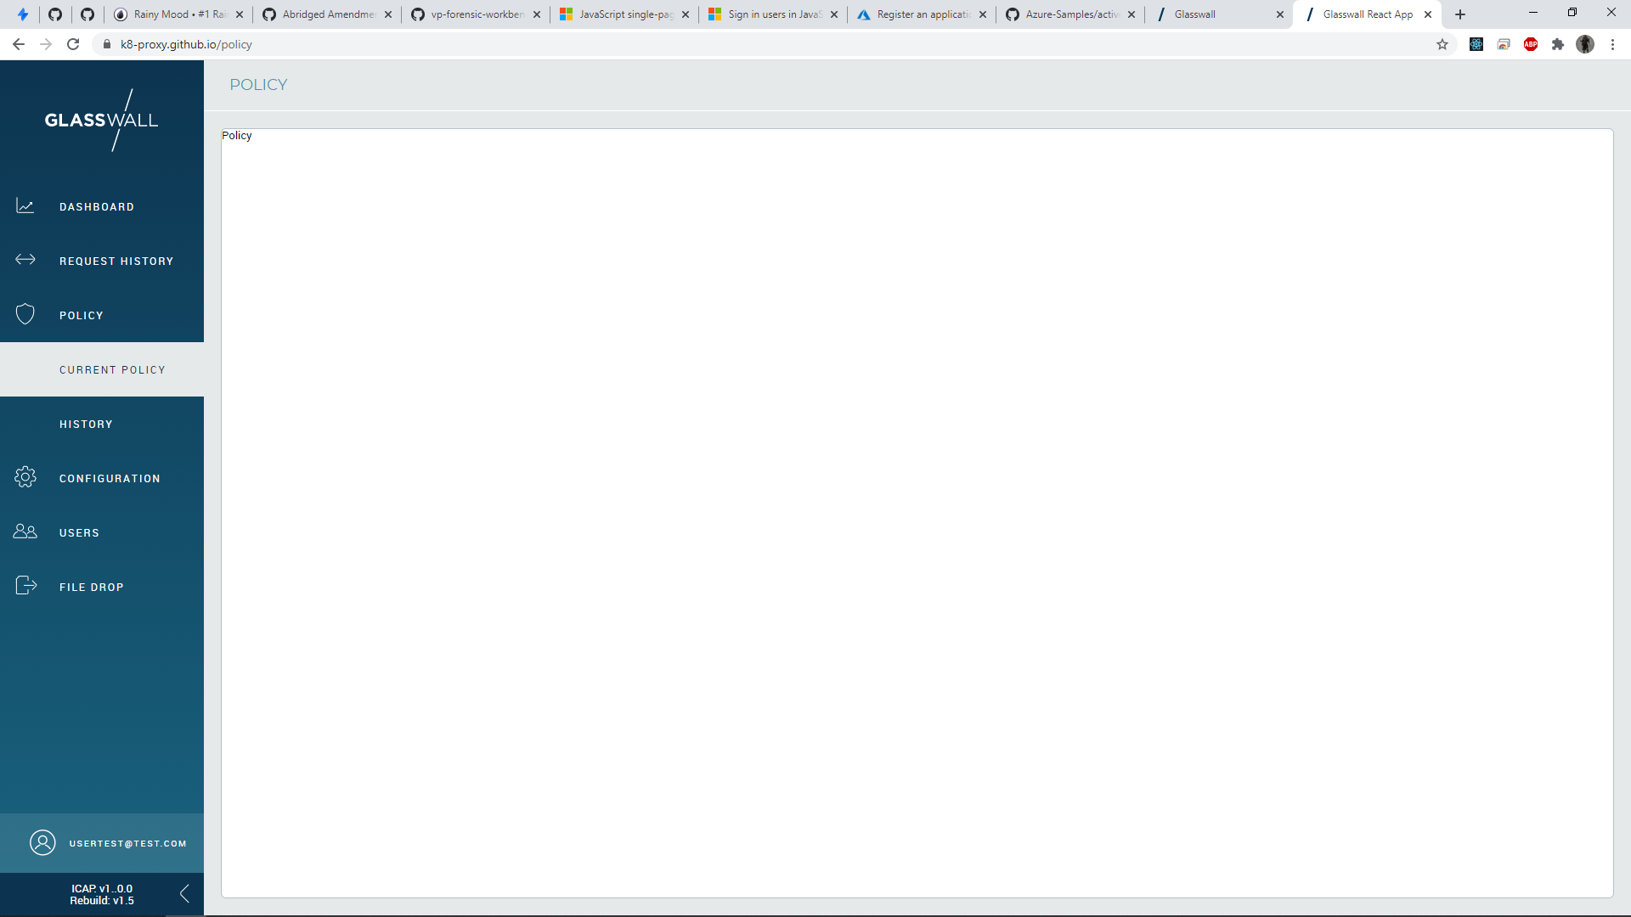
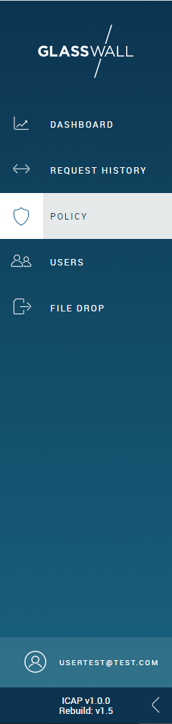
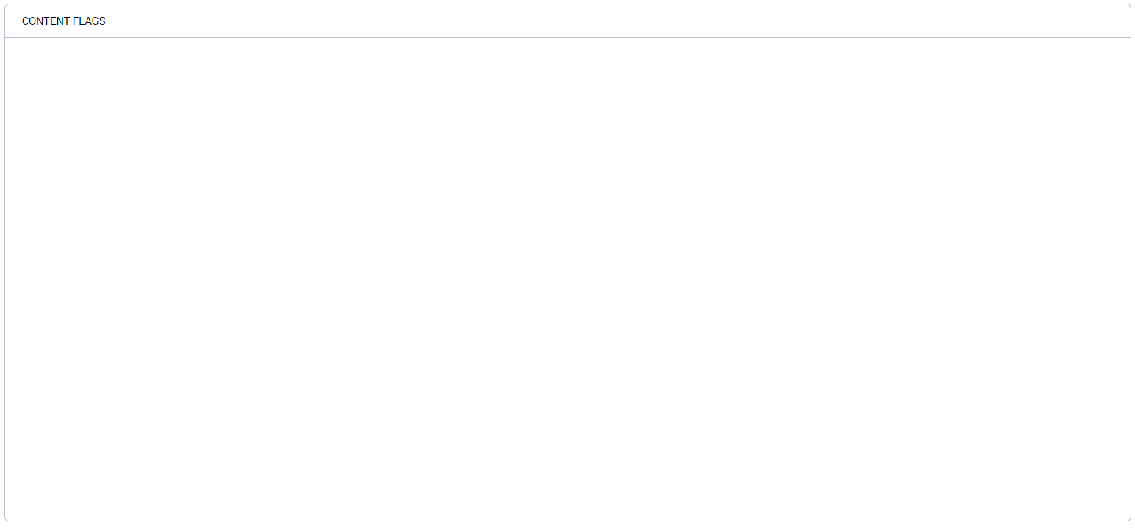
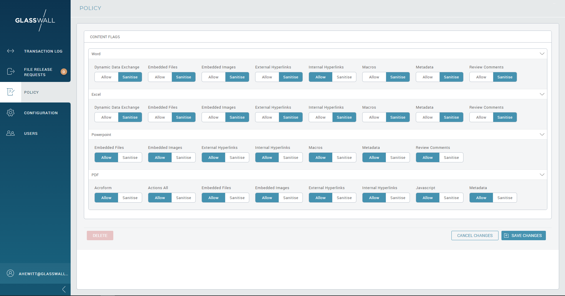
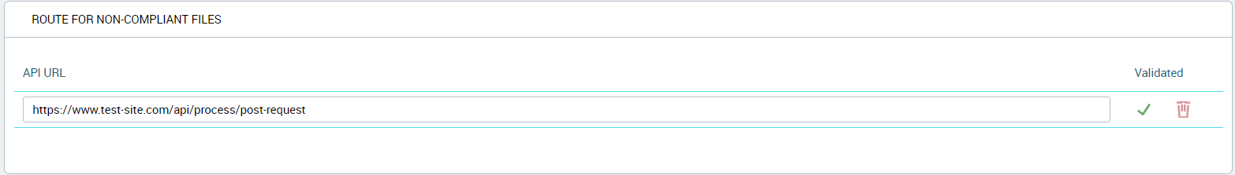
3.2.2 – Policy Management

Slide 7

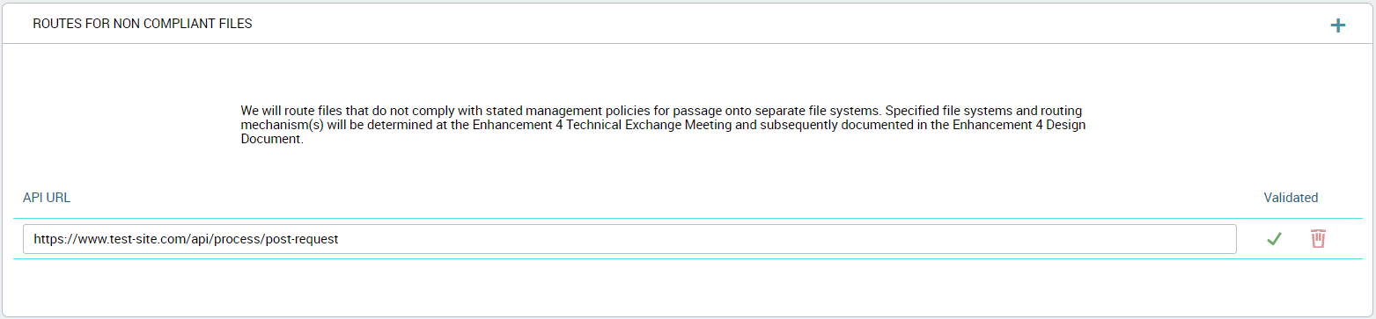
3.2.2 – Policy Management –Policy Edit

Slide 8
3.2.2 – Policy Management – Non Compliant Files

Slide 9
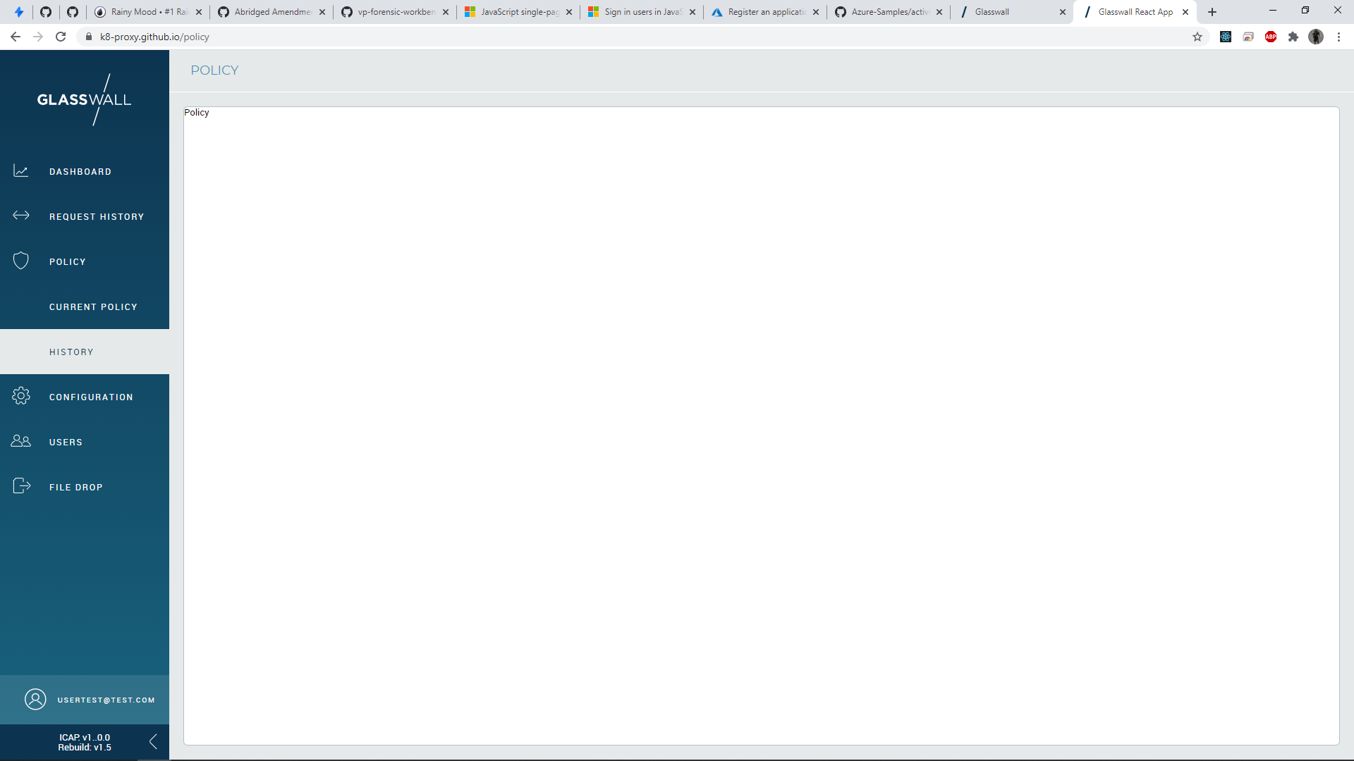
3.2.2 – Policy Management – Policy History

Slide 10
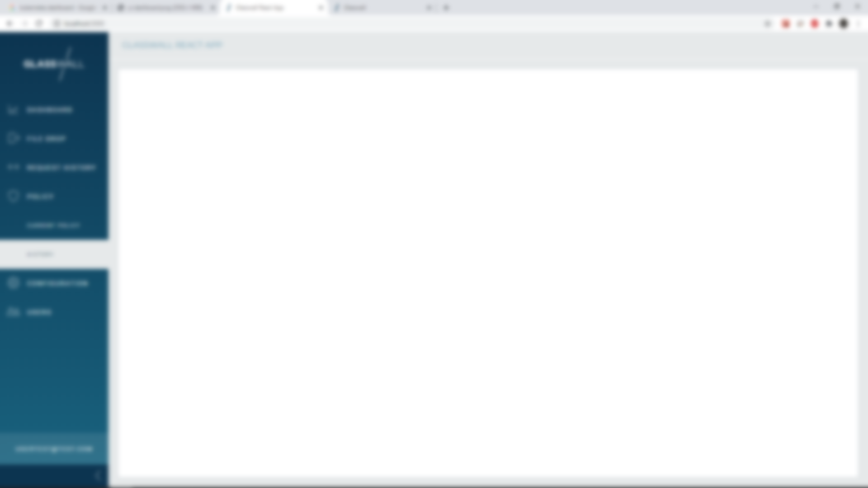
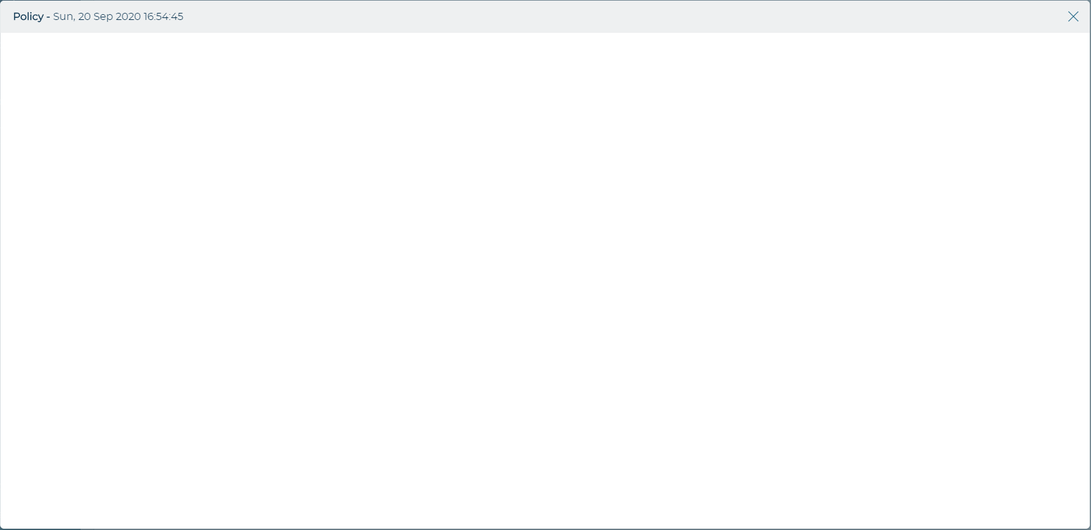
3.2.2 – Policy Management – View a Previous Policy

Slide 11
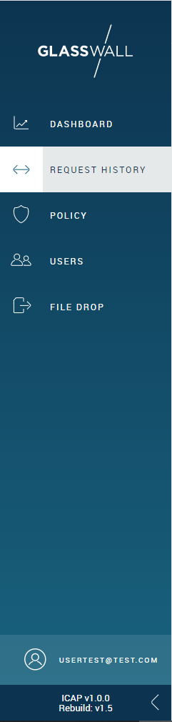
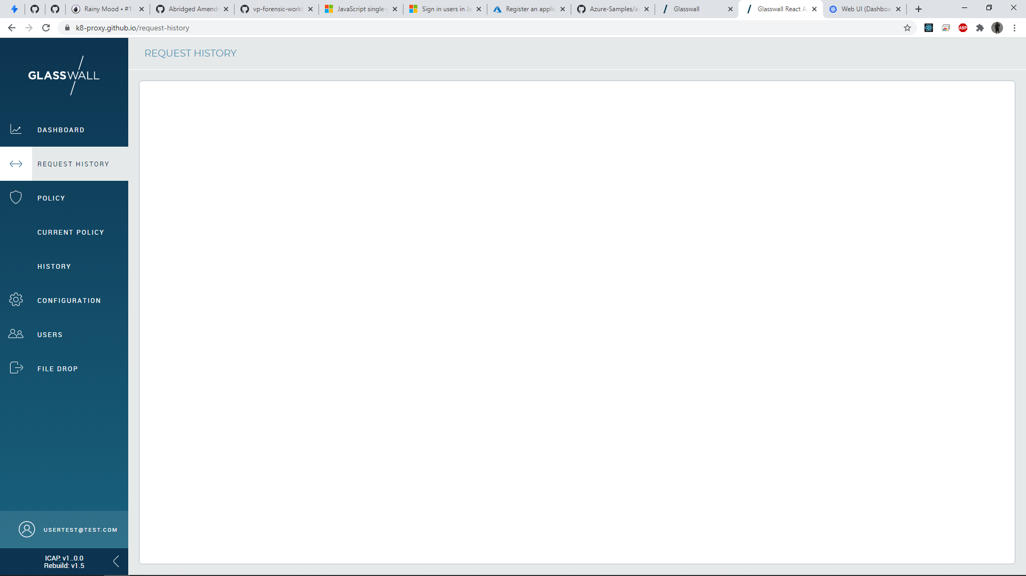
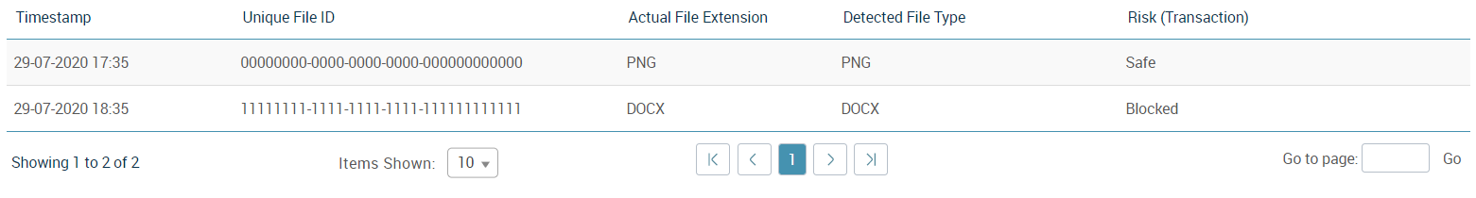
3.2.4 – Risk and File Extension-based Views

Slide 12

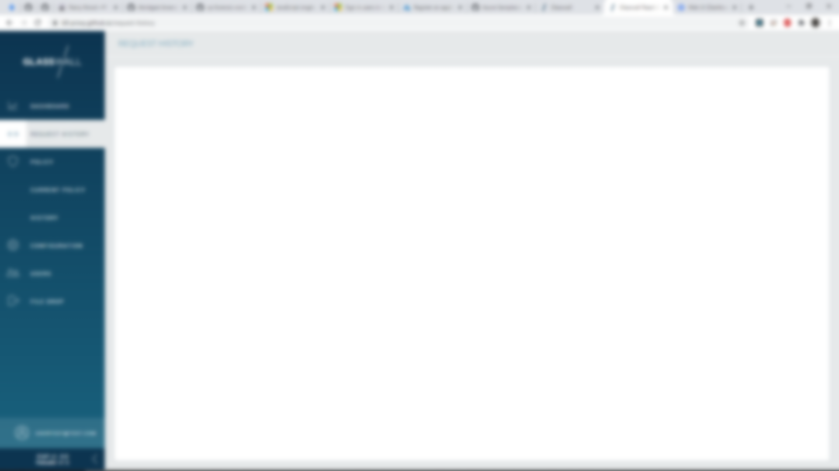
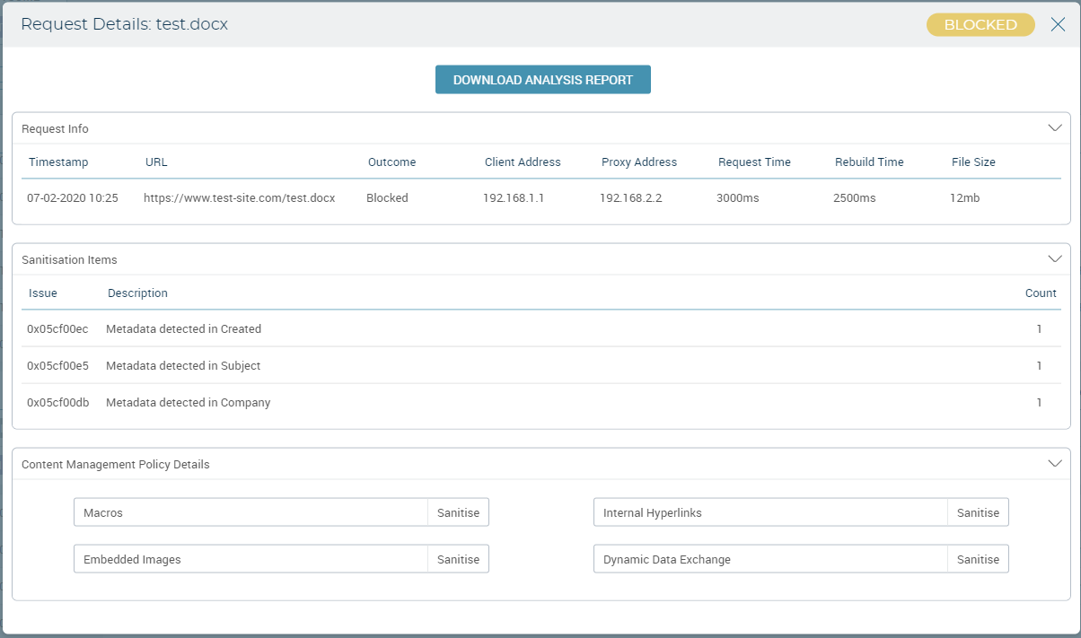
3.2.4 – Risk and File Extension-based Views – Clicking a Row in the Table

Slide 13
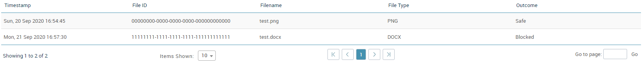
3.2.4 – Risk and File Extension-based Views

Slide 14
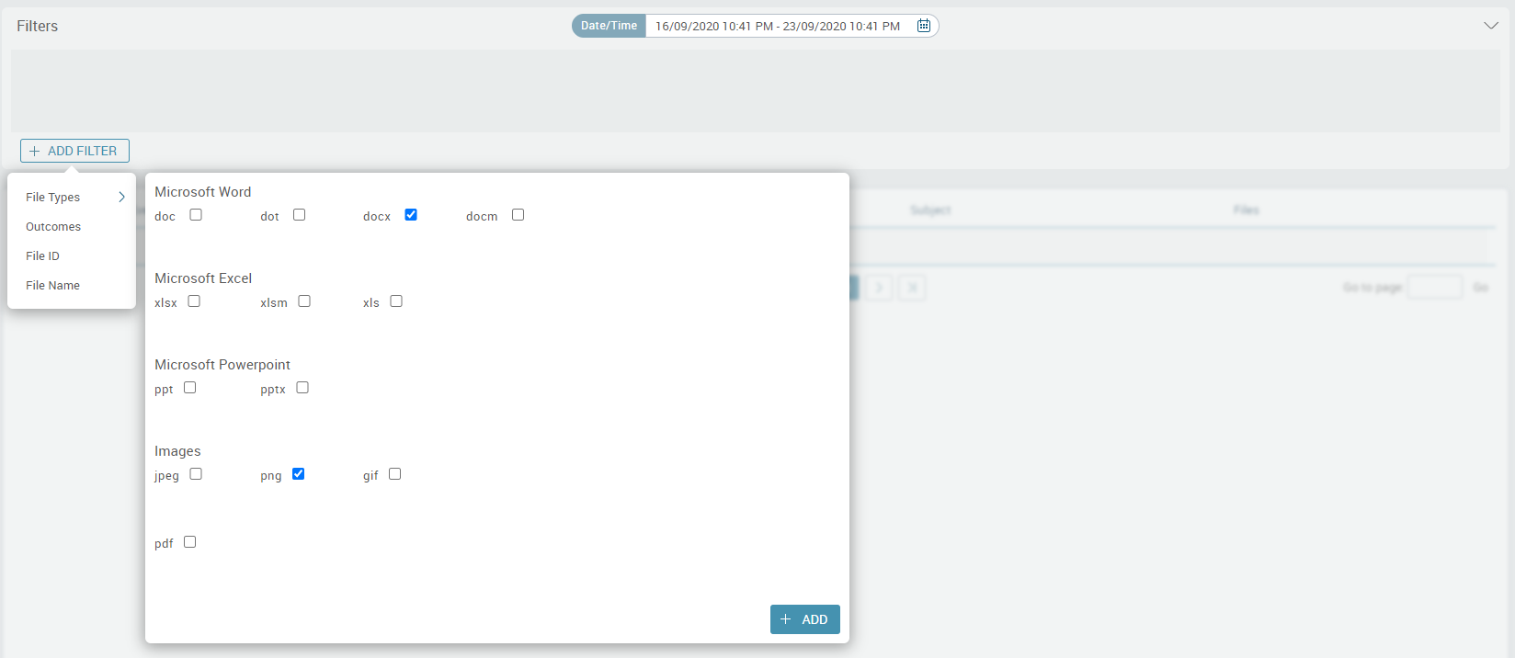
3.2.4 – Risk and File Extension-based Views – Selecting a File Type Filter

Slide 15
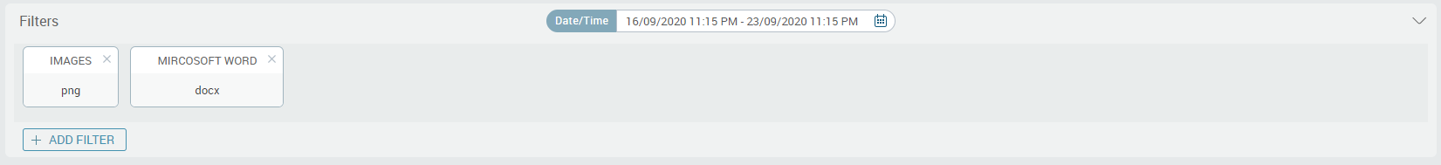
3.2.4 – Risk and File Extension-based Views – Adding a File Type Filter

Slide 16
3.2.4 – Risk and File Extension-based Views

Slide 17
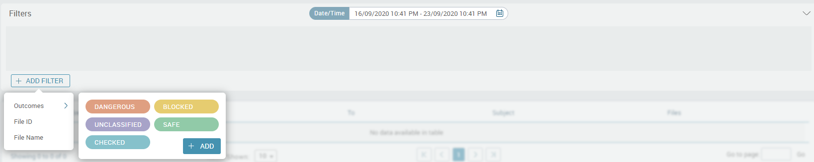
3.2.4 – Risk and File Extension-based Views – Selecting an Outcome Filter

Slide 18
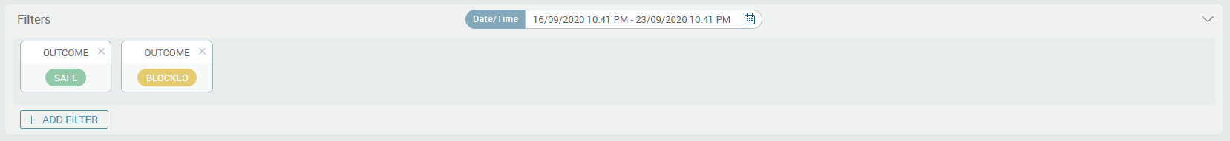
3.2.4 – Risk and File Extension-based Views – Adding an Outcome Filter

Slide 19
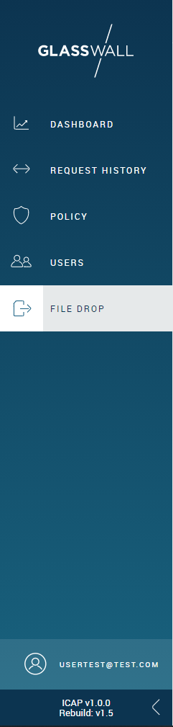
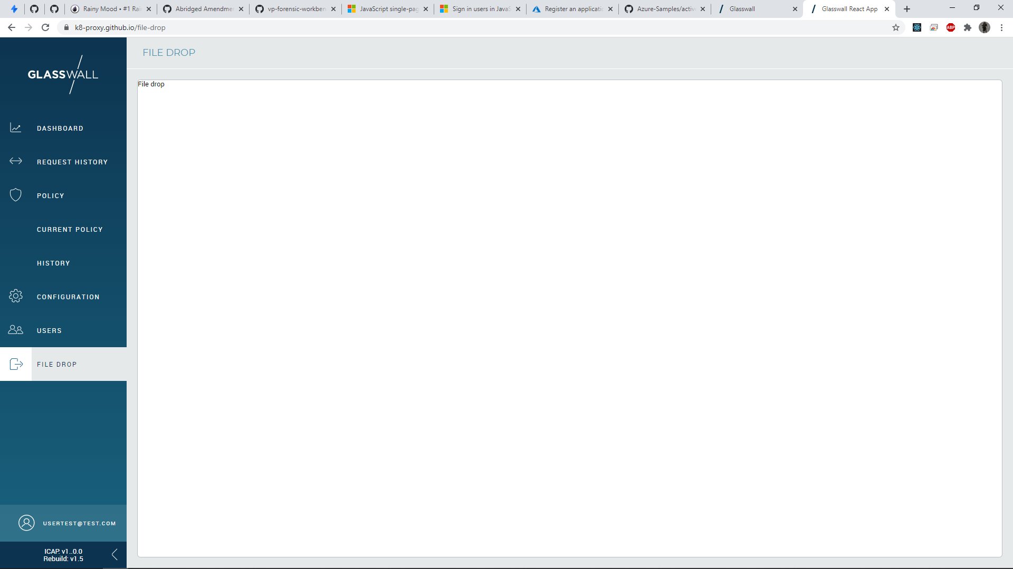
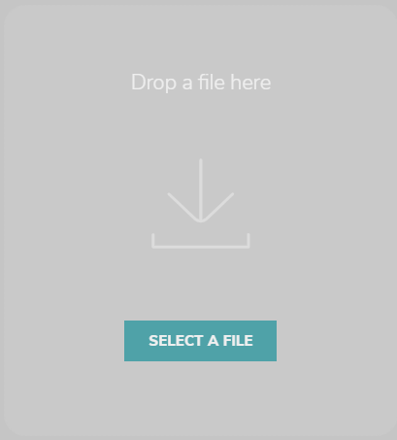
3.2.5– File Drop Service

Slide 20
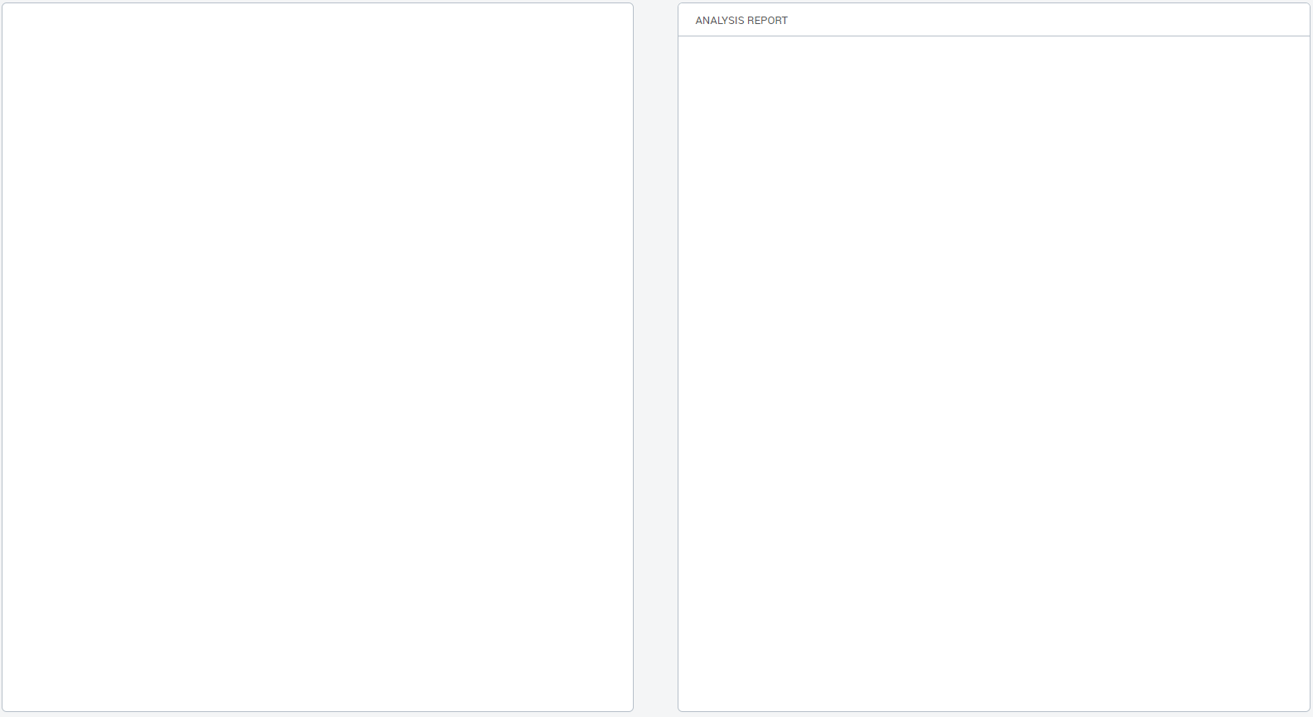
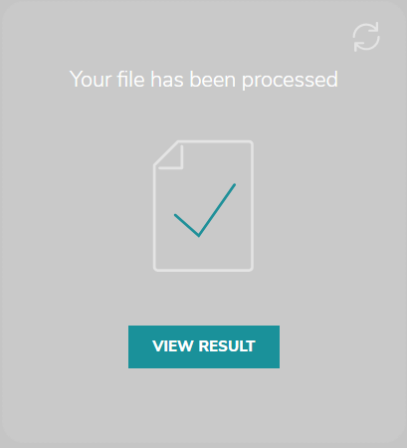
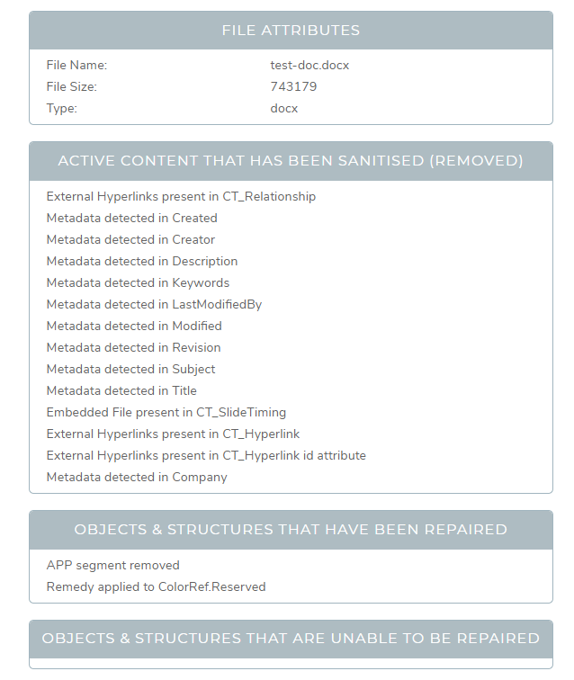
3.2.5– File Drop Service
PDF
XML

Slide 21
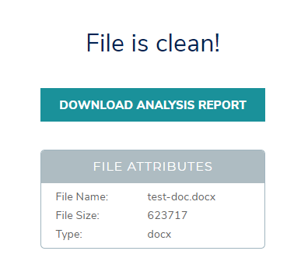
3.2.5– File Drop Service

Slide 22
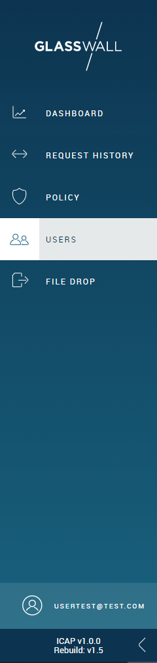
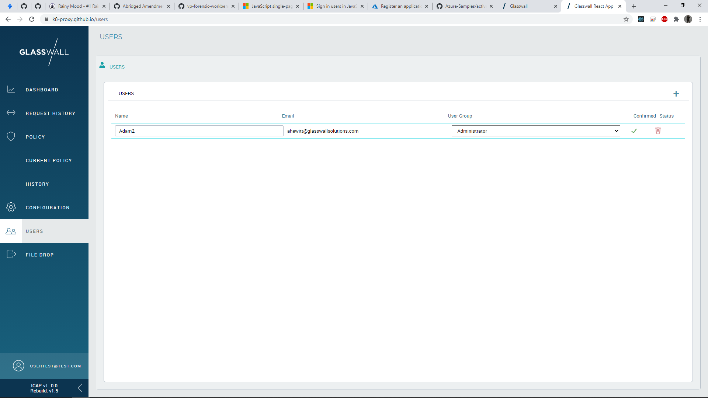
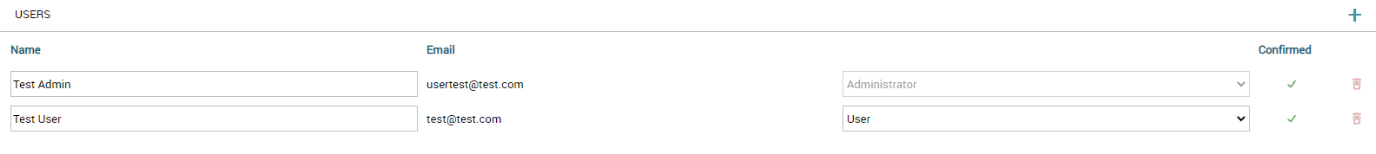
User Management
ICAP - v1.0.0
Rebuild - v1.5

Slide 23
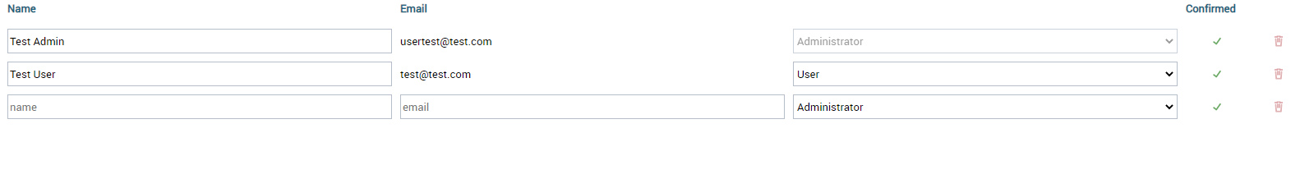
User Management -> New User

