Slide 1
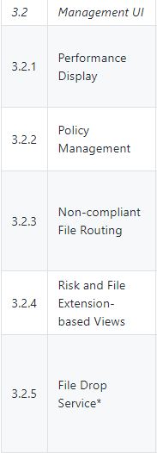
Wireframe – ICAP Management UI
https://github.com/filetrust/program-icap/wiki/Abridged-Amendment-3

Slide 2
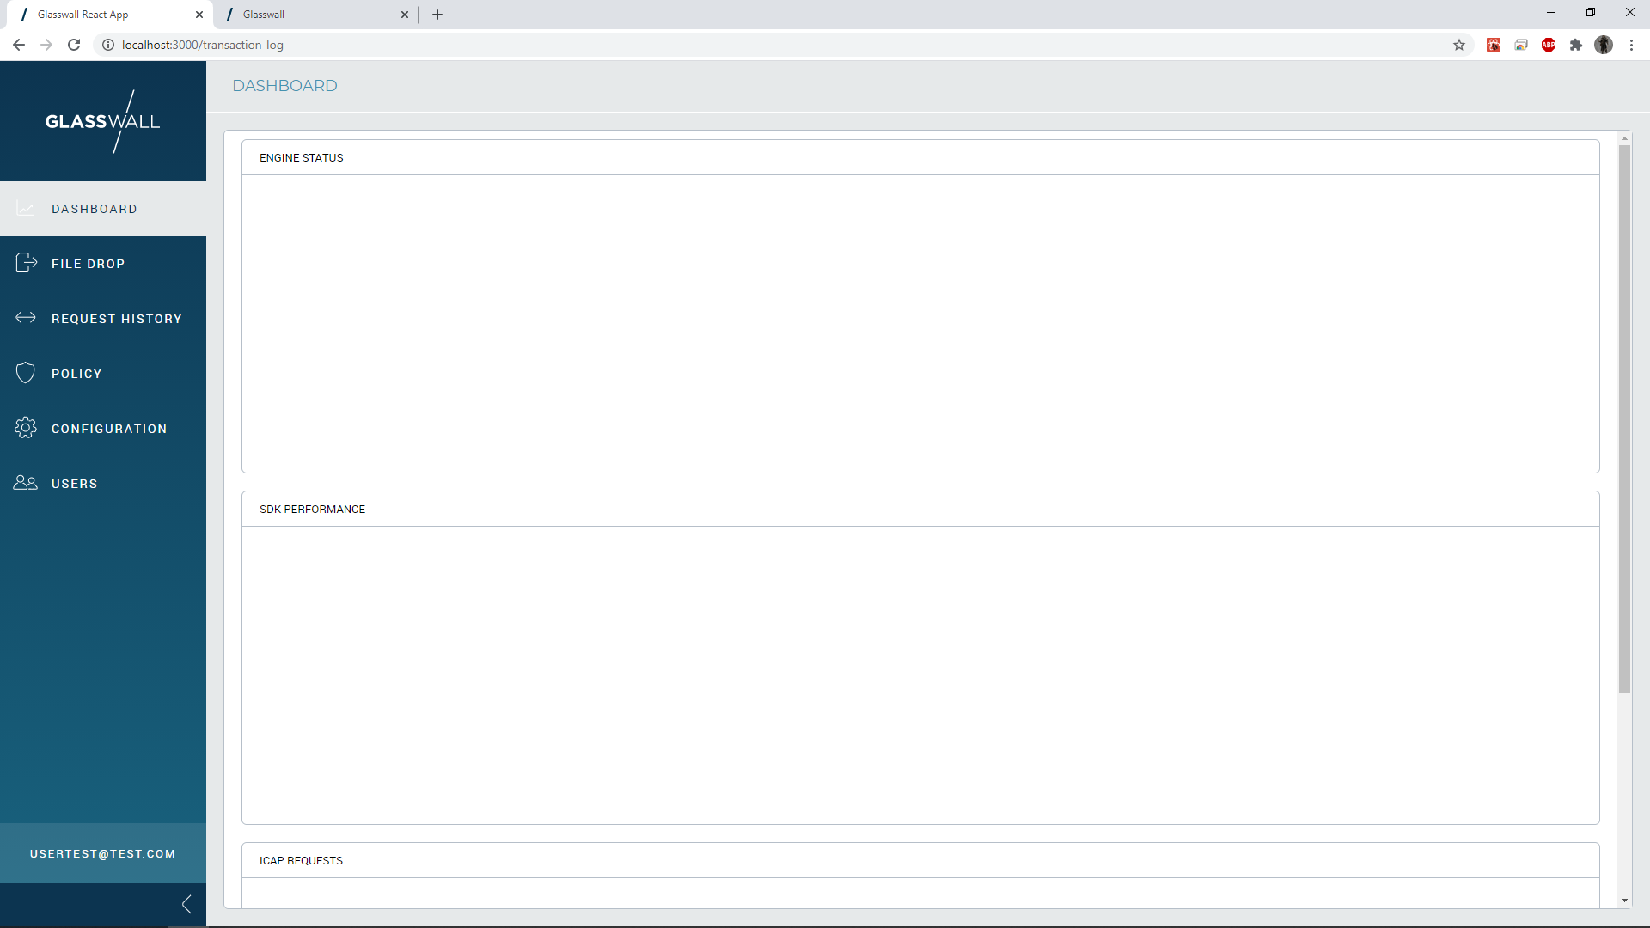
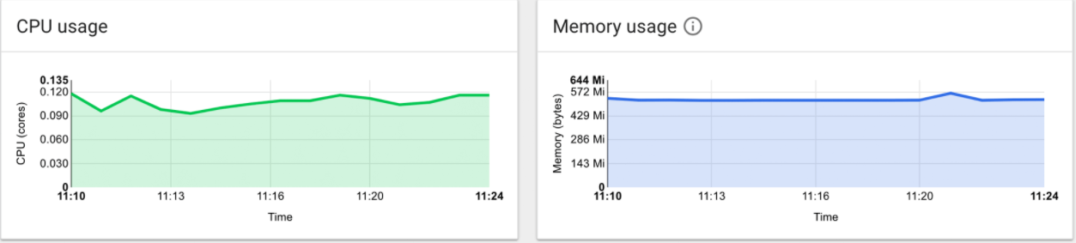
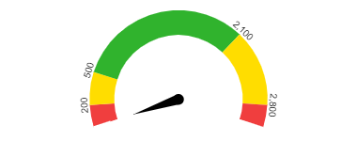
3.2.1 – Performance Display
Files Processed MB/s
Files Processed Per Second

Slide 3
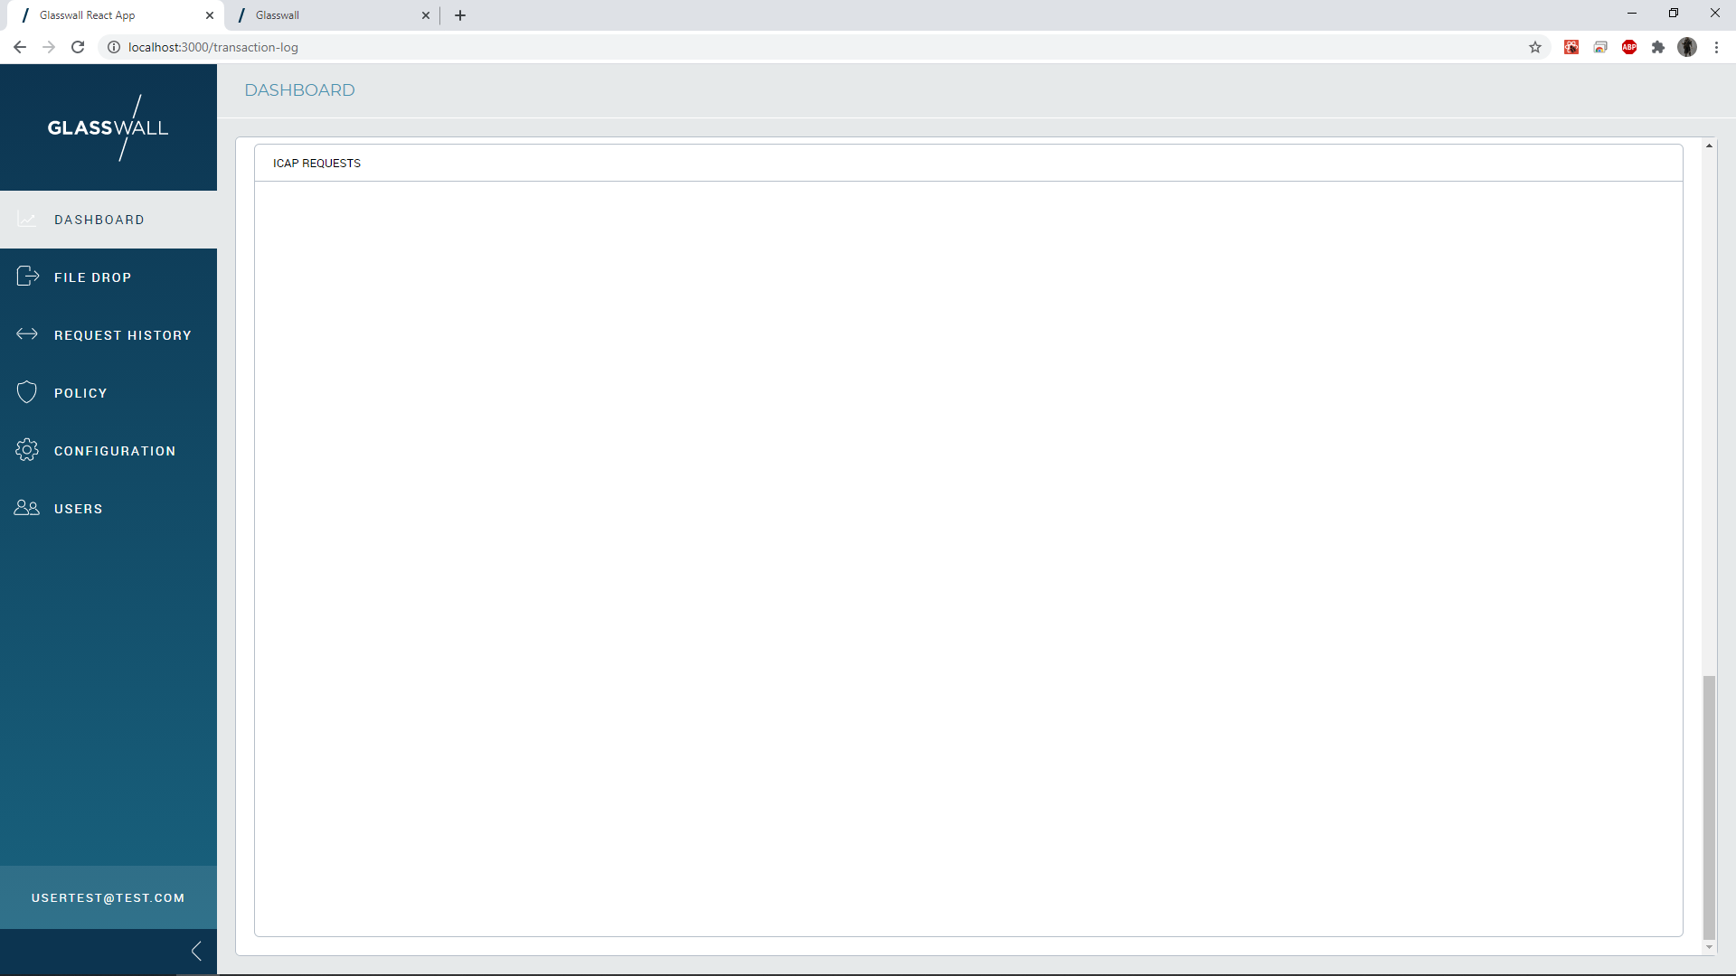


3.2.1 – Performance Display
Past 24 Hours

Slide 4
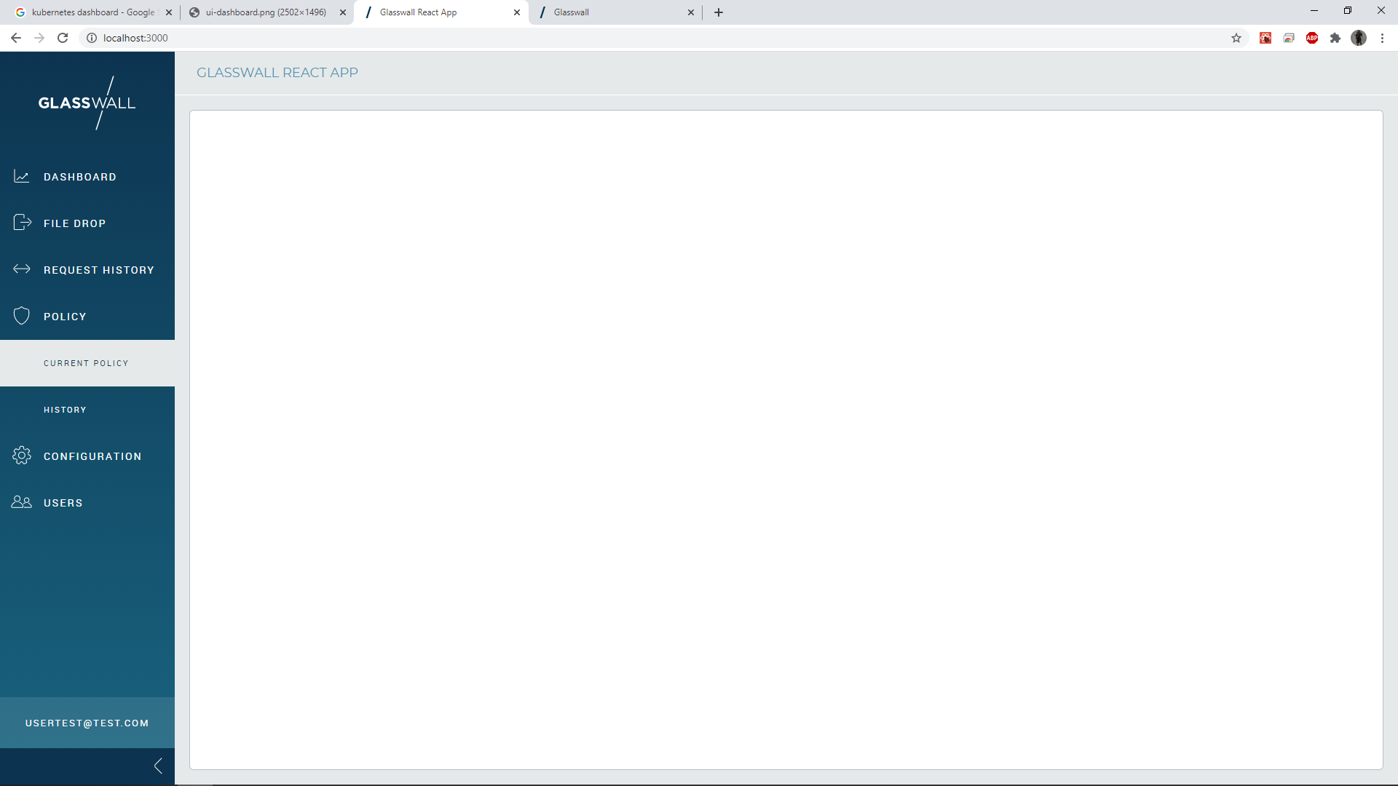
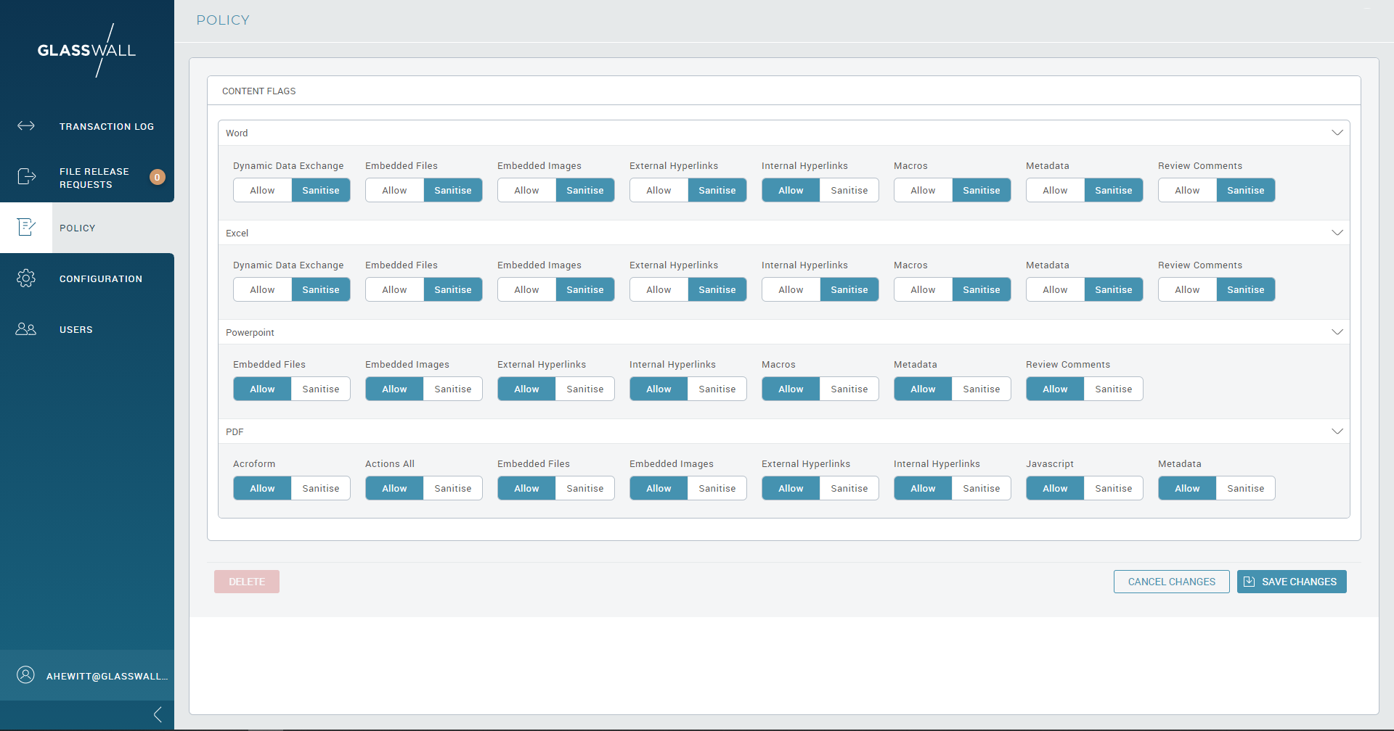
3.2.2 – Policy Management

Slide 5
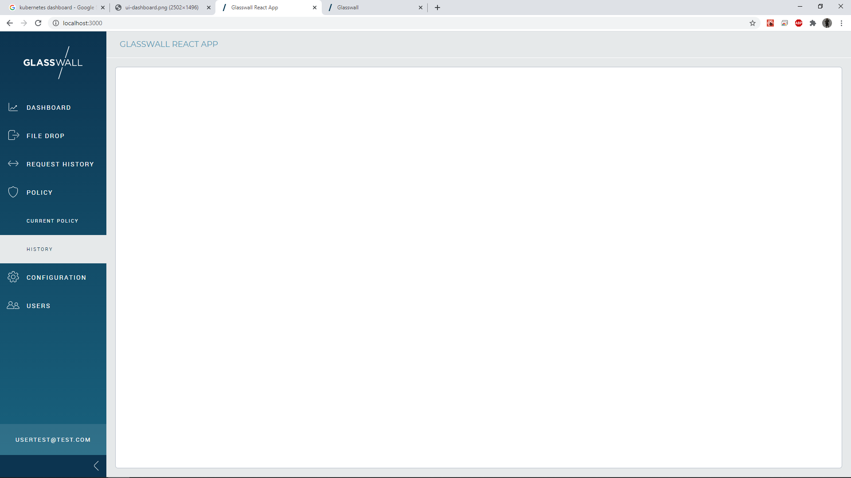
3.2.2 – Policy Management

Slide 6
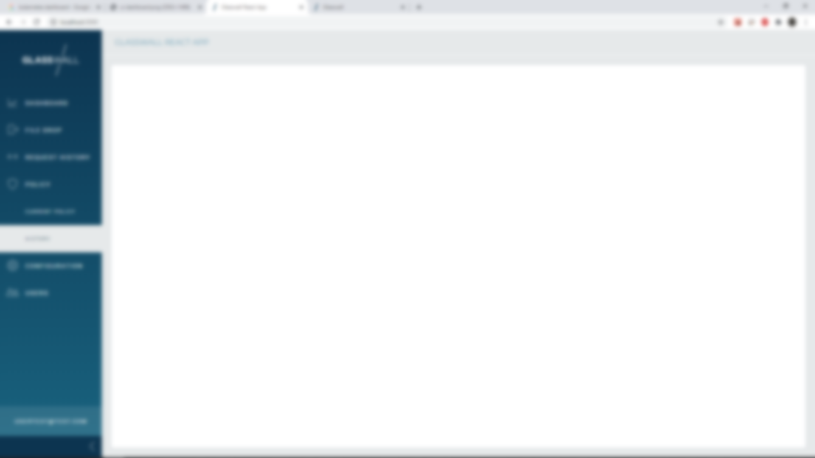

3.2.2 – Policy Management

Slide 7
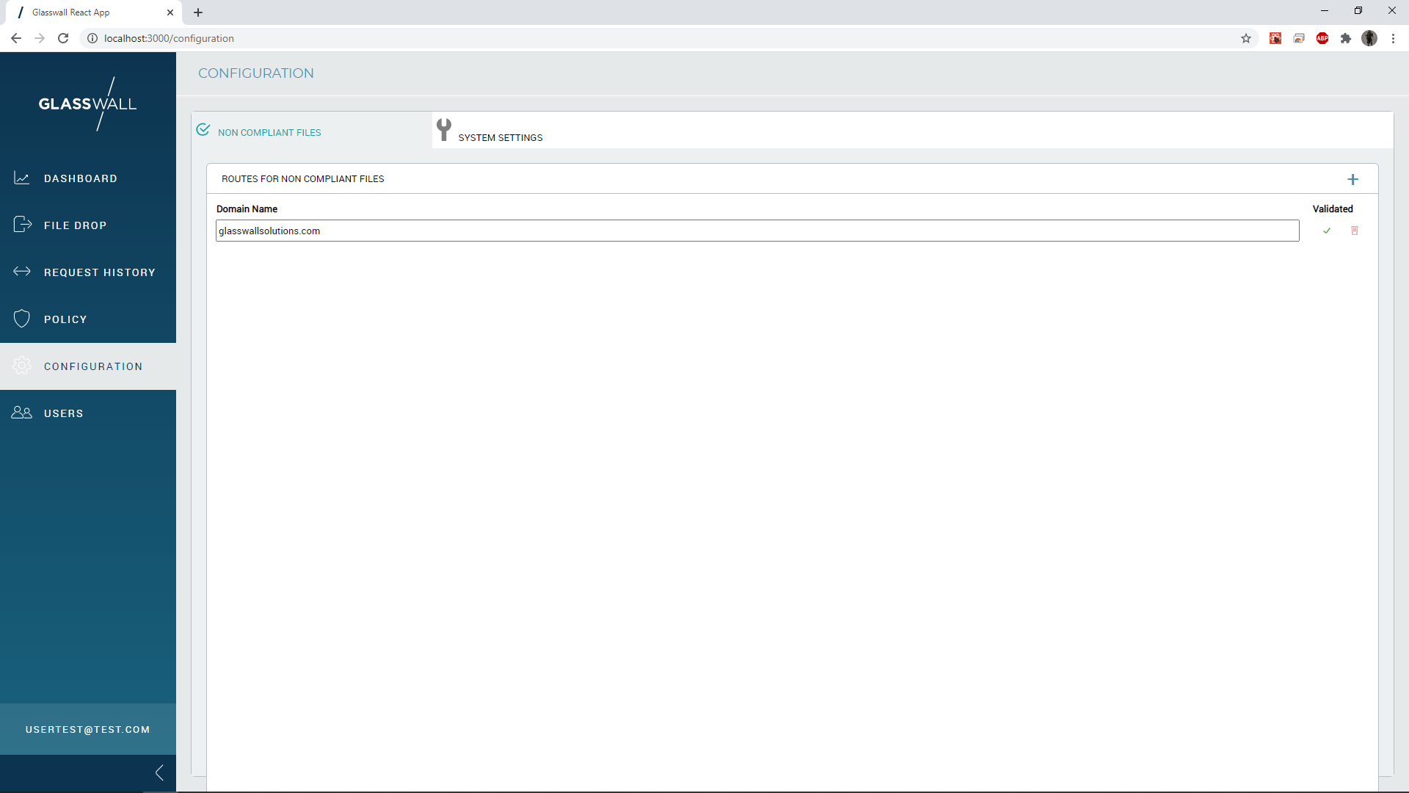
3.2.3 – Non-compliant File Routing

Slide 8
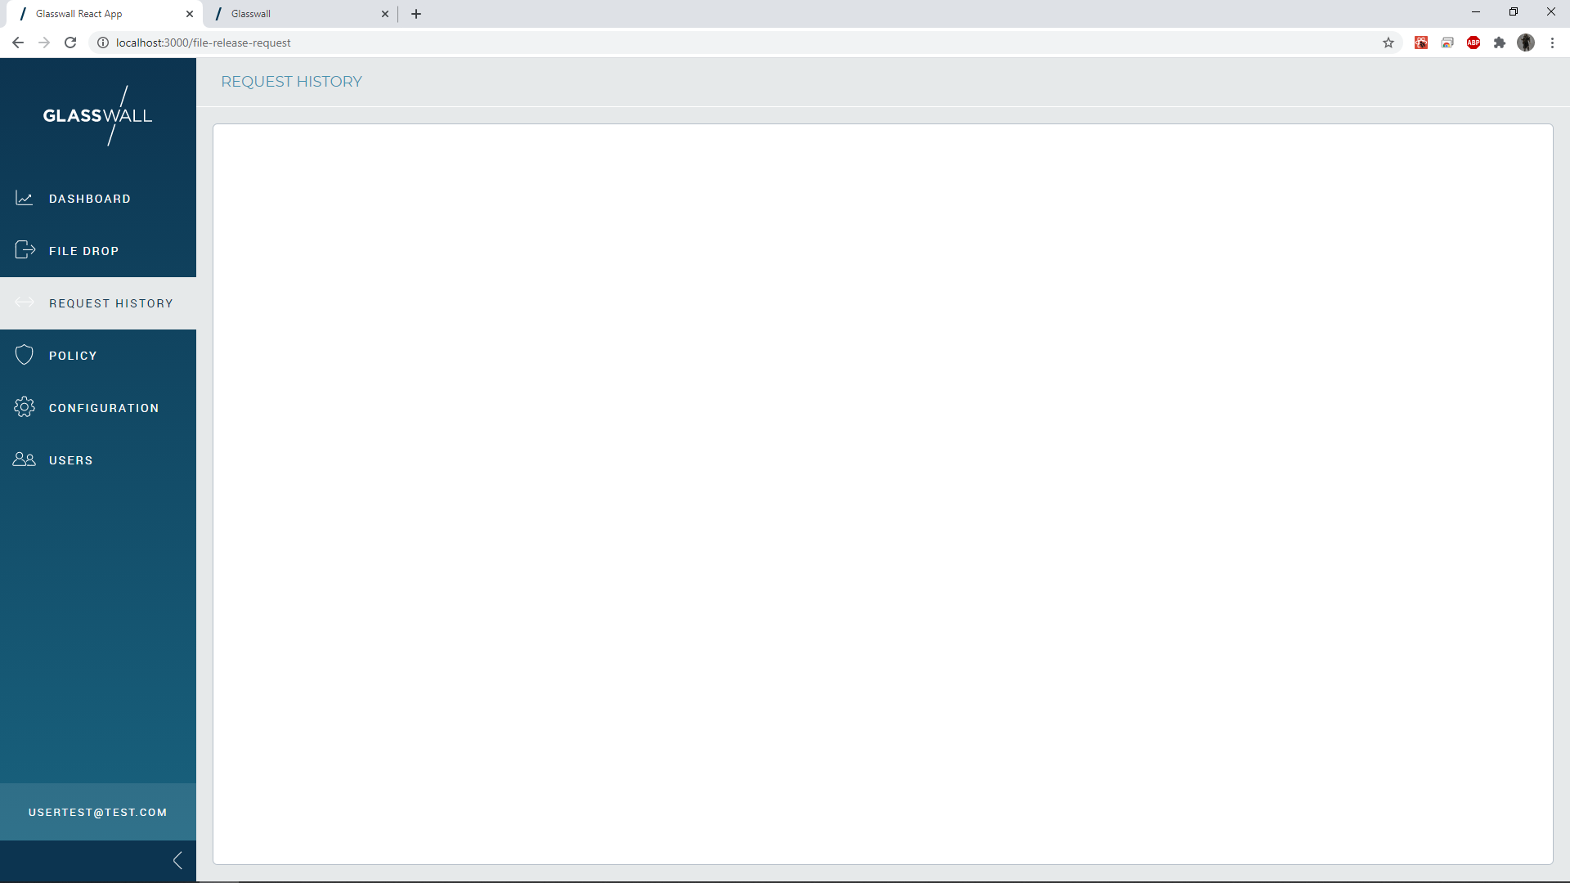
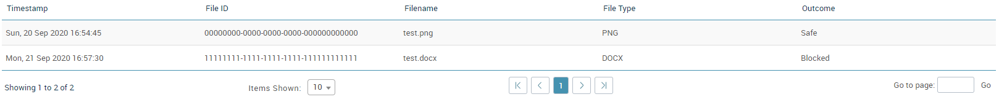
3.2.4 – Risk and File Extension-based Views

Slide 9
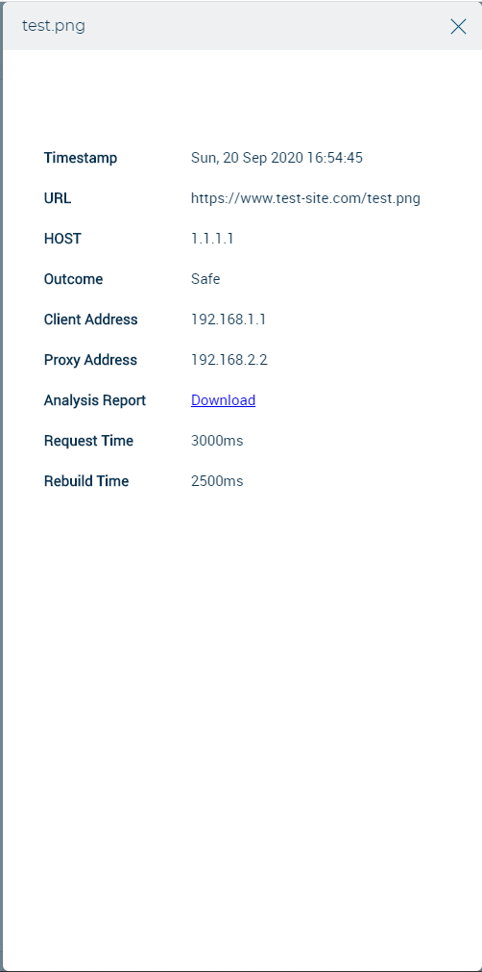
3.2.4 – Risk and File Extension-based Views

Slide 10
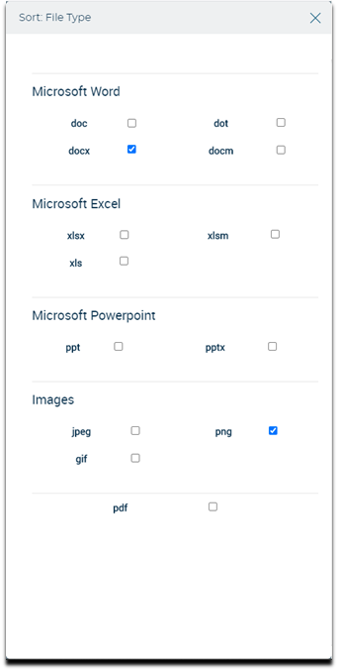
3.2.4 – Risk and File Extension-based Views

Slide 11
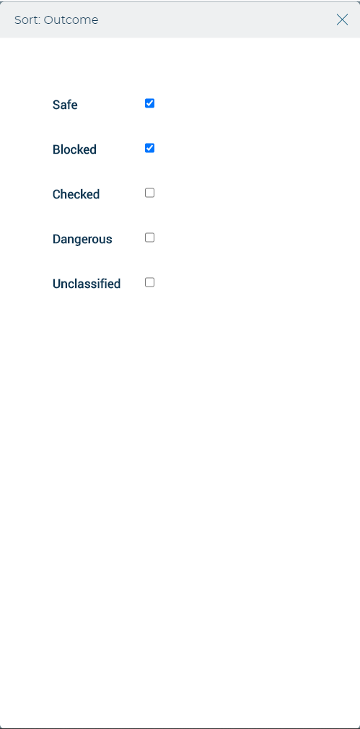
3.2.4 – Risk and File Extension-based Views

Slide 12
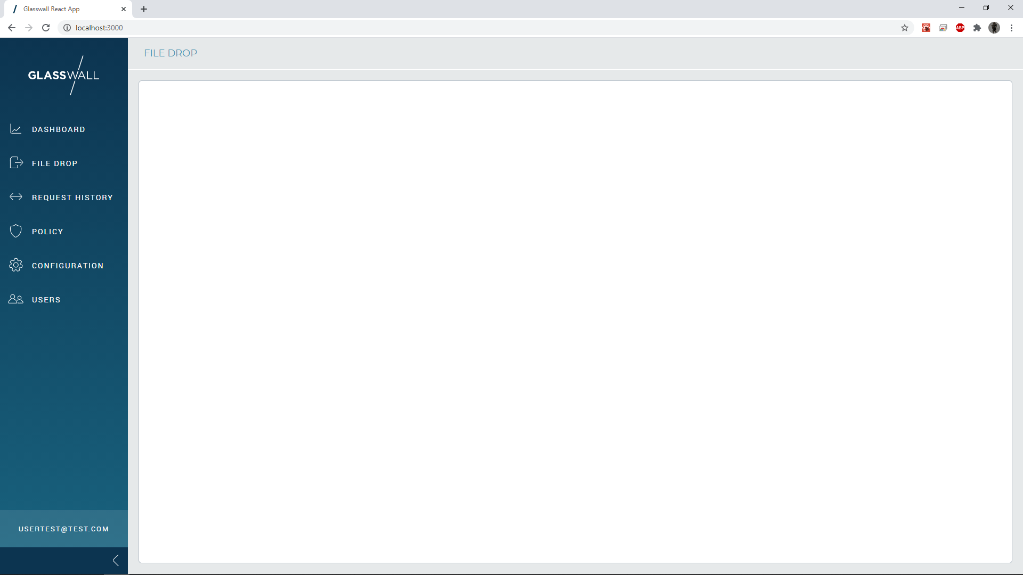
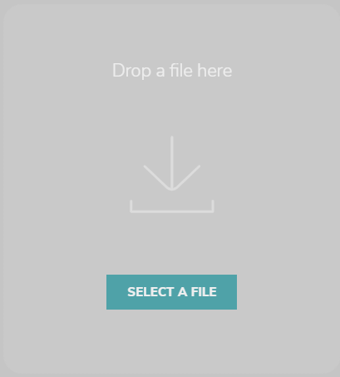
3.2.5– File Drop Service

Slide 13
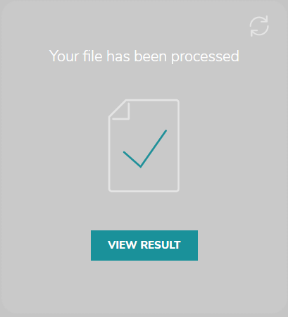
3.2.5– File Drop Service

Slide 14
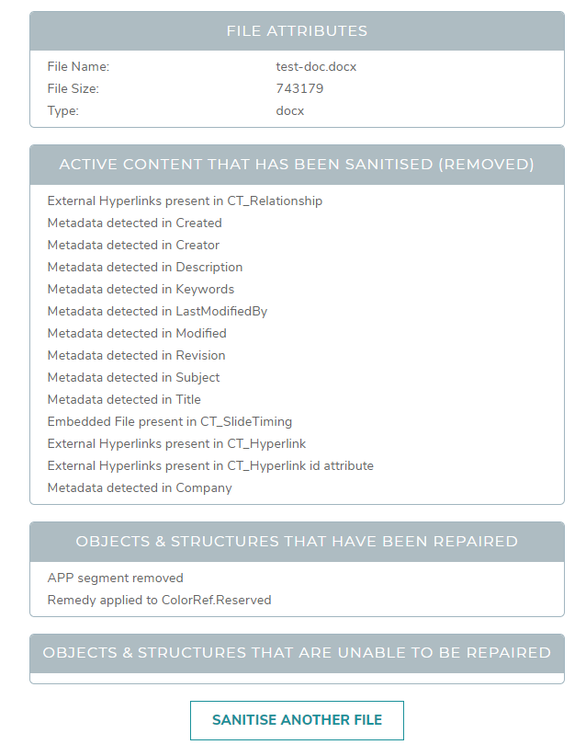
3.2.5– File Drop Service
Analysis Report
PDF
XML

Slide 15
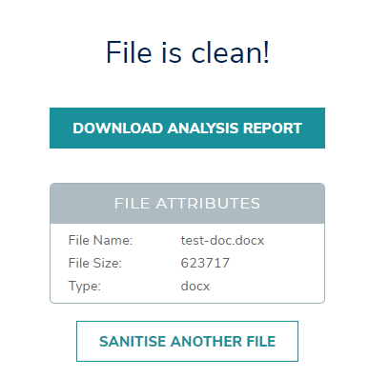
3.2.5 – File Drop Service

Slide 16
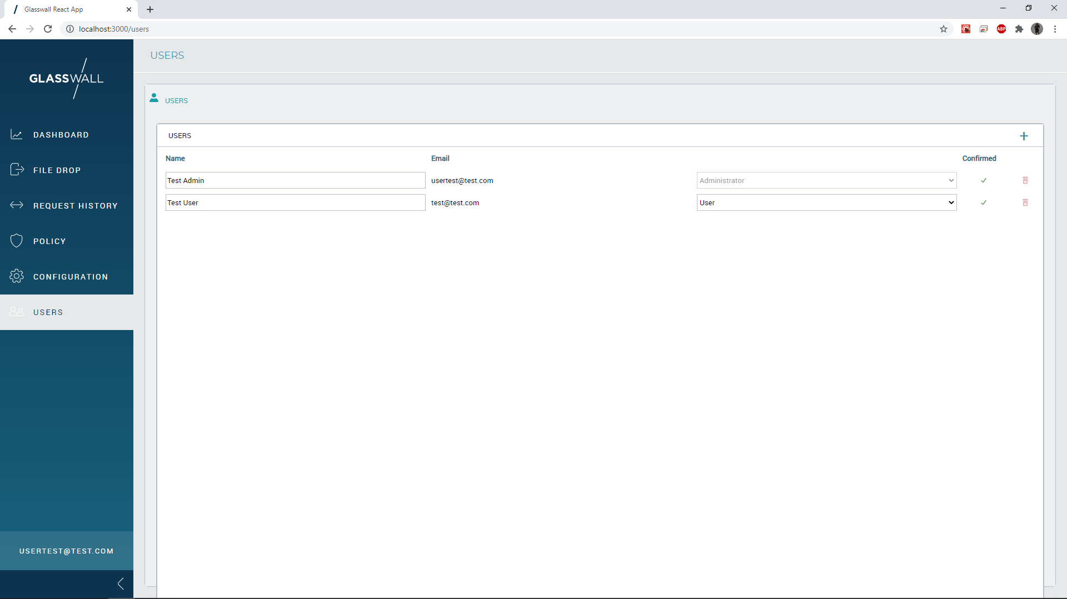
User Management

Slide 17
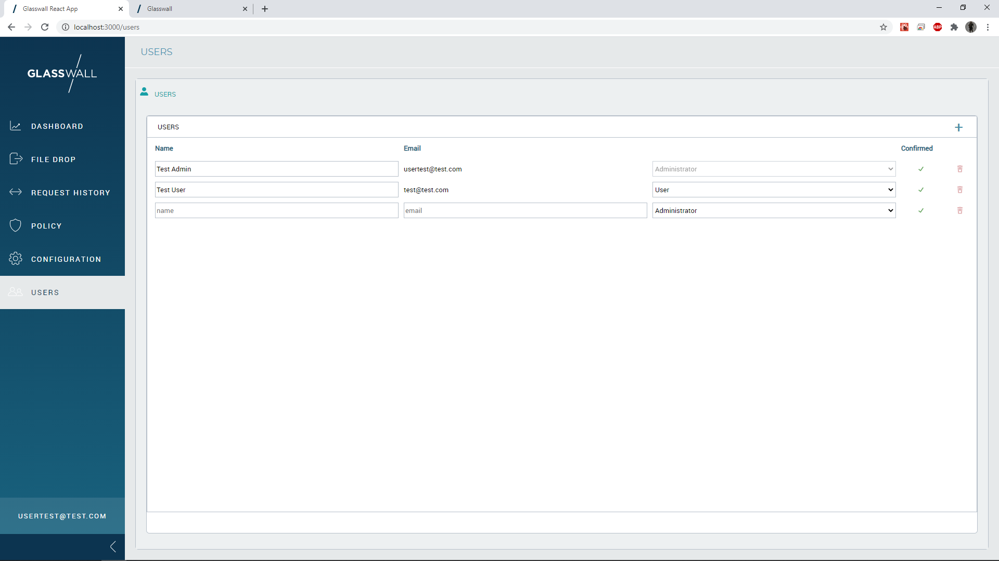
User Management -> New User

