Slide 1
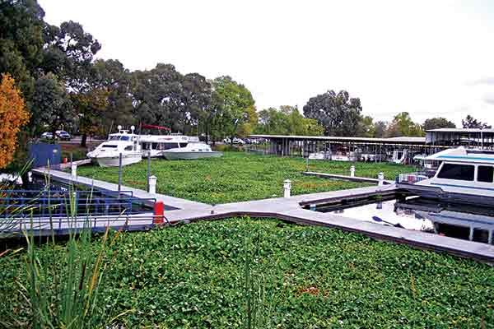
1. Research Question
What value (map data) if any can the use of Hyperspectral UAS technology contribute to the existing invasive weed management program in the Sacramento-San Joaquin River Delta that utilizes hyperspectral manned flights?

Slide 2
2. Scientific Hypotheses
H1: Random Forest (RF) classification maps from the Nano-Hyperspec will be better than that of RF classification maps based on HyMap imagery due to increased spatial resolution, which will allow detection of smaller patches of invasive weeds and reduce pixel mixing.
H2: RF Classification maps from the Nano-Hyperspec will be worse than those created from the HyMap imagery because it has worse spectral quality and can only detect light in the VIS-NIR as opposed to the VIS-SWIR.

Slide 3

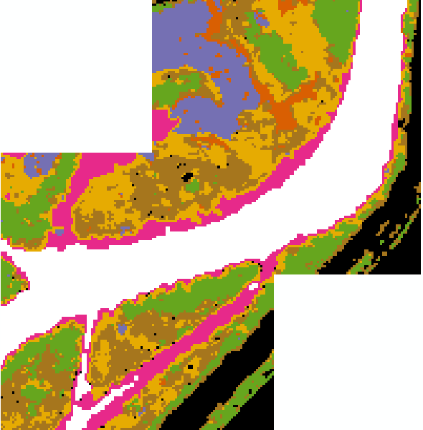
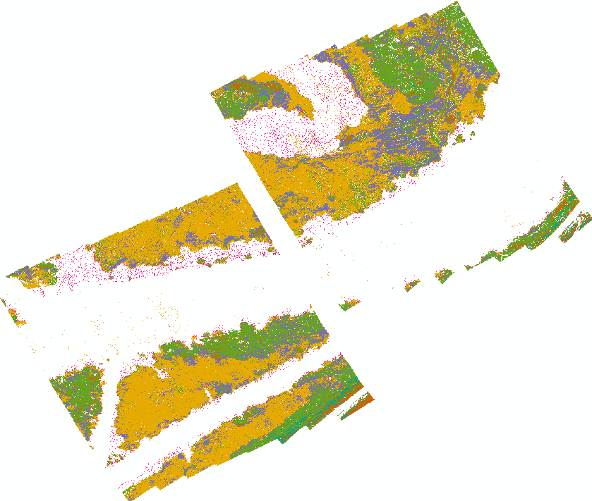
Example Classification Maps
Landsat 8 – 30m pixel
AVIRIS – 2.5m pixel
Nano-Hyperspec – 0.051m pixel
Water
Schoenoplectus acutus (Tule)
Riparian Trees
Submerged Aquatic Vegetation (SAV)
Typha spp. (Cattail)
Riparian Shrubs
Eichornia crassipes (Water Hyacinth)
Ludwigia spp. (Water Primrose)
Road/Bare Ground
Notes:
Set up hyperspectral as a given - Focus on resolution and study area size
Classification from Satellite > Aerial > drone – advantages/disadvantages
Discrimination between native and non-native

Slide 4
3. Anticipated Data
Categorical – Species type, other data records, RF results
Continuous – Spectral data and associated products
Data distribution will be non-normal
Challenges will include
No direct quantification of prediction error
Actual accuracy dependent on quality of training data

Slide 5
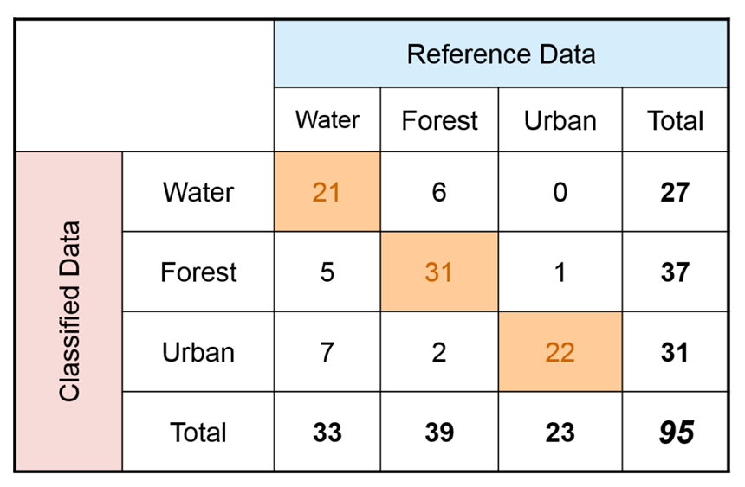
4. Anticipated Analysis:
Contingency Table / Confusion Matrix
Producer’s Accuracy – how often are real features on the ground correctly shown on the classified map or the probability that a certain land cover of an area on the ground is classified as such
User’s Accuracy – how often the class on the map will actually be present on the ground
Water: Correctly classified reference sites = 21 Total # of reference sites = 33 Producer’s Accuracy = 21/33 = 64%
Water: Correctly classified sites = 21 Total # of classified sites = 27 User's Accuracy = 21/27 = 78%
Notes:
Remember – Challenge – dependency on training data evaluate based upon iterations of training/test data splits.

Slide 6
5. Statistical Hypotheses
Scientific Hypothesis 1: Spatial Quality
Null: Nano Error >= HyMap Error
Alternative: Nano Error < HyMap Error
Scientific Hypothesis 2: Spectral Quality
Null: Nano Error <= HyMap Error
Alternative: Nano Error > HyMap Error

