Slide 1

Bangladesh University of Business And Technology (BUBT) Parbon
-And it’s done

Slide 2
Supervised By | Presented By (Group members Details)
Dipu Akter Shila Teaching Assistant Dept. Of. CSE BUBT | Ahmed Mahir Shoaib ID: 18192103235 Abu Zobayer Bin Siddique ID: 18192103226 All Moon Tasir ID: 18192103256

Slide 3
Parbon
We basically get all the services around through the app. So we thought that if we can bring the catering service in the app, then the hassle of organizing any event for everyone will be reduced and the facilities will be easily available. So we have chosen this project.

Slide 4
Parbon (Catering Service based App)
User Details
Send Confirmation Email when create any account
Food Order Service
Catering Service
User’s Booking Information
Seller’s Order Information
Decorator Service
Rent Community Center from software.

Slide 5
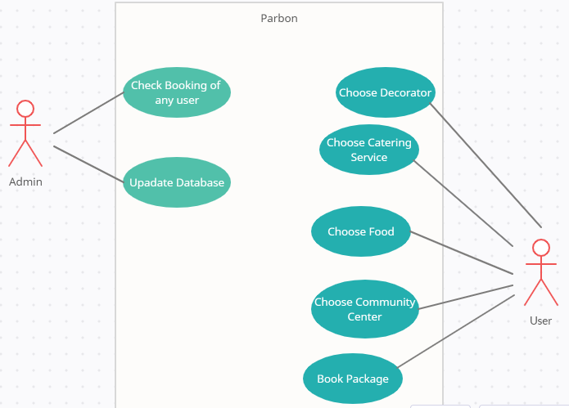
Case Diagram of This Project

Slide 6
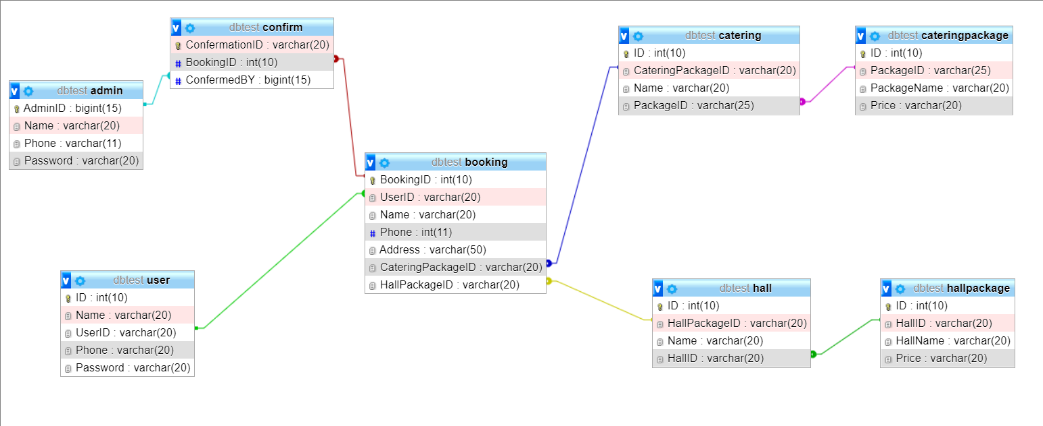
ER Diagram

Slide 7
Services
Home Page
Catering Service
Desh Catering, Pine Catering etc.
Stage Decoration (Wedding, Holud, Birthday, Khatna), Bed Decoration
Food Order
Aabesh Hotel & Biriyani House
Food List: Vat, Mach, Dal, Polao, Porota, Grill etc.
Decorator Service
Community Center

Slide 8
Admin, Security & Database
Admin Login
User Login
User Registration
Account Create and Confirmation mail
User’s Data Saved In Database.
Package Booking
Package & Customer Information Saved In Database

Slide 9


