Slide 1
News Sentiment Prediction
- Anshuman Sahu

Slide 2
Task
Design and develop the solution to predict sentiments for headline and title of news.

Slide 3
Process followed
Choosing appropriate model
Data Acquisition
Data Analysis
Data Preparation
Model Creation
Model Training
Model Testing
Prediction and submission

Slide 4
Dataset
Contains news title, headline and their respective sentiments.
Train data shape (row, column): (55932, 11)
Test data shape (row, column): (37288, 9)
Important columns: “Title”, “Headline”, “SentimentTitle”, “SentimentHeadline”

Slide 5
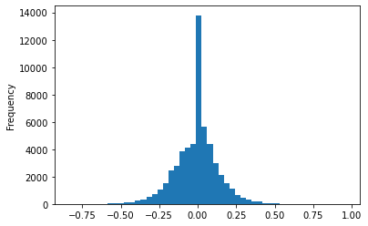
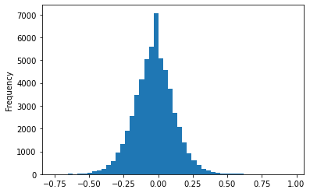
EDA
Histogram of “SentimentTitle”
Histogram of “SentimentHeadline”

Slide 6
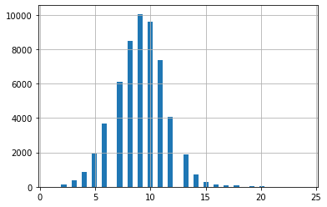
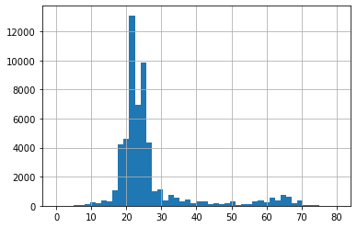
EDA
Histogram of length of sentence for “Title”
Histogram of length of sentence for “Headline”
Max token length for “Title”: 24
Min token length for “Title”: 1
Max token length for “Headline”: 80
Min token length for “Headline”: 0

Slide 7
Approach description
Solved the problem with neural networks.
Solved the problem as a regression problem with considering output inside the boundary of -1 to 1.

Slide 8
Data Preparation / Pre-processing
Combined all data to create a single sentiment model.
Removed data containing NULL values.
Removed hyperlinks/ websites using regex.
Removed numbers and punctuations.
Used spacy to lemmatize the words.
Removed Pronouns.
Created one-hot encodings for the corpus.
After cleaning, found that maximum sentence length is 87, so taken 90 as maximum length.
Added padding to all the data which are less than 90 words.
Created training and validation sets.

Slide 9
Models used
LSTM: Long Short Term Memory networks are a special kind of RNN, capable of learning long-term dependencies.
BiLSTM: It contains LSTM only but with bidirectional flow, which helps to store information from both the directions.

Slide 10
Model metrics summary
sn | model_name | model_type | layer_size | dropout | batch_size | rmse | r2
1 | model_1 | lstm | 128 | 0.25 | 1024 | 0.092888046 | 0.561096524
2 | model_2 | lstm | 64 | 0.25 | 512 | 0.098441945 | 0.507042205
3 | model_3 | lstm | 128 | 0.5 | 1024 | 0.093005362 | 0.559987171
4 | model_4 | lstm | 64 | 0.5 | 512 | 0.097804032 | 0.513410327
5 | model_5 | bilstm | 128 | 0.25 | 1024 | 0.100669541 | 0.484479972
6 | model_6 | bilstm | 64 | 0.25 | 512 | 0.090233157 | 0.585827111
7 | model_7 | bilstm | 128 | 0.5 | 1024 | 0.092983215 | 0.560196703
8 | model_8 | bilstm | 64 | 0.5 | 512 | 0.099157471 | 0.499850025

Slide 11
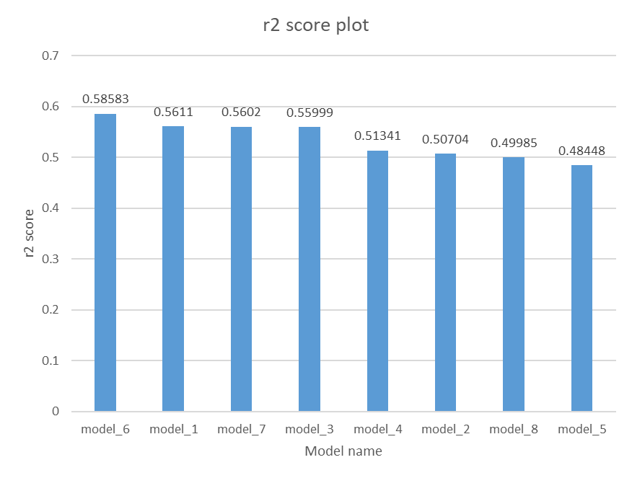
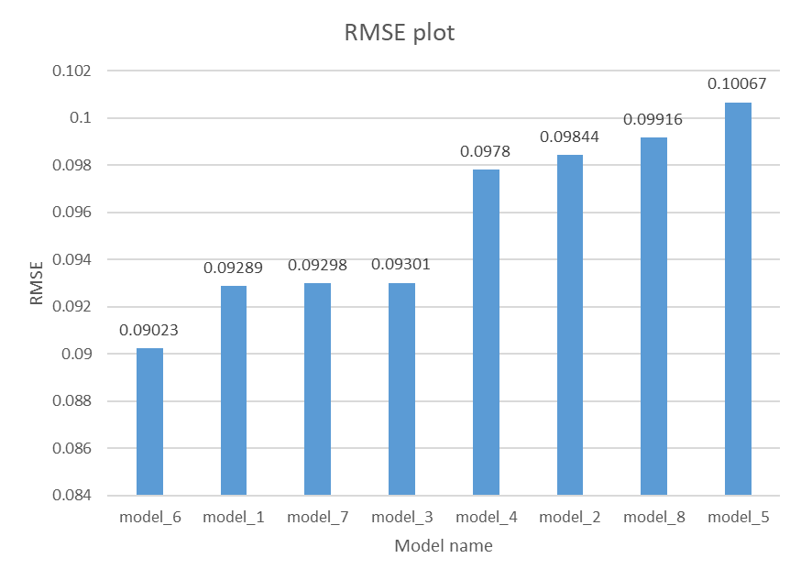
Metrics plot

Slide 12
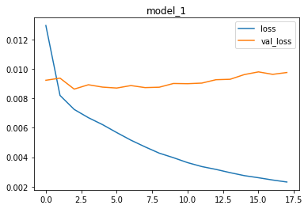
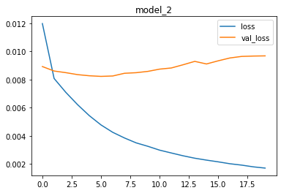
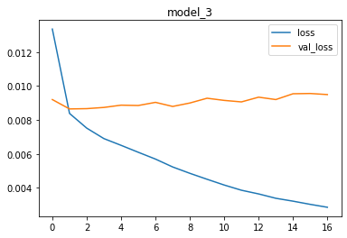
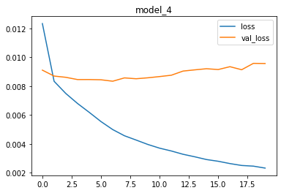



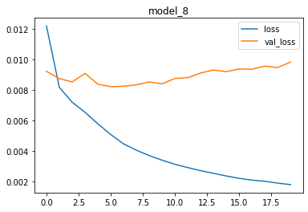
Training plots for losses

Slide 13
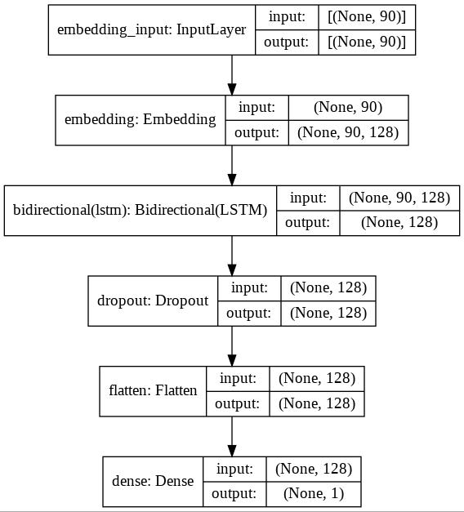
Final model architecture

Slide 14
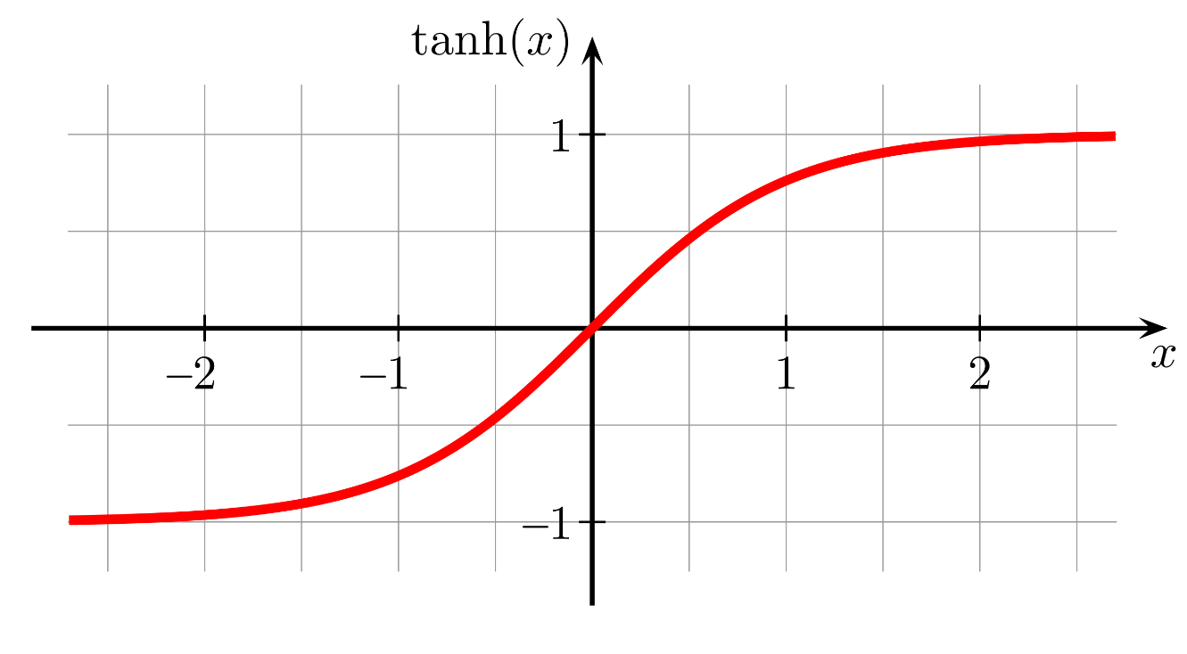
Output Layer
Used activation function: tanh

Slide 15
Final model architecture
Embedding Layer
Size: 90x128
Output
Dense output layer
Activation=‘tanh’
Input
Size: 90
Bidirectional LSTMs
No. of neurons: 64
Flattening the 2d output to 1d
Size: 128

Slide 16
Achievements
Achieved a sentiment prediction model to predict news title and headline sentiments.
Achieved comparison of various combinations of parameters for two different models.

Slide 17
Scope of improvements
Data cleaning/ pre-processing steps can be further improved to get better results.
Can try stacked LSTMs and BiLSTMs.
Can do appropriate hyper-parameter tuning to improve performance.
Can try finding proper embedding dimension to get minimal dimension with improved results.

Slide 18
Queries?

Slide 19
Thank you

