Slide 1

Lab Book 1.0. Waveguides
Student: Andrés Sanchez-Toril

Slide 2
Instructions
General
SCRIPTS
From GitHub →
  Fork the repo: cccanvas-upv/pic-upv-lab1
  Clone the repo using VSCode
Run the Jupyter Notebook:
  WAVEGUIDES_Student.ipynb
W (width)
W (width)
Core
Core
h_core
h
(height)
Cladding
Cladding
Slab
h_slab
deep waveguide
shallow waveguide

Slide 3
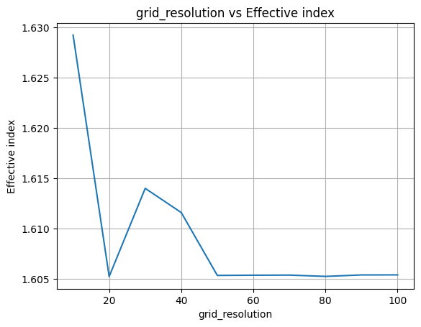
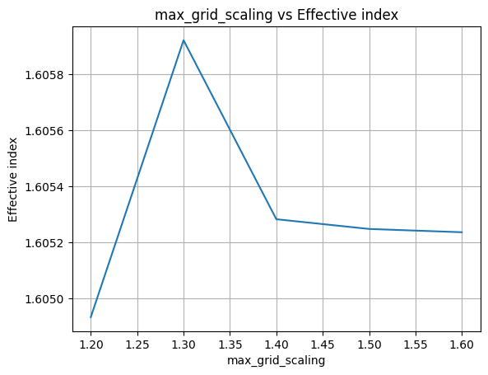
Learning outcome #1 – Convergence tests
DE waveguide, w = 1.2 µm, neff_TE0, wvl 1.55 µm.
deep waveguide
Paste neff_TE0 vs grid_resolution plot here
deep waveguide
Paste neff_TE0 vs max_grid_scaling plot here
Insufficient spatial discretization across the core-cladding interfaces causes noticeable numerical fluctuations for grid_resolution < 30. However, the effective index converges asymptotically and stabilizes ($Δn_{\text{eff}}<{10}^{−4}$) beyond grid_resolution $≥$50. Coupled with max_grid_scaling $≥$1.5—which provides sufficient domain clearance for evanescent field tails to fully decay to zero—this parameter set eliminates artificial boundary reflections while optimizing computational runtime.

Slide 4
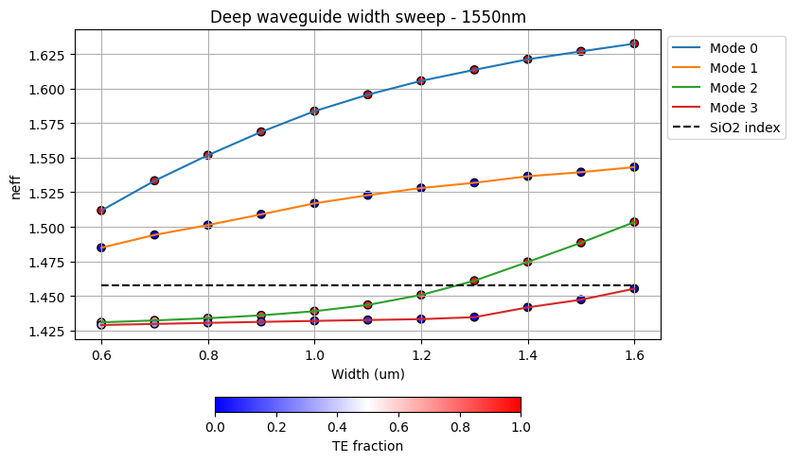
Learning outcome #2 – Width dependence
Width 0.6 - 1.6 µm (step 0.1 µm) – Wavelength 1.55 µm
deep waveguide
Paste plot here

Slide 5
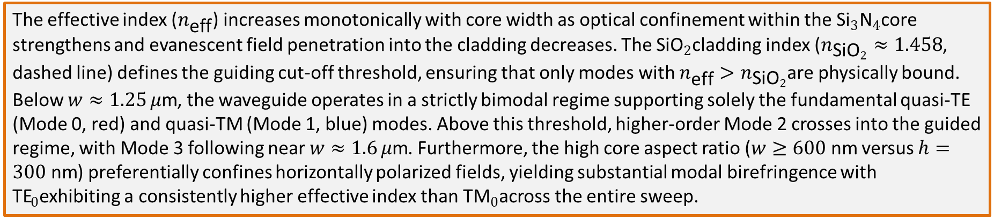
Learning outcome #2 – Width dependence
Width 0.6 - 1.6 µm (step 0.1 µm) – Wavelength 1.55 µm
The effective index ($n_{\text{eff}}$) increases monotonically with core width as optical confinement within the ${\text{Si}}_{3}{\text{N}}_{4}$core strengthens and evanescent field penetration into the cladding decreases. The ${\text{SiO}}_{2}$cladding index ($n_{{\text{SiO}}_{2}}≈1.458$, dashed line) defines the guiding cut-off threshold, ensuring that only modes with $n_{\text{eff}}>n_{{\text{SiO}}_{2}}$are physically bound. Below $w≈1.25 μ\text{m}$, the waveguide operates in a strictly bimodal regime supporting solely the fundamental quasi-TE (Mode 0, red) and quasi-TM (Mode 1, blue) modes. Above this threshold, higher-order Mode 2 crosses into the guided regime, with Mode 3 following near $w≈1.6 μ\text{m}$. Furthermore, the high core aspect ratio ($w≥600\text{ nm}$ versus $h=300\text{ nm}$) preferentially confines horizontally polarized fields, yielding substantial modal birefringence with ${\text{TE}}_{0}$exhibiting a consistently higher effective index than ${\text{TM}}_{0}$across the entire sweep.

Slide 6
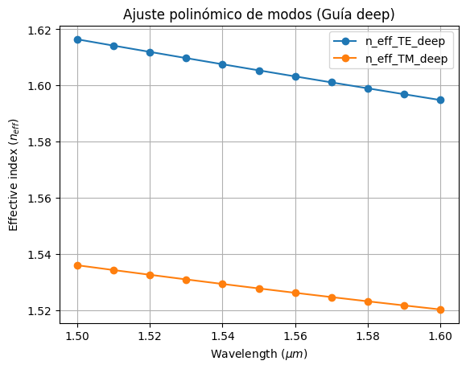
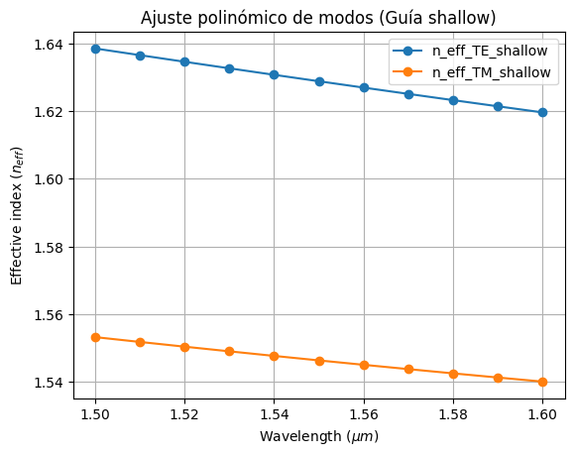

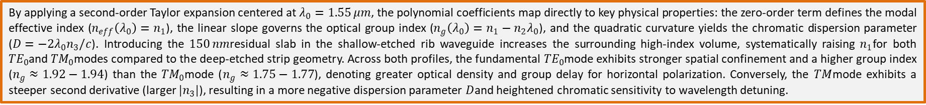
Learning outcome #3 – Waveguide compact model
Let’s model the waveguide using a second order polynomial:
$$n_{eff}\left(λ\right)=n_{1}+n_{2}\left(λ−λ_{0}\right)+n_{3}{\left(λ−λ_{0}\right)}^{2}$$
By applying a second-order Taylor expansion centered at $λ_{0}=1.55 μm$, the polynomial coefficients map directly to key physical properties: the zero-order term defines the modal effective index ($n_{eff}\left(λ_{0}\right)=n_{1}$), the linear slope governs the optical group index ($n_{g}\left(λ_{0}\right)=n_{1}−n_{2}λ_{0}$), and the quadratic curvature yields the chromatic dispersion parameter ($D=−2λ_{0}n_{3}/c$). Introducing the $150 nm$residual slab in the shallow-etched rib waveguide increases the surrounding high-index volume, systematically raising $n_{1}$for both ${TE}_{0}$and ${TM}_{0}$modes compared to the deep-etched strip geometry. Across both profiles, the fundamental ${TE}_{0}$mode exhibits stronger spatial confinement and a higher group index ($n_{g}≈1.92−1.94$) than the ${TM}_{0}$mode ($n_{g}≈1.75−1.77$), denoting greater optical density and group delay for horizontal polarization. Conversely, the $TM$mode exhibits a steeper second derivative (larger $|n_{3}|$), resulting in a more negative dispersion parameter $D$and heightened chromatic sensitivity to wavelength detuning.

Slide 7
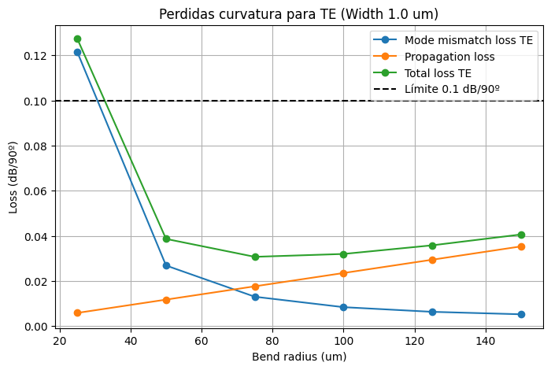
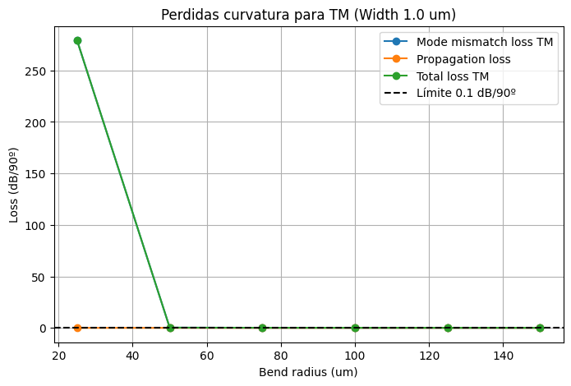
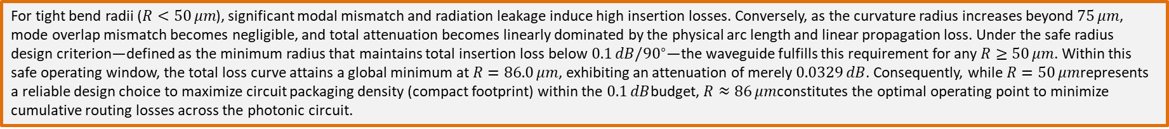
Learning outcome #4 – Bend waveguide radius vs. loss – deep
Find neff_TE0 for wvl 1.55 µm, width 1.0 µm for R=25,50,75,100, 125,150 µm
$α\left[\frac{dB}{90°}\right]=$ $R\frac{π}{2}α\left[\frac{dB}{µm}\right]$
For tight bend radii ($R<50 μm$), significant modal mismatch and radiation leakage induce high insertion losses. Conversely, as the curvature radius increases beyond $75 μm$, mode overlap mismatch becomes negligible, and total attenuation becomes linearly dominated by the physical arc length and linear propagation loss. Under the safe radius design criterion—defined as the minimum radius that maintains total insertion loss below $0.1 dB/{90}^{∘}$—the waveguide fulfills this requirement for any $R≥50 μm$. Within this safe operating window, the total loss curve attains a global minimum at $R=86.0 μm$, exhibiting an attenuation of merely $0.0329 dB$. Consequently, while $R=50 μm$represents a reliable design choice to maximize circuit packaging density (compact footprint) within the $0.1 dB$budget, $R≈86 μm$constitutes the optimal operating point to minimize cumulative routing losses across the photonic circuit.

Slide 8
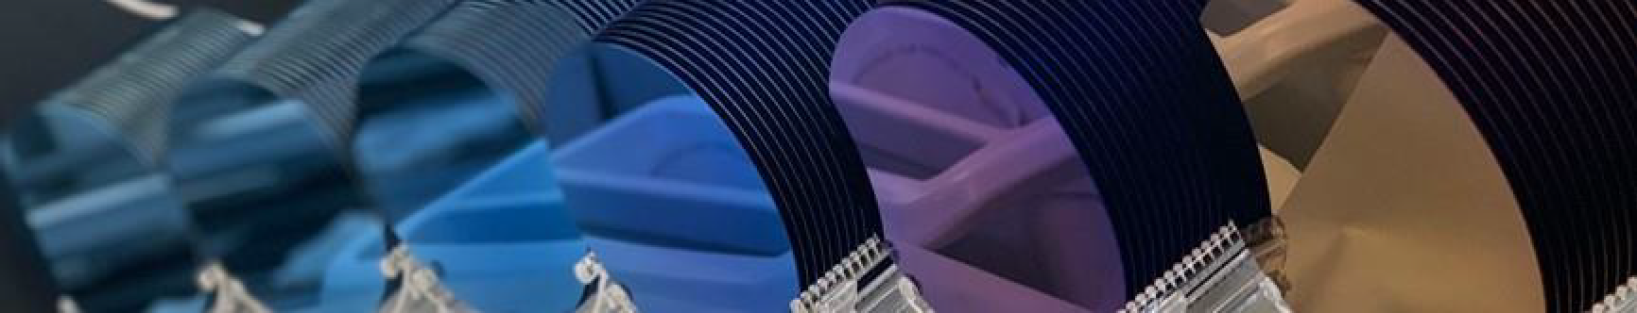
Thank you

