Slide 1

Mini Projet SIG
Auteurs :
Abdoul Madjid SANOUSSI
Moussa SIDIBÉ
CONCEPTION & IMPLÉMENTATION D’UN SIG Web avec R POUR L’ANALYSE DES DONNÉES : COVID

Slide 2
SOMMAIRE
INTRODUCTION
Analyse des données
Conception du Web
CONCLUSION
<numéro>

Slide 3
Introduction :
Data visualization is an effective tool for disseminating information and accessible to everyone. In this perspective, we are going to set up spatial data visualization tools to provide updated information on the cov19 pandemic. Because according to William Playfair "We do calculations and proportion, the surest way to strike the mind is to speak to the eyes". So this tool can be used for decision-making purposes as for awareness-raising to encourage compliance with restrictive measures.
<numéro>

Slide 4
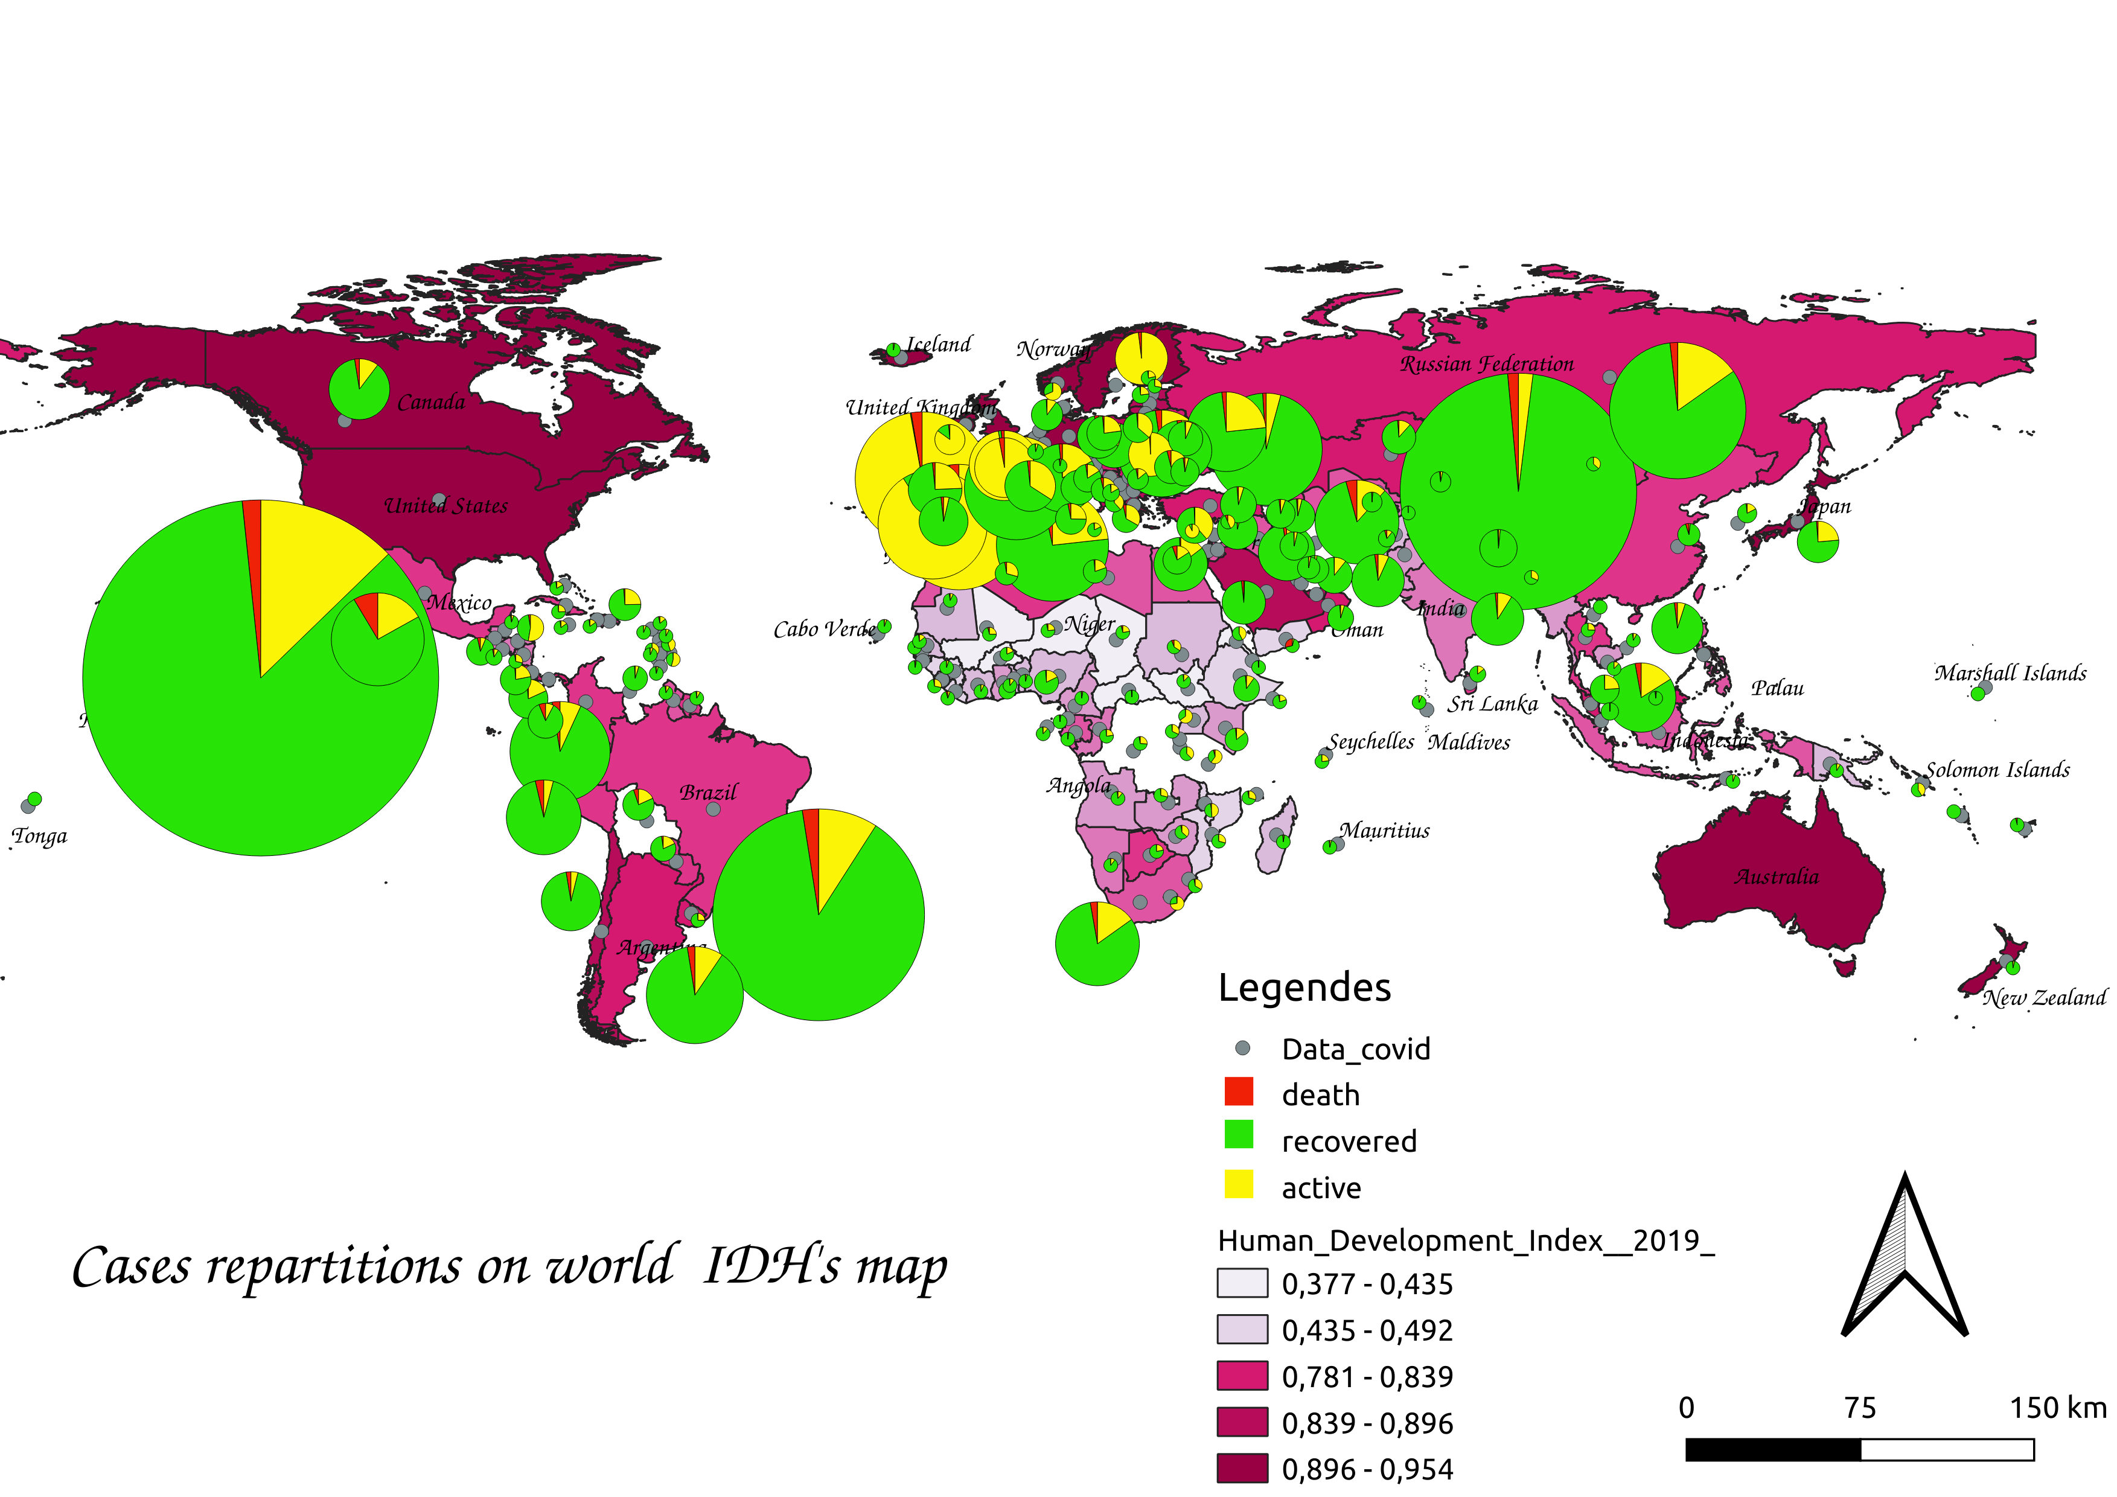
Partie Analyse :
1- Human Development Index(HDI) vs Coronavirus :

Slide 5
Partie Analyse :
Spatial analysis on HDI and covid-19 illustrate that even if the most developed countries are more affected with a high propagation of covid but they resist again virus fatality than sub-developed countries which is clearly observed on death rate for example Niger with 3,27% than 2,37% in France.

Slide 6
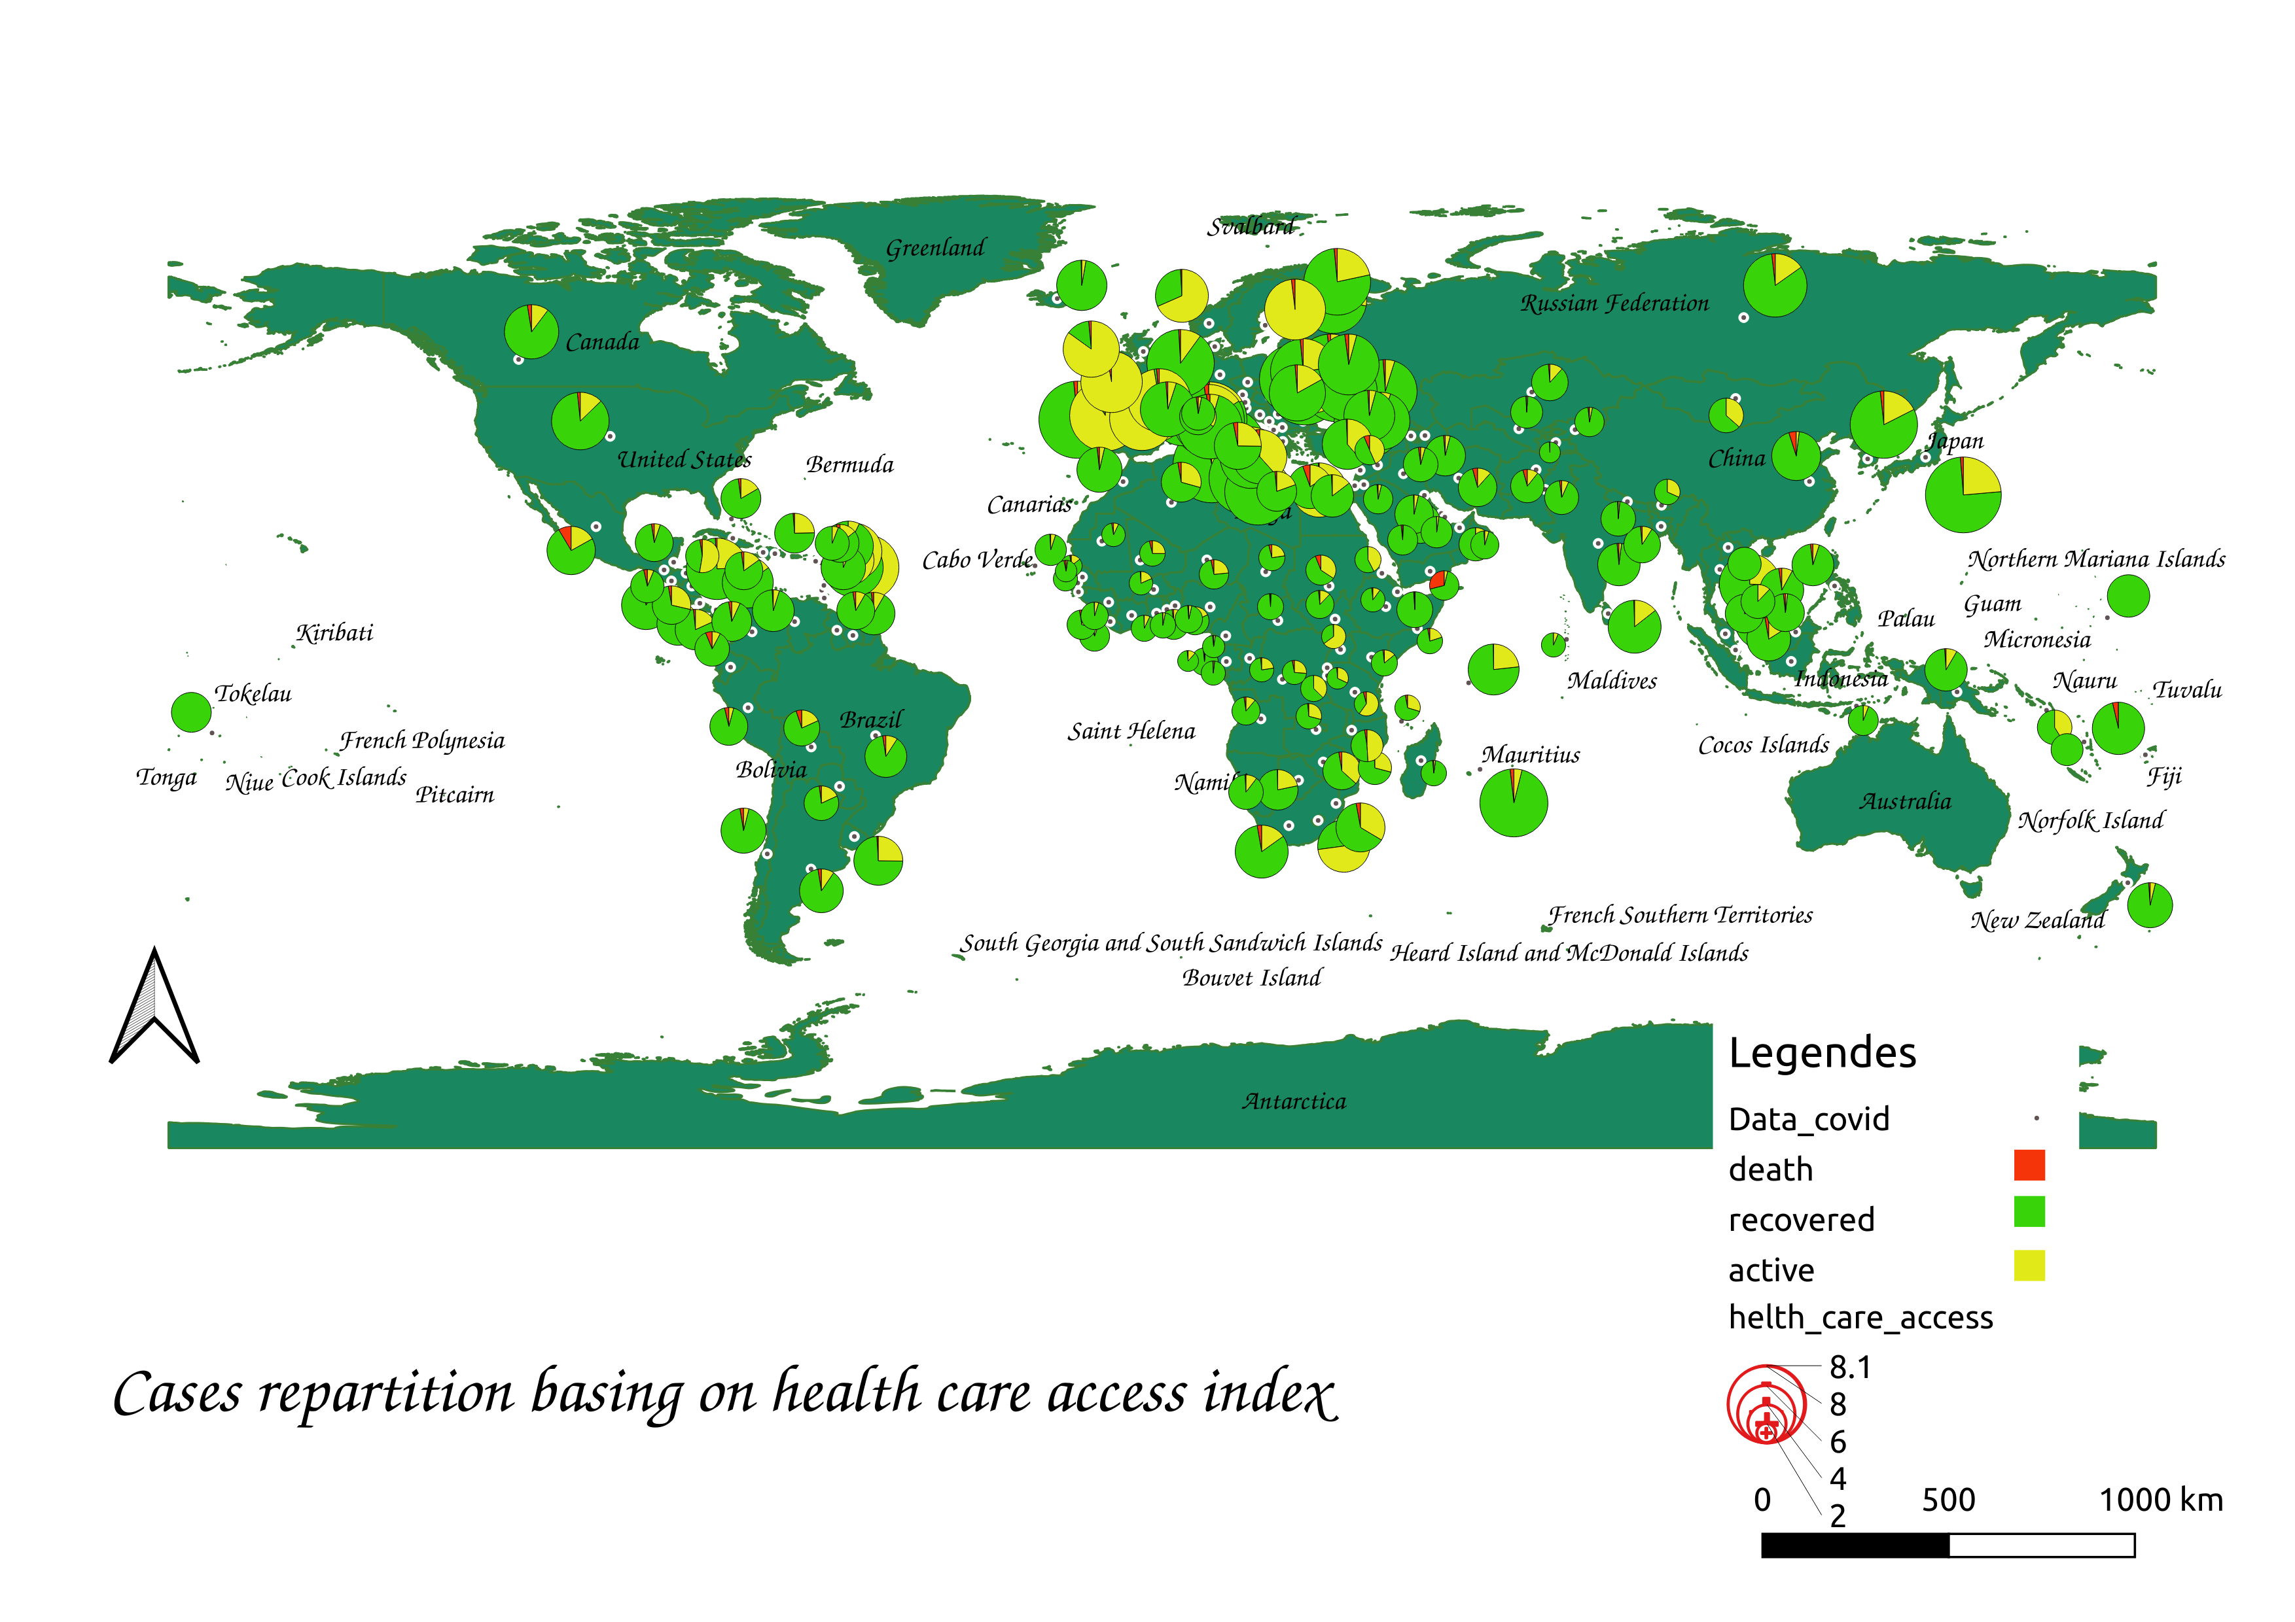
Partie Analyse :
2- Health care access index vs cov19 :

Slide 7
Partie Analyse :
Of course, there are other factors that influences on recover rate but health care access play an important role also, one hand there are a huge contamination rate but a large space to receive more critical patient with breathing problem or diabetic,… That avoid explosion of death rate as we can see in African countries or some American poor countries with less cases than other but a high death ratio as Egypt with 5,49%,Mexico with 8,57%.

Slide 8
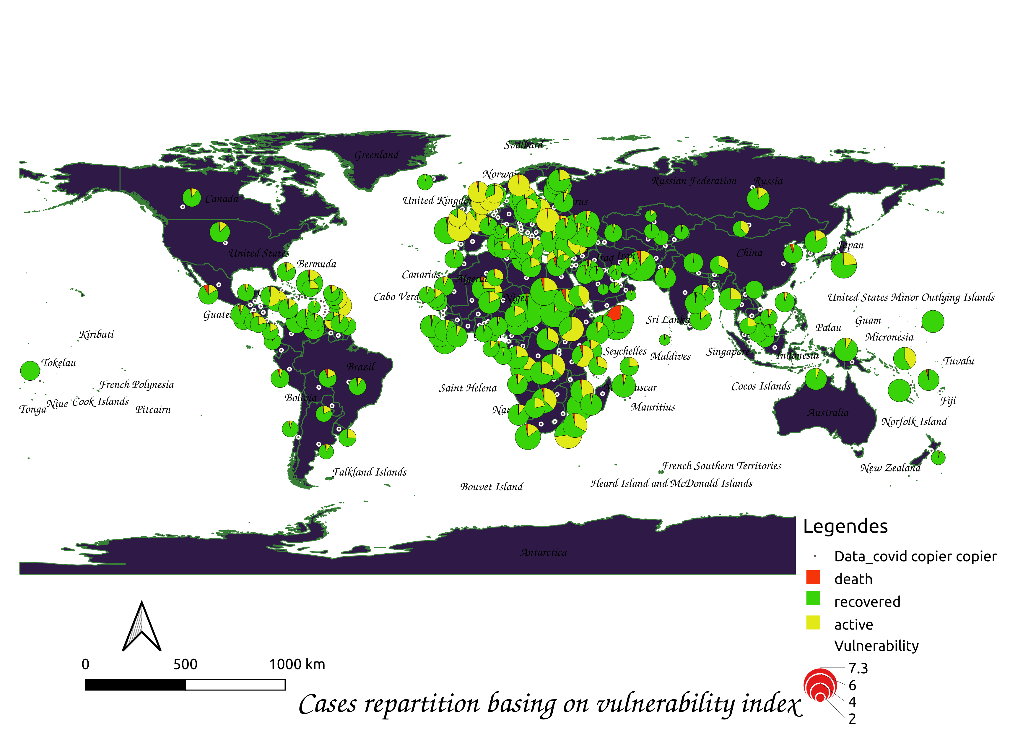
Partie Analyse :
3-Vulnerability vs Covid19 :

Slide 9
Partie Analyse :
As precedent analysis plus the the country is vulnerable to face the pandemic plus death ratio is high cause of lack of means to invest in hospital, to make a consistent measures as lock-down, telecommuting,...

Slide 10
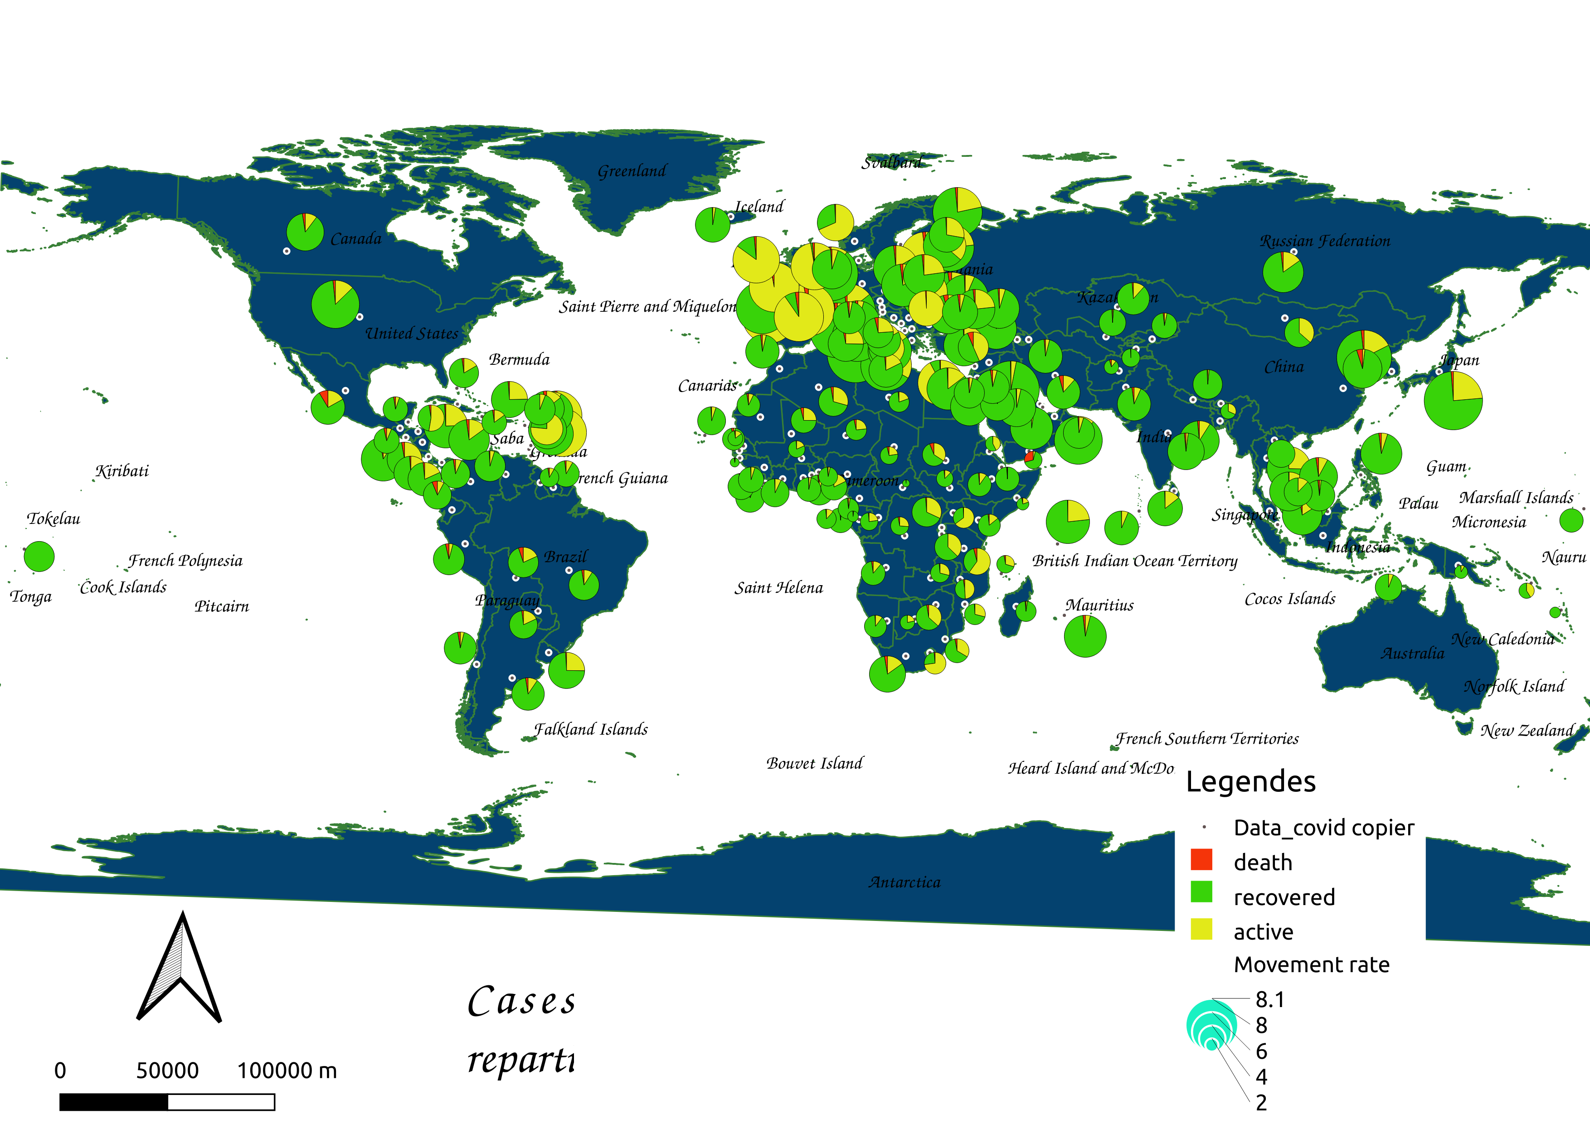
Partie Analyse :
4-Mouvements vs Cov19 :

Slide 11
Partie Analyse :
In this part, we analyze the impact of mobility in the contamination. These travels can be business plan that support economic or importation of subsistence, also inside the country interdependence of cities that can cause a huge damage in the spread of viruses. Fortunately, this impact was cushioned by sanitary barriers. But it has caused problems in high mobility countries like the United States, Canada, ...

Slide 12
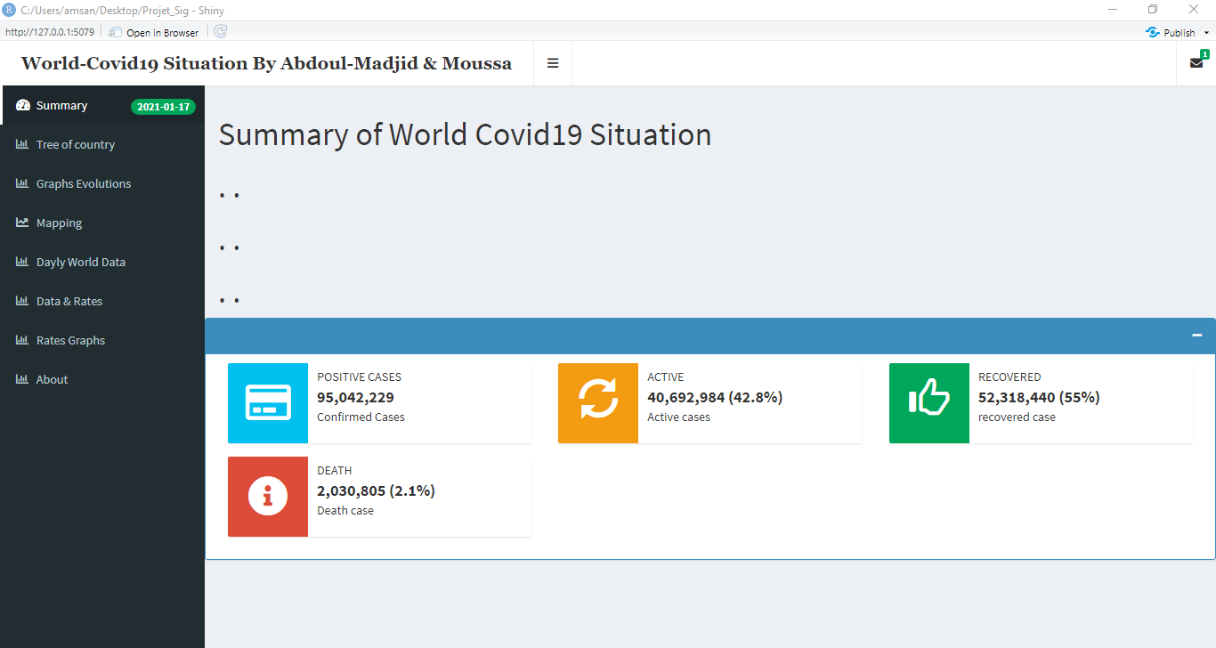
Partie Conception :
This tab display a summary of world pandemic situation with cumulative sum values by state from the start to actualized cases.

Slide 13
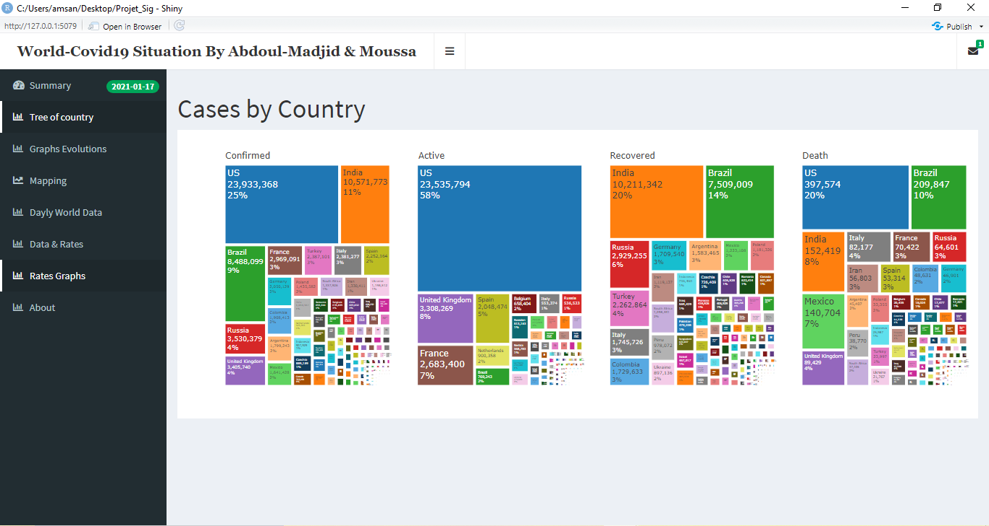
Partie Conception :
Here we display information by country with the different visibility to country most affected to least affected.

Slide 14
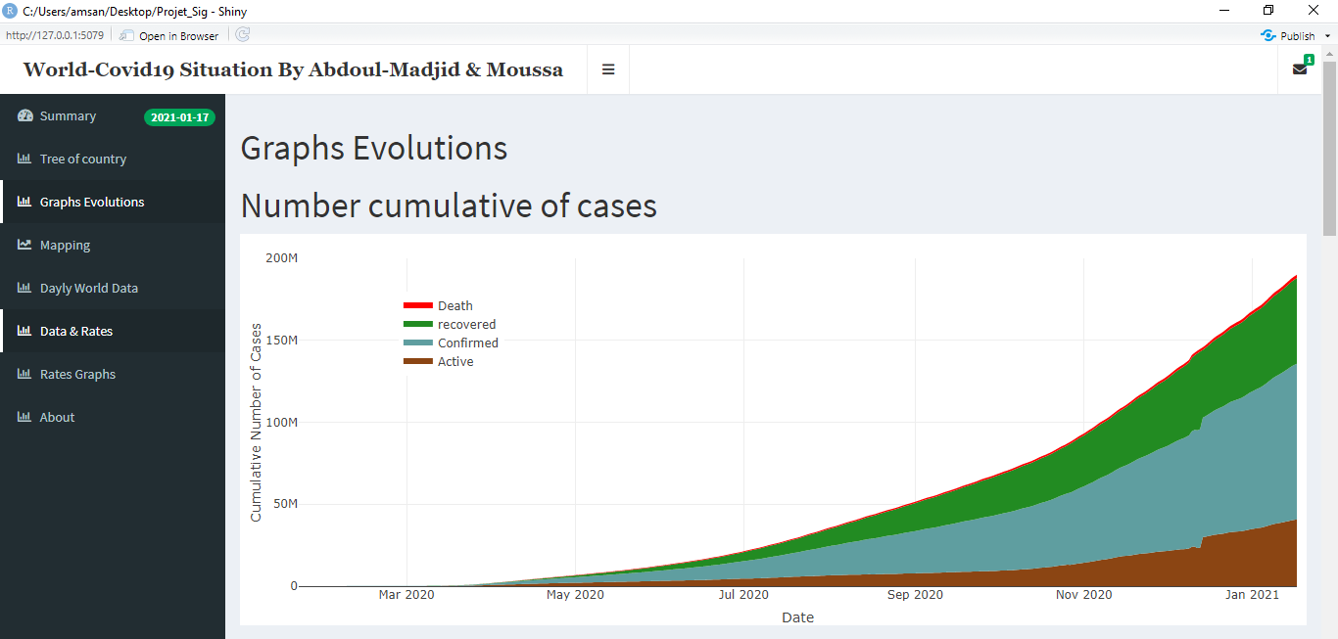
Partie Conception :
With area plot, we draw quantities of every state. Then we can realize that the cov-19 is not so fatal, with her law death rate.

Slide 15
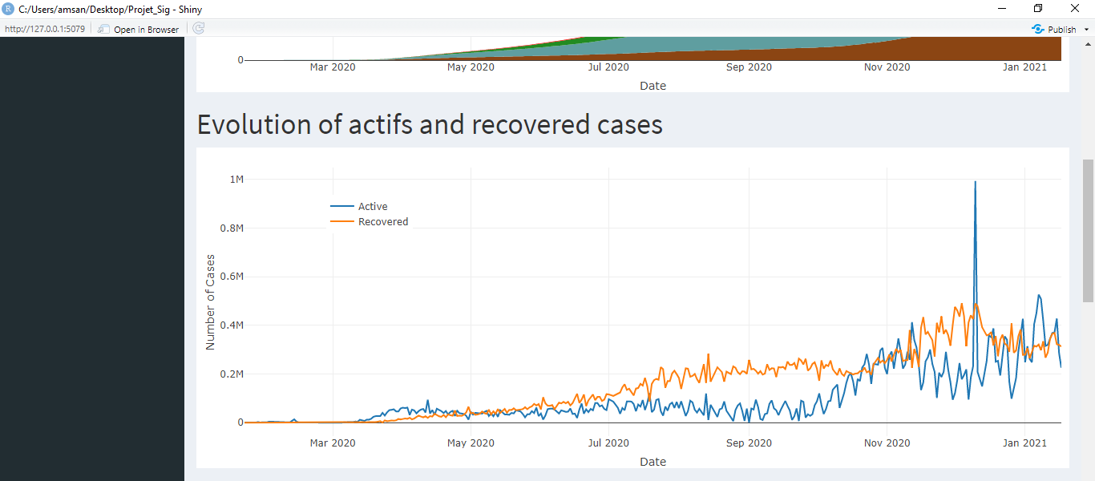
Partie Conception :

Slide 16
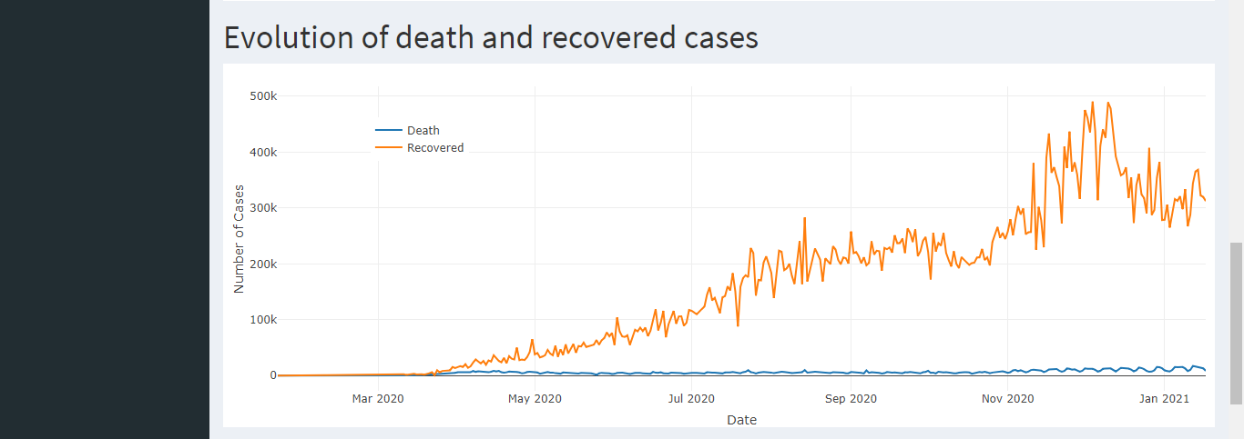
Partie Conception :

Slide 17
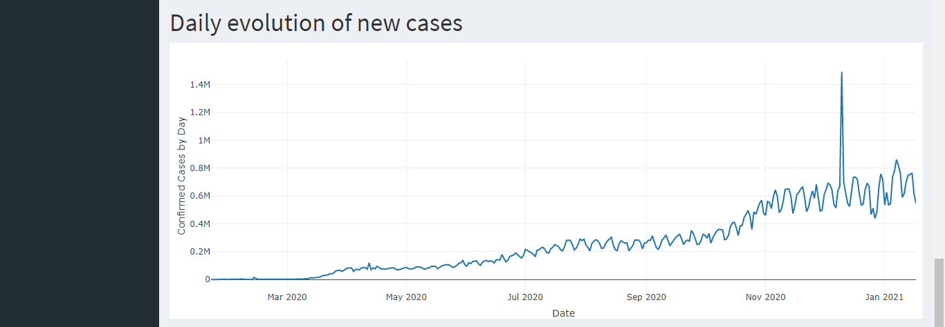
Partie Conception :

Slide 18
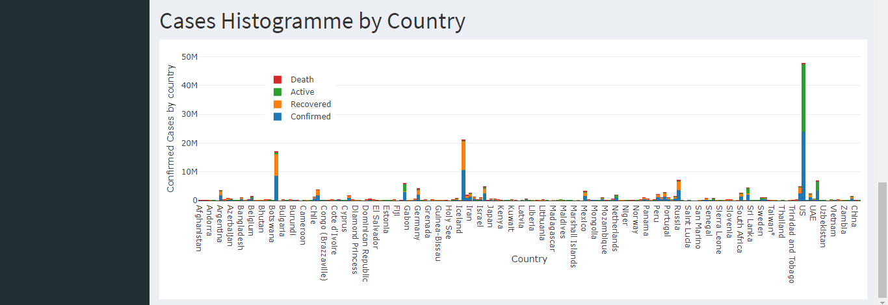
Partie Conception :
In this tab we use hist to plot the different aggregated state of patient. The picture is not clear here but on app we have possibility to zoom on every country or many together.

Slide 19
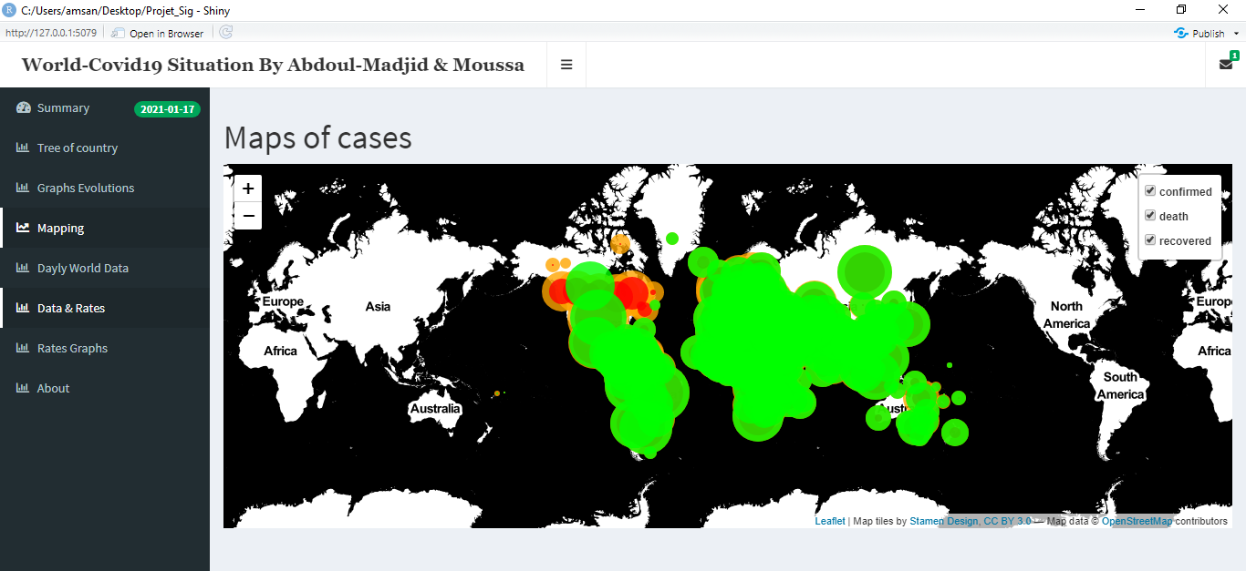
Partie Conception :
We projected the different cases on the map with the scale of country. Death by red, confirmed by green and recovered by orange. As all circle in this project the ray is correlated with the number of cases.

Slide 20
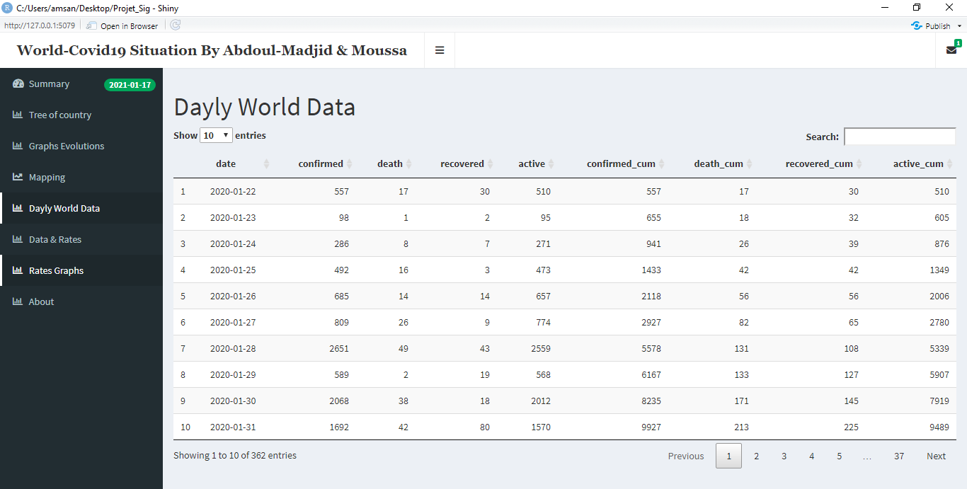
Partie Conception :

Slide 21
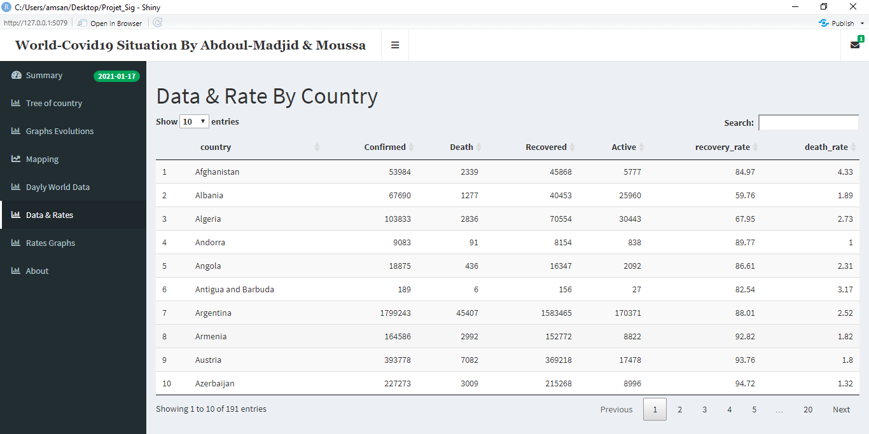
Partie Conception :

Slide 22
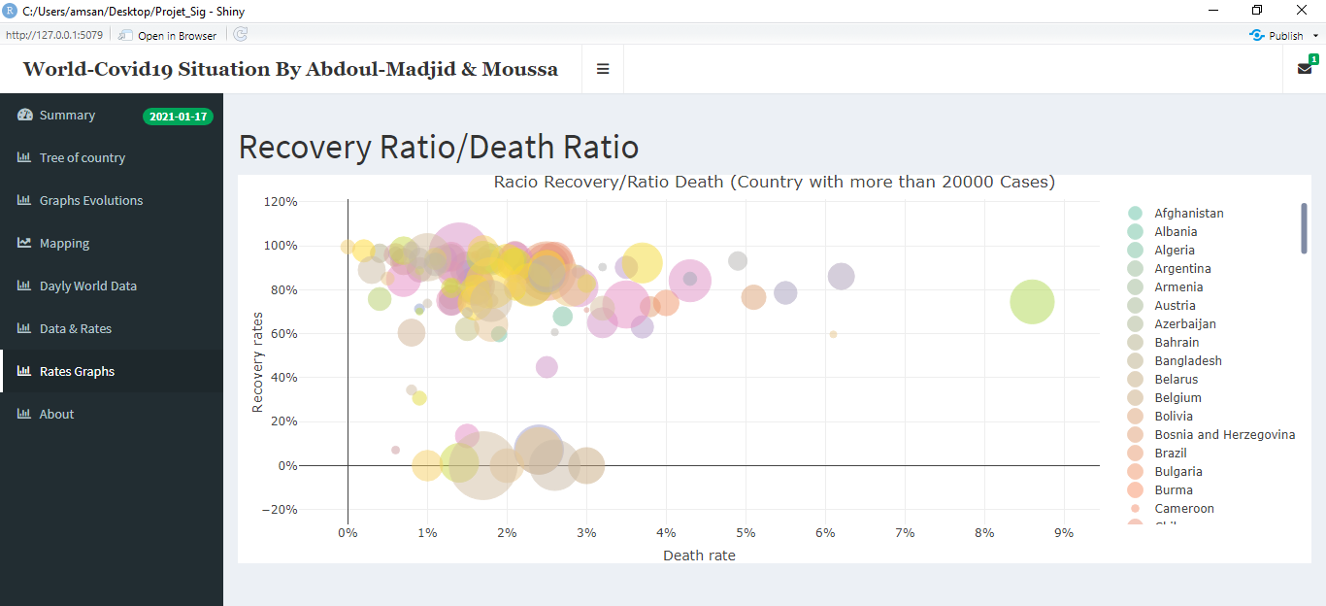
Partie Conception :
In this interface, we represented countries with have most than 20 000 effective cases of covid-19 by death rate and recover rate. And the circle ray correlated with confirmed case by country. It allow possibilities to zoom on county selected.

Slide 23
Conclusion :
For resume, in this project we make up a web based on R for visualization and and analysis purpose of situation of cov-19 in the world. This map can help the decision maker to take restrictions measures to fight the spreads of this phenomenon. And other side with the map, information is most accessible to every one without reading anything and vaccine will be use accurately.
<numéro>

