Slide 1
Instructions
For an executive presentation, start with the problem identification and your recommendation before moving into how you arrived at that recommendation. Here is how we recommend you structure your slide deck:
Problem identification (1-2 slides)
Recommendation and key findings (1 slide)
Modeling results and analysis (3-4 slides)
Summary and conclusion (1 slide)
Make sure that your slide deck's share settings allow anyone with the link to view your slide deck. When you are finished, please push your slide deck to GitHub. Please submit a link to the location of your slide deck in your repository.

Slide 2
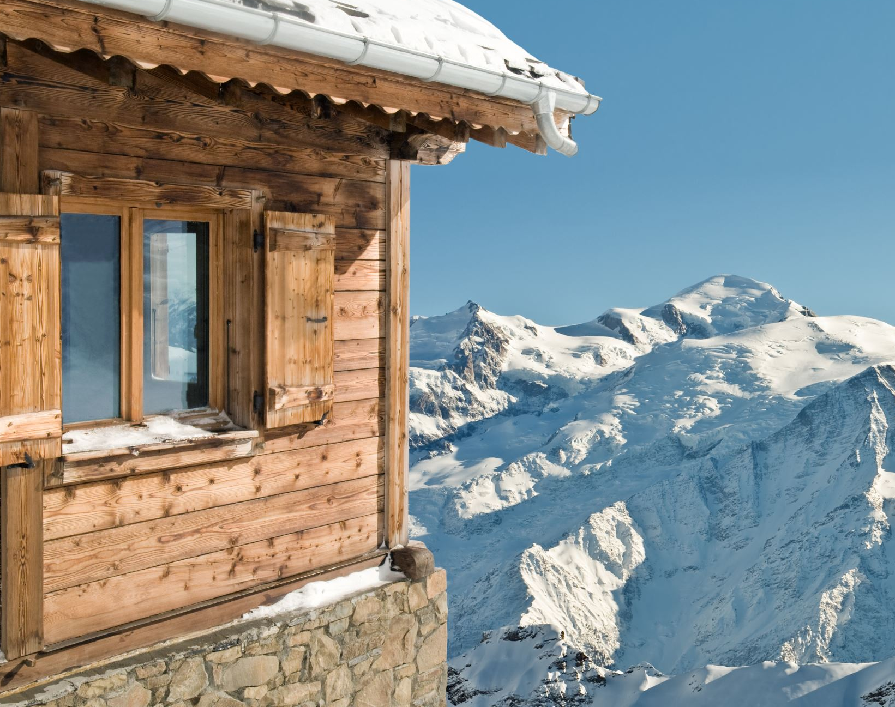
Big Mountain Resort Pricing Strategy
Unlocking $26M in Revenue Opportunity Through Data-Driven Market Analysis

Slide 3
Problem Identification

Slide 4
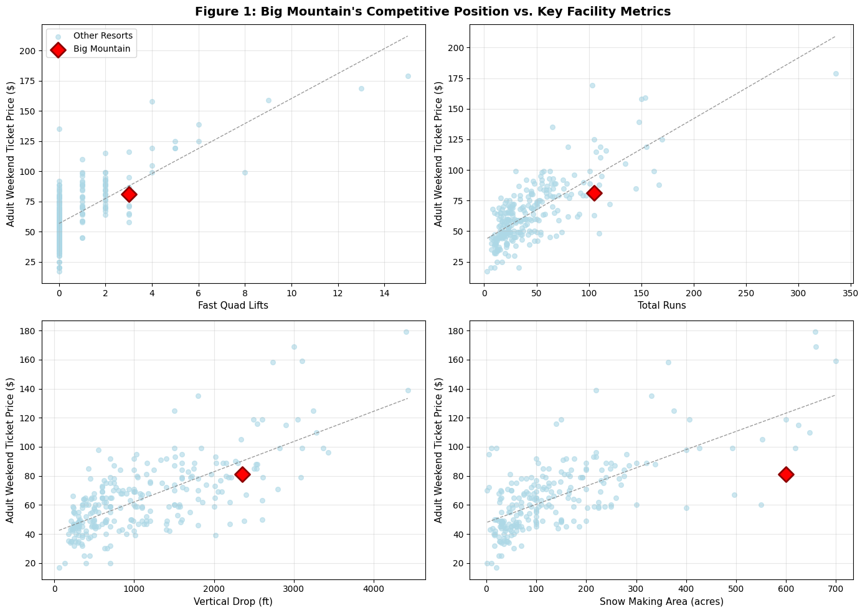
The $26M Question
Are we underpricing our premium facilities?
Current reality: $81/ticket vs. $95.87 market potential
$26M annual revenue opportunity from 18% price optimization
Recent $1.54M chair lift investment requires revenue strategy
Big Mountain ranks top quartile for facilities but underprices vs. market

Slide 5
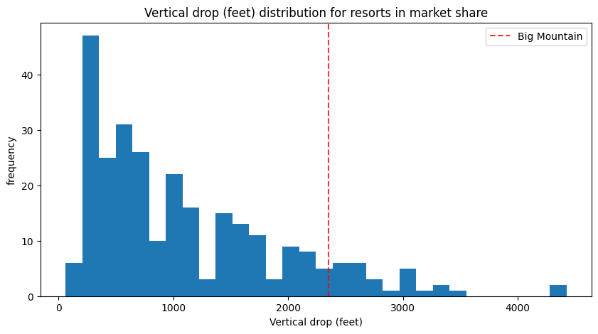
Market Context
Big Mountain's Competitive Disconnect
Top quartile facilities across key metrics: runs, lifts, vertical drop, snow making
Pricing 15% below market potential for comparable resort quality
Facility quality drives pricing more than location (analysis of 277 resorts)
Strong correlations: ticket prices vs. runs (0.76), fast quads (0.73), vertical drop (0.71)
Figure: Feature distribution plot from EDA showing Big Mountain's position (red line) vs. industry distribution

Slide 6
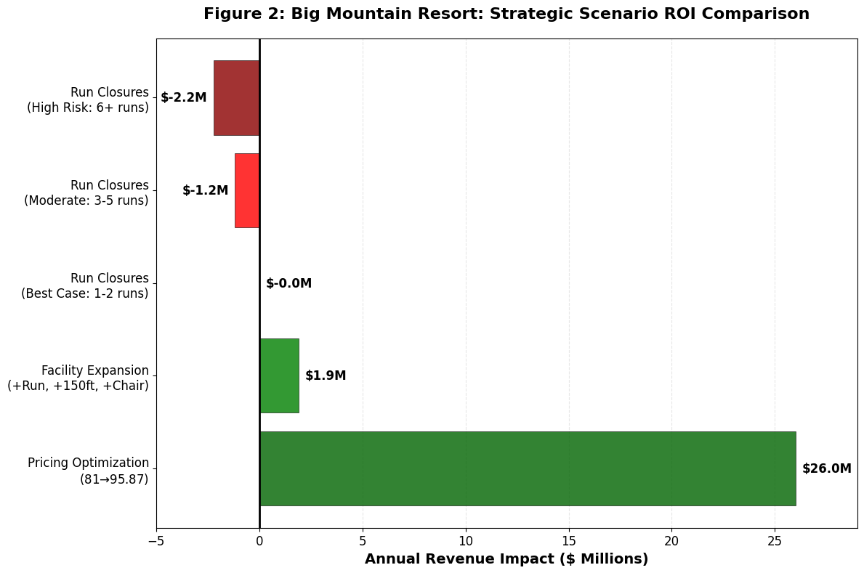
Recommendations & Key Findings
Revenue Optimization Strategy
Pricing optimization: $26M annual revenue (highest ROI, immediate implementation)
Facility expansion: $1.9M profit (125% ROI, requires capital investment)
Figure: ⭐ ROI comparison horizontal bar chart (your money slide from 05_modeling_ams.ipynb)

Slide 7
Modeling Results and Analysis

Slide 8
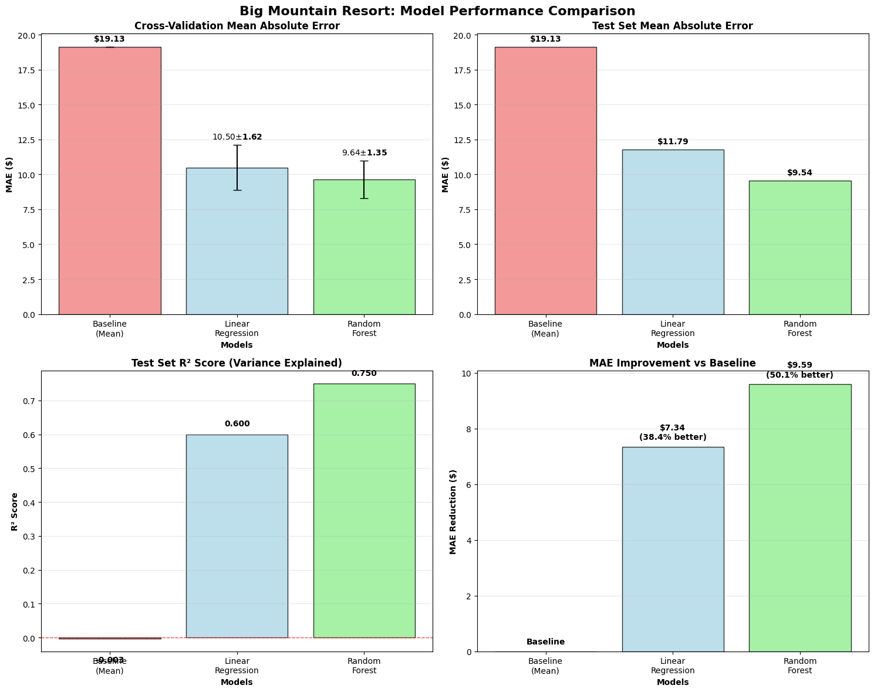
Model Performance & Validation
Random Forest model: 75% accuracy, $9.54 average error
Outperforms linear regression (60% accuracy, $11.79 error)
50% better than baseline guessing ($19.13 error)
Validated across 277 ski resorts and 25 facility variables

Slide 9
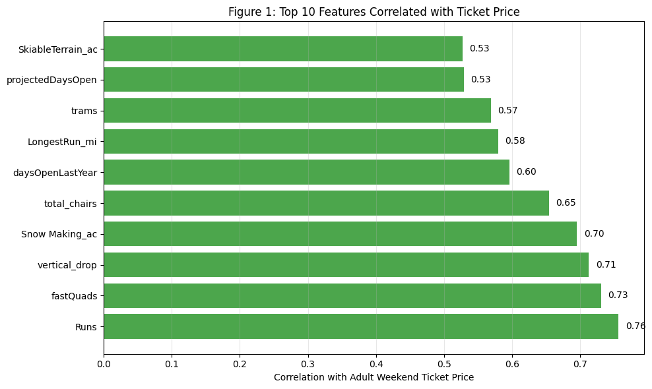
What Drives Pricing Power
Why Big Mountain Can Command Premium Pricing
Top pricing drivers: Fast quads (0.73), vertical drop (0.71), runs (0.76), snow making (0.70)
Big Mountain excels in all key categories but prices below market potential
Facility quality drives pricing more than location across 277 resort analysis
Model validates premium pricing strategy with 75% accuracy

Slide 10
Facility Investment Scenarios
Additional Value Creation Opportunities
Facility expansion: $1.9M annual profit (new run + 150ft vertical + chairlift)
125% ROI on infrastructure investment - strong business case
Run closures: Minimal revenue impact (1-2 runs) vs. major risk (6+ runs)
Snow making/longest run upgrades: No additional pricing power

Slide 11
Summary & Conclusion
$27.9M Total Opportunity with Clear Implementation Path
Immediate action: $26M pricing optimization ($81 → $95.87 ticket price)
Medium-term opportunity: $1.9M facility expansion with 125% ROI
Total potential: $27.9M annual profit increase from data-driven strategy
Phased implementation: Price testing → demand monitoring → competitor response analysis

