Slide 1

Austin Crime Analysis
Prepared by: Kelly, Mounica, Amro, Petros
12/15/2018

Slide 2
Motivation Summary
Hypotheses:
Crime rates will increase with Austin’s growing population
Low income areas are prone to higher rates of crime
Questions:
Which are Austin’s safe/dangerous neighborhoods according to ZIP code?
How has crime evolved over the years?
When do crimes occur more frequently?

Slide 3
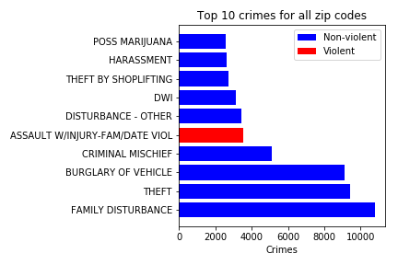
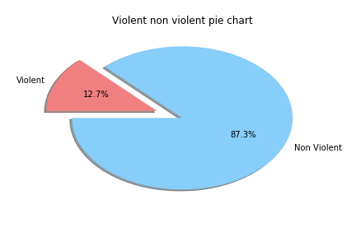
Exploratory Analysis -Types of Crime 2017
Non-violent crimes constitute approximately ~90% of all crimes
Family disturbance, theft, and burglary are the most frequently reported
Notes:
Petros

Slide 4
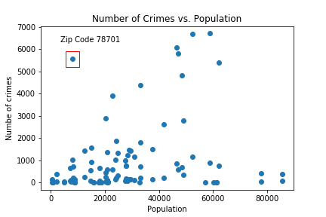
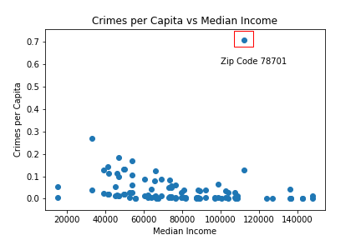
Exploratory Analysis - Crimes per Population 2017
Hypothesis: Crime increases with population
Highly populated zip codes are prone to more crime
Zip code 78701 has unusually higher amounts of crime for its population’s income
2017
Notes:
Amro

Slide 5
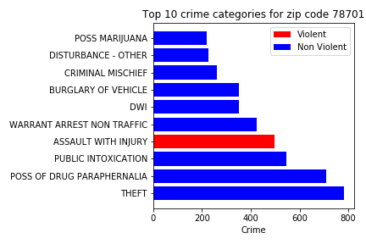
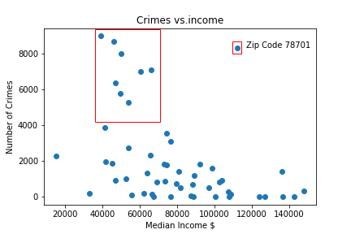
Data Analysis - Crimes per income of zip code 2017
Hypothesis: Crime decreases with increasing income
More crime in low income neighborhoods
Downtown (ZIP 78701) is an outlier
In downtown (78701), alcohol and drugs related crimes increase significantly
Notes:
Amro

Slide 6
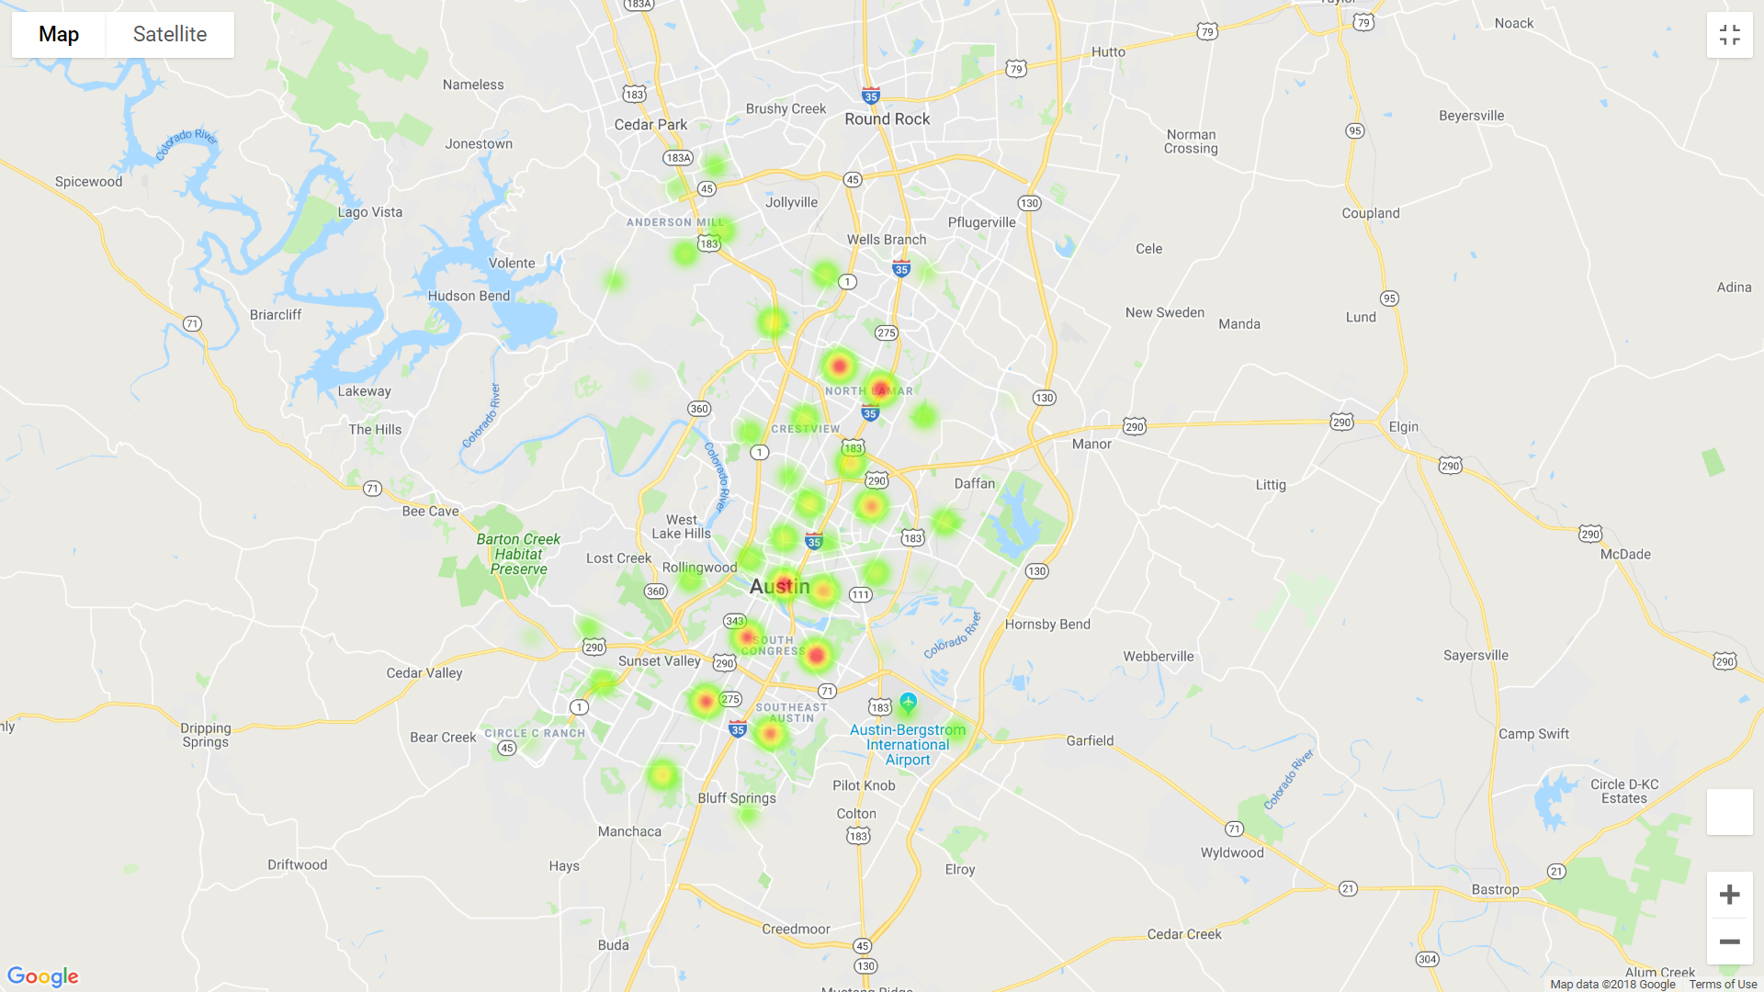
Geomapping High Crime Areas
2017
Higher crime zones along I-35
Low income areas like east Austin have lower crime rates (78724, 78721)
Popular areas have higher crime rates
South Congress
The Domain
Downtown
Notes:
Amro

Slide 7
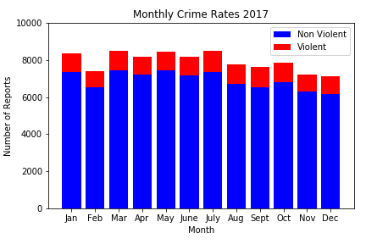
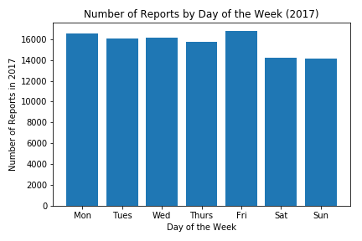
Exploratory Analysis - Crimes vs. Time of the Year 2017
No clear correlation between crime rate and months of the year
Violent vs. non-violent crime ratio remains stable throughout the year
There is a slight decrease in crime reported on the weekend (~15%)
Notes:
Kelly

Slide 8
Major Holidays and Events
Average daily arrest count for alcohol-related crimes: 19
2017 Alcohol-Related Reports
Date | No. of Reports | Possible Explanation
Feb. 5 | 40 | Super Bowl Sunday
July 1 | 39 | Saturday before 4th of July
Feb. 18 | 36 | ?
March 11 | 35 | SXSW
Jan. 15 | 35 | ?
Notes:
Kelly

Slide 9
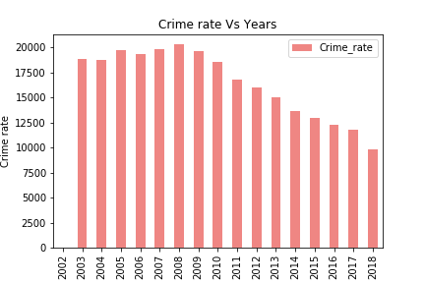
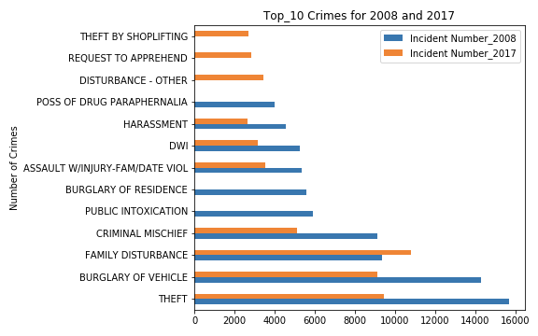
Austin Crime Analysis (2003-2018)
Hypothesis: Crime increases over years because of increasing population
Crime rate = (Crimes reported/population)*100,000
Crime rate reached a maximum in 2008 (recession)
After 2008, crime rates decreased steadily despite population increase.
In 2008, property crimes (ex. theft, burglary) increased significantly
Notes:
Mounica: https://utaus201810data2.slack.com/

Slide 10
Conclusions
Higher crime rates associated with lower income areas (except downtown)
Crime rates steadily declined after 2008
Major holidays/events attract more criminal activity
Violent crime rates appear consistent throughout the year

Slide 11
Sources:
APD Crime data : https://data.austintexas.gov/Public-Safety/Crime-Reports-beta-/fdj4-gpfu
Census : https://www.census.gov/
Gmaps : https://cloud.google.com/maps-platform/
- Cleanup process :
Converting Data csv files to Dataframes.
Merging Census income data, Austin population data, Violence crime rate data with Austin crime reports.
Adding ‘Year’ column to the DataFrame for finding crime rate for each year.
Insights : Extracting data using APD crime data API doesn’t allow data more than 50k instead we downloaded csv.

