Slide 1
Food Finder
Finding you the best burrito
Kevin Wecht
The Problem:
There is no way to aggregate reviews of the best restaurant “dishes” in your area.
Notes:
The problem:
There is no way to get reviews of the best restaurant “dishes” in your area.
If you want a burrito, and you search yelp, you’ll get the highest rated restaurants that serve burritos. However, reviewers rate restaurants based on many qualities, not just burritos. These may include: tacos, enchiladas, guacamole, service, décor, etc. My app scours the text of reviews from each restaurant to compute a rating of each quality on which users judge the restaurant.

Slide 2
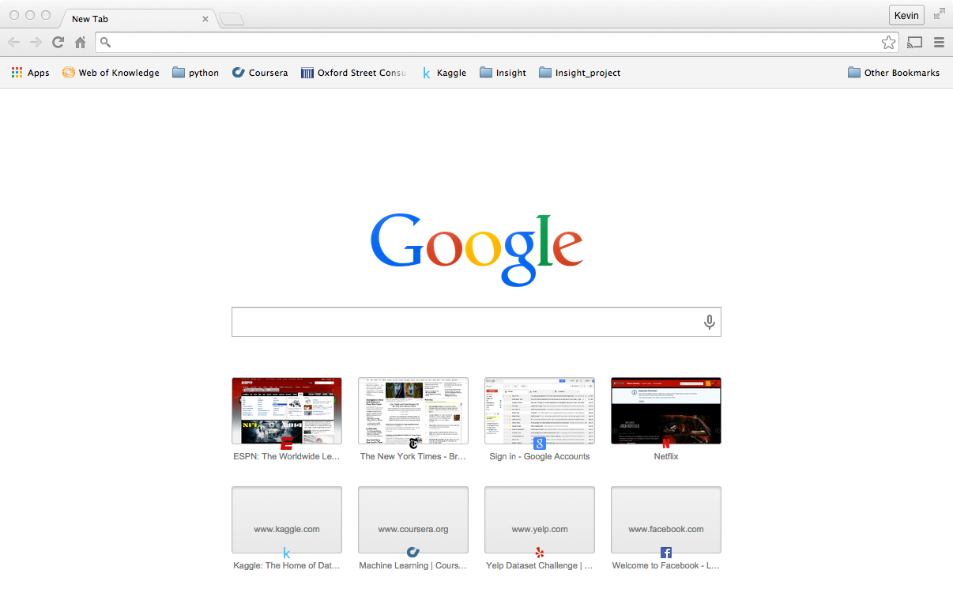
Mock-up
logo or background picture
Enter attribute
Enter Location

Slide 3
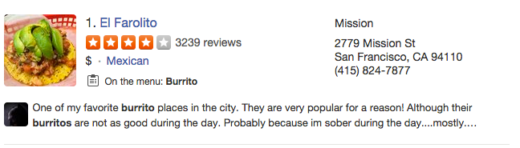
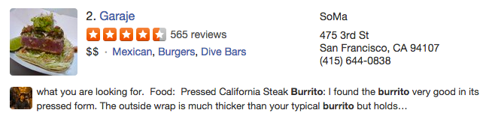
Mock-up
Burrito Score
4.9
4.3
Return results with a burrito score

Slide 4
Mock-up
4.9
Burritos
Tacos
Cleanliness
Margaritas
Show restaurant info with other common objects of sentiment at that restaurant
4.6
3.8
2.0

Slide 5
Data and Algorithms
Data
~300K Yelp restaurant reviews from Phoenix, AZ (hopefully SF for demo).
Business name and category
Rating: [1-5] Stars
Text of the review
Algorithms
1. determine objects of sentiment and features that encapsulate sentiment
Discover domain dependent objects and features
2. assign sentiment values to unknown features
3. classify (calculate) the sentiment felt toward objects using full set of features
Will involve NLP for sentiment analysis, clustering, classification?

Slide 6
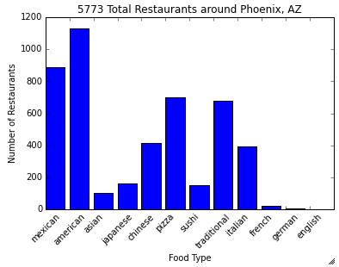
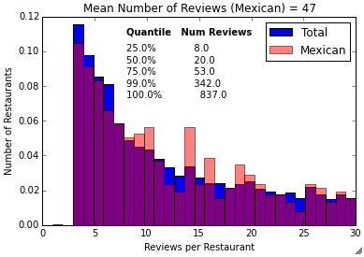
Visualizing the Data
Yelp reviews from Phoenix, AZ (hopefully SF).
How many reviews, how many restaurants, what does the data look like?
How many restaurants?
How many reviews?
Focus on Mexican restaurants for minimum viable product

Slide 7
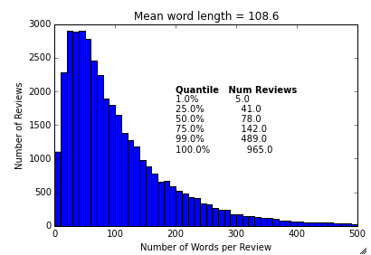
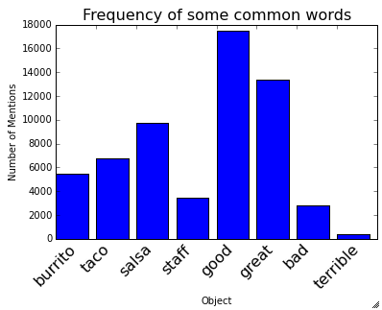
Visualizing the Data
How long are the reviews?
How many reviews mention common words?

Slide 8
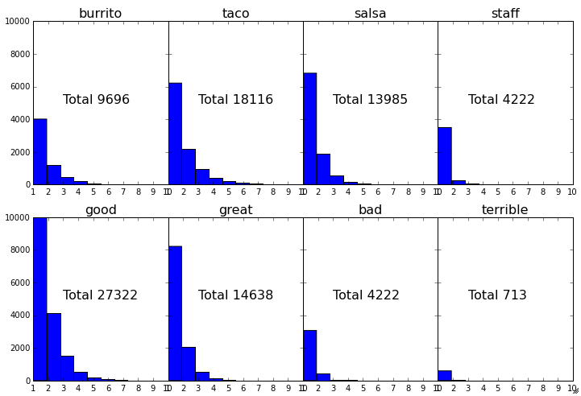
Visualizing the Data
How frequently are words repeated in a review?

Slide 9
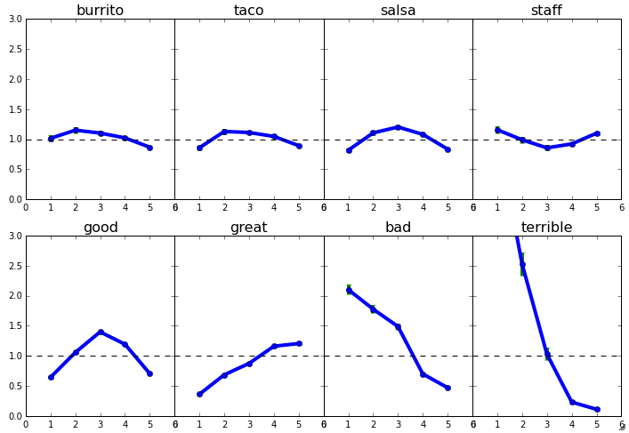
Visualizing the Data
How frequently are words used based on their overall sentiment?

Slide 10
Validating Results
How do I know that my results are informative?
Anecdotal
Select a few reviews to read by hand, see if my algorithm does what’s expected.
Sanity Check
Results should correlate with overall restaurant ranking.
Evaluate against baseline performance
Baseline algorithm: avg. rating of reviews that mention each object for each restaurant.
Independent Data
538.com ratings of burritos (perform more highly in my rankings than would be expected given restaurant overall rating or even the baseline above?)
Health inspection records (testing sentiment toward cleanliness)
Other? Open to brainstorms!
While in use
Do users use the product? Do returning users use it?
Do A/B tests swapping the default ordering of results or the sorting options

Slide 11
Expanding Analysis
How can I expand this beyond burritos?
How to change for other cuisine types?
How to change for other locations?
How to change for other businesses types?
I cannot answer these Qs. The goal entering is to use a framework that can easily be scaled (isn’t sensitive to domain-dependent information). In two weeks, the limitations of my actual product will inform the answers to these questions.

