Slide 1
Food Finder
Finding you the best burrito
Kevin Wecht
The Problem:
There is no way to evaluate reviews of the best restaurant “dishes” in your area.
Notes:
The problem:
There is no way to get reviews of the best restaurant “dishes” in your area.
If you want a burrito, and you search yelp, you’ll get the highest rated restaurants that serve burritos. However, reviewers rate restaurants based on many qualities, not just burritos. These may include: tacos, enchiladas, guacamole, service, décor, etc. My app scours the text of reviews from each restaurant to compute a rating of each quality on which users judge the restaurant.

Slide 2
Visualizing the Process
800 Mexican restaurants in Phoenix, AZ 40,000 Yelp reviews
Pull apart Yelp reviews for sentiment on the sentence level.
1
2
3
4
5
Yelp Review Rating

Slide 3
Visualizing the Process
800 Mexican restaurants in Phoenix, AZ 40,000 Yelp reviews
Pull apart Yelp reviews for sentiment on the sentence level.
5
4
Food Finder Score
3
2
1
1
2
3
4
5
Yelp Review Rating

Slide 4
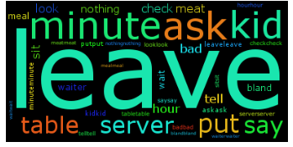
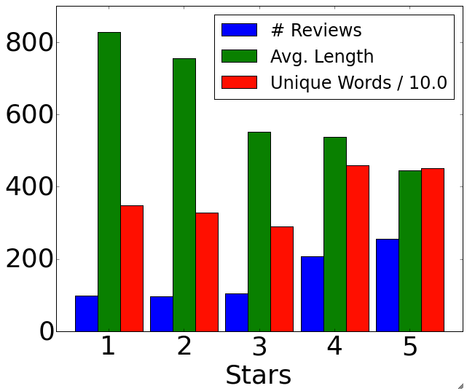
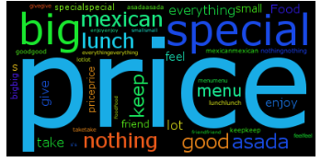
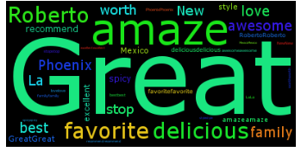
Visualizing the Data
Reviews grouped by star rating
1 Star
3 Star
Each group of ratings has a unique vocabulary that we exploit to classify individual sentences.
5 Star

Slide 5

Algorithm
Natural Language Processing
- tokenizing, POS tagging, lemmatizing, negation handling, N-grams
Classification
Multinomial naïve bayes, “logistic regression”, SVM
What is the probability that your sentence was constructed by randomly picking from each of the 5 distributions? Returns rating with highest probability.
Interpretability: Examine most distinguishing features
Feature selection: word frequency, tf-idf, doc2vec
Calculate “burrito score”
SELECT AVG(sentence)
FROM all_sentences
WHERE text LIKE “%burrito%”
GROUP BY Restaurant_ID;

