Slide 1
Food Finder
Finding you the best burrito
Kevin Wecht
The Problem:
There is no way to evaluate reviews of the best restaurant “dishes” in your area.
Notes:
The problem:
There is no way to get reviews of the best restaurant “dishes” in your area.
If you want a burrito, and you search yelp, you’ll get the highest rated restaurants that serve burritos. However, reviewers rate restaurants based on many qualities, not just burritos. These may include: tacos, enchiladas, guacamole, service, décor, etc. My app scours the text of reviews from each restaurant to compute a rating of each quality on which users judge the restaurant.

Slide 2
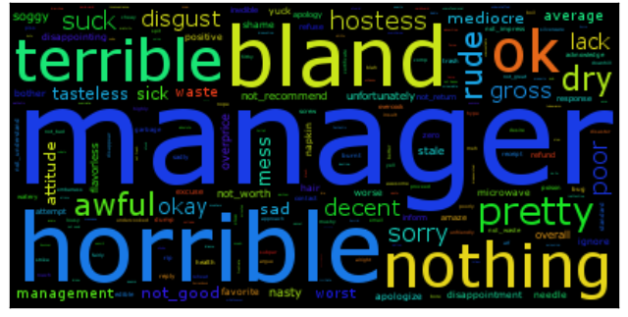
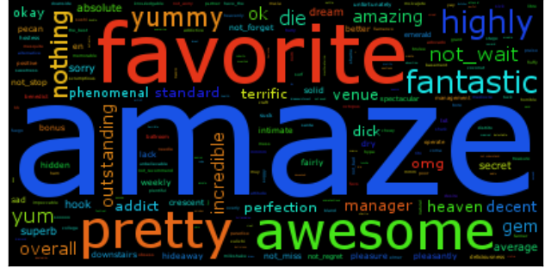
Mining Yelp reviews for sentiment of individual sentences
The Data:
Yelp Academic Dataset (Phoenix, AZ)
800 Mexican restaurants
40,000 reviews
300,000 sentences
1-Star Words
The Idea:
“The burrito was amazing…
… service was terrible.”
5-Star Words
The Strategy:
1. Extract unique vocabulary of 1-5 star reviews
2. Use unique vocabulary to classify sentences
3. Find search term in classified sentences

Slide 3
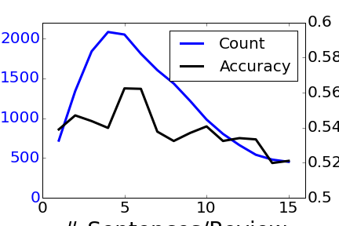
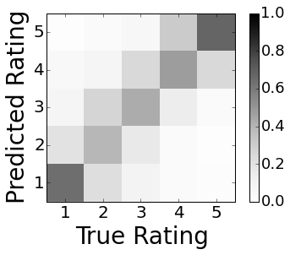
Mining Yelp reviews for sentiment of individual sentences
NLP: Lemmatization, negation handling, N-grams, TF-IDF
Classification: Multinomial Naïve Bayes
Classification of Reviews
Extension to Sentences
# Sentences/Review
55% classification accuracy for full reviews, applicable to individual sentences.

Slide 4
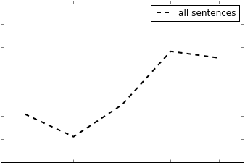
Enhancing Customer and Business Experience
Distribution of Ratings
0.3
Relative Frequency
0.2
0.1
1
2
3
4
5
Star Rating

Slide 5
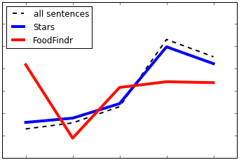
Enhancing Customer and Business Experience
Distribution of Ratings
0.3
Relative Frequency
0.2
0.1
1
2
3
4
5
Star Rating
Food Findr successfully extracts sentiments associated with different common terms
Provides more precise review summary to customers.

Slide 6
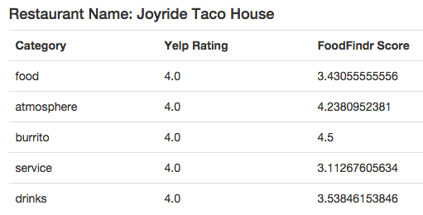
Enhancing Customer and Business Experience
One review on the restaurant’s Yelp page:
“It is super cute and I love the décor…
I have to say that the food is inconsistent…
I am still thinking about how good the veggie burrito is…”
Food Findr successfully extracts sentiments associated with different common terms
Provides more precise review summary to customers.

Slide 7
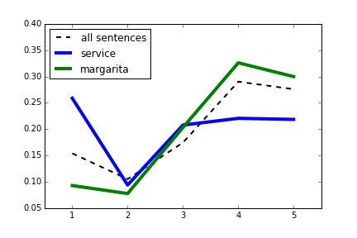
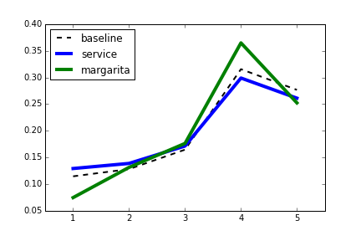
Improving Customer Experience
0.3
Food Findr pulls extracts sentiments out of reviews more effectively than the simpler thing to do.
0.2
0.1
Relative Frequency
0.3
0.2
0.1
1
2
3
4
5
Star Rating

