Slide 1

Kevin Wecht
Insight Data Science Fellow 2 February 2015
Notes:
The problem:
There is no way to get reviews of the best restaurant “dishes” in your area.
If you want a burrito, and you search yelp, you’ll get the highest rated restaurants that serve burritos. However, reviewers rate restaurants based on many qualities, not just burritos. These may include: tacos, enchiladas, guacamole, service, décor, etc. My app scours the text of reviews from each restaurant to compute a rating of each quality on which users judge the restaurant.

Slide 2
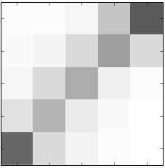
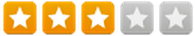
Mining Yelp reviews for sentiment of individual sentences
The Data:
Yelp Public Dataset (Phoenix, AZ)
800 Mexican restaurants
40,000 reviews
300,000 sentences
NLP: Lemmatization, negation handling,
bi/tri-grams, TF-IDF
Classification: Multinomial Naïve Bayes
Classification of test data
1.0
5
The Idea:
4
“The guacamole was amazing…
… service was terrible.”
Food Findr Rating
0.5
3
2
1
0.0
1
2
3
4
5
True Review Rating
Scalable: feature creation requires no domain expertise.
Accuracy on 1-sentence reviews equals that of full test set --> Apply to individual sentences.

Slide 3
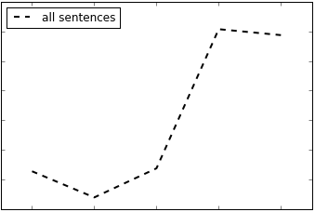
Extracting information from reviews
Distribution of FoodFindr Ratings
0.3
Relative Frequency
0.2
0.1
1
2
3
4
5
Star Rating

Slide 4
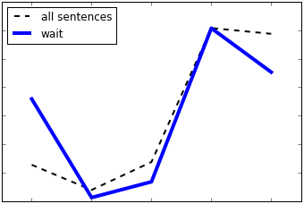
Extracting information from reviews
Distribution of Ratings
0.3
Relative Frequency
0.2
0.1
1
2
3
4
5
Star Rating

Slide 5
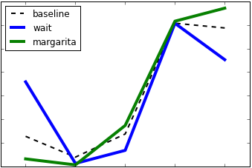
Extracting information from reviews
Distribution of Ratings
0.3
Relative Frequency
0.2
0.1
1
2
3
4
5
Star Rating
Food Findr extracts sentiments associated with common terms,
providing a richer information experience to customers.

Slide 6
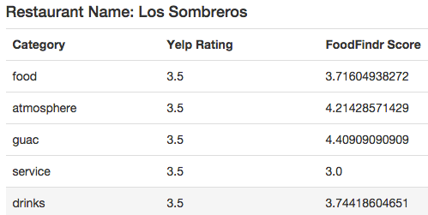
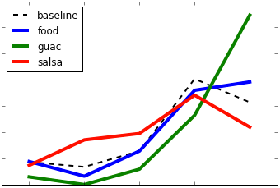
Examining a single business
This capability becomes particularly valuable to both customers and businesses when looking at a single restaurant.
Front page of Yelp reviews:
“The salsa was ok…
The guacamole was actually very good…
Tacos and chile relleno were mediocre.”
Extract and visualize actionable information regarding customer sentiment of a business’s products.

Slide 7
Kevin Wecht
This page is about me

