Slide 1
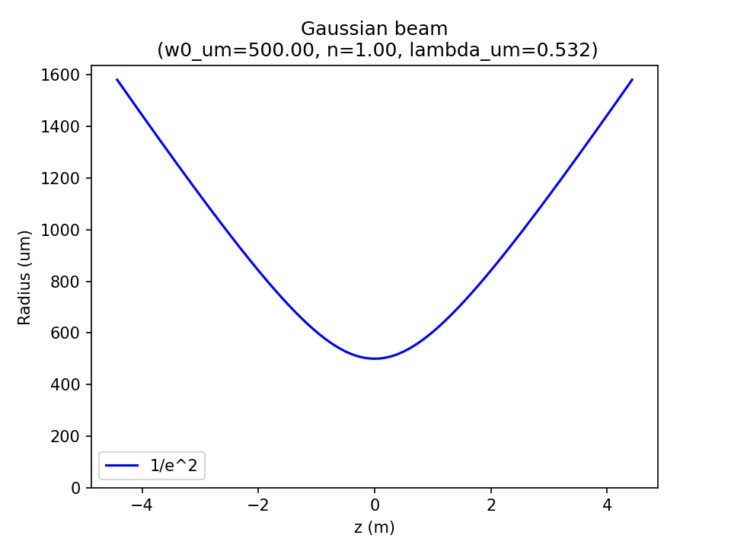
w(z)
w0
θ
z

