Slide 1
Group 6
Power Cable V2
Final Presentation
Santiago Remis | Shaun Varghese | Yunus Emre Sahin | Eusebio Rodriguez
Notes:
Hello
We are group 6 the Weightlifting muchachos
My name is yunus. this shaun, usb and santi
Today, we will present the problem, our solution, the user interaction, our results, and our project methodology.

Slide 2
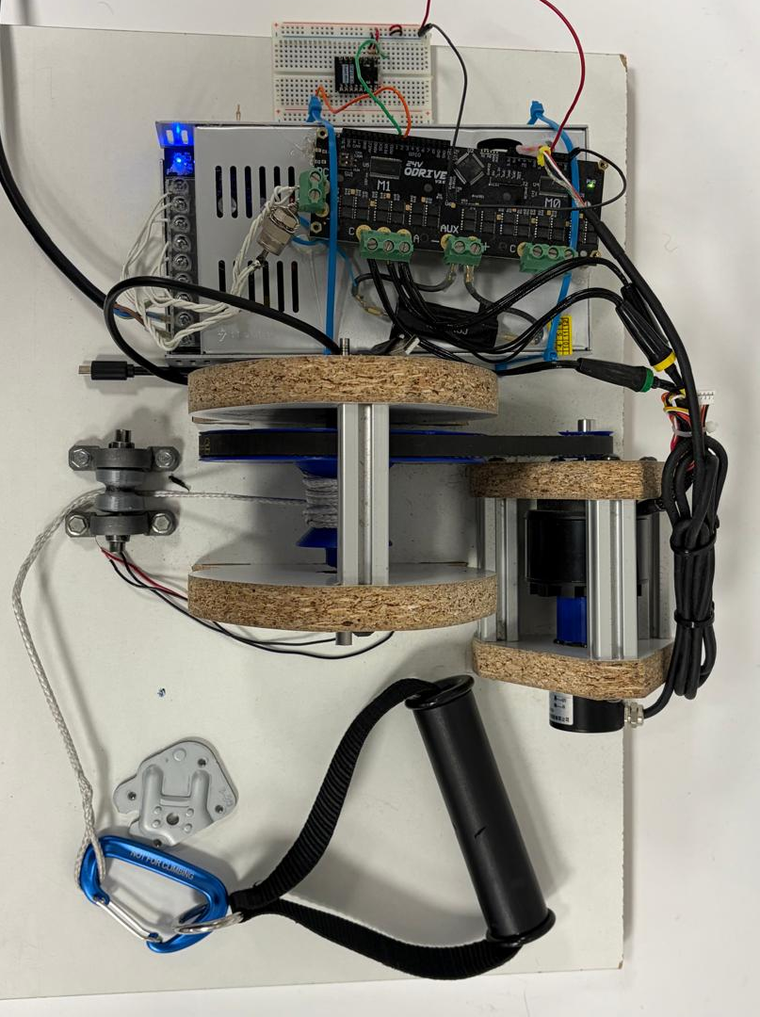
Introduction
- Power Cable: Uses a motorized cable system to provide electronically controlled resistance.
- Drawback: Resistance is fixed at the beginning of each set and cannot be adjusted during exercise.
- Project focus: Develop an intelligent resistance system that automatically adjusts resistance according to the user’s current capacity.
- Intends for user favorability for home workouts.
Previous Prototype
Notes:
Power Cable is a compact cable-training device. Instead of weight plates, an electric motor creates the resistance.
The previous prototype allowed the user to select a digital weight, but the resistance remained fixed during training.
Our goal was to make the system more intelligent by measuring the user’s movement and performance.
We also developed different interfaces to make the device easier to control.
Our intended users are people who want flexible strength training at home.

Slide 3
Problem Statement
Market Limitations: Home gym equipment is often bulky, expensive (e.g., commercial alternatives costing upwards of 28,300 SEK), and noisy.
Technical Drawback: Fixed-resistance motorized cable devices set load prior to exercise, failing to adjust to daily user strength fluctuations or intra-workout fatigue.
Training Inefficiency: Without dynamic resistance adjustment during reps, users cannot effectively achieve progressive overload or muscular failure for optimal hypertrophy training.
Notes:
Traditional strength-training equipment is often large, heavy, and expensive.
Some electronic cable machines cost more than 28,000 SEK
Fixed resistance is another problem because the user's performance changes during a workout.
A weight that feels correct at the beginning may become too difficult because of fatigue
Our solution measures repetition speed and uses it to estimate fatigue. #
This information can help the system recommend a more suitable resistance for the following set

Slide 4


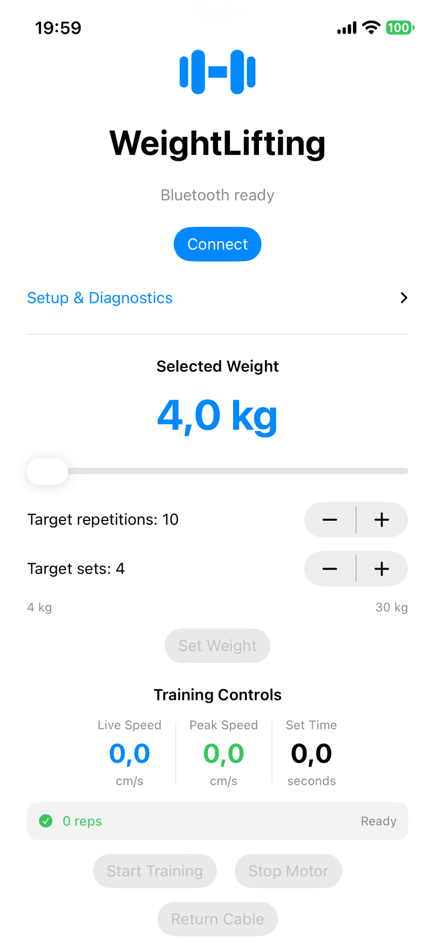
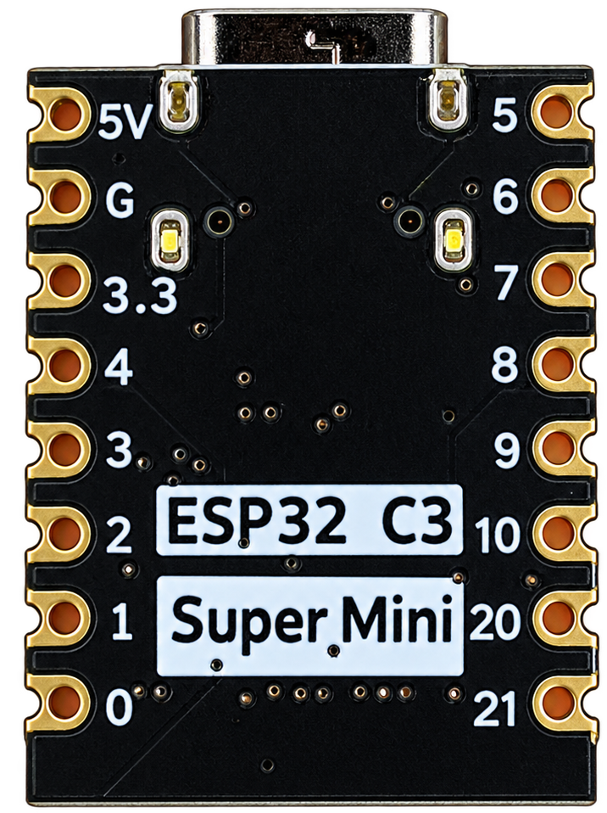
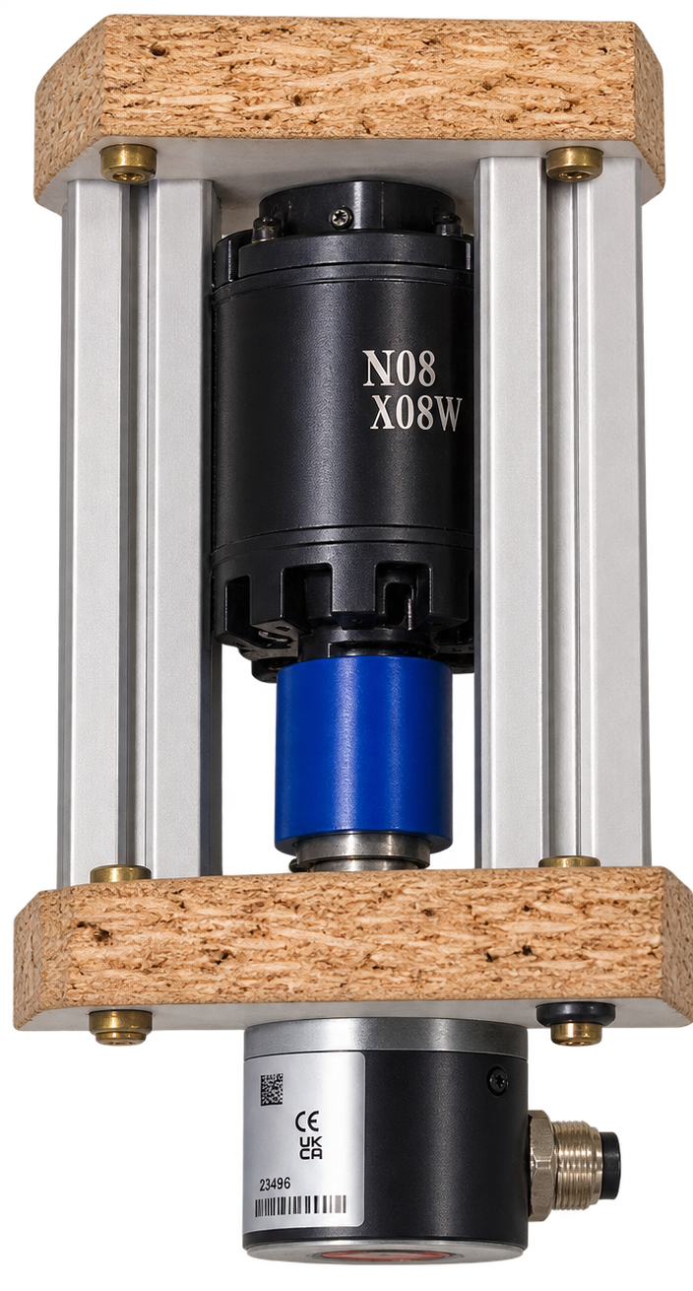
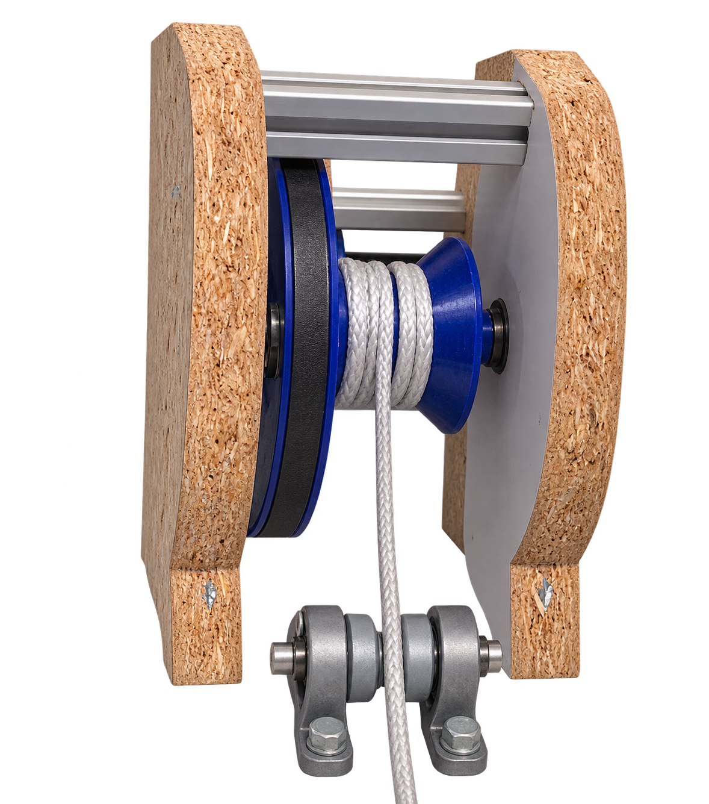
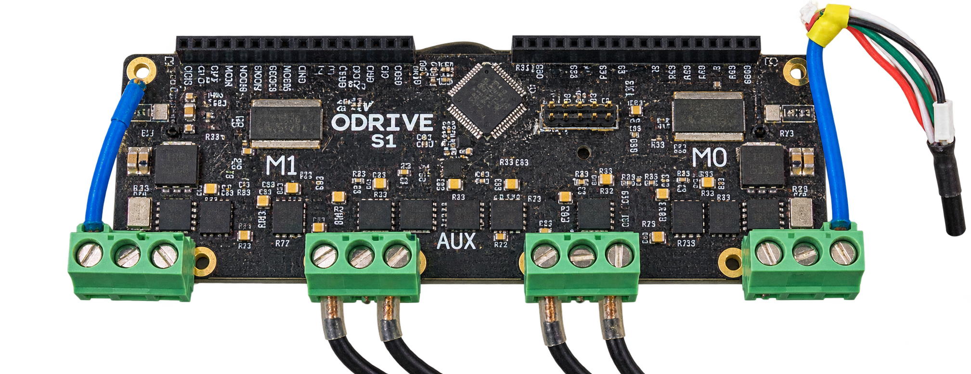
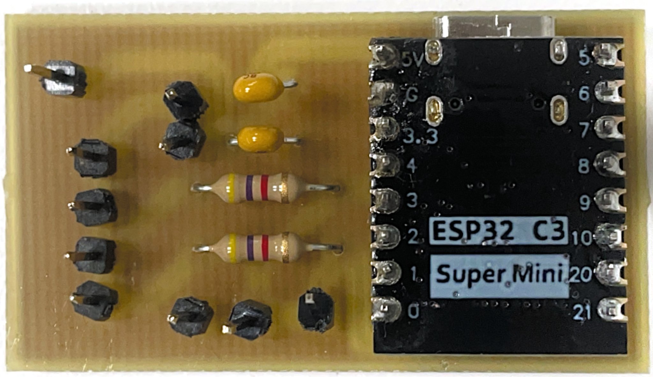
Technical Approach
App/HTML
📱| 💻
ESP32 C3
🛜 | 🌉
Bluetooth bridge
ODrive
🧠
motor controller
Motor + Encoder
🫀
feedback Kg to current
Cable Mechanism
💪
resistance to user
Notes:
The user selects the workout setting through an interface
The ESP32 receives these settings and sends commands to the ODrive motor controller.
The selected weight is converted into a motor-current limit
The motor creates resistance while the encoder measures its position and velocity.
The cable mechanism transfers this resistance to the user
The measurements return to the interface, where the user can see repetitions, cable speed, set time, and workout progress

Slide 5
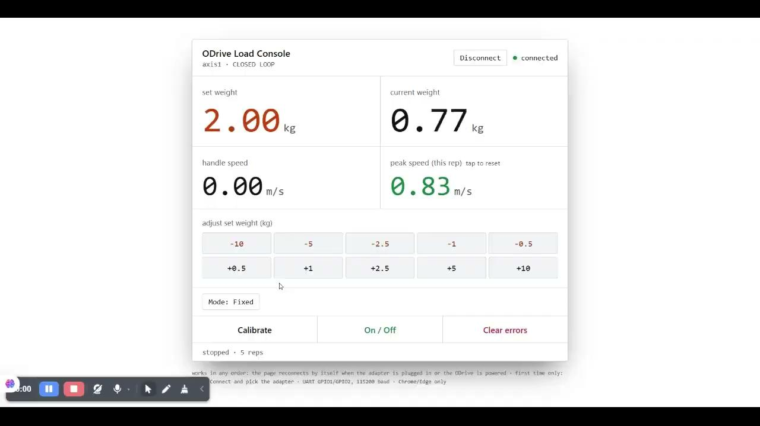

User Interaction with USB
Browser Interface:
Fixed resistance setting
Adaptive resistance setting
Access and operate directly from GitHub
Live training data
Notes:
The first interaction option uses a computer connected through USB.
The user opens the browser interface from GitHub and selects fixed or adaptive resistance.
The interface also shows live information such as force and repetition speed.

Slide 6
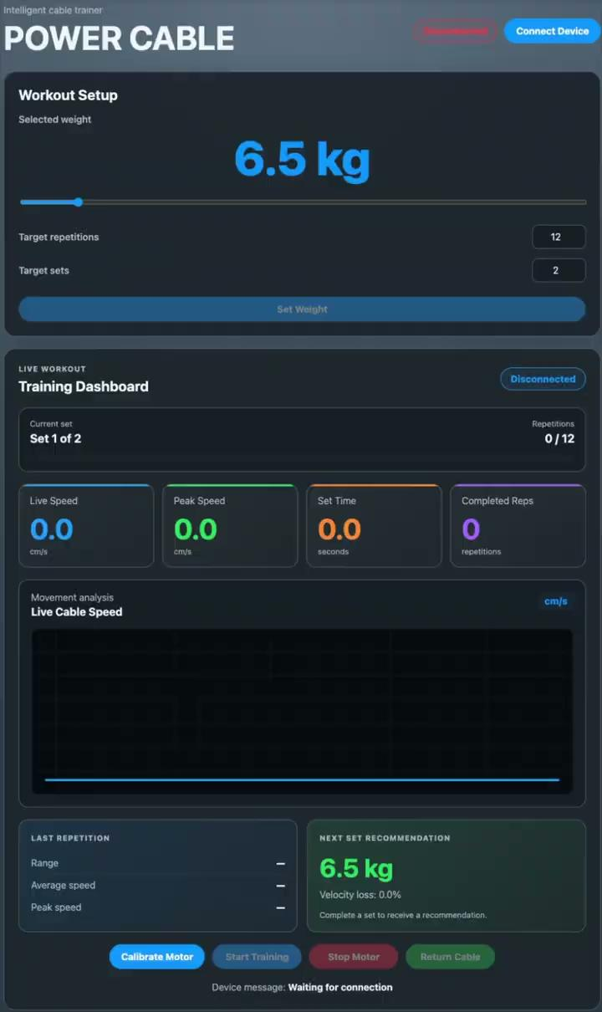
Wireless User Interaction
iOS App - Bluetooth | Web Dashboard - Wi-Fi
portable Workout control | no installation required
Live training data | Live speed visualisation
Sound feedback | Next-set recommendation
Notes:
We also developed two wireless options.
On the left side the iOS application communicates with the ESP32 through Bluetooth and provides workout control and sound feedback.
On the right side the Wi-Fi dashboard runs directly on the ESP32 and does not require an installed application.
Both interfaces display repetitions, set progress, cable speed, set time, and the recommended weight for the next set.

Slide 7
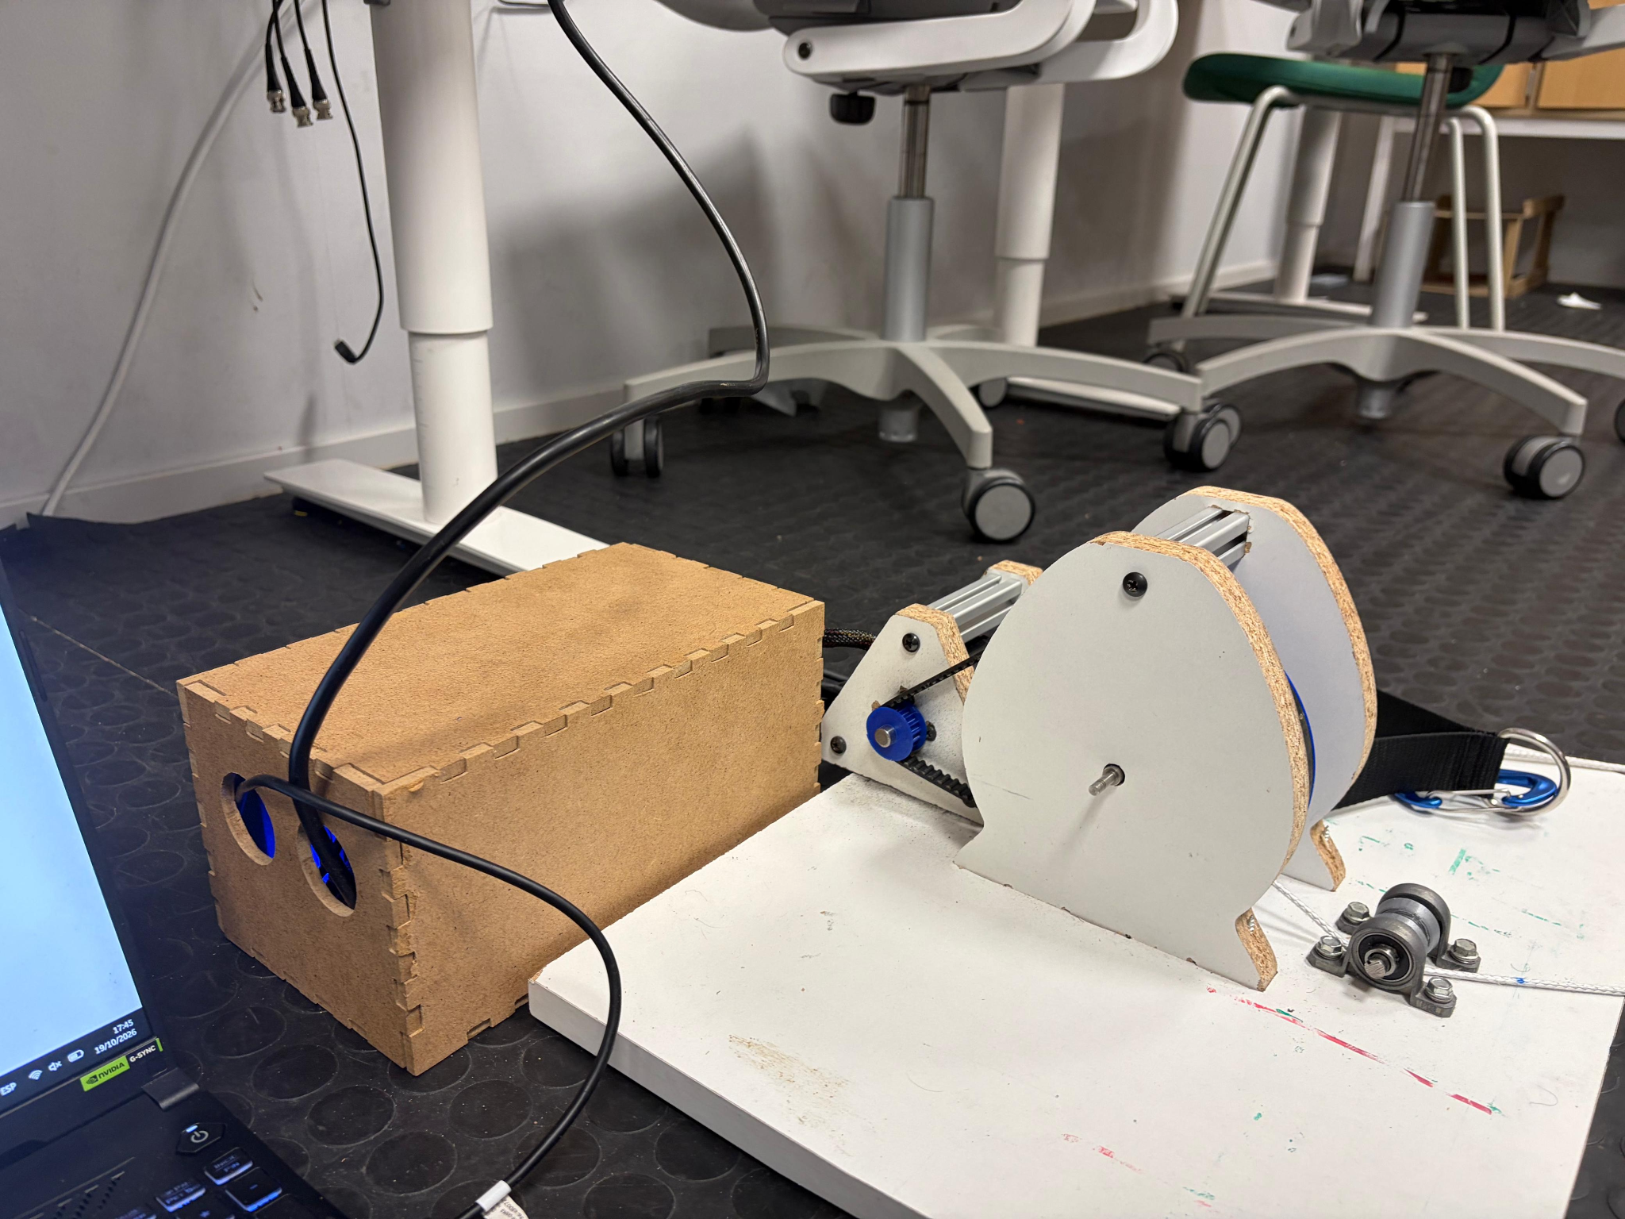
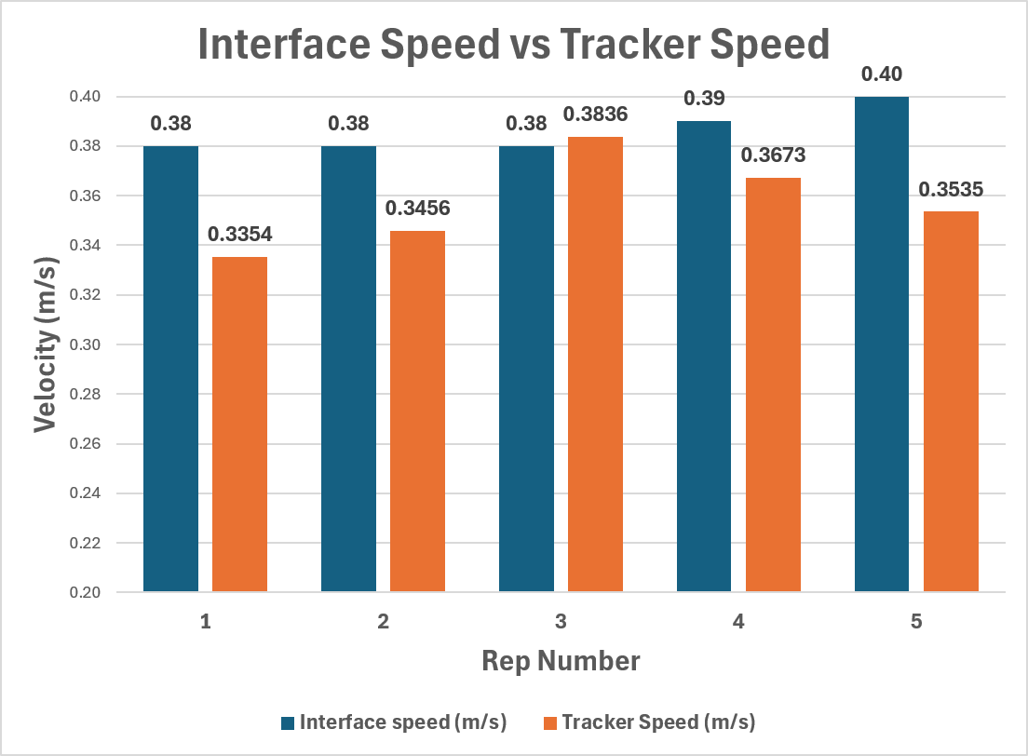
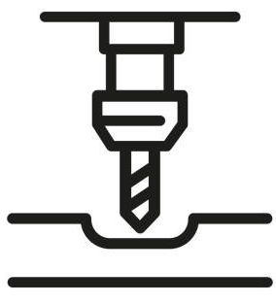
Results
Evaluation
Accurate user speed measuring
8 % average error
Final Prototype:
Covers wires and circuits
Safe and aesthetic
Built with CNC machining
CNC
Notes:
Our result is a working prototype that combines the mechanical system, motor control, and user interfaces
We added an enclosure around the electronics to improve safety and appearance
The user can control the device through the computer interface, iOS application, or WiFi dashboard
The system measures cable movement, counts repetitions, and displays live speed.
During validation, the speed measurement showed an average error of approximately eight percent

Slide 8
PROJECT METHODOLOGY
Hardware | HTML Software | Wi-Fi and App Software
Created a closed box to cover the cables from the power supply an ODrive safely. | Implemented the python project into an HTML interface operable from GitHub Designed the adaptive resistance mode tracking the rep speed | Developed the iOS app using Bluetooth Developed the ESP32-WiFi dashboard Integrated both interfaces with the shared ESP32 firmware
Find a better way of anchoring the cable system. | More research on training efficiency to make the adaptive mode better | Test the adaptive system with more users Start complete system testing earlier
Did Well
Would do differently
Notes:
We divided the project into hardware and software tasks
For the hardware, we developed an enclosure.
For the software, we created the browser interface, ESP32 program, iOS application, and WiFi dashboard
We tested the parts separately before integrating the complete system
The task division and regular testing worked well.
Next time, we would begin full-system testing earlier, improve the cable anchoring, and evaluate the adaptive resistance with more users.

Slide 9
Tack for öss
Questions?
POWER CABLE V2

