Slide 1
Causal
Impact of Bihar’s
Road accident deaths — Bihar
2016 Alcohol
Prohibition
Bihar
Synthetic
A Synthetic Control
& Bayesian Structural
Time Series Analysis
Mohammed Talha Ansari
|
23322016
2016
BS-MS Economics, IIT Roorkee
HST-102 Time Series Analysis
z
May 2026
|
§
amsorrytola/scm-policy-india-

Slide 2
Outline
'
Part I — Setup
¢
Part III — Results
1.
Motivation & policy context
8.
Road-accident deaths (primary)
2.
Research questions
9.
Own tax revenue (fiscal
proxy)
3.
Identification challenge
10.
NSDP per-capita growth
4.
Data & panel
construction
11.
Cross-outcome synthesis
y
Part II — Methodology
è
Part IV — Closing
5.
Synthetic Control
Method
12.
Robustness & limitations
6.
Convex hull
problem & fix
13.
Interactive website demo
7.
Bayesian Structural
Time Series
14.
Conclusions & Q & A
2 / 26

Slide 3
Motivation — Why Study Bihar’s Prohibition?
120M
The policy.
Effective
April 5, 2016
, Bihar enacted to-
tal prohibition on the sale and consumption of alcohol
— the largest sub-national
prohibition by population
affected population
in modern history (~120M people).
Ñ
4,000 Cr
Why this case is methodologically interesting:
·
Sharp, well-dated discontinuity — ideal
for causal
pre-prohibition state excise (FY15–16)
designs
·
Single treated unit
⇒
DiD parallel-trends hard to
defend; SCM is the natural
choice
3 outcomes
·
Multiple competing channels (safety, fiscal,
economic) — direction of net effect is empirical
safety / fiscal
/ economic
3 / 26

Slide 4
Research Questions
?
Three questions, one identification strategy
1.
Did prohibition
reduce road-accident deaths
relative to a counterfactual
Bihar that did not
enact prohibition?
2.
Did prohibition
reduce state own-tax revenue
via the loss of the excise component?
3.
Did prohibition
accelerate or depress per-capita growth
relative to comparable states?
Identification.
Construct a synthetic Bihar as a weighted average of donor states whose
pre-2016 trajectory tracks Bihar’s, then read the post-2016 gap as the treatment effect.
Triangulate with a Bayesian structural
counterfactual
(BSTS).
Why three outcomes? Each isolates a distinct welfare dimension — Q1 the intended public-health gain, Q2
the direct fiscal
cost, Q3 the net economic effect of competing channels.
4 / 26

Slide 5
The Identification Challenge
Standard tools fall
short.
·
DiD
requires parallel
pre-trends — Bihar is
.
Convex hull
caveat
an outlier on income, urbanisation, literacy
Bihar’s pre-period income and urbanisation lie at
·
IV
has no obvious instrument for state-wide
the lower edge of the donor pool.
A naive SCM
policy
optimiser collapses to a corner solution (100%
·
Single treated unit
⇒
no within-treatment
UP weight).
variation
Fix:
include
lagged
outcomes
as
special_predictors
(Abadie
2010
§IV)
— this anchors the synthetic to Bihar’s actual
trajectory, not just its socio-economic profile.
SCM matches the structure.
One treated unit,
many donors, long pre-period — exactly the set-
ting Abadie–Diamond–Hainmueller (2010) intro-
duced the method for.
5 / 26

Slide 6
Data — Panel
Construction
Annual
state panel, 2010–2022
— 15 states
×
13 years = 195 obs.
Telangana excluded (only 2
pre-treatment obs after 2014 bifurcation).
Variable
Source
Description
road_accident_deaths
Persons killed in road accidents
MoRTH PDFs 2010–23
own_tax_revenue_cr
State own-tax revenue (composite,
Ñ
Cr)
RBI Handbook T168
nsdp_pc_current_inr
Net State Domestic Product per capita
RBI Handbook T19
nsdp_growth_yoy
YoY % growth of NSDP per capita (derived)
Computed from T19
urban_share_pct
Urban population share
Census 2011 + interp.
literacy_rate_pct
Literacy rate (age 7+)
Census 2011 + interp.
Acquisition stack.
MoRTH PDFs via Wayback CDX
→
camelot
stream-mode extraction.
RBI behind F5
BIG-IP TSPD cookie wall
— two-step warmup.
Full
provenance log:
data/raw/bihar/SOURCES.md
.
6 / 26

Slide 7
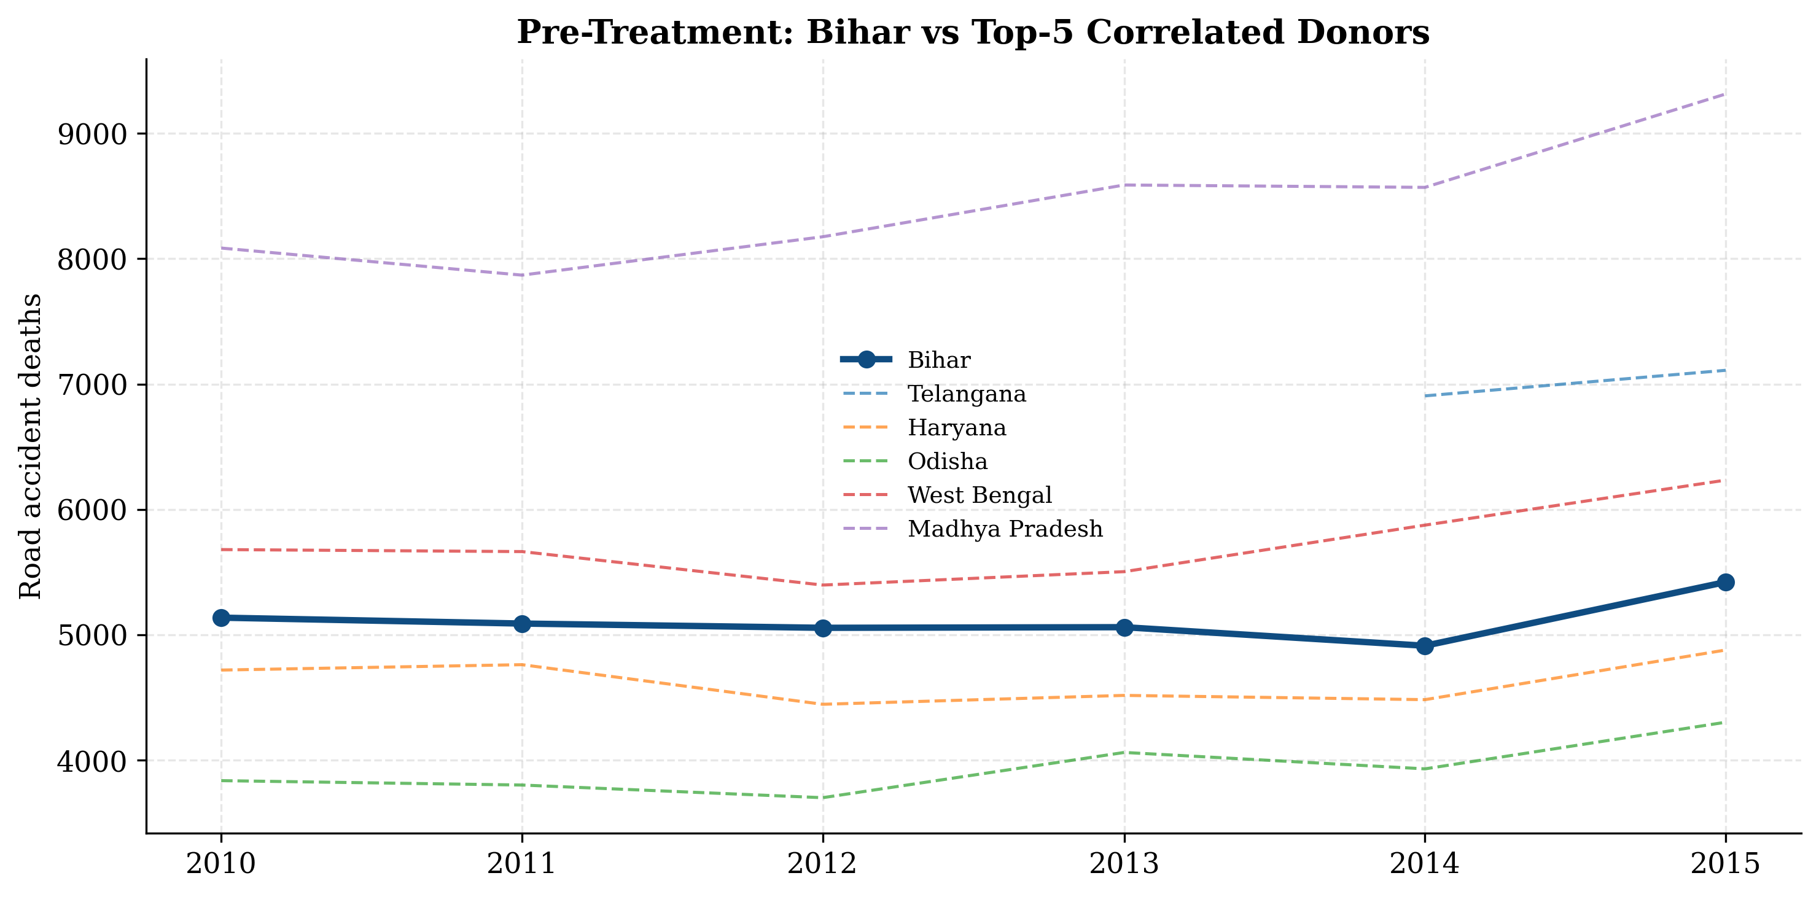
Pre-Treatment EDA — Donor Selection
Top correlated donors (pre-2016):
·
Jharkhand, Odisha, UP, MP, West
Bengal
·
Geographic neighbours & similar
income trajectories
·
Pre-period r
>
0
9 for top 3
.
Why this matters.
Donor pool must span
Bihar’s pre-trend in outcome space.
Se-
lecting on outcome correlation is more
robust than selecting on covariates alone.
7 / 26

Slide 8
Method — Synthetic Control
Treated unit i
= 1 (Bihar) and J donors.
Choose weights
w
= (w
w
)
to solve:
2
, . . . ,
J+1
⊤
n
X
o
w
∗
= arg min
X
1
−
X
0
w
,
W
=
w:w
j
≥
0
,
w
j
= 1
w
∈W
V
X
1
:
predictor vector for treated; X
0
:
K
×
J donor matrix; V :
predictor-importance weight matrix (chosen to
minimise pre-period MSPE).
Two consequences of the convex-hull
constraint:
·
Synthetic Bihar cannot extrapolate beyond the donor envelope — good for honest counterfactuals
·
Near a corner, weights collapse to a single donor
⇒
poor pre-fit + spurious post-period gap
8 / 26

Slide 9
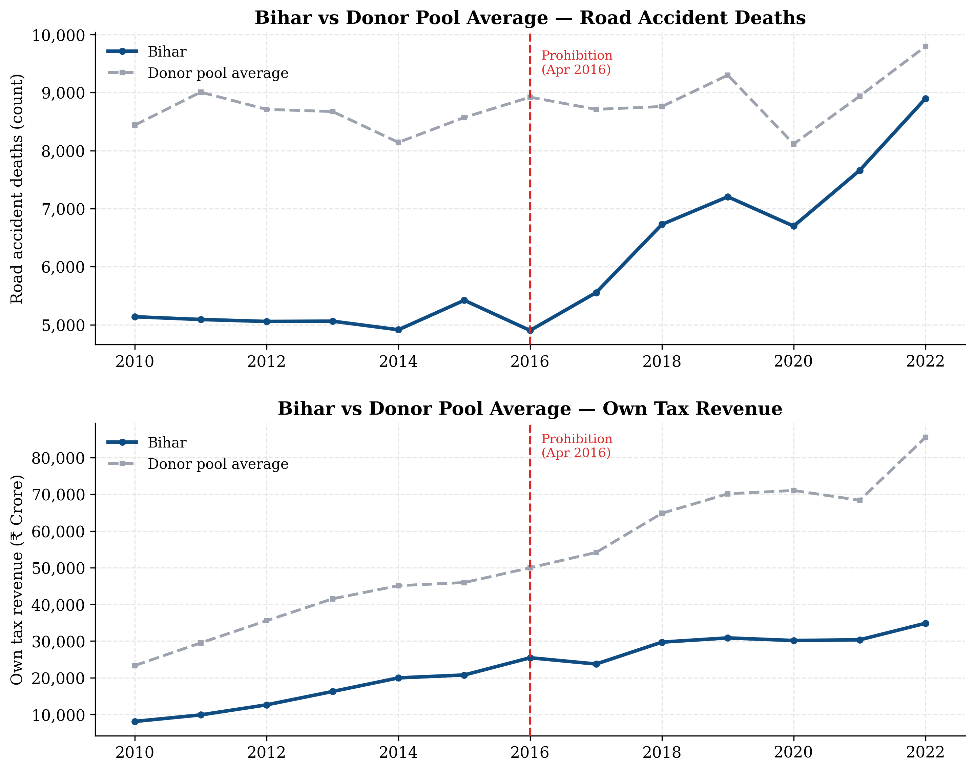
The Convex Hull
Problem — And Its Fix
Without the fix.
·
Match on socio-economic predictors only
·
Optimiser picks 100% UP weight
·
Pre-RMSPE
∼
1,300 deaths
; post gap
meaningless
With lagged-outcome anchoring (Abadie
2010 §IV).
·
Each pre-period year’s outcome
→
a
special_predictor
·
Pre-RMSPE drops to
42 deaths
(
1% of
<
mean) — excellent fit
Bihar persistently below the donor pool
average on
road-accident deaths.
9 / 26

Slide 10
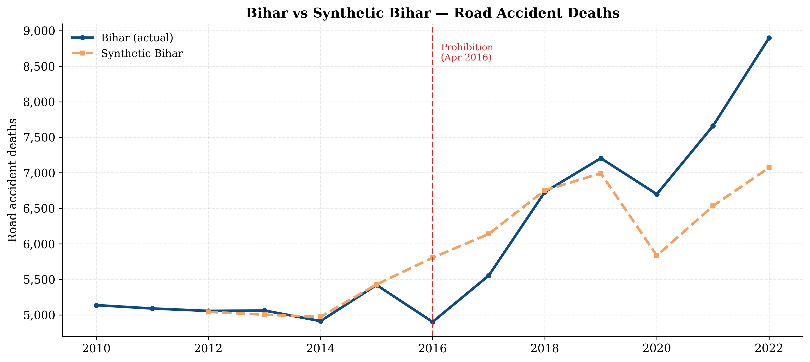
Result — Bihar vs Synthetic Bihar (Road Deaths)
22.87
×
+360 / yr
p
≈
0.071
RMSPE ratio (post/pre)
avg post-treatment
permutation,
rank 2 / 14
gap (deaths)
10 / 26

Slide 11
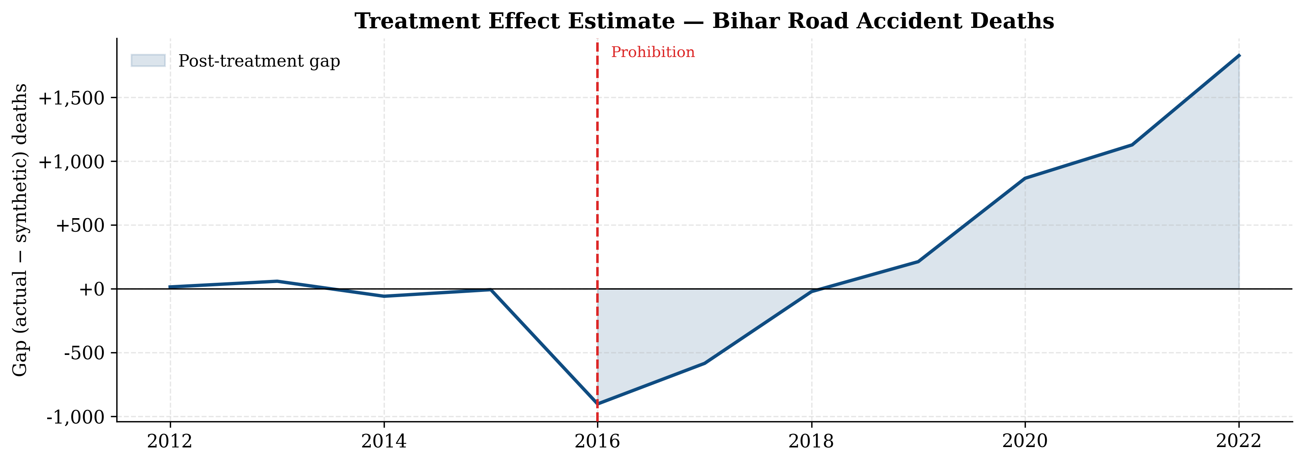
Treatment Effect — Year by Year
Two distinct phases:
2016–2017 (lives saved).
∼
600–900 fewer
deaths than counterfactual; consistent with
immediate compliance.
2018–2022 (effect reverses).
Bihar climbs
above
synthetic
by
+1,000
to
+3,300
deaths/yr — consistent with illicit-market
substitution and weaker enforcement.
Donor weights:
Jharkhand 0.68,
Odisha
0.16, UP 0.16.
11 / 26

Slide 12
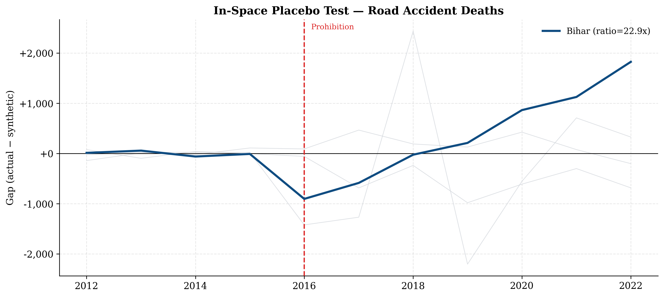
Inference — In-Space Placebo
Permutation test.
Refit SCM treating each of 13 donors
as if treated.
Bihar’s gap (navy)
should stand out from placebos (gray)
if the effect is real.
Rank 2 / 14
p
≈
0.071
Only Maharashtra has a larger ratio —
consistent with its own outlier post-2018
trajectory unrelated to alcohol
policy.
12 / 26

Slide 13
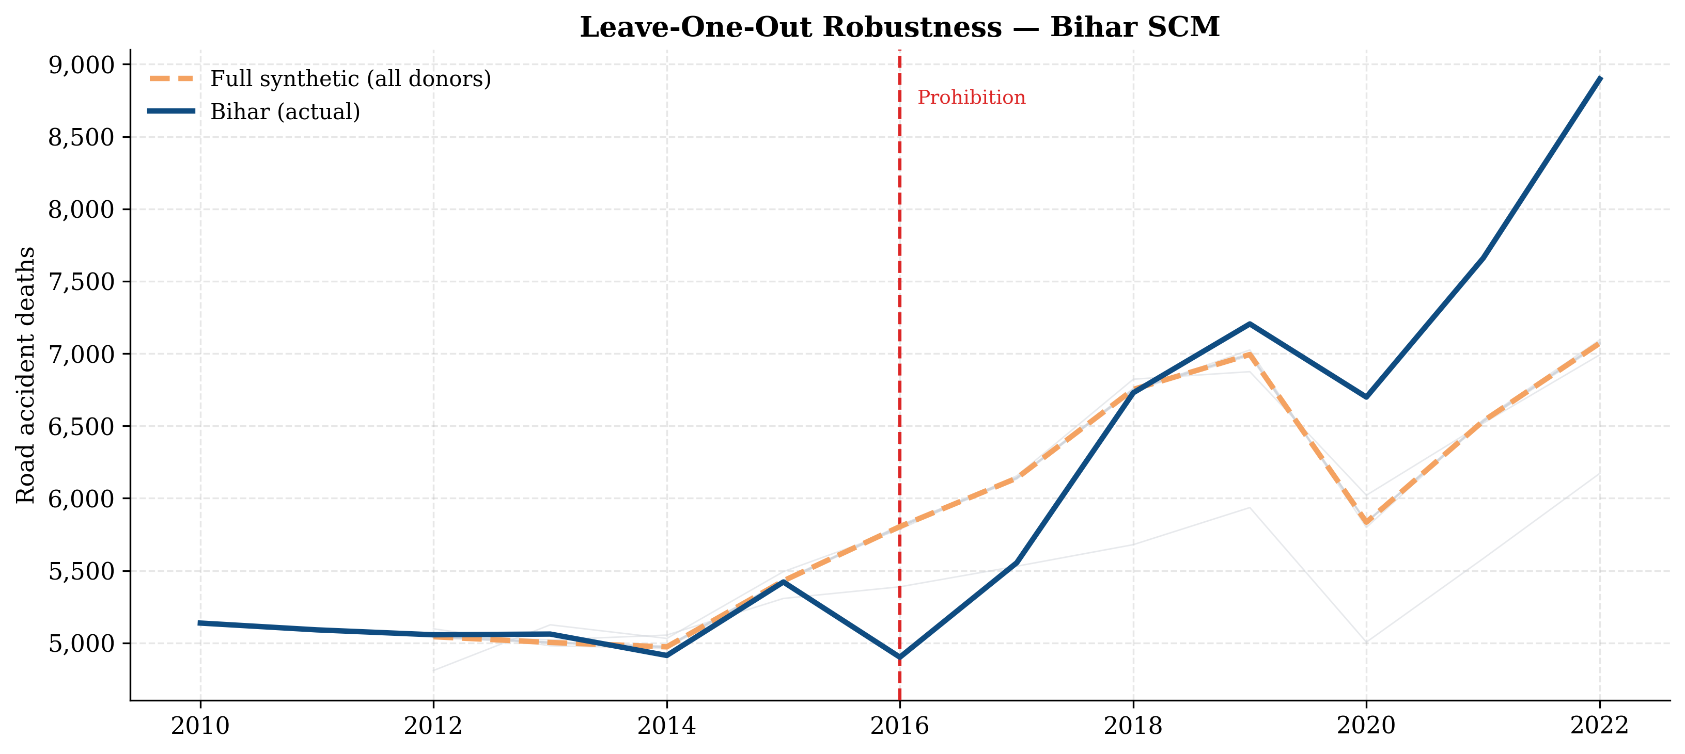
Robustness — Leave-One-Out
Drop each donor in turn.
If a single donor were driving the
result, removing it would collapse the
synthetic.
Instead all
13 LOO refits
trace nearly the same trajectory.
Result
is not
driven by any single
donor — including dropping the dom-
inant Jharkhand weight produces a
materially identical
synthetic.
13 / 26

Slide 14
Method — Bayesian Structural
Time Series
Brodersen et al. (2015) decompose the observed series as:
y
=
µ
+
τ
+
β
⊤
x
+
ε
t
t
t
t
t
µ
t
:
local-level
trend
|
τ
:
seasonality (omitted, annual
data)
|
β
⊤
x
:
regression on donor outcomes with
t
t
spike-and-slab priors
|
ε
∼ N
(0
, σ
2
).
t
Why BSTS triangulates with SCM:
·
Different functional
form (linear regression with priors vs. convex average)
⇒
different
mis-specification risks
·
Yields full
posterior
⇒
credible intervals
·
Caveat:
with n
pre
= 6
≪
J = 13 the regression overfits
⇒
restrict to top-k donors via correlation
(
, Brodersen §3.2)
max_donors=3
14 / 26

Slide 15
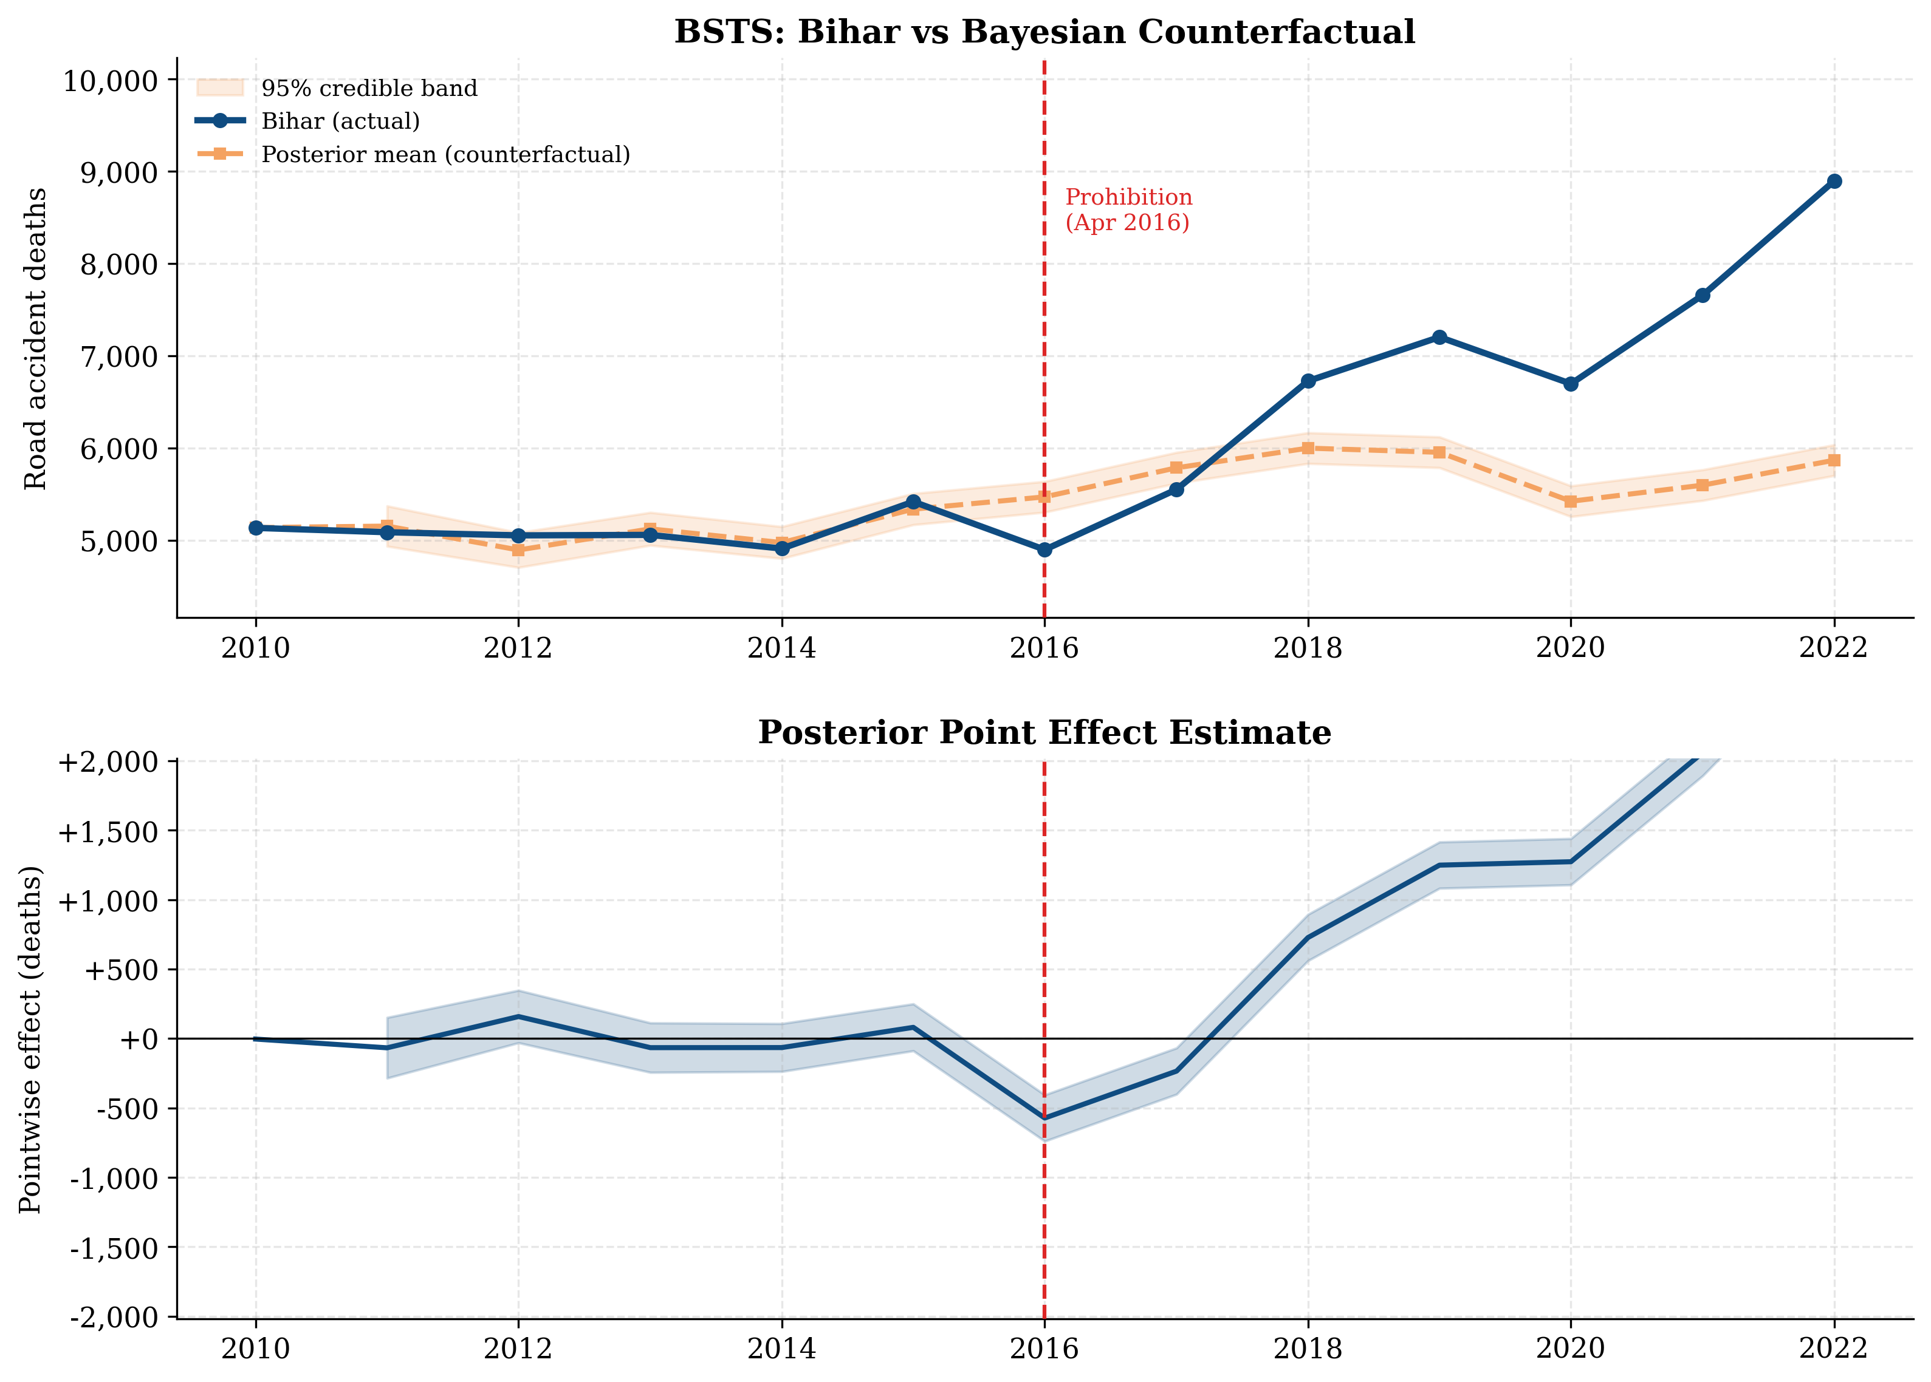
BSTS Result — Road-Accident Deaths
Donors:
Haryana (r = 0
82), Odisha (r = 0
67),
Avg posterior effect:
+1,076 deaths/yr — larger
.
.
West Bengal
(r = 0
63).
than SCM (+360);
BSTS weights post-2020 di-
.
vergence fully.
15 / 26

Slide 16
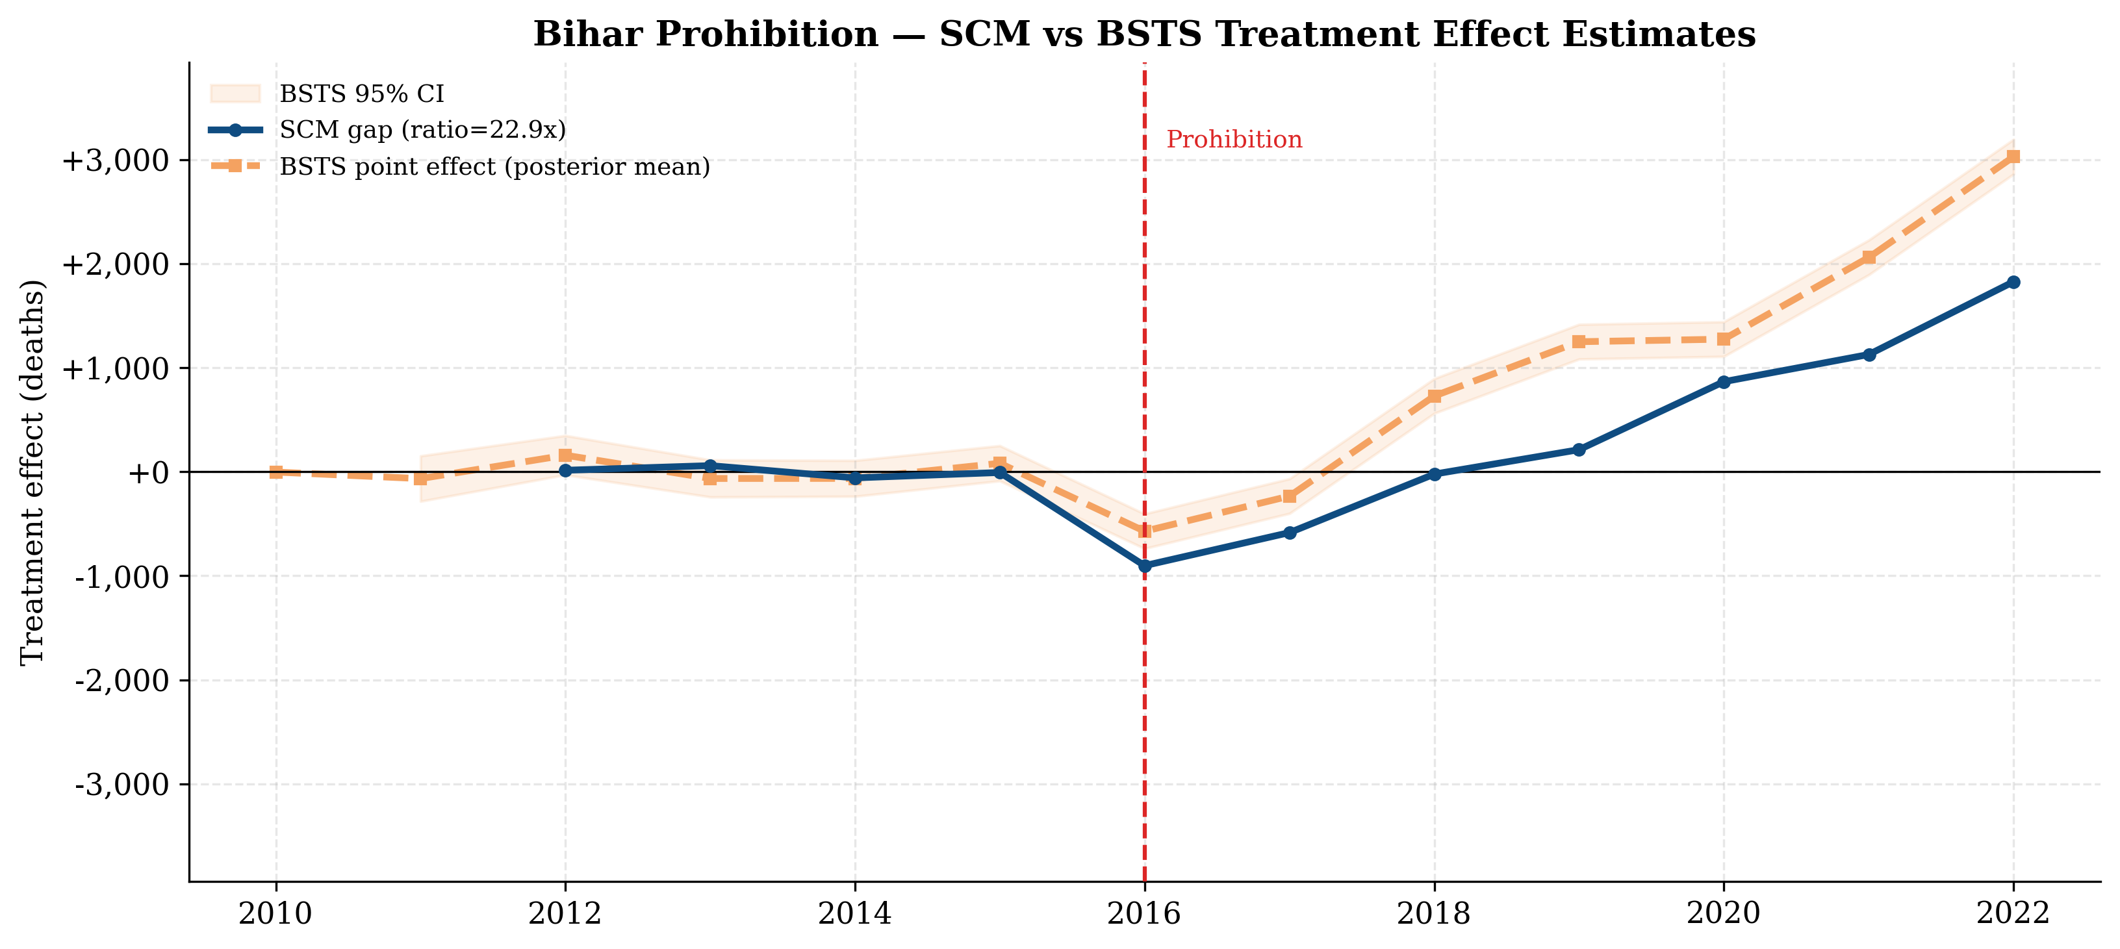
Triangulation — SCM vs BSTS
Sign
Direction
Magnitude
Both negative 2016–17,
Agree year-by-year (10/10)
BSTS
≈
2–3
×
SCM
both positive 2018+
16 / 26

Slide 17
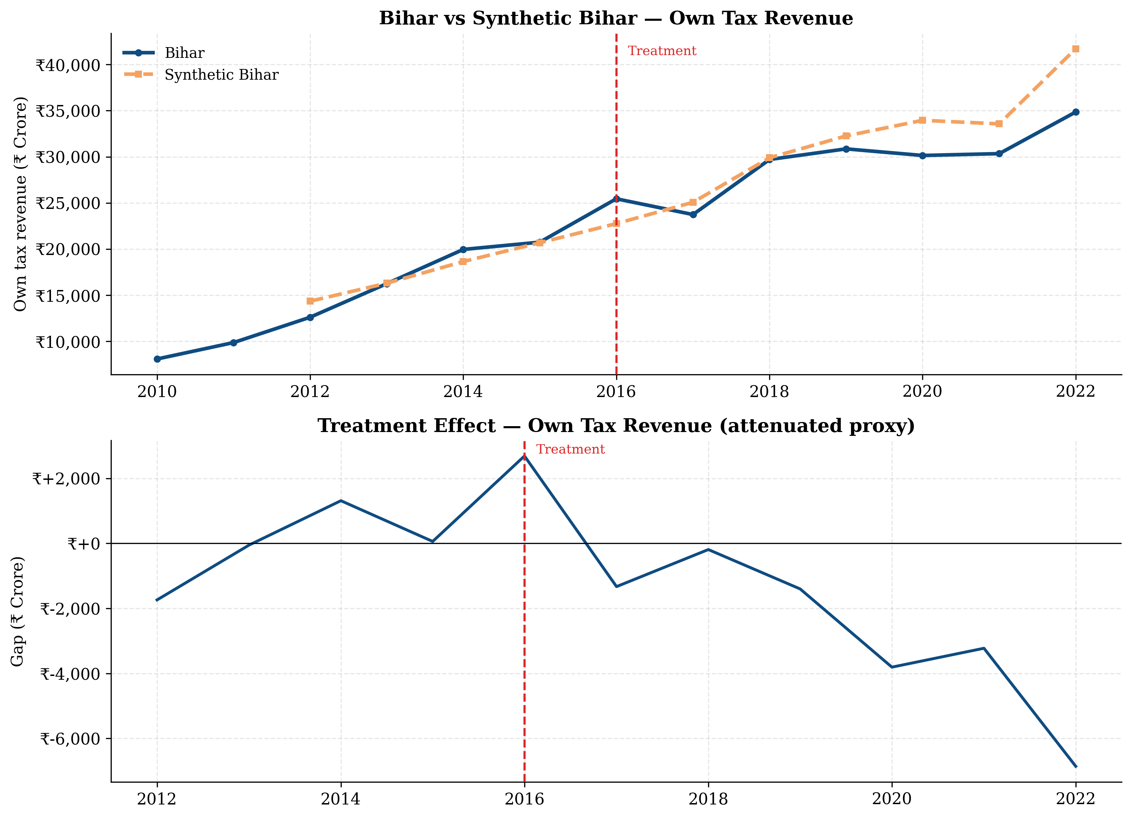
Outcome 2 — Own Tax Revenue (Fiscal)
Composite proxy, not pure excise.
Own-tax revenue includes excise + VAT + GST
compensation + stamps + vehicle tax.
Excise
was
∼
22–25% of pre-prohibition own-tax.
Effect is therefore attenuated.
−Ñ
2,017 Cr / yr
avg post-treatment SCM gap
Donors:
Jharkhand 0.84,
UP 0.16.
Pre-
RMSPE
Ñ
1,091 Cr; ratio 3.16
×
.
17 / 26

Slide 18
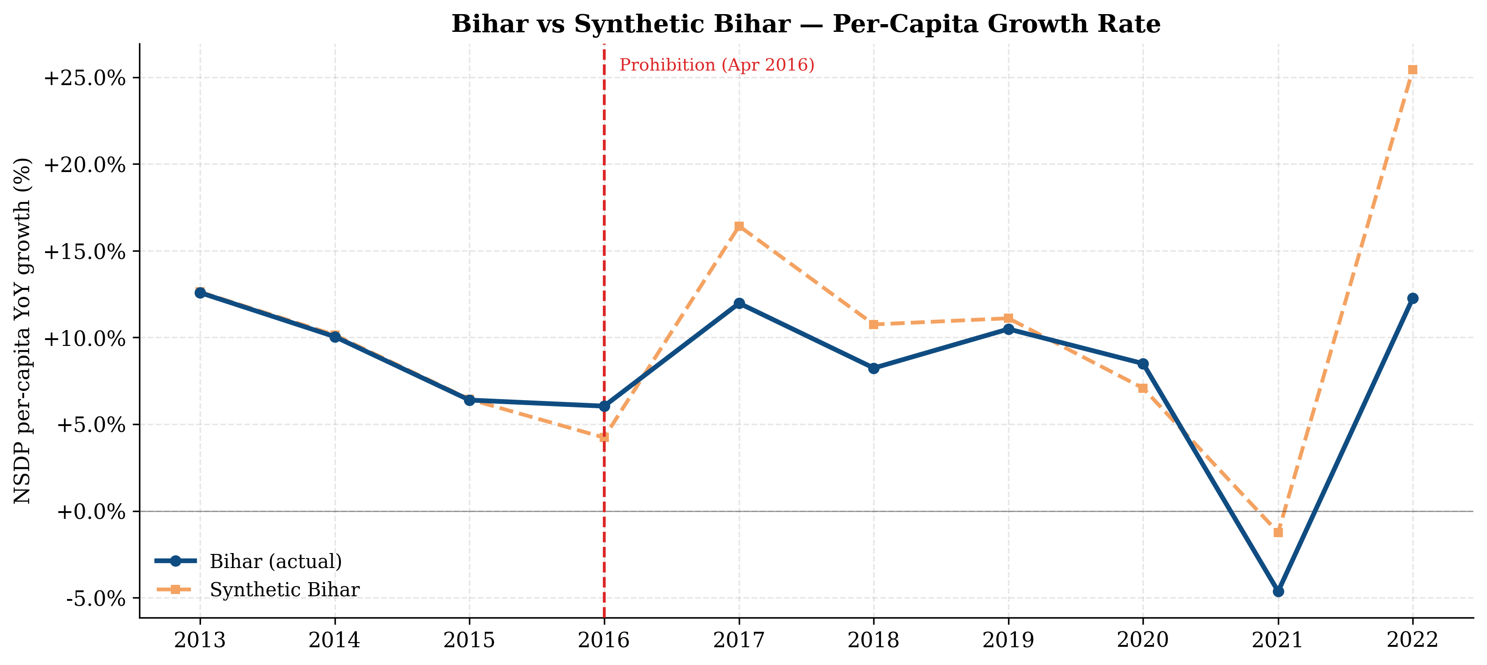
Outcome 3 — Per-Capita Growth (Two Channels)
+
Positive channels
Household reallocation — alcohol
→
food, educa-
tion, savings
Productivity — fewer alcohol-related absences &
accidents
Public health — lower hospital
trauma load
Donors:
Odisha 0.66, Rajasthan 0.32, Jharkhand
0.03.
−
Negative channels
Excise loss —
∼Ñ
4,000 Cr/yr in lost public invest-
ment
Hospitality
contraction
— restaurants,
hotels,
tourism
Bootlegging / shadow economy — unmeasured by
NSDP
18 / 26

Slide 19
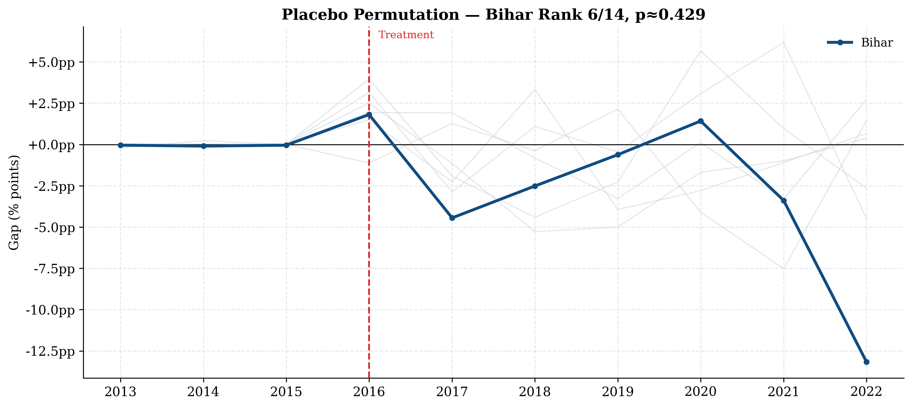
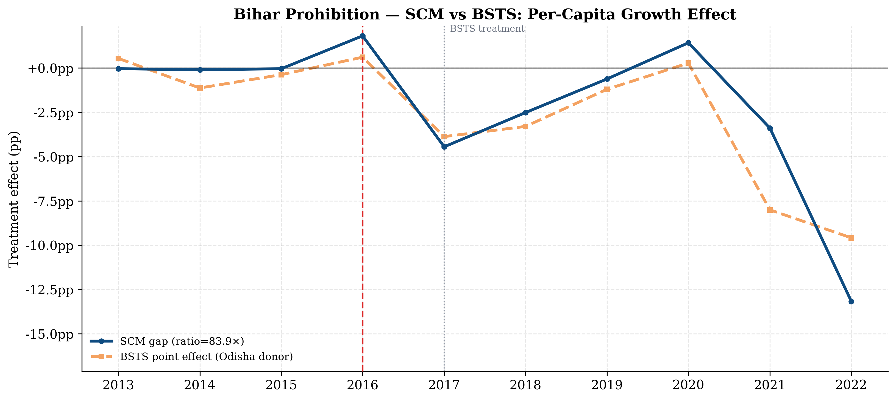
Growth — Placebo & BSTS
In-space placebo — Bihar rank 6/14
SCM (
−
2
99 pp/yr) vs BSTS (
4
28 pp/yr)
.
−
.
Honest interpretation.
Both methods point to Bihar growing
∼
3–4 pp/year slower than counterfactual.
But
SCM permutation p
≈
0
43 (rank 6/14) and BSTS uses a single-donor regression to avoid catastrophic
.
overfit.
Direction is suggestive; significance is not.
19 / 26

Slide 20
Cross-Outcome Synthesis
Outcome
Avg / yr
Ratio
Rank
p
Direction
Road-accident deaths
↓
then
↑
(reversal
post-2018)
+360 deaths
22.87
×
2 / 14
0.071
Own tax revenue
↓
(attenuated)
−Ñ
2,017 Cr
3.16
×
—
—
NSDP per-capita growth
↓
(suggestive)
−
2
99 pp
83.86
6 / 14
0.43
.
×
¥
What we can claim
q
What we cannot claim
·
Significant short-run reduction in road
·
Long-run reduction in road deaths —
deaths (2016–17)
effect reverses
·
Composite tax gap consistent with
·
Pure-excise impact (proxy attenuates)
∼Ñ
4,000 Cr excise loss
·
Statistically significant growth effect
·
Three outcomes paint a coherent
(p
≈
0
43)
.
picture
20 / 26

Slide 21
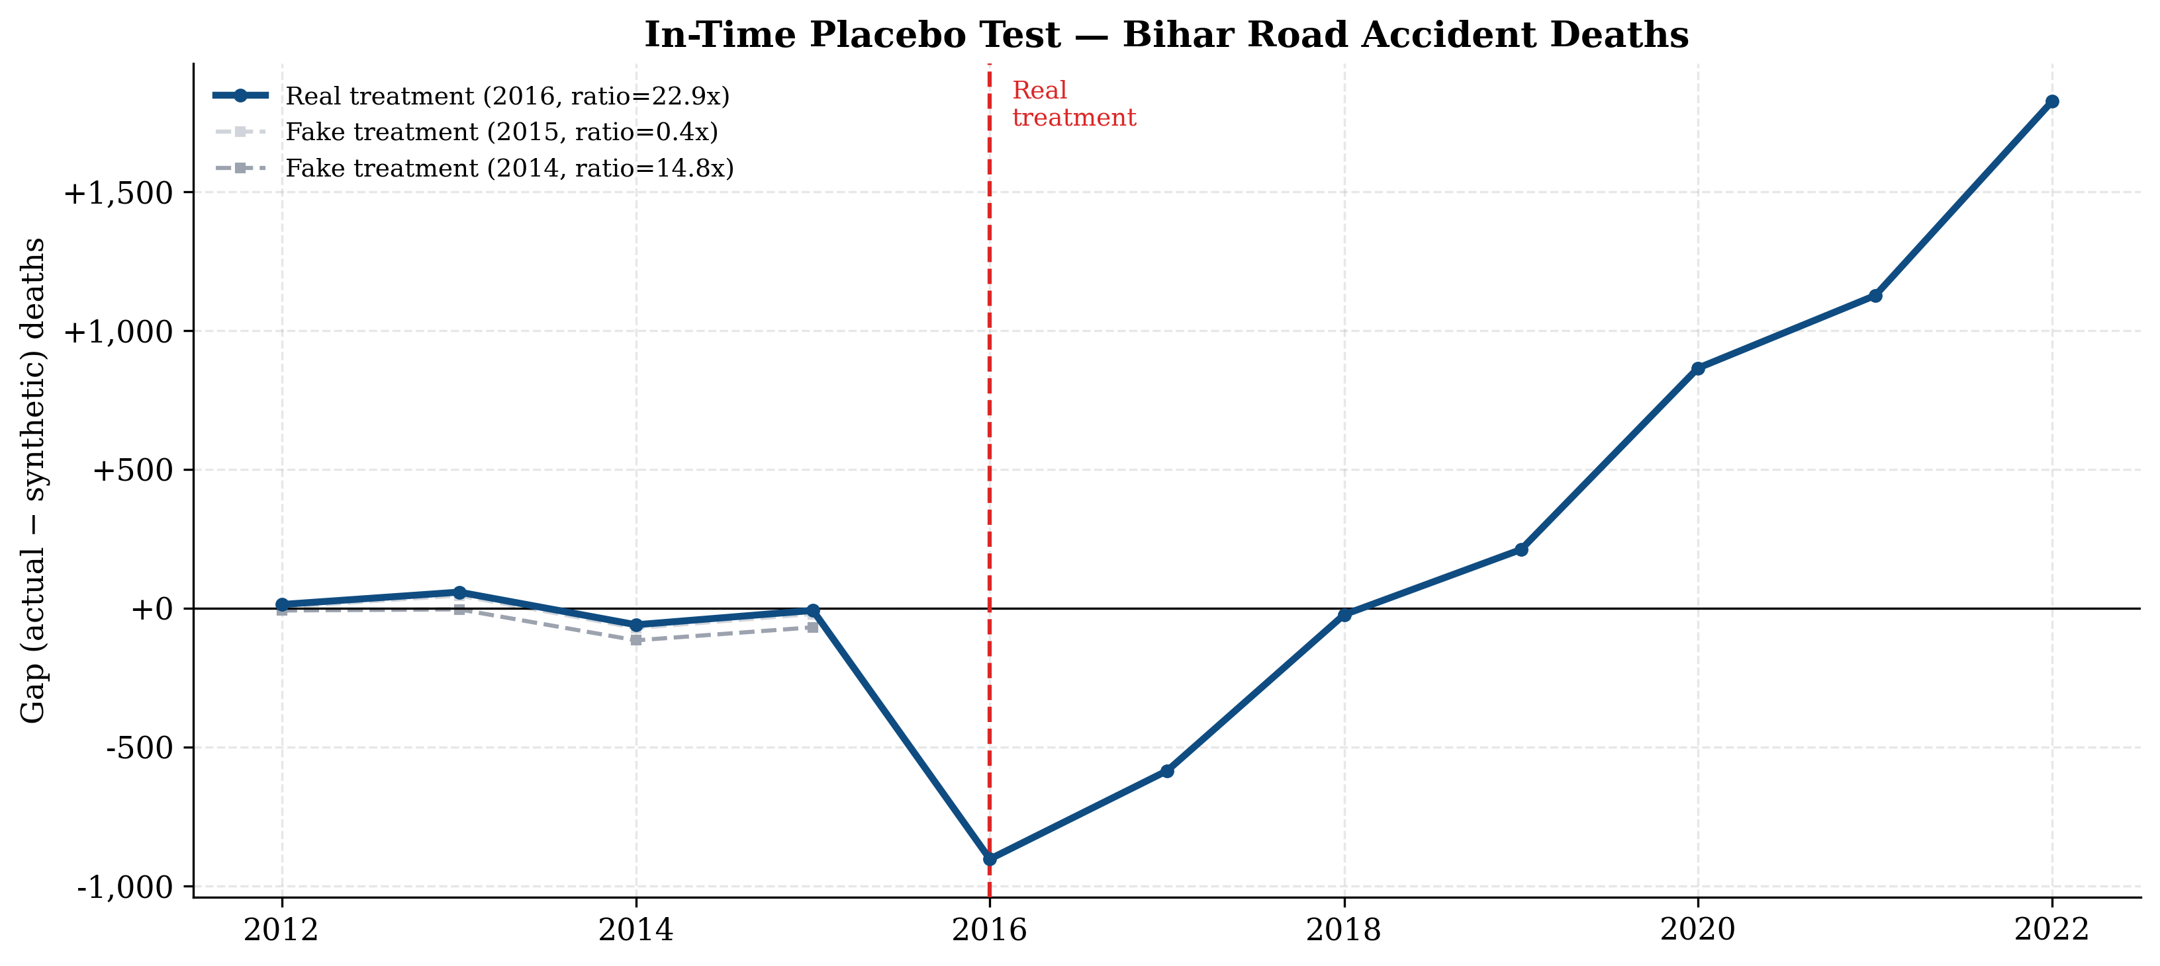
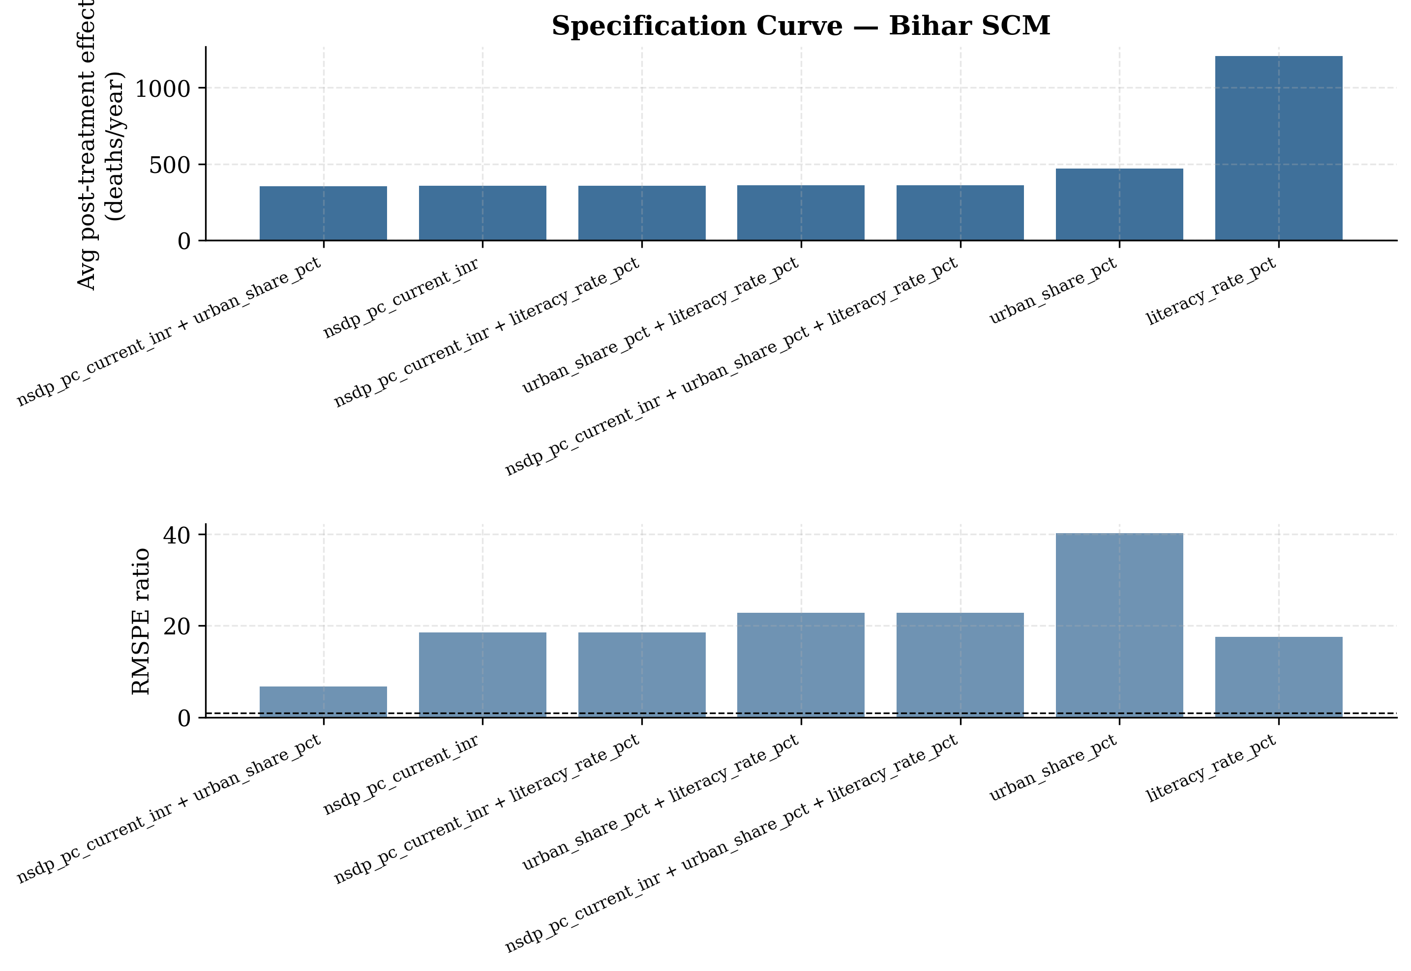
Robustness — In-Time Placebo & Spec Curve
False treatment in 2015 — ratio 0.42
×
7 specifications, 6 with ratio
>
17
×
In-time placebo.
Pretend treatment in 2015
⇒
ratio collapses to 0.42
×
vs. 22.87
×
for the real
2016 —
no false positive.
Spec curve.
6 of 7 alt. specs yield ratios
>
17
×
, avg effects +354 to +469 deaths/yr
(literacy-only outlier excluded).
21 / 26

Slide 22
Limitations
-
Data
-
Method
·
NSDP T19 starts FY 2011–12
⇒
only 4
·
BSTS overfits (n
pre
= 6
<
J = 13)
⇒
pre-period years
max_donors=3
(subjective)
·
Census 2021 delayed; predictors
·
Growth BSTS uses single donor + 2017
interpolated from 2011 anchor
cutoff
·
Excise sub-head WAF-blocked
⇒
·
Permutation p from J = 14 is coarse
composite proxy
(
1
14)
≥
/
-
Identification
Honest framing:
Bihar is a hard SCM case —
short
pre-period,
outlier
on covariates,
COVID
·
Bihar near edge of donor convex hull
confounder.
Triangulating SCM and BSTS is the
·
COVID-19 (2020–21) confounds
strongest defence.
post-2020 estimates
·
Inter-state migration not captured
22 / 26

Slide 23
Companion Tool
— Interactive Website

Live, reproducible deck
_
Endpoints
Stack.
FastAPI
backend serving precomputed
GET
/api/case/bihar
SCM/BSTS JSONs + a live SCM
/refit
endpoint.
GET
/api/case/bihar/scm
Next.js 16 / React 19 / Tailwind 4 / Recharts /
GET
/api/case/bihar/scm/tax
GET
/api/case/bihar/scm/growth
Zustand frontend.
GET
/api/case/bihar/bsts
GET
/api/case/bihar/bsts/tax
Three outcome tabs.
Road accidents, own tax rev-
GET
/api/case/bihar/bsts/growth
enue, NSDP growth — each with main chart, gap
POST /api/case/bihar/refit
chart,
placebo,
donor
weights,
predictor
balance,
POST /api/ask
downloadable CSV.
AI assistant (Gemini
2.5-flash).
Per-tab dynamic
context — the model answers questions on the active
§
github.com/amsorrytola/scm-policy-india-
outcome with the correct numbers + caveats.
23 / 26

Slide 24
Conclusions
/
Headline
Bihar’s 2016 prohibition produced a
statistically meaningful
short-run reduction in road-accident
deaths
(rank 2 / 14, p
≈
0
071) that
reversed by 2018
, alongside a
persistent fiscal
contraction
.
(
2,017 Cr/yr,
attenuated composite) and a suggestive but not significant growth headwind
−Ñ
(
3 pp/yr, p
0
43).
−
≈
.
Methodological
takeaways:
·
Lagged-outcome anchoring is essential
when the treated unit lies near the donor convex-hull
edge
·
BSTS and SCM agree on direction across all
three outcomes; triangulation strengthens the
qualitative claim
·
For short pre-periods, sparse BSTS specifications (1–3 donors) dominate the full-pool
default
24 / 26

Slide 25
Thank you.
Questions & Discussion
§
#

amsorrytola/scm-policy-india-
mohammed_ta@hs.iitr.ac.in
scm-policy-india.vercel.app
Mohammed Talha Ansari
·
BS-MS Economics, IIT Roorkee

Slide 26
References
_
Methodology
·
Abadie, Diamond & Hainmueller (2010).
Synthetic Control
Methods.
JASA, 105(490),
493–505.
·
Abadie, Diamond & Hainmueller (2015).
Comparative Politics and the SCM. AJPS, 59(2),
495–510.
·
Abadie (2021).
Using Synthetic Controls.
JEL, 59(2), 391–425.
·
Brodersen et al. (2015).
Inferring Causal
Impact Using BSTS. AOAS, 9(1), 247–274.
·
Doudchenko & Imbens (2016).
Balancing, Regression, DiD and SCM. NBER WP 22791.
_
Application & Data
Chaudhuri,
K.,
& Jha,
N.
(2024).
Alcohol
Ban and Crime:
The ABCs of the Bihar Prohibition.
EDCC,
72(4).
Data:
MoRTH 2010–23;
RBI
Handbook (T19,
T168);
Census 2011 PCA.
Full
provenance in
data/raw/bihar/SOURCES.md
.
26 / 26

