Slide 1
Using Twitter and Sentiment Analysis to Predict Metacritic Scores
Aidan Spies
Christopher Mendez
Jacob Stovall

Slide 2

Why the Project is Awesome
Metacritic is a review aggregate site that takes critics’ reviews of entertainment products and gives that product a score from 1-100 based on the reviews
We wanted to use Twitter to predict the Metacritic score of a product before it was released
We also wanted create a UI to see how people were reacting to a product in real time.

Slide 3
Usefulness of Knowing a Metacritic Score before a product’s release
Businesses
Knowing a Metacritic score ahead of time can inform the likely demand of product (before it goes to market)
Consumers
Knowing a Metacritic score before the critic’s scores are aggregated can help consumers make a better purchase decision

Slide 4

Data Collection
Our system’s input was text (Twitter Data)
We used the Twitter’s Search API (using a Python library called Tweepy) to gather tweets and save them to csv files based on product
Only Problem is that Twitter’s Search API is restrictive
Can only look 7 days in past for tweets
Ended up with 20 datasets of 1,000 tweets
15 were used for training and 5 were used for testing

Slide 5
Other Data Collection
Sentiment Dictionary
Used dictionary created by Finn Arup Nielsen from the web
Rated words and phrases from 5 (being very positive) to -5 (being very negative)
Metacritic Scores
Collected manually and saved to a text file

Slide 6
Feature Extraction Process
Each tweet was set to all lower case and had the following removed during analysis:
Stop Words
Usernames
Links
“rt” Strings
Topic Words (So if you searched “Forest Gump”, “Forest” and “Gump” was removed)
Sentiment Analysis was then performed and the tweet was checked for uniqueness

Slide 7
Chosen Features Not Chosen Features
Average Positive Sentiment Score for Topic
Total Positive Sentiment / # Tweets
Average Negative Sentiment Score for Topic
Total Negative Sentiment / # Tweets
Uniqueness
Unique Count of Tweets / # Tweets
Individual Word Count
Too easy to skew for a specific topic and possibly spam
Average Unique Positive and Negative Sentiment
T-test scores weren’t very good (They weren’t really good for any of the variables but we’ll get to that later)

Slide 8
Final Model
Predicted Score = 65.6814 + 18.9509 (avgNeg) + 0.5334(avgPos) – 3.2850 (unique)
We’ll talk more about model evaluation in a bit but first…

Slide 9
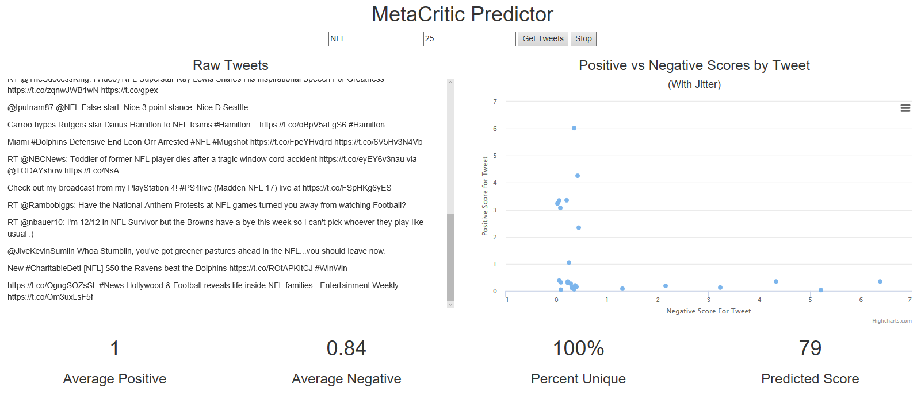
DEMO of User Interface

Slide 10
Model Quantitative Evaluation
Average Percent Error: 31.05%

Slide 11
Possible Issues & Ways it Could Be Fixed
Small Dataset
The regression model is only based on 15 points of data (which isn’t a lot to work with). With more data, the model might’ve improved and showed better trends.
Advertising / Spam Tweets
Could be skewing the sentiment scores. Hard to deal with without manually removing those tweets or creating a classifier to remove those tweets.
The Data Itself
The T-Scores for all of the variables were non-significant. If someone wanted to predict Metacritic scores and the two steps above didn’t help, the next step might be to look at other data sources.

Slide 12
In Conclusion
The regression model ended up being inaccurate but there are a few steps that could be taken in order to possibly improve it.
However, we still believe our project was a success because we got a pretty neat user interface and learned a lot working on this project

Slide 13
QUESTIONS?

