Slide 1

Intro to Haml
Amy Lee
amy@sequencemediaworks.com
Notes:
Self intro:
- a friend introduced me to Haml a couple of years ago
- used it on my last/current assignment
- I’m here today to show you why I think it’s cool

Slide 2
Today’s Menu
A little background
What’s Haml look like?
Haml’s goals
… live coding demo …

Slide 3
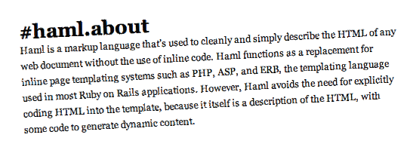
A little background…

Slide 4

Notes:
Back in 2006 Hampton Catlin released Haml to the world

Slide 5
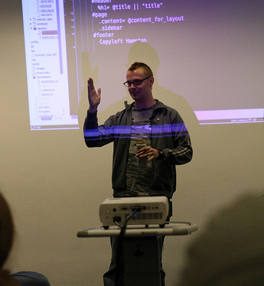
Hampton Introduces Haml
RailsConf Europe 2006
London
*http://www.ror-exchange.com/railsconf-europe-2006
Notes:
RailsConf Europe 2006: “HAML: Naughty Boys Need Structure”
Audio still available:
http://www.ror-exchange.com/railsconf-europe-2006

Slide 6
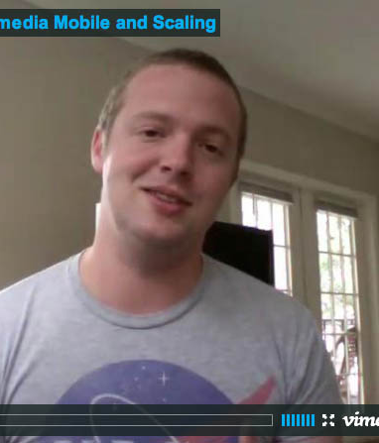
Hampton in the Present
Currently in England
Head of Wikipedia Mobile “is written 100% in Haml, Sass, Merb”

Slide 7
Hampton vs. Rails
Rails templates were icky … “all code should be beautiful”
“templating language with principles”

