Slide 1

Intro to Haml
Amy Lee
amy@sequencemediaworks.com
Notes:
Self intro:
- a friend introduced me to Haml a couple of years ago
- used it on my last/current assignment
- I’m a web apps programmer, designer, sysadmin-lite
- I’m here today to show you why I think it’s cool

Slide 2
Today’s Menu
A little background
What’s Haml look like?
Haml’s goals
… live coding demo …

Slide 3
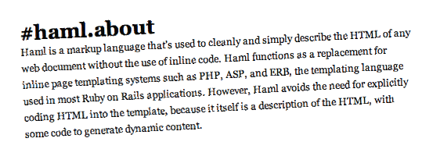
A little background…

Slide 4

Notes:
Back in 2006 Hampton Catlin released Haml to the world

Slide 5
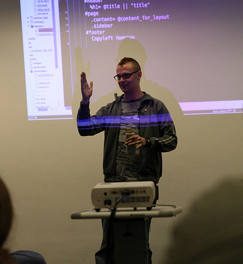

Hampton Introduces Haml
RailsConf Europe 2006
London
*http://www.ror-exchange.com/railsconf-europe-2006
Notes:
RailsConf Europe 2006: “HAML: Naughty Boys Need Structure”
Audio still available:
http://www.ror-exchange.com/railsconf-europe-2006

Slide 6
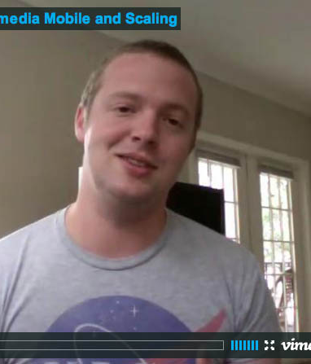
Hampton in the Present
Currently in England
Head of Wikipedia Mobile “is written 100% in Haml, Sass, Merb”
http://hamptoncatlin.com/
Notes:
- Since they can’t be here I wanted to at least show what they look like
“I think it took me about a week of coding to get it done. Except, really we were maturing it over about 2 months. But, if you counted actual coding, probably a week or so at the time (Ruby newbie then).
Nathan started sending patches right away. And I think it was only a couple of months in before he was basically re-writing the engine. The handover was in slow motion over a year or so... but it kind of just happened naturally. Nathan is an amazing programmer and is fantastic at getting every little detail taken care of.”

Slide 7

… Nathan Weizenbaum
Univ. Wash.
Sent patches to Hampton
Rewrote the Haml engine
Current maintainer
http://nex-3.com/
Notes:
“I think it took me about a week of coding to get it done. Except, really we were maturing it over about 2 months. But, if you counted actual coding, probably a week or so at the time (Ruby newbie then).
Nathan started sending patches right away. And I think it was only a couple of months in before he was basically re-writing the engine. The handover was in slow motion over a year or so... but it kind of just happened naturally. Nathan is an amazing programmer and is fantastic at getting every little detail taken care of.”

Slide 8
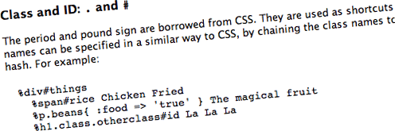
What’s Haml look like?
Notes:
… next slide: Plain ol’ HTML

Slide 9
<p><a href=“menu.html” class=“navitem”>Le Menu<span class=“editlink”>Edit</span>
</a></p>
Ay!
So cluttered!
So repetitive!

Slide 10
<p><a href=“menu.html” class=“navitem”>Le Menu<span class=“editlink”>Edit</span>
</a></p>
Ooo… shiny!
%p
%a.navitem{:href=>“menu.html”}
Le Menu
%span.editlink Edit

Slide 11
One tag per line (roughly)
2 spaces indentation
Class names
Attributes in hashes
%p
%a.navitem{:href=>“menu.html”}
Le Menu
%span.editlink Edit

Slide 12
<p>
<a href=‘menu.html’ class=‘navitem’>
Le Menu
<span class=‘editlink’>Edit</span>
</a>
</p>
%p
%a.navitem{:href=>“menu.html”}
Le Menu
%span.editlink Edit

Slide 13
Hampton vs. Rails
Rails templates were icky … “all code should be beautiful”
“templating language with principles”

