Slide 1

Intro to Haml
Amy Lee
amy@sequencemediaworks.com
Notes:
Self intro:
- a friend introduced me to Haml a couple of years ago
- used it on my last/current assignment
- I’m a web apps programmer, designer, sysadmin-lite
- I’m here today to show you why I think it’s cool

Slide 2
Haml
Haml
XHTML Abstraction Markup Language
Notes:
HAML = XHTML Abstraction and Markup Language

Slide 3
Today’s Menu
A little background
What’s Haml look like?
Haml’s goals
… live coding demo …
Wrapping up

Slide 4
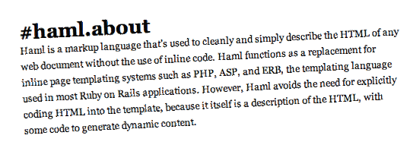
A little background…

Slide 5

Notes:
Rewind time … back in 2006 Hampton Catlin released Haml to the world…

Slide 6
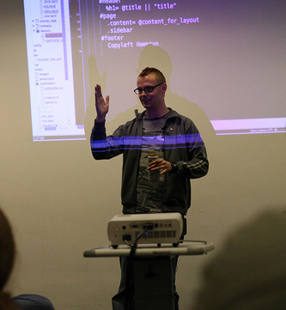

Hampton Introduces Haml
RailsConf Europe 2006
London
*http://www.ror-exchange.com/railsconf-europe-2006
Notes:
RailsConf Europe 2006: “HAML: Naughty Boys Need Structure”
Audio still available:
http://www.ror-exchange.com/railsconf-europe-2006
Sensitive ears warning: a bit of profanity

Slide 7

Hampton in the Present
Currently in England
Head of Wikipedia Mobile “is written 100% in Haml, Sass, Merb”
http://hamptoncatlin.com/
Notes:
- Since they can’t be here I wanted to at least show what they look like
“I think it took me about a week of coding to get it done. Except, really we were maturing it over about 2 months. But, if you counted actual coding, probably a week or so at the time (Ruby newbie then).
Nathan started sending patches right away. And I think it was only a couple of months in before he was basically re-writing the engine. The handover was in slow motion over a year or so... but it kind of just happened naturally. Nathan is an amazing programmer and is fantastic at getting every little detail taken care of.”

Slide 8

… Nathan Weizenbaum
(why•zen•bowm)
Univ. Wash.
Sent patches to Hampton
Rewrote the Haml engine
Current maintainer
http://nex-3.com/
Notes:
“I think it took me about a week of coding to get it done. Except, really we were maturing it over about 2 months. But, if you counted actual coding, probably a week or so at the time (Ruby newbie then).
Nathan started sending patches right away. And I think it was only a couple of months in before he was basically re-writing the engine. The handover was in slow motion over a year or so... but it kind of just happened naturally. Nathan is an amazing programmer and is fantastic at getting every little detail taken care of.”

Slide 9

What’s Haml look like?
Notes:
… next slide: Plain ol’ HTML

Slide 10
<p><a href=“menu.html” class=“navitem”>Le Menu<span class=“editlink”>Edit</span>
</a></p>
Ay!
So cluttered!
So repetitive!
Notes:
Have to keep typing < and >, quotes, equals signs
that’s just straight HTML!
ERB stuff means more <%= … %>
take a look at Haml…

Slide 11
<p><a href=“menu.html” class=“navitem”>Le Menu<span class=“editlink”>Edit</span>
</a></p>
Ooo… shiny!
%p
%a.navitem{:href=>“menu.html”}
Le Menu
%span.editlink Edit
Notes:
BAM!
Simple
Features

Slide 12
One tag per line (roughly)
2 spaces indentation
Class names
Attributes in hashes
%p
%a.navitem{:href=>“menu.html”}
Le Menu
%span.editlink Edit
Notes:
Tags can be made up too
Class names … or IDs
Attributes get auto-escaped
… see output …

Slide 13
<p>
<a href=‘menu.html’ class=‘navitem’>
Le Menu
<span class=‘editlink’>Edit</span>
</a>
</p>
%p
%a.navitem{:href=>“menu.html”}
Le Menu
%span.editlink Edit
Notes:
Nice and neat

Slide 14

Haml’s goals

Slide 15
Goals
Clean, predictable conventions “Markup should be beautiful”
Fast to type, less redundancy DIVs by default, implied closing tags, !!! shortcuts
Strong relationship: Haml ←→ CSS Makes cut-n-paste soooo fast
Raw HTML/JS/CSS still OK! Doesn’t force you to abandon custom code
Notes:
Haml is clean, simple, predictable, fast
Strong tie-in between CSS syntax and Haml templates
You still can do all the normal HTML stuff, evals
Lots of helpers and shortcuts

Slide 16
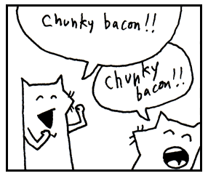
Live Demo

Slide 17
(Live coding)

Slide 18
Wrapping up

Slide 19
Easy install gem install haml
Haml <3s CSS %li.navItem.otherClass
Simple syntax %tag{attrs=>vals} text
Indentation! 2 spaces
Auto-closing %p => <p>…</p>
Easy to add Ruby - some_method.each do
Plenty of helpers &= !!!Strict :javascript
Notes:
Haml is clean, simple, predictable, fast
Strong tie-in between CSS syntax and Haml templates
You still can do all the normal HTML stuff, evals
Lots of helpers and shortcuts

Slide 20
Resources
Haml – The main home page http://haml-lang.com/
Tutorial http://haml-lang.com/tutorial.html
Google group http://groups.google.com/group/haml
Rendera – HTML5 editor w/ Haml+Sass http://rendera.heroku.com/
Notes:
-also Peepcode

Slide 21
Thx!
Thx!
(Any questions … ?)
Notes:
HAML = XHTML Abstraction and Markup Language

Slide 22
(Backup slides)

Slide 23
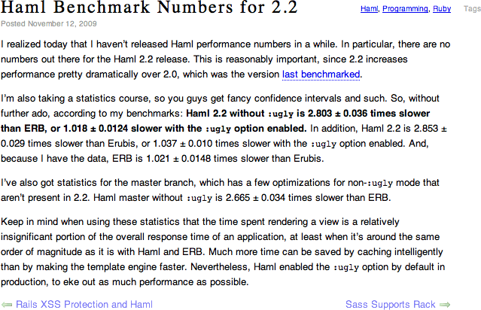
Haml 2.2 Benchmarks
vs. ERB:
Without :ugly 2.8 times slower
With :ugly 1.018 times slower
http://nex-3.com/posts/87-haml-benchmark-numbers-for-2-2

Slide 24










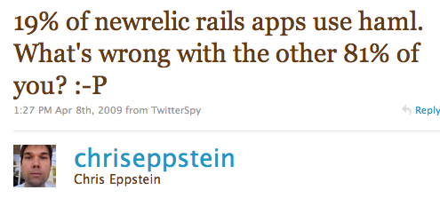

Who’s using Haml?

Slide 25
Hampton vs. Rails
Rails templates were icky … “all code should be beautiful”
“templating language with principles”

