Slide 1
CapStone Final Project
Ioannis Samaras
Objectives: Two major Greek Cities, Athens & Thessaloniki
Determine whether the two are similar or dissimilar
Classification of areas inside the city and determine if they are suitable for locals or tourists

Slide 2
Data
1. Athens - https://github.com/amstersam/Coursera_CapStone_FInal_Project/blob/master/Athens.csv
2. Thessaloniki - https://github.com/amstersam/Coursera_CapStone_FInal_Project/blob/master/Thessaloniki.csv
3. Greek Postal Codes - https://github.com/amstersam/Coursera_CapStone_FInal_Project/blob/master/postcode_lat_long_gr.csv

Slide 3
Data Exploration
1. Group by Area, District
2. Head
3. Subset to identify specific District
4. Foursquare function getNearbyVenues

Slide 4
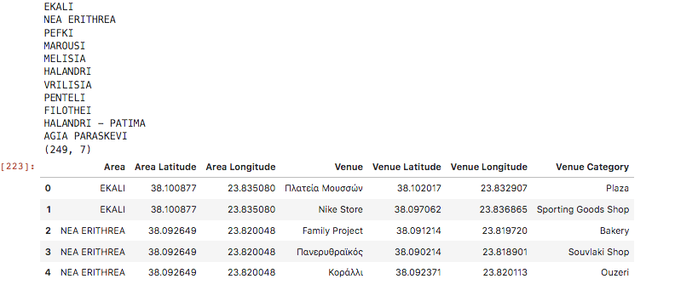
Analysis I
Athens

Slide 5
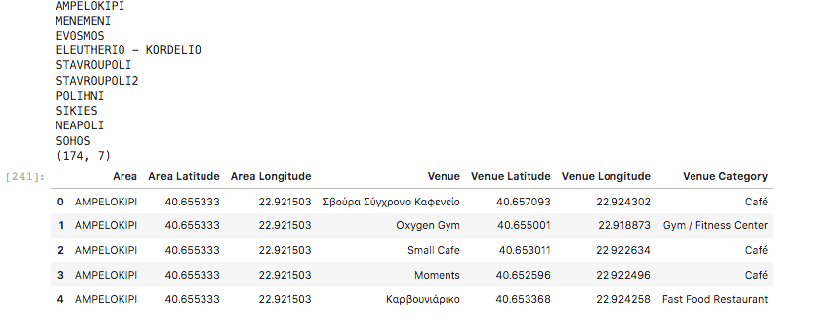
Analysis II
Thessaloniki

Slide 6
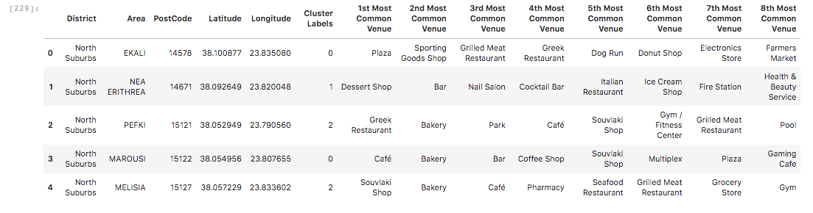
K-means I
Athens

Slide 7
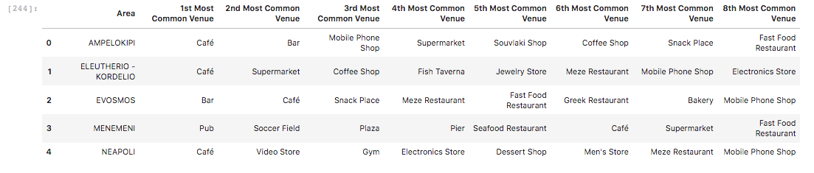
K-means II
Thessaloniki

Slide 8
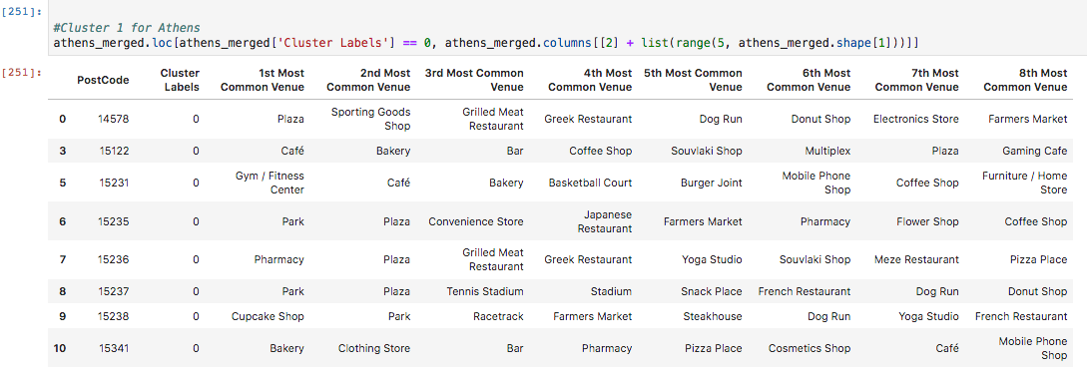
Conclusions

Slide 9
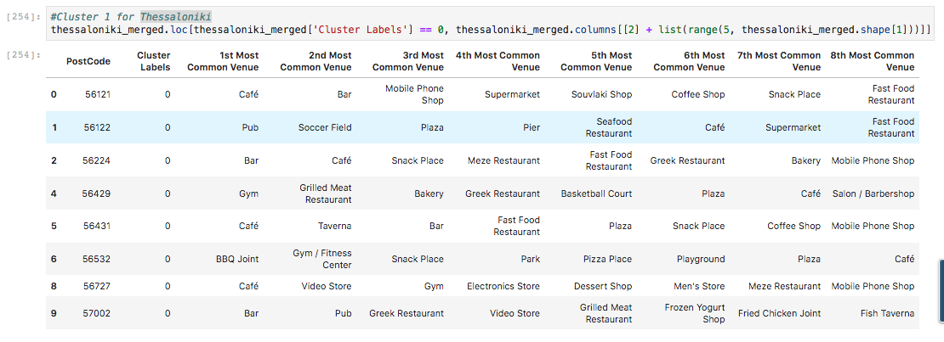
Conclusions

Slide 10
Conclusions
All things considered:
North Suburbs of Athens ≈ West Suburbs of Thessaloniki
Both areas are highly residential, thus attractive to locals

