Slide 1


Chapter 6
Personal Growth and Development

Slide 2
Chapter Overview
Personal development—receptiveness to change
Making behavior modification work for you
Understanding yourself
Understanding others/Respecting differences
Assessment of your strengths and areas for improvement
Developing your communication skills
Leadership and Teamwork
Mental and physical wellness
Motivating Yourself

Slide 3
Receptiveness to Change
How many of you want to change something about yourself?

Slide 4
Personal Development Receptiveness to Change
Personal Total Quality Management (TQM)
Strive to change, grow, and improve yourself continuously in every area that impacts your effectiveness
Student Development
Areas in which you need to grow, change, or develop to achieve your goal of receiving your B.S. degree in engineering or Computer Science

Slide 5
Value Judgments Applied to Our Actions
Actions
Productive actions – support the achievement of your goals
Non-productive actions – Interfere with or work against the achievement of your goals

Slide 6
Thoughts and Actions
Negative Thought | Non-Productive Action
“I’m so far behind I don’t get anything out of going to class.” | Cut class
“I learn better studying by myself.” | Spend 100% of time studying alone
“Physics is too hard. I just can’t do it.” | Procrastinate. Don’t study
“The professors don’t seem to want to help me.” | Avoid seeking help from professors or TAs
“I don’t like having my life run by a schedule.” | Waste time by not scheduling it
“I’m not good at writing and I don’t like doing it.” | Avoid opportunities to develop writing skills

Slide 7
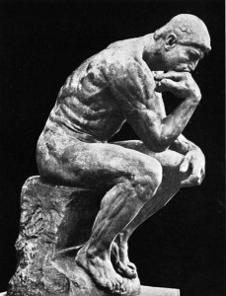
Value Judgments Applied to Our Thoughts
Thoughts
Positive thoughts - result in our choosing productive actions
Negative thoughts – result in our choosing non-productive actions

Slide 8
Value Judgments Applied to Our Feelings
Feelings
Positive feelings – produce positive thoughts, which in turn lead to productive actions
Negative feelings – produce negative thoughts, which in turn lead to non-productive actions

Slide 9
Models for Change
Therapy
Change negative feelings to positive feelings and thoughts and behaviors will follow
Behavior modification
Choose productive behaviors and work to change negative thoughts to positive thoughts and your feelings will follow

Slide 10
Making Behavior Modification Work for You
Must successfully navigate three steps
Step 1. Knowledge – “You know what to do.”
Step 2. Commitment – “You want to do it.”
Step 3. Implementation – “You do it.”

Slide 11

Barriers to Choosing Productive Actions
Current behaviors satisfy some need or want that you have
Have difficulty choosing to do things you don’t find easy or enjoyable
Afraid to study because if you do and still fail, it will reflect on your ability
Prefer to blame your failure on people or factors external to yourself

Slide 12
“The Common Denominator of Success” – Albert E.N. Gray
Successful [people] are influenced by the desire for pleasing results. [They] have a purpose strong enough to make them form the habit of doing things they don’t like to do in order to accomplish the purpose they want to accomplish.
Failures are influenced by the desire for pleasing methods and are inclined to be satisfied with such results as can be obtained by doing things they like to do.

Slide 13
Understanding Yourself
Maslow’s Hierarchy of Needs
Satisfying Your Need for Self-Esteem
Myers-Briggs Type Indicator

Slide 14
Maslow’s Hierarchy of Needs
Physiological needs: Food, water, air, shelter
Safety needs: Security, freedom from fear, order
Belongingness and love needs: Family, friends
Esteem needs: Self-respect, achievement, reputation
Self-Actualization – To become what you are most fitted for

Slide 15
“Needs” vs. “Wants”
Needs are things that you must have, things that are essential.
Wants are things that you desire.

Slide 16
Self-Esteem
Self-esteem is:
Appreciating my own worth and importance and having the character to be accountable for myself and to act responsibly toward others
Self-esteem is made up of two components:
Self-efficacy – your sense of competence
Self-respect – your sense of personal worth

Slide 17
Self-Esteem
Healty Self-Esteem
Rationality | Realism
Intuitiveness | Creativity
Independence | Flexibility
Cooperativeness | Willingness to admit mistakes
Benevolence | Ability to manage change
Poor Self-Esteem
Irrationality | Blindness to reality
Rigidity | Fear of the new and unfamiliar
Rebelliousness | Inappropriate conformity
Defensiveness | Overcontrolling behavior
Fear of others | Hostility toward others
Notes:
Add “magical thinking” to poor self-esteem

Slide 18
Myers-Briggs Type Indicator
E-Extrovert or I-Introvert
S-Sensing or N- Intuiting
T-Thinking or F-Feeling
J-Judging or P-Perceiving
Most frequent types among engineering students – ISTJ followed by ESTJ, INTJ, INTP, and ENTJ

Slide 19
Benefits of Knowing Your Personality Type and Learning Styles
Guide you in creating your own learning experience to meet your needs
Guide you in selecting the engineering job functions you are most suited for
Assist you in appreciating your own uniqueness
Assist you in appreciating the uniqueness of others

Slide 20
Understanding Others/Respecting Differences
Differences in personality types and learning styles
Ethnic and gender differences
A stereotype is a fixed conception of a person or a group that allows for no individuality
Stereotyping is unnecessary and unfair
Improving your effectiveness in cross-cultural communication

Slide 21
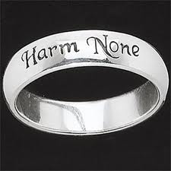
Silver Rule
What you would not want others to do unto you, do not do unto them
If we practiced this simple principle, we certainly wouldn’t put others down, stereotype others, resent others, or make others the butts of our jokes, since we would not like to have these things done to us.

Slide 22
Assessment of Your Strengths and Areas for Improvement
Assessment based on attributes model
Assessment based on employment model
Assessment based on Astin’s Student Involvement Model
Rate yourself on a scale of 0 to 10 on each item listed

Slide 23
Personal Development Plans
Identify areas for improvement
Prioritize them in order of importance
Choose several items to work on
Create a personal development (action) plan

Slide 24
Developing Your Communication Skills
Importance of communication skills in engineering
Employers want more
Developing a positive attitude
Developing a plan to improve your communication skills

Slide 25
Writing Demands of an Engineer
Letters, memoranda, and e-mail correspondence
Design specifications
Requests for proposals (RFPs)
Proposals submitted in response to RFPs
Contracts, patents, and other government documents
Written progress reports
Technical reports
Publications in professional engineering journals
Written performance evaluations of subordinates

Slide 26
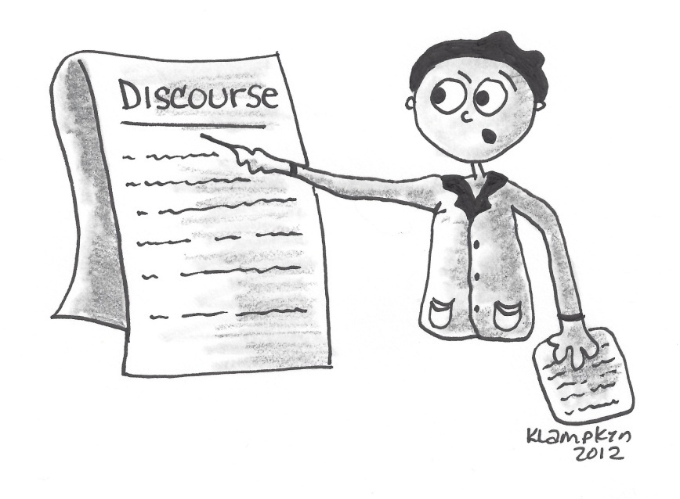
Oral Communication Demands of an Engineer
Oral progress reports
Formal presentations
Project and committee meetings
Team collaborations
Short courses and training seminars
Guest lectures at engineering schools or professional society conferences
Oral evaluations of subordinates

Slide 27
Employers Want More
National survey of over 1,000 engineering employers revealed that industry’s #1 concern was:
To give engineering students more instruction in written and oral communication

Slide 28
Develop a Plan to Improve Your Communication Skills
Take courses in oral and written communications
Look for opportunities to write (keep a journal, write a poem or short story, send e-mails)
Read – anything and everything (newspaper, magazines, technical journals, novels)
Look for opportunities to speak (student organizations, high school class, regular class)

Slide 29
Leadership and Teamwork
Definition – Team is two or more people who interact regularly and coordinate their work to accomplish a mutual objective
Nothing of significance is ever achieved by an individual acting alone
ABET attribute of engineering graduate – Ability to function on multi-disciplinary teams

Slide 30
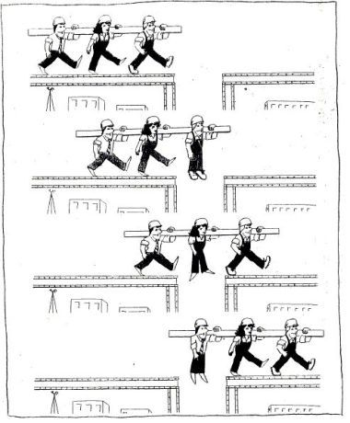
Example of Teamwork

Slide 31
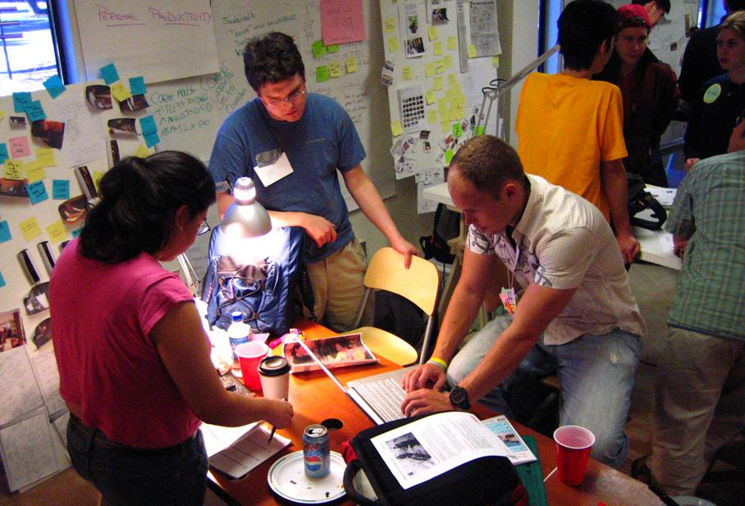
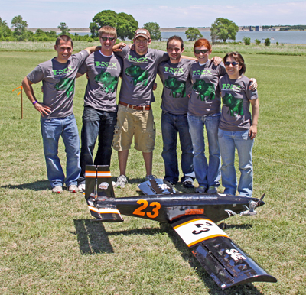
Participation on Teams During Engineering Study
Required Participation
Laboratory groups
Engineering design project teams
Elective Participation
Study groups
Engineering student design competitions
Research teams
Service project teams
Student organizations and student government

Slide 32
Principles of Teamwork
Purpose Trust/Reliance
Synergy Discipline
Cooperation Focus
Roles Values
Difficulty Leadership
Motivation Morale
Weakest Link Planning and resources
Attitude Decision-making

Slide 33
Attributes of an Effective Team Leader
Willingness to lead and take charge
Ability to keep the team focused on its purpose
Ability to set goals, priorities, and standards of performance
Proficiency at being a team builder
Ability to plan appropriately/accordingly
Able to run productive meetings
Ability to communicate effectively
Ability to promote harmony and inspire trust
Ability to foster high levels of performance by team members

Slide 34
Leadership Styles
Autocratic – Leader makes decisions independently with little input from team members.
Democratic – Leader offers guidance but also encourages strong participation from team members.
Laissez-Faire – Leaders offer little guidance and leave decision-making up to team members.

Slide 35
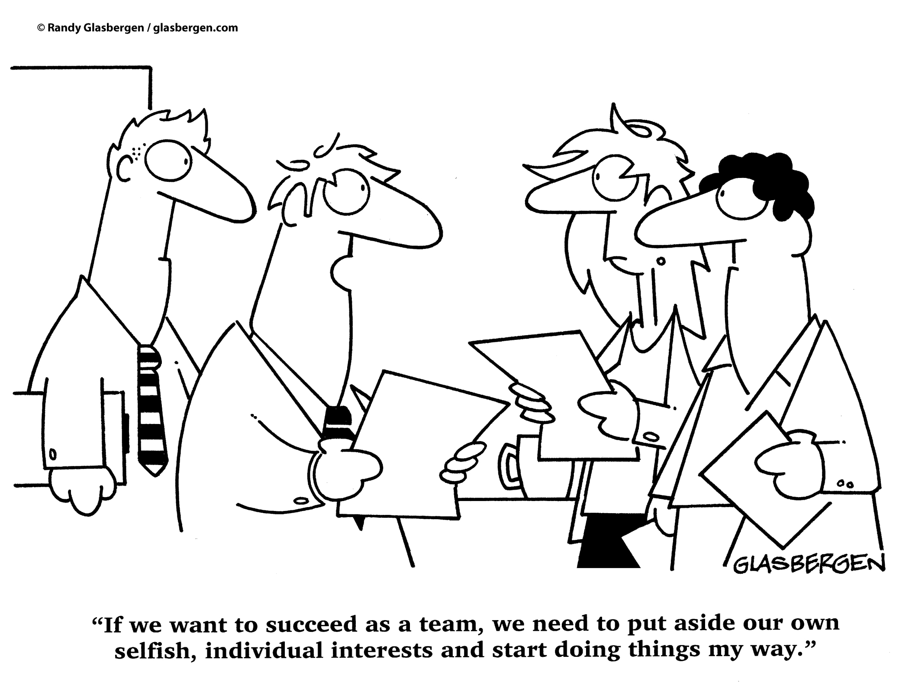
How Not to Lead

Slide 36
Characteristics of an Effective Team Member
Supports and helps the team leader succeed
Understands and supports the team mission, purpose, and goal
Subordinates self-interest on behalf of the team’s purpose
Welcomes being a member of the team and works to get to know and build trust with other team members
Communicates openly and honestly
Respects differences and diversity in team members
Works to elicit the ideas of others; listens to understand others’ points of view
Views conflict as useful and necessary; works toward consensus
Is reliable; follows through on tasks; meets deadlines
Is willing to work hard, often “beyond the call of duty,” for the success of the team

Slide 37

Stages of Team Development
Stage 1 – Forming
Stage 2 – Storming
Stage 3 – Norming
Stage 4 – Performing
Stage 5 - Adjourning

Slide 38

Mental and Physical Wellness
Tips for good health
Balancing work and play
Managing stress

Slide 39

Tips for Good Health
Eat nutritionally
Engage in regular aerobic exercise
Get adequate sleep
Avoid drugs
Notes:
Antioxidants; trace minerals; exercise for good circulation

Slide 40
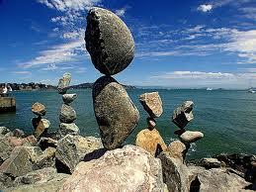
Balancing Work and Play
Strike a balance between immediate and future gratification
Too much immediate gratification – Don’t get work done; feel guilty
Too much delayed gratification – feelings of deprivation and resentment can sabotage your commitment
Find a proper balance between work and play!

Slide 41
Managing Stress
Eustress – Positive form of stress. Can motivate individuals to attain high levels of performance
Distress – Negative form of stress. Can distract you from being the best that you can be.
Learn strategies for coping with and managing stress

Slide 42

Motivating Yourself
“No deposit, No return”
Jesse Jackson’s “Excel” Message
Inspirational and Motivational Quotes
Power of Positive Thinking

Slide 43
Group Discussion Exercise Positive Aspects of College
In your group, brainstorm a list of the positive aspects of being a college student. Then discuss each item.
Select a leader to keep the discussion on topic and a recorder to write down and report out on what was learned

Slide 44
Alternate Group Discussion Importance of Attitude
In your group, discuss the following quote:
"The longer I live, the more I realize the impact of attitude on life. Attitude to me, is more important than facts. It is more important than the past, than education, than money, than circumstances, than failures, than successes, than what other people think or say or do. It is more important than appearance, giftedness, or skill. It will make or break a company, a church, a home.
The remarkable thing is we have a choice every day regarding the attitude we will embrace for that day. We cannot change our past. We cannot change the fact that people will act in a certain way. We cannot change the inevitable. The only thing we can do is play the one string we have, our attitude.
I am convinced that life is 10% what happens to me and 90% how I react to it. And so it is with you. We are in charge of our Attitudes."
Select a leader to keep the discussion on topic and a recorder to write down and report out on what was learned.

