Slide 1
Software Design
CS1200
Fall 2018
Thanks to John Cole, Michael Christiansen, Janell Straach for slide reuse

Slide 2
What is Design?
“Design describes the structure of anything that is made by conscious human effort”.
A design is a model, or abstract representation, of a desired system or structure.
  A building’s blueprints are a model of the desired structure.
A design is the decomposition (breaking down of) a complex structure / problem into simpler structures / sub-problems.
  Where each simple structure / sub-problem contributes to solving the larger problem.
A design is a description of the individual components that make up a system / structure.
  And how the components communicate / interact with each other.

Slide 3
A Successful Engineering Project Requires both Design and Perseverance
There are many problems to be overcome when transforming a design into a physical reality.
One Step Back, Two Steps Forward
  Often, every other step we take towards our goals requires a “step back” to address an unforeseen obstacle that lies between where we are and where we want to be.
Engineers are responsible for identifying and overcoming these problems to successfully complete projects.

Slide 4
How To Design
As you can imagine, building something of any real complexity requires a fair amount of planning.
  The engineer can’t just sit down and start throwing together components or code and ‘hope it works’.
For the solution to be useful to the customer, engineers need to understand the problem and the constraints on a solution.
There is an Engineering Process that is followed by most engineering disciplines.
  A series of steps that are followed from project inception to delivery i.e. from project start where the engineers know nothing about the customer’s problem to the successful delivery of a solution.

Slide 5

What is a Process?
In engineering terms, a process is the steps one follows to plan and execute the building of something.
Lets create a process for “Preparing a Chocolate Cake” from scratch.
  What are the steps involved with building a cake?
  What are the resources needed to build a cake?
  How many cakes are we preparing?
  Can we reduce the cost of
  materials or labor?
  Can we minimize the time needed
  to prepare a cake?

Slide 6
What is an Engineering Design Process?
A process is the description of a series of actions taken which leads from a problem’s description to a system’s design.
More formally, an engineering process is:
  A series of steps / actions to be executed by the engineer.
  The order in which the steps are executed.
  The artifact that is produced by each step in the process.
It is usually the case that an artifact produced by step_{j} is used by step_{j+1} e.g. information.

Slide 7
Why Should You Care?
Designing a process is at the heart of programming.
  Defining and recording the processing steps the computer executes when performing a routine in support of an application.
For example, what are the steps in enrolling a new member / customer of an e-commerce site?
  Gather information from the new member.
  Validate the information is correct.
  Record the information for later retrieval.
  Notify the new member of their new status.
Each of these steps is implemented in as many of hundreds of individual instructions in a programming language.

Slide 8
Recording a Design
Our designs must be communicated to others.
Consider a residential home’s design i.e. blueprint.
  The customer is involved with helping design their home and must be shown the final version before construction begins.
  Tradespeople (carpenters, plumbers, etc.) work from and coordinate with others using the blueprint design.
Designs are recorded using a method / notation that all involved parties understand.
  A blueprint presents three views of the desired structure (top, front, side) providing sufficient detail to allow its construction.

Slide 9
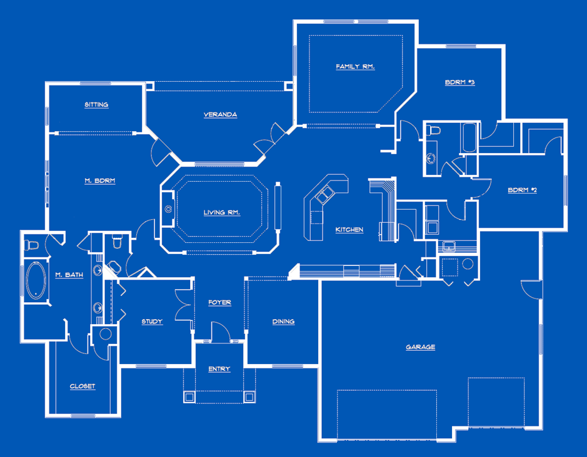

Slide 10
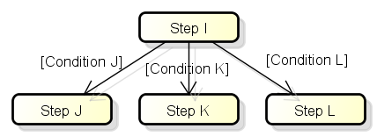
Recording a Process Design
There are many ways to capture / record a process.
The process can be recorded textually.
  Recorded as ordered written statements i.e. step 1, step 2, etc.
The process can be recorded graphically.
  Using a notation that describes each step, the order the steps are performed, and ‘branching conditions’.
  Branching conditions describe which path is taken when a decision is present in the steps i.e. after step I take J, K, or L.
Notes:
The choice of J, K, or L is mutually exclusive. Only one path can be taken and once taken the alterative paths are closed.

Slide 11
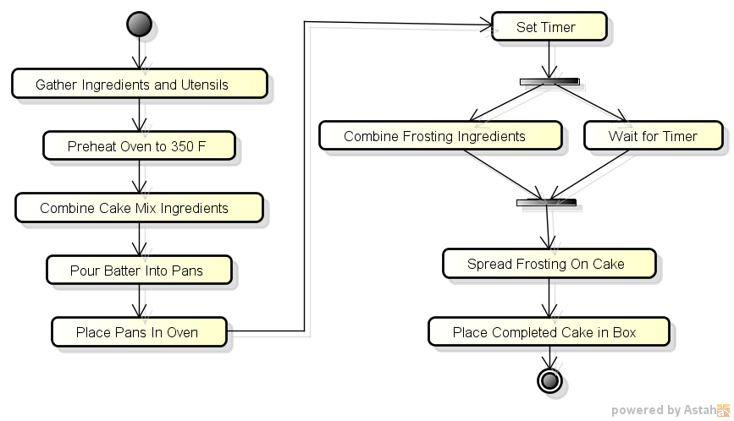
Bake a Cake
Described using UML Activity Diagram

Slide 12
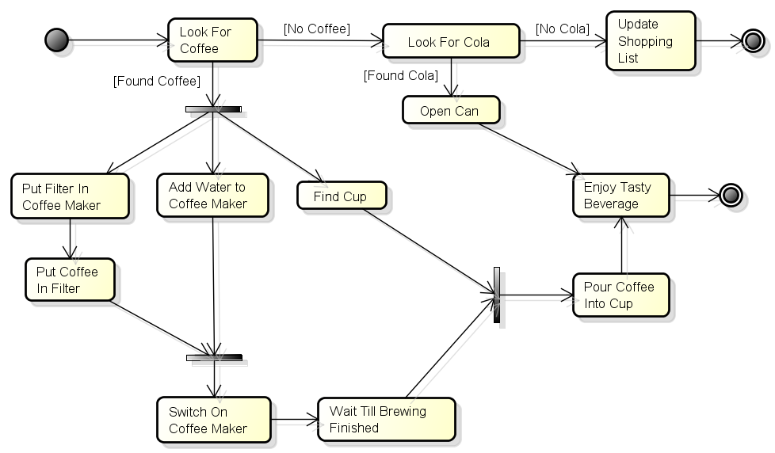
Example Process: Enjoy a Tasty Drink described using a UML Activity Diagram

Slide 13
UML Activity Diagrams
UML stands for Unified Modeling Language.
  UML is the ‘standard’ notation used to describe a software design.
UML provides notations that describe the structure of a software system using object-oriented concepts.
  Classes: A method of capturing important entities from the application’s problem domain.
  Attributes: Properties of the entities that will be maintained by the system software.
  Methods: Operations (functions) that the classes provide.
  Associations: Descriptions of how entities relate with each other.
Notes:
UML is the ‘standard’ notation used to describe an object-oriented software design.

Slide 14
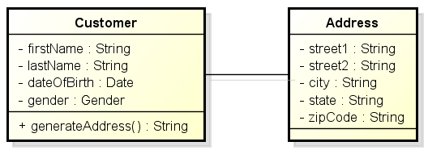
Example of a UML Class Diagram
This is an example of a software ‘object’ that represents a customer and their address.
  The customer and address classes maintain several attributes that describe specific aspects of each.
  The Customer object provides an operation that builds and returns an address string that can be used to send postal mail.
  Each Customer is associated with an Address.

Slide 15
Example of a UML Class Diagram
The plus sign on an attribute or method means it is public, accessible to functions outside of the class
The minus sign means that the attribute or method is private, and accessible only to functions that are members of the class
The default is private

Slide 16
Elements of an Activity Diagram
An activity diagram is composed of nodes and edges that connect nodes.
  Nodes: Each node represents a step in the overall process.
  Edges: Each edge indicates a transition from one node to the next.
Each edge is directed i.e. provides an arrow which describe the correct transition from one node to the next.
  The process cannot backup or move against the arrow.
When multiple edges leave a node, each edge is labeled with the condition that causes the graph’s execution to exclusively follow the specific path.

Slide 17
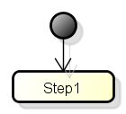
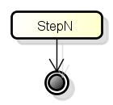
Other Elements of an Activity Diagram
Start Symbol: Signifies the entry point or first step in the process.
  A process can have only a single starting point.
End Symbol: Signifies a final step in a process’s execution.
  A process can have multiple final steps.

Slide 18
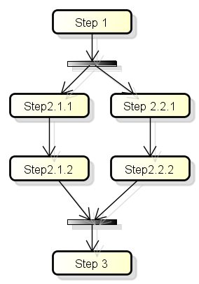
Other Elements of an Activity Diagram
Fork Operation: Signifies that the process’s execution will occur along two paths concurrently i.e. at the same time.
  Steps 2.1.x and 2.2.x are executed concurrently.
Join Operation: Signifies that two paths of execution (threads) will join back into one.
  Step 3 will not be executed until both paths (2.1.x and 2.2.x) have completed execution.
Notes:
There is not conditions on the fork operation because all exiting edges are taken.

Slide 19
An Activity Diagram can be used to Model / Design a Program’s Execution.
It is good practice to plan / design a program before starting coding.
  It is far easier to identify problems / shortcomings in the design of your process that to identify these problem in your program code.
The graphical representation provided by a diagram is both concise and easily understood.
  Understood by the author when considering alternative designs.
  Understood by one’s peers (team members) when communicating your design to others.

Slide 20
UML Diagramming Tools
A diagraming tool allows the developer to build a visual model using a specific notation.
One such tool is The Astah UML Modeling Tool.
  A modeling tool that can be used to build, modify, and print software design using UML.
Astah provides a Community Edition.
  The Community edition is free and provides all of the capabilities needed for this course.

Slide 21
Obtaining Astah
Download and install Astah on your PC.
The website is http://astah.net/.
Download the Astah UML Community edition.
Install on your PC.
Astah UML is provided for Windows, OSX, and Linux.

Slide 22
Desired Properties of a Software Design…
We can judge the quality of a software design by evaluating how the design delivers these desired system qualities…
  Correctness: The ability of the software system to perform its tasks as defined by the customer’s requirements.
  Robustness: The ability of the software system to react appropriately to abnormal inputs and other failures.
  Extensibility: The ease of adapting the software to changes to its requirements.
  Reliability: A system which runs for extended periods without crashing and without errors.

Slide 23
Desired Properties of a Software Design …
  Testability: The ability to verify the correctness of components and classes as they are created or modified.
  Understandability: The ability to infer the intent of the software design using only the source code.
  Maintainability: The ability to install and operate the system in the production environment.
  Reusability: The ability to use a subsystem, component or class in more than one system / application.
It is up to the organization to decide which of these, and other, qualities is most important to their goals and to invest their development resources accordingly.

Slide 24
A few comments on UI design

Slide 25
Every Program Has A User Interface
With a few exceptions, such as device drivers, every program interacts with a user.
Most of us who write programs don’t use the kinds of programs we write.
The more work you put into the program, the less work your users will have to do to use it.

Slide 26
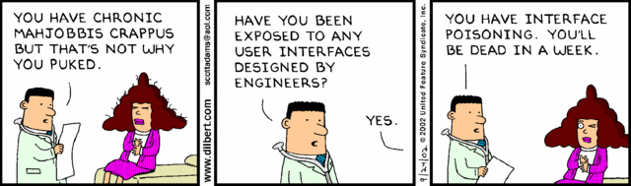
The Dilbert Take

Slide 27
The User’s Goals
Not looking stupid
Getting a reasonable amount of work done
Not making serious mistakes or being able to fix mistakes easily
Having fun, or at least not being too bored
(Notice that the user doesn’t care about business goals, like balancing the account or entering insurance claims.)

Slide 28
The Programmer’s Goals
Write the minimum amount of code necessary (we work under a deadline)
Have the programs mirror the data model (we spent a lot of time learning their business and creating the domain model)
Not having to do too much maintenance (unless we’re paid really well to do it)

Slide 29
Guiding Principle
The Principle of Least Astonishment: Your program should not do things that take the user by surprise.

Slide 30









Slide 31
Data Entry Applications
A great many applications involve entering large amounts of data. The people who do this are really good at it. They’re fast, and don’t want anything to slow them down.
They don’t want to take their hands off the keyboard.
They don’t want to click buttons.
They don’t want to answer questions.

Slide 32
Consistency
Since there are no intuitive user interfaces, go for consistent ones:
If the Save (or Submit) button is on the bottom of one screen, it should be in roughly the same position on all of them.
If the Save button is the default (meaning that when you hit Enter, it’s equivalent to pressing that button) on one screen, it should be the default on all of them.
If your program has a menu, File (if this makes sense as a menu item) should be the leftmost item and Help the rightmost.

Slide 33
Consistency (continued)
The F1 key is common for help
The Tab key always moves from control to control. It should do so in some rational order
The Enter key can move between fields too, depending upon state

Slide 34
Guiding Principle
Simple things should be easy to do. Complex things should be possible.
For example, in an accounting program, entering checks should be easy. Deleting a check, which is dangerous, should be possible. Maintaining configuration information should be possible.
We won’t discuss audit trail here.

Slide 35
Program Navigation
Many programs have menus for navigation. This is good as far as it goes.
The next program offers a way to navigate to another screen so you don’t have to exit to a main menu, enter new data, then return to it.
Also note the amount of on-screen text.

Slide 36
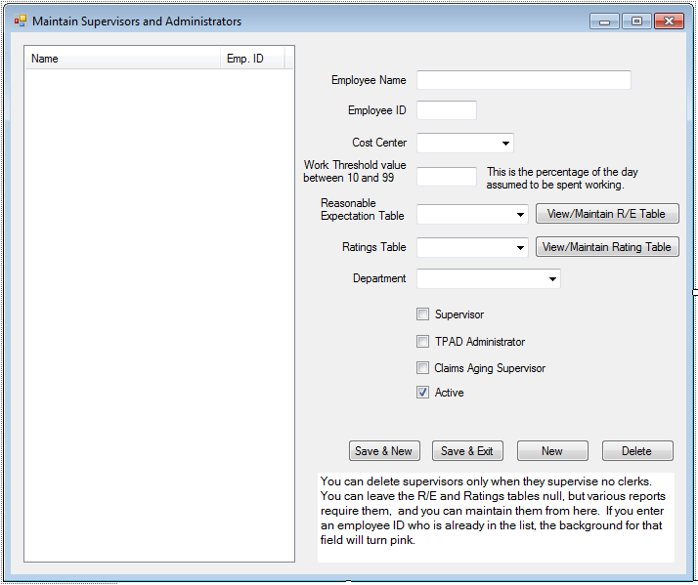

Slide 37
On-Screen Instructions
Some screens are not used very often. Give the user help with them
For example: Tooltips on controls that explain the kind of data expected.
A label control (or equivalent) that contains a paragraph of explanatory text.

Slide 38
Intelligent Defaults
In the screen shown, the default button, the one that Enter presses, is Save & New
The “Active” checkbox defaults to “checked” state for new supervisors
In the previous screen the Department defaults to the department of the person entering the data.

Slide 39
Screen Navigation
The tab key must move from one field to the next.
Do not automatically move from one field to the next unless it makes sense. For example, choosing something from a list should not necessarily move to the next control.
Upon completion of an entry, the list of items entered should be updated and focus should be on the first control, which is the employee name in the screen shown above.

Slide 40
Down or Across?
In the screen shown, flow is down the page. English reads left to right, top to bottom. Another layout could have multiple fields per line. However, beware making the entry area too wide. This is why newspapers have columns.
Position of labels: To the left for a “mostly down” layout, above (usually) for a “mostly across” layout.

Slide 41
The Need for Speed
Drop-down lists (combo boxes) are great if you don’t know what you want. If you do, they slow you down. Ideally, you should be able to key into the edit part, but (usually) only things that are in the list.

Slide 42
Other Considerations
If they’re keying from a printed form, screen fields should correspond to the reading order of form fields.
Indicate optional fields somehow. Color can be a good way to do this.
The form shown is good when there are more data fields than will easily fit in a listview or datagrid.

Slide 43
Other Considerations (continued)
The Save & New button is active only when the fields contain valid data. Another way of doing this is to have it active and pop a message box when the user clicks it and tries to save.
Delete is only active when deleting the supervisor would not violate referential integrity.

Slide 44
Programs Should Be Forgiving
Accept multiple forms of some data, such as dates.
For dollar amounts, you can have an implicit decimal point; this saves one keystroke per entry.
Allow commas in large dollar amounts.
Don’t restrict the delimiters for a phone number.

Slide 45
Lists
If your program has a list, at the very least have sort headers on significant columns.
If the list has, of necessity, a large number of items (all possible parts in an auto-parts store) provide several ways to search.
Virtual lists.

Slide 46
Use of Color
A light pink background can be used to signal invalid input.
Green can be used to indicate things in balance, for example, and red, out of balance.
Yellow can indicate optional fields.
Colored backgrounds can be distracting or pleasing
Use color with caution. Some people have red-green colorblindness.

Slide 47
Visual Metaphors
Visual metaphors are on-screen artifacts that most people will recognize. For example:
An arrow pointing down invites the user to click it to make something drop down.
Red means warning.

Slide 48
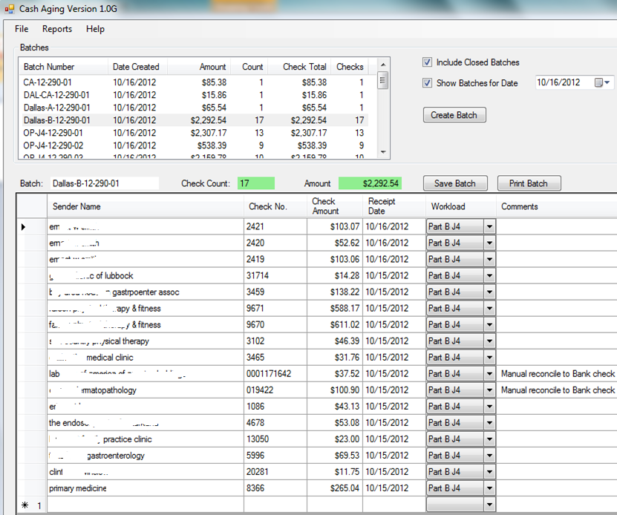
Even Faster Entry

Slide 49
Notes on the Preceding Screen
This is used for entry of checks. They know, from the batch, the number of checks and the dollar amount
Each check goes on a separate line.
Function key F5 duplicates the previous amount and check type.
F5 increments the previous check number.
The program makes a sound when the correct number of checks has been entered and the dollar amount is correct. Note the use of color.

Slide 50
More Notes
This lends itself best to records that do not have a natural primary key.
The user can save at any time, so no data loss if the system crashes.
Control-s saves at any time. (It won’t save a partially-entered line.)
It has a familiar look: Excel

Slide 51
Use of Sound
Many programs make a sound to signal success or error.
Quicken’s “cash register” sound when you enter a check.
Sounds associated with message boxes.
Reading text to the user.

Slide 52
When to Use Message Boxes
If they’re not for keying mistakes, then when?
System errors, such as database unavailability, attempts at unauthorized access, etc.
Messages must be explanatory. Not “The Checks database is offline” but “You do not appear to be connected to the server. Please call tech support at 5555.”
Not “Record not found” but “You do not appear to be an authorized user of this system. Please contact your supervisor.”

Slide 53
Configurability
It’s easy to hard-code things.
Allow your users (or a supervisor) to set various defaults.
For example, one of the programs lets the user load data from a spreadsheet. The default location of these spreadsheets is configurable.
Colors can be configurable.

Slide 54
Configurability (continued)
Information that appears in report headers, such as the company name.
Fiscal year end.
Time zone offset.
Internationalization.
Notes on writing the configuration screen.

Slide 55
Conclusions
Programs can be made, if not user-friendly, at least not user-hostile.
Programs can be written that provide visual cues for data entry without slowing down the user.
Programs can be written that are operated almost entirely from the keyboard.

Slide 56
References for User Interface topic
Cooper, Alan, About Face
Cooper, Alan, The Inmates Are Running the Asylum
Petzold, Charles, Programming Windows

