Slide 1
The 5 Elements of Effective Thinking
Introduction

Slide 2
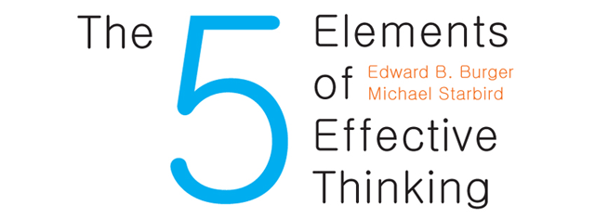

Slide 3
Thinking
Everything we do has its roots in thought
Much of our thinking is automatic, following patterns laid down over years
You can do better than this

Slide 4
Effective Thinking
The phrase is telling: thinking that will have an effect, that will do something
This requires creativity, imagination, and observation
Learning how to think effectively will carry over into every aspect of your life
Notes:
Tell Barometer story here

Slide 5
Ponder This
“I know quite certainly that I myself have no special talent. Curiosity, obsession, and dogged endurance, combined with self-criticism, have brought me my ideas.” -- Albert Einstein
Brilliant ideas don’t just drop out of the sky; it takes work to not only think of them but follow through
You have to not only think, you need to examine how you think

Slide 6
Control Your Thoughts
And you control your life
Stay with old patterns of thinking and they will get you what you have always gotten
Develop new patterns of thinking and you will get things you never dreamed of

Slide 7
Genius
People see the same things yet they don’t always see them the same way
This sort of thinking can be learned
It is far less dependent upon any kind of “magical” intuition than most people think
“Luck favors the prepared mind.” – Louis Pasteur

Slide 8
Application to Computer Science
Learn the programming languages as they’re taught
However, spend much more time on concepts
By the time I finished my undergrad, I had learned at least 8 programming languages. You won’t learn any of those 8, and chances are good you have never heard of most of them.
However, I’m still using linked lists, stacks, queues, binary trees, and so on. I write recursive programs. Etc.
Concepts and principles.

Slide 9
Five Learnable Habits
Understand deeply (Earth)
Make mistakes (Fire)
Raise questions (Air)
Follow the flow of ideas (Water)
The quintessential element: Change
Notes:
In a movie, novel, or play the main character is the one who has changed the most

Slide 10
How to Read the Book
Read it once through without worrying about the details
Read it again, more slowly and taking time to absorb what you have read
Make the material your own

Slide 11
Some Quotes
“Reading furnishes the mind only with materials of knowledge; it is thinking that makes what we read ours.” – John Locke
“Nothing is good or bad but thinking makes it so.” – William Shakespeare, in Hamlet

