Slide 1
Software Lifecycle Models
CS1200
Fall 2018
Thanks to John Cole for creating parts of this lecture

Slide 2
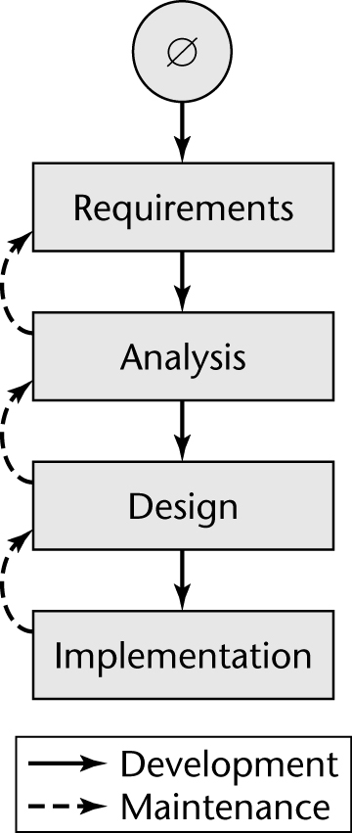
Software Life Cycle in Theory
Ideally, software is developed like this:
Linear
Starting from scratch
This is called the “Waterfall Model”

Slide 3
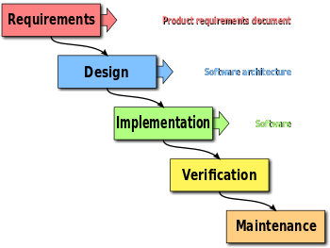
Another View of Waterfall

Slide 4
Waterfall Model
Characterized by
Feedback loops
Documentation-driven
Advantages
Documentation
Maintenance is easier
Disciplined approach
Disadvantages
Specification document may not stay accurate
It can be very difficult to completely specify a large system
Client sees nothing until late in the process

Slide 5
Requirements
Talk to the customer or people representing your potential market
Determine as precisely as possible what the project should do
Document everything
Notes:
You’re not allowed to use cattle prods, waterboarding, or pepper spray to assist in gathering requirements.

Slide 6
Design
Consider alternative ways of solving the problem
For example, should the program be Web-based or a stand-alone application? Does it need to be cross-platform?
Next, come up with a detailed description of each of the components of your best solution
Build prototypes
Assess risks
Start writing user-level documentation

Slide 7
Implement
Write the program
Do high-risk activities first
Do unit testing along the way to make sure the pieces work
Do integration testing to make sure modules work together
Document your code and processes
Finish the user-level documentation

Slide 8
Verification
Test to make sure the program meets the requirements
Use known data to ensure that calculations are being done correctly
Test error cases
Document your tests

Slide 9
Maintenance
There will be bugs after delivery; you will have to fix them
The customer will request changes; you will have to make (some of) them
“It’s not complete until it’s obsolete.”

Slide 10
Waterfall In Practice
In the real world, software development is totally different
We make mistakes
The client’s requirements change while the software product is being developed
Clients like to be able to see something work early in the process

Slide 11
The Waterfall Model
It is the oldest paradigm for SE. When requirements are well defined and reasonably stable, it leads to a linear fashion.
(problems: 1. rarely linear, iteration needed. 2. hard to state all requirements explicitly. Blocking state. 3. code will not be released until very late.)
The classic life cycle suggests a systematic, sequential approach to software development.

Slide 12
The Incremental Model

Slide 13
The Incremental Model
When initial requirements are reasonably well defined, but the overall scope of the development effort precludes a purely linear process. A compelling need to expand a limited set of new functions to a later system release.
It combines elements of linear and parallel process flows. Each linear sequence produces deliverable increments of the software.
The first increment is often a core product without many supplementary features. Users use it and evaluate it with more modifications to better meet the needs.

Slide 14
Evolutionary Models
Software system evolves over time as requirements often change as development proceeds. Thus, a straight line to a complete end product is not possible. However, a limited version must be delivered to meet competitive pressure.
Usually a set of core product or system requirements is well understood, but the details and extension have yet to be defined.
You need a process model that has been explicitly designed to accommodate a product that evolved over time.
It is iterative that enables you to develop increasingly more complete version of the software.

Slide 15
Evolutionary Models: Prototyping
When to use: Customer defines a set of general objectives but does not identify detailed requirements for functions and features. Or Developer may be unsure of the efficiency of an algorithm, the form that human computer interaction should take.
What step: Begins with communication by meeting with stakeholders to define the objective, identify whatever requirements are known, outline areas where further definition is mandatory. A quick plan for prototyping and modeling (quick design) occur. Quick design focuses on a representation of those aspects the software that will be visible to end users. ( interface and output). Design leads to the construction of a prototype which will be deployed and evaluated. Stakeholder’s comments will be used to refine requirements.
Both stakeholders and software engineers like the prototyping paradigm. Users get a feel for the actual system, and developers get to build something immediately. However, engineers may make compromises in order to get a prototype working quickly. The less-than-ideal choice may be adopted forever after you get used to it.

Slide 16
Evolutionary Models: Prototyping
Quick
plan
communication
Modeling
Quick design
Deployment
delivery &
feedback
Construction
of prototype
Construction
of prototype

Slide 17
Evolutionary Models: The Spiral
Couples the iterative nature of prototyping with the controlled and systematic aspects of the waterfall model and is a risk-driven process model generator that is used to guide multi-stakeholder concurrent engineering of software intensive systems.
Two main distinguishing features: one is cyclic approach for incrementally growing a system’s degree of definition and implementation while decreasing its degree of risk. The other is a set of anchor point milestones for ensuring stakeholder commitment to feasible and mutually satisfactory system solutions.
A series of evolutionary releases is delivered. During the early iterations, the release might be a model or prototype. During later iterations, increasingly more complete version of the engineered system are produced.
The first circuit in the clockwise direction might result in the product specification; subsequent passes around the spiral might be used to develop a prototype and then progressively more sophisticated versions of the software. Each pass results in adjustments to the project plan. Cost and schedule are adjusted based on feedback. Also, the number of iterations will be adjusted by project manager.
Good to develop large-scale system as software evolves as the process progresses and risk should be understood and properly reacted to. Prototyping is used to reduce risk.
However, it may be difficult to convince customers that it is controllable as it demands considerable risk assessment expertise.

Slide 18
Evolutionary Models: The Spiral

Slide 19
Agile Process
Characterized by short iterations and quick delivery of working code
The Unified Process (also called Rational Unified Process) is an implementation of Agile

Slide 20
Agile Manifesto
We are uncovering better ways of developing software by doing it and helping others do it. Through this work we have come to value:
Individuals and interactions over Processes and tools
Working software over Comprehensive documentation
Customer collaboration over Contract negotiation
Responding to change over Following a plan
That is, while there is value in the items on the right, we value the items on the left more

Slide 21
Agile Principles (1)
1. Customer satisfaction by rapid delivery of useful software
2. Welcome changing requirements, even late in development
3. Working software is delivered frequently (weeks rather than months)
4. Close, daily cooperation between business people and developers
5. Projects are built around motivated individuals, who should be trusted
6. Face-to-face conversation is the best form of communication (co-location)
Notes:
Welcome changing requirements, as long as the deadline extends or we’re paid really well.

Slide 22
Agile Principles (2)
7. Working software is the principal measure of progress
8. Sustainable development, able to maintain a constant pace
9. Continuous attention to technical excellence and good design
10. Simplicity—the art of maximizing the amount of work not done—is essential
11. Self-organizing teams
12. Regular adaptation to changing circumstances

Slide 23

Questions

