Slide 1
Student attendance: simplified
Group Name: The Techies
Group Number: 11
Group Names: Anja Sheppard, Reg Gonzalez, Ethan Yong, Timothy An
Basic Function: Automatically record attendance of students via their mobile devices

Slide 2
Main points of our app
GPS Tracking
Linkage to UTD ELearning
Notifications
Reports

Slide 3
GPS Tracking
Students are checked for attendance via GPS tracking on their mobile devices.
Class data is pulled from ELearning (explained further later) and stored for each individual student.
Attendance is checked every five minutes during the duration of a class period, allowing for some fluctuation.
Students can opt to receive notifications if they are not in class or are tardy to class (explained further later)

Slide 4

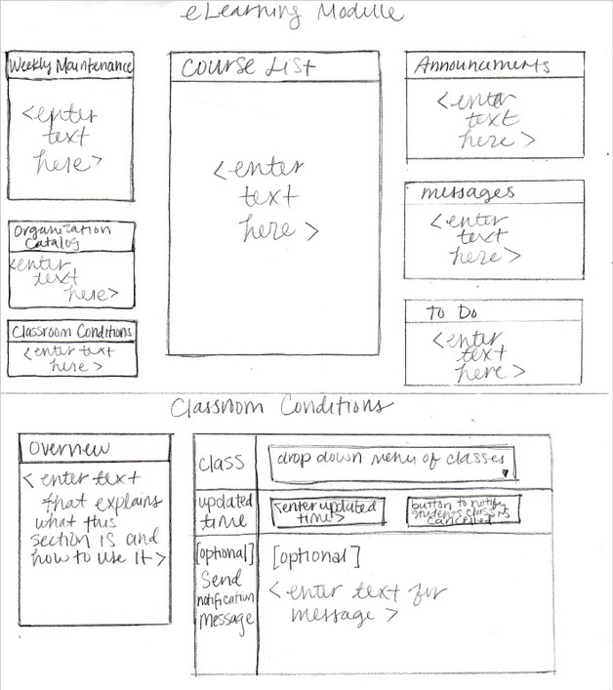
Linkage to UTD eLearning
The app will 'sync' to UTD's eLearning system
Log in using eLearning credentials
Program a function that would store info such as your name, course name, school year, and the time of your classes
Professor can enter in "special conditions"
I.E. change class time

Slide 5
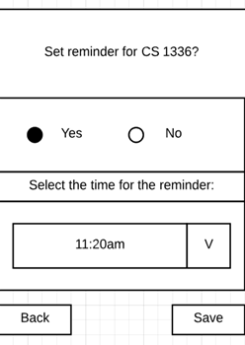
Notifications/Reminders
App sub-issue made to notify students
Able to set up reminders for students
Selectable for all classes

Slide 6
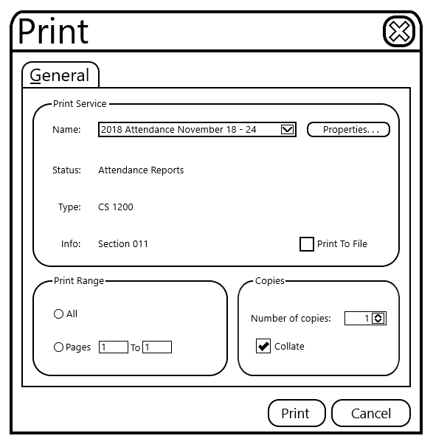
Reports
Attendance will be automatically be recorded and sent to a report sheet for every student.
Reports will be generated every week and saved as a file for the professor to review and save if needed.
Reports will contain overall results for each class sections and display each student's performance throughout the week and semester.
The professor can use these reports to determine which part of the semester attendance is lower and higher.
If the professor needed to print the reports, (to the right) is the ui on how they would print it.

Slide 7
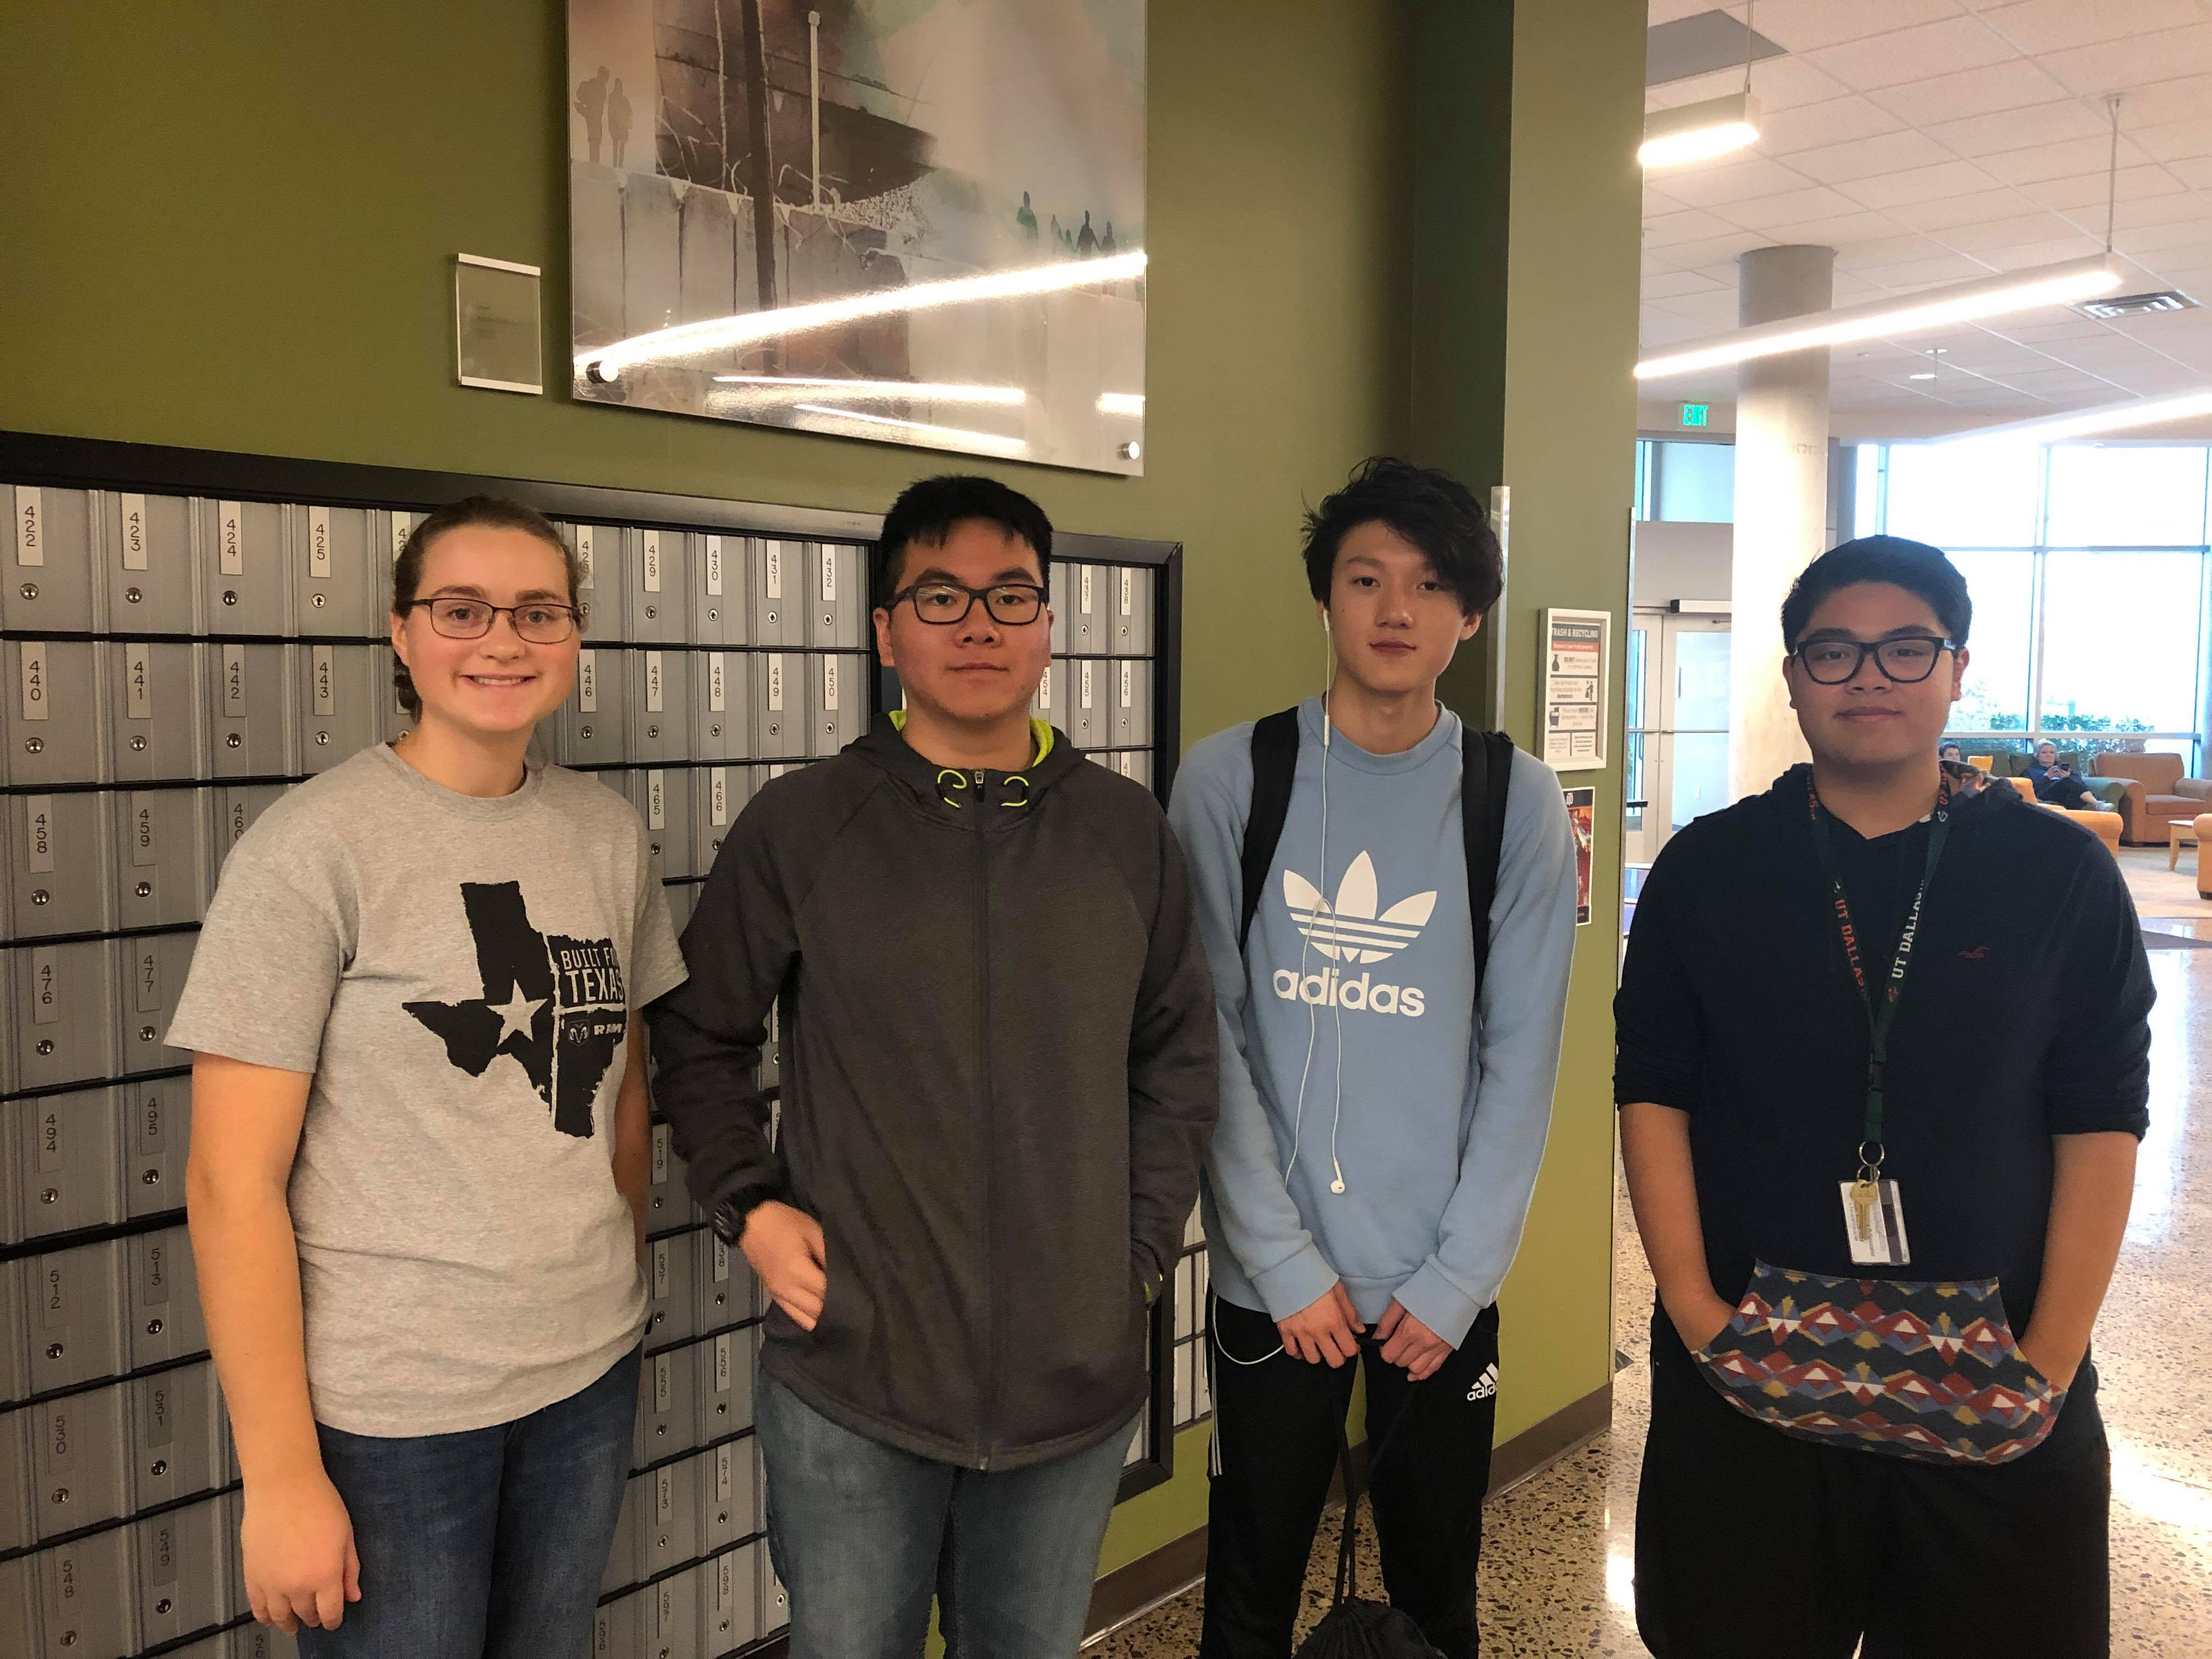
Our Group Photo

