Slide 2
先行研究と比べてどこがすごい？
present a novel study on LOCATEDNEAR relationship from texts
most commonsense KB are manually crowd-sourced, thus do not scale well
ConceptNet 5.5 has only 49 triples of LOCATEDNEAR relation
create benchmark dataset for LOCATEDNEAR relation extraction
About 5000 instances ( Entities and sentence pair )
This dataset has double the size of the most popular relations in SemEval task 8

Slide 3
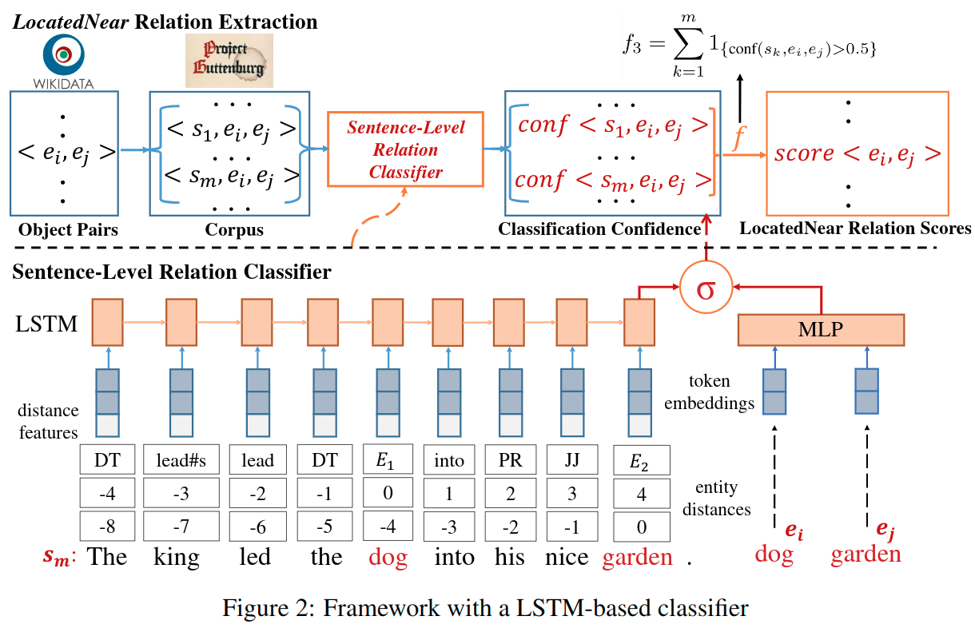
技術や手法のキモはどこ？
Overall workflow
construct a vocabulary of physical objects and generate all candidate instances.
apply sentence-level relation classifier on this instance
calculate a probabilistic score s indicating the confidence of the instance
Finally, all scores of the instances from the corpus are grouped by the object pairs

Slide 4
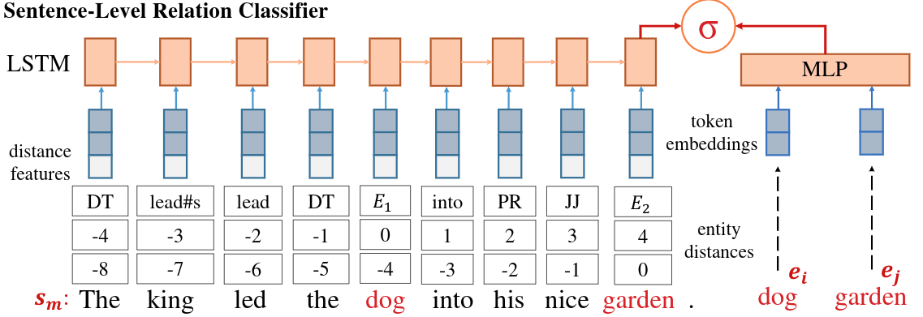
Sentence-level LOCATEDNEAR Relation Classifier
Problem statement
Given a sentence s mentioning a pair of physical objects <ei,ej>
the problem is to determine whether ei and ej are located near each other in the physical scene described in the sentence s.

Slide 5
Sentence-level LOCATEDNEAR Relation Classifier
The right part
encoding the semantic similarity between e1 and e2
The left part
encoding the syntactical and semantic information of the sentence s
the original word sequence of a sentence s has two problems
the irrelevant words in the sentence can introduce noise into the model
the large vocabulary of original sentences induce too many parameters

Slide 6
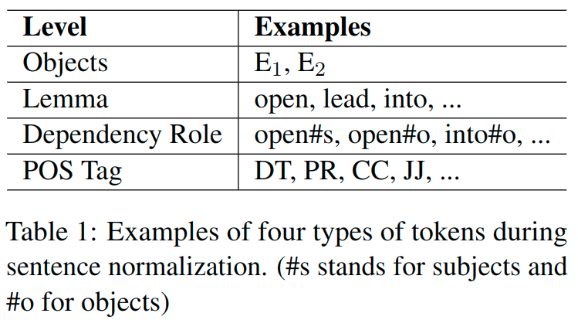
Sentence-level LOCATEDNEAR Relation Classifier
the irrelevant words in the sentence can introduce noise into the model
the large vocabulary of original sentences induce too many parameters
→ Introduce Masking process

Slide 7
Sentence-level LOCATEDNEAR Relation Classifier
Position Embeddings
the intuition that information needed to determine the relation between entities normally comes from the words which are close to the entities.
Conf<Sm, ei, ej>

Slide 8
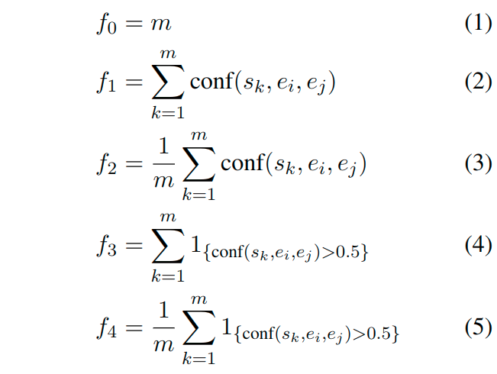
Caluculating final aggregated score
Heuristic scoring function f
M denotes the number of sentences
F0 does not use Sentence-level Relation Classifier

Slide 9
Feature-based Method
SVM classifier based on linguistic features
Bag of Words
Bag of Path Words
The words that appeared on shortest dependency path between entities
The words in the two subtrees rooted at entities
Bag of Adverbs and Prepositions
Global Features
The length of the sentence, the number of nouns, verbs, adverbs, adjectives, determiners, prepositions and punctuations in the sentence
Shortest Dependency Path Features
Global features in dependency parse tree and shortest path between entities
Semantic Similarity Features
The cosine similarities between entities embeddings

Slide 10
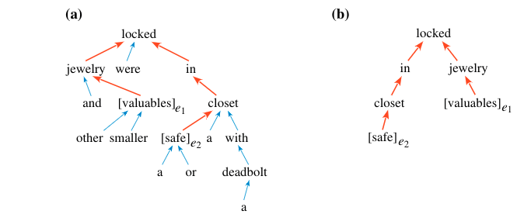
Shortest dependency tree
Jewelry and other smaller valuables were locked in a safe or a closet with a deadbolt.
Dependency tree
Shortest dependency tree

Slide 11
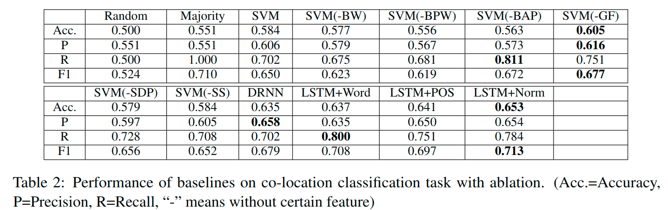
Experiment
Results of feature-based method
SVM model without the Global Features result is good
indicates that BOW features benefit more in shortest dependency paths than on the whole sentence

Slide 12
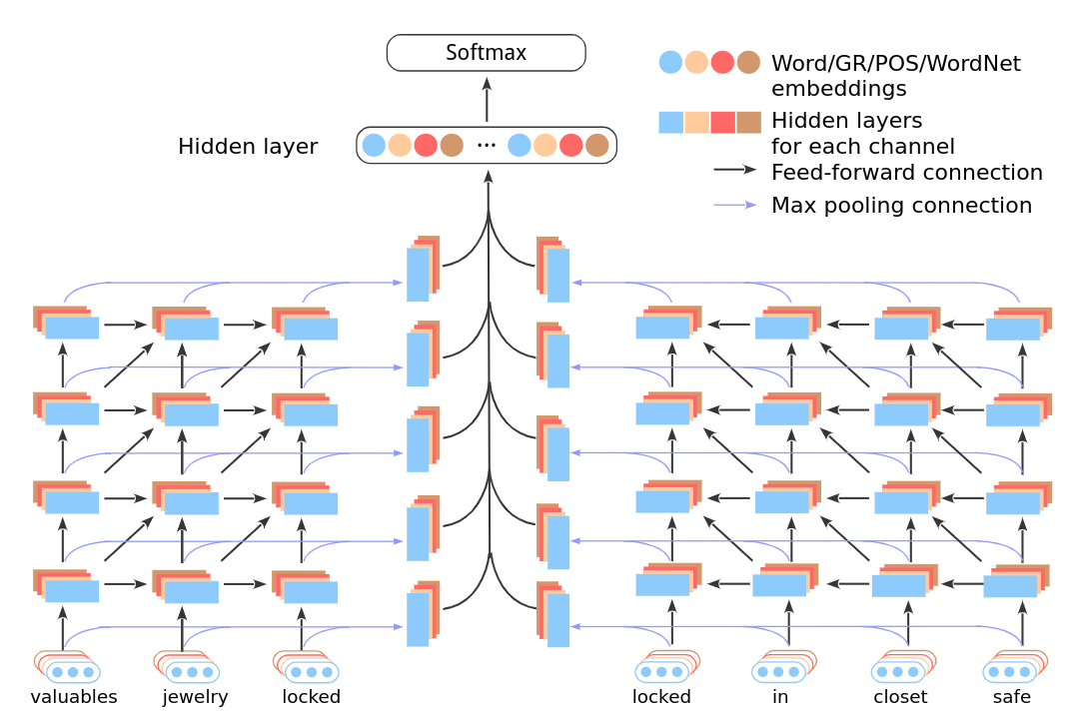
Experiment
DRNN
Improved Relation Classification by Deep Recurrent Neural Networks with Data Augmentation

Slide 13
Experiment
Results of LSTM-based method
LSTM+Word
The original word as the input tokens
LSTM+POS
Uses only POS tags as the input tokens
LSTM+NORM
Uses the token of sequence after sentence normalization
LSTM+Norm is the best one in terms of the overall performance
the normalization process reduces the vocabulary of input sequence
the LOCATEDNEAR relation are described in sentences decorated with prepositions/adverbs
these words are usually descendants of the object word in the dependency tree, outside of the shortest dependency paths

Slide 14
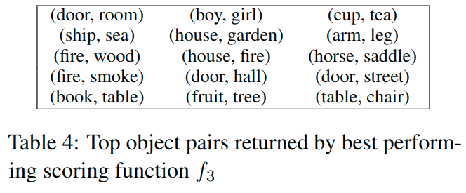
Experiment
This paper obtained a total of 2067 relations
Precision of 68% by human inspections
Future directions
better leveragingdistant supervision to reduce human efforts
incorporating knowledge graph embedding techniques
applying the LOCATEDNEAR knowledgeinto downstream applications in computer vision and natural language processing

